Slide 1



Have you got what it takes to be a Junior Road Safety Officer? (JRSO)

Slide 2
A Junior Road Safety Officer (or ‘JRSO’ for short) is a pupil at school who is involved in promoting Road Safety to the other pupils.
As a JRSO for your school your main roles will be:
To create and maintain a road safety notice/display board, with relevant information for each term.
To arrange and carry out road safety activities/ competitions/ surveys/ etc.
To read school assembly messages that you have agreed with your headteacher
Use the information in your JRSO pack and the website to develop road safety awareness to everyone within your school.
To become a good JRSO representative for your school by setting an example of good road safety practice.

Slide 3
What are the benefits of a JRSO?
What are the benefits of JRSO?
It is an excellent way to engage with other pupils and encourage them to be involved in their school and the local community. It enables you and other students to participate in the development and maintenance of an active and successful school travel plan.
If people know how to travel safely and feel that your school is trying to make walking, cycling or scooting to school safer, the more people will travel actively. This helps the planet, creates less pollution, giving cleaner air and creating less congestion. It also helps us stay active, and we know walking/cycling or scooting is good for our bodies. It keeps us happy and healthy. It also helps to stop people driving to school meaning a safer car park and less inappropriate parking.

Slide 4
Are you willing to give up some lunch times? Play times?
Who will your supporting adult be?

Slide 5
https://www.junior-rso.org.uk/information-for-jrsos/assembly-ideas/
Let’s have a look at some assembly/display ideas…

Slide 6
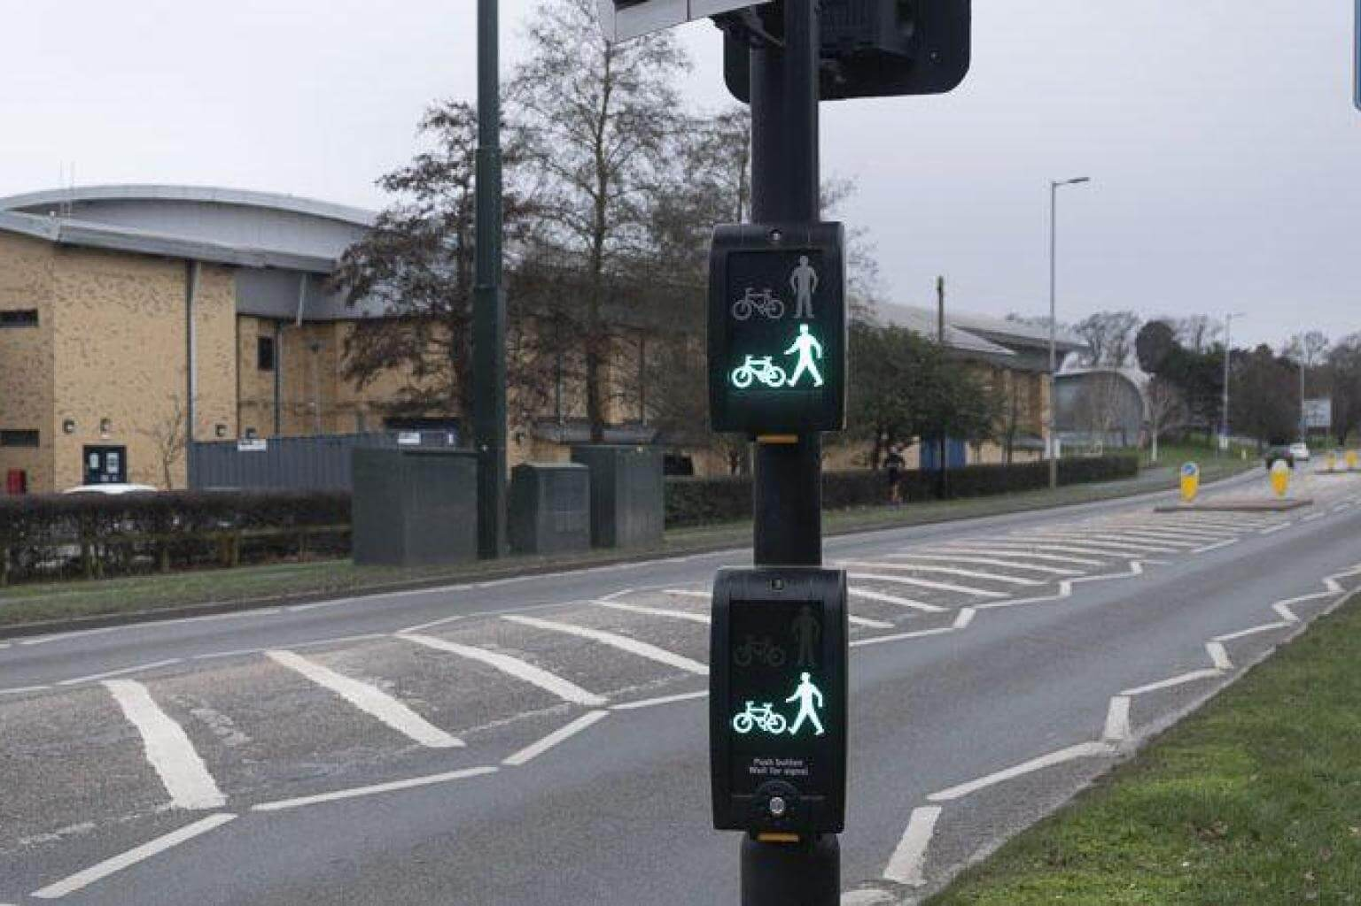
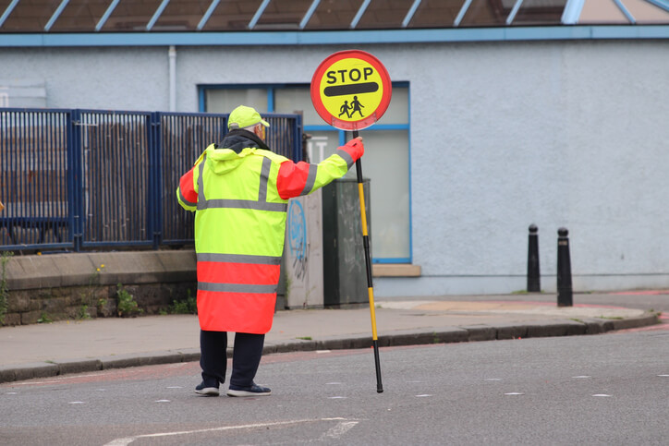
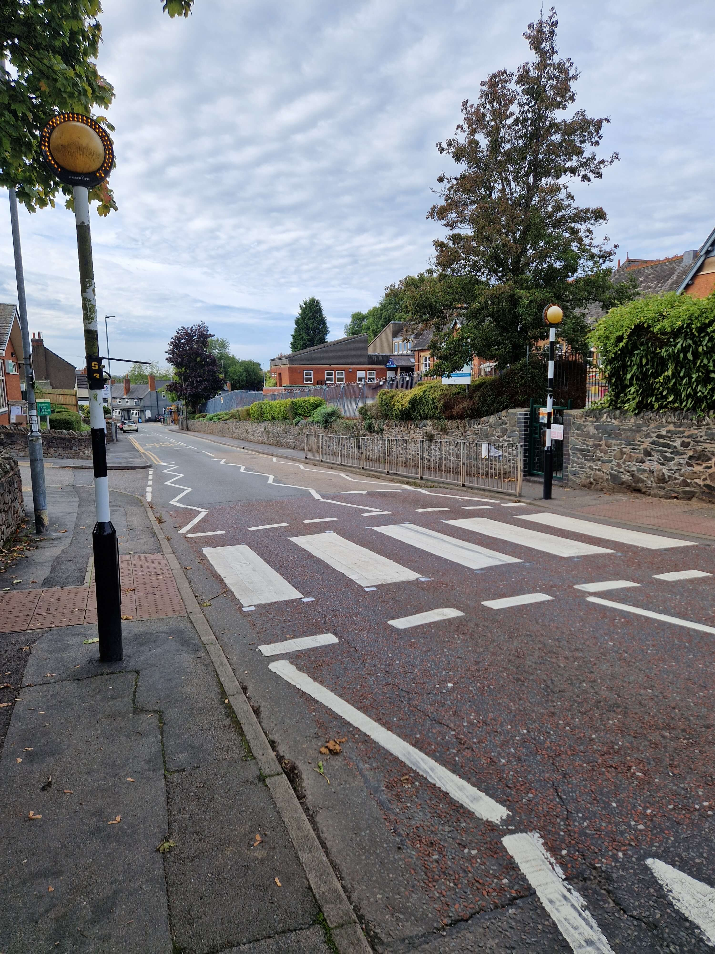
What can you tell people about crossing types?

Slide 7

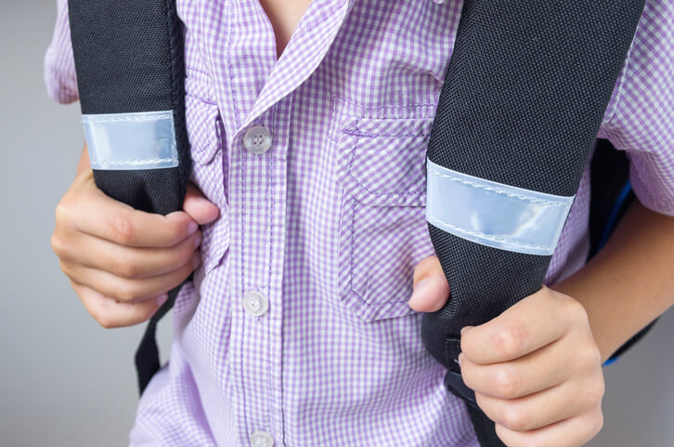

What can you tell people about:
Be Bright, Be Seen?

Slide 8
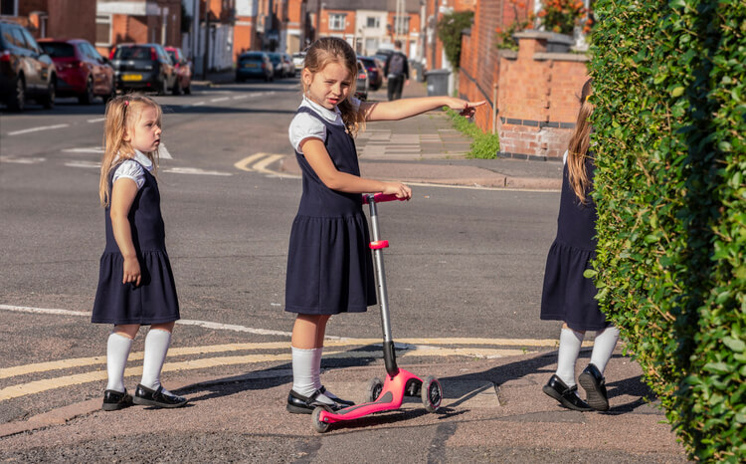
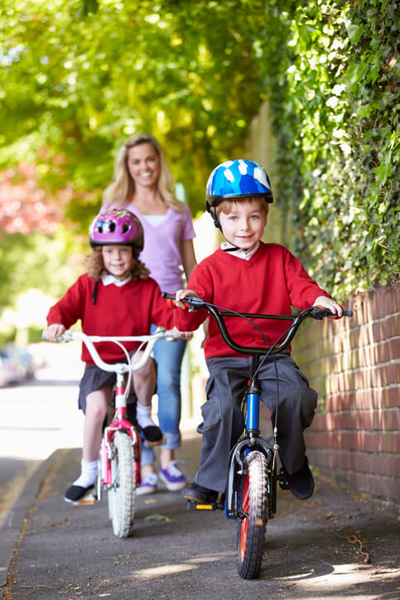
What can you tell people about:
Biking and scooting to school SAFELY?

Slide 9
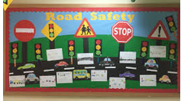
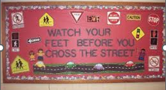
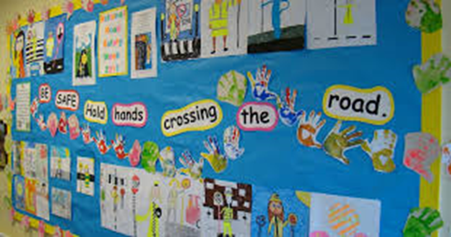
Display ideas

Slide 10
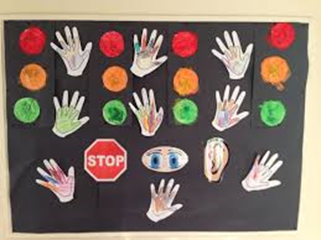
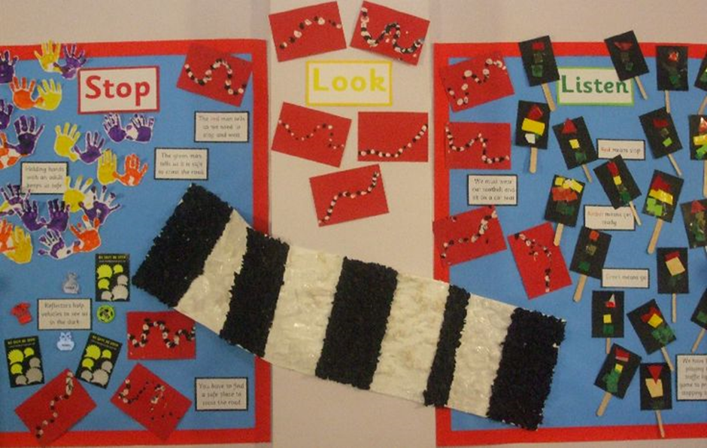
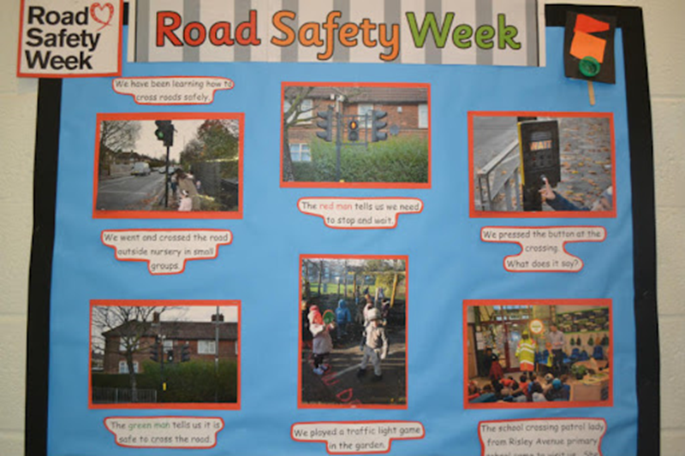
Display ideas

Slide 11

Ready for the challenge?
You can even order badges for the JRSOs and download certificates too!
https://www.junior-rso.org.uk/information-for-schools/

