Slide 1
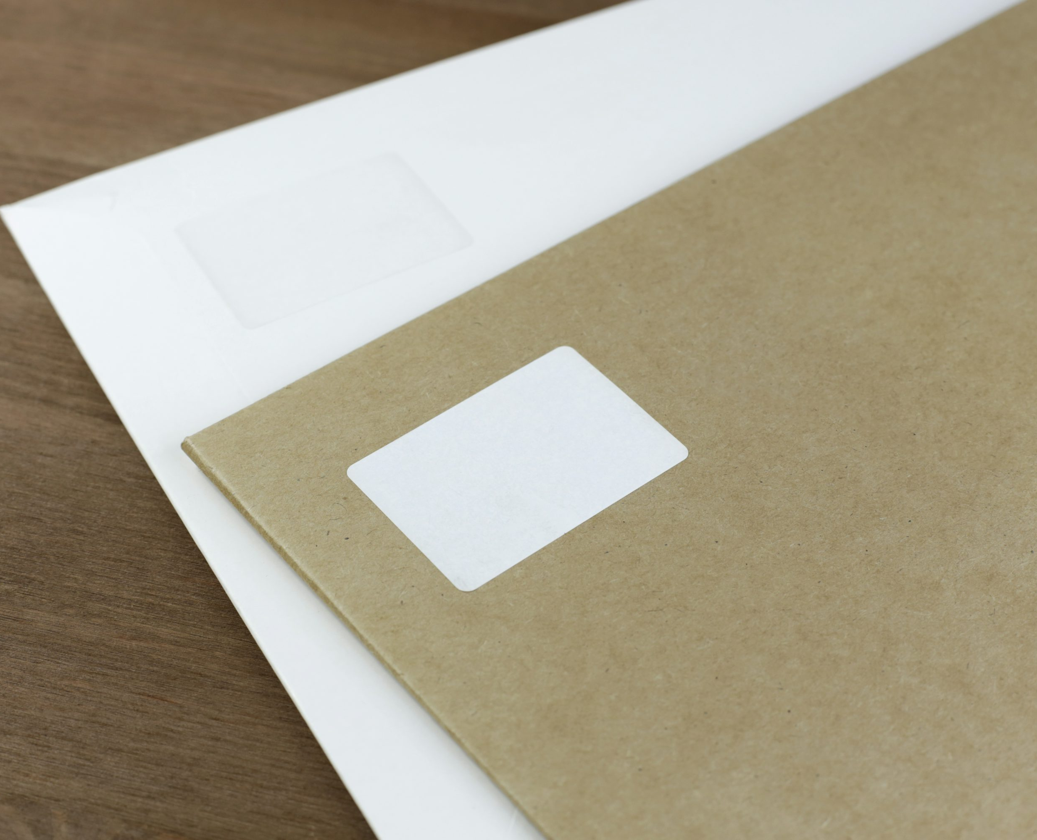



Reception’s Road Safety Mission

Slide 2

Reception's Road Safety Mission
Notes:
Click and ‘mission music’ should play.

Slide 3

Our Mission:
To be able to identify safe and non-safe places to play.
To be able to explain the 5 key steps to cross a road safely.
Notes:
Click to reveal the lesson objectives.

Slide 4
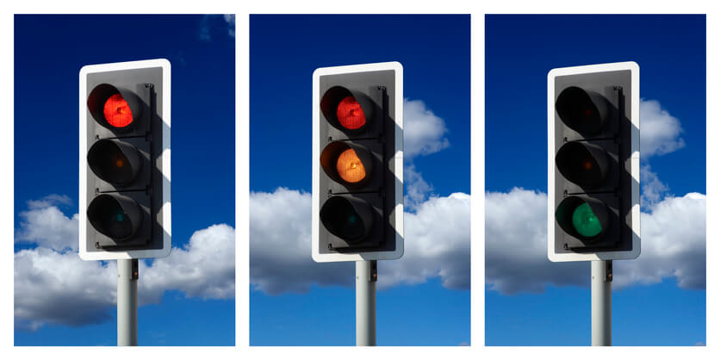
What is Road Safety?
Road Safety helps to keep everyone who uses the road safe and stops us from getting hurt.
It is important to know how to behave when we are near the road and that’s what we are going to learn today.
We are also going to learn how to cross a road safely and decide where is safe to play?
Notes:
Read out each bullet point.

Slide 5

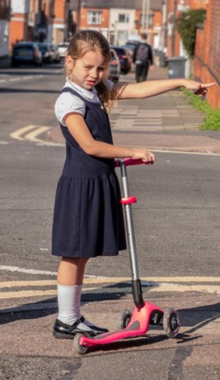
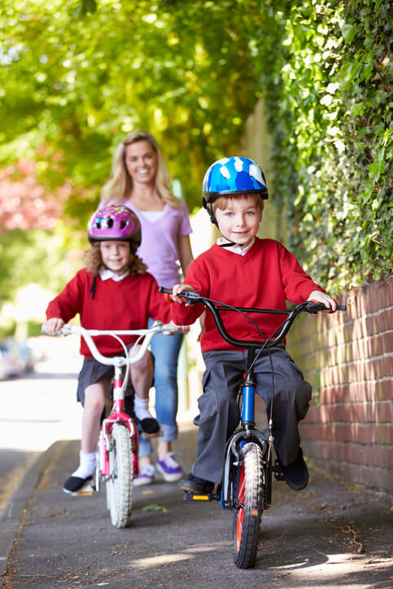
Who uses the road?
Notes:
Accept answers before we reveal.

Slide 6
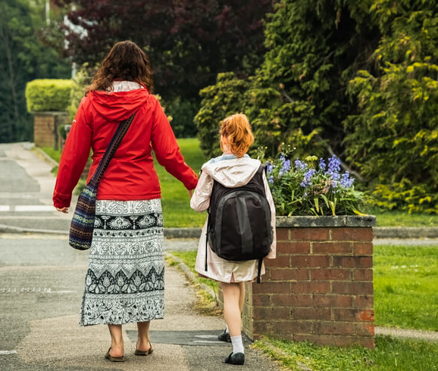
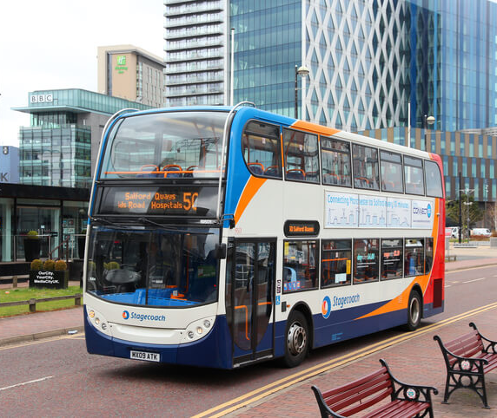
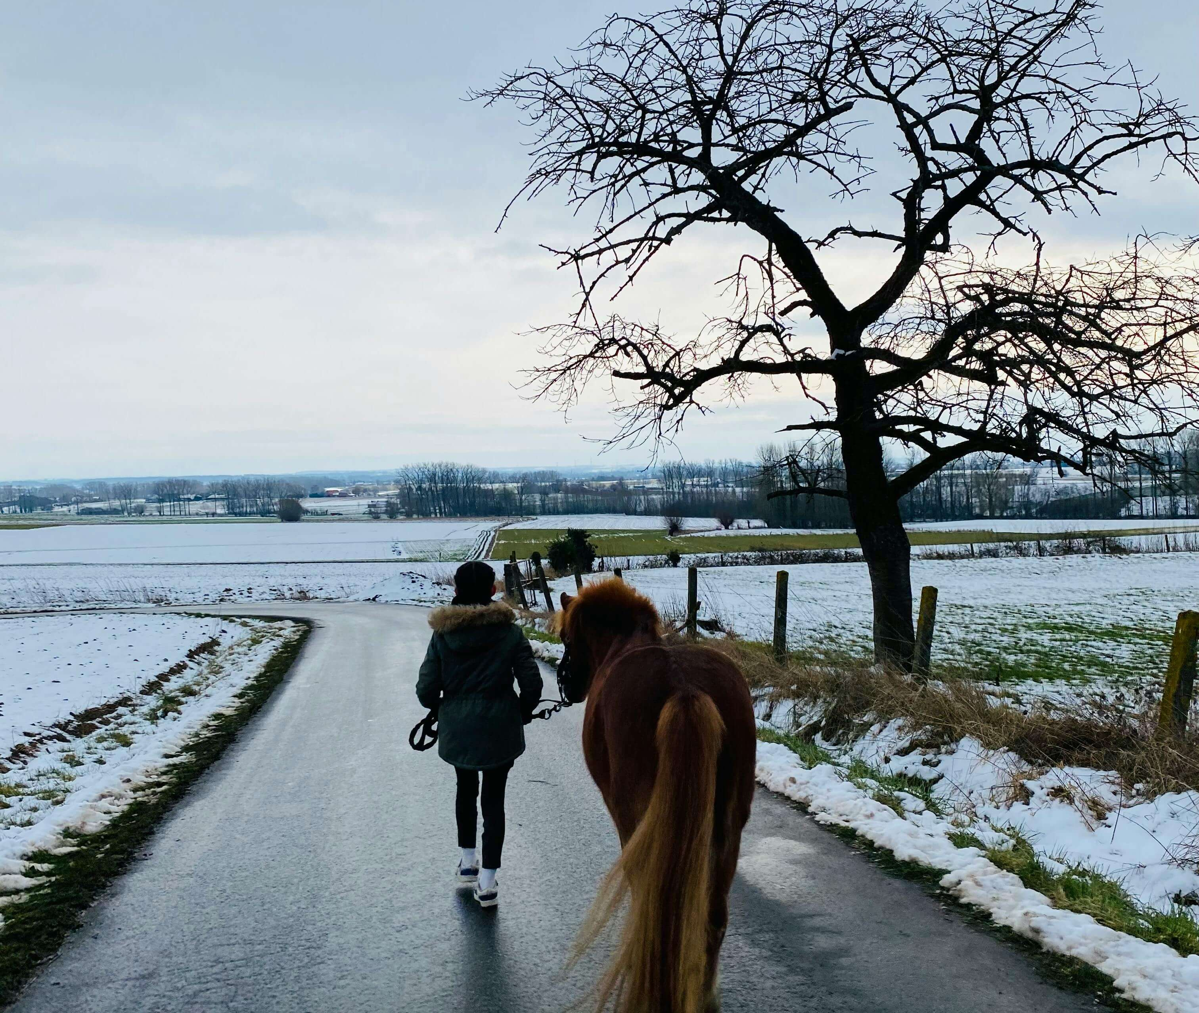
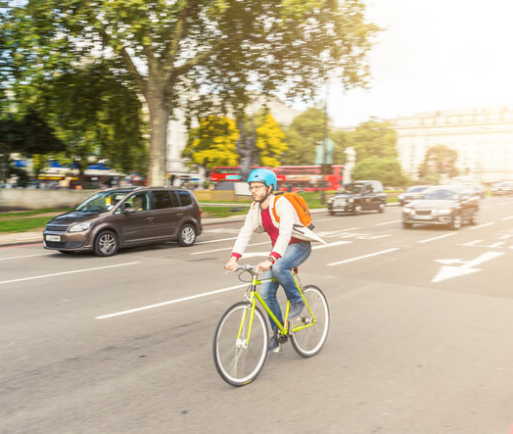
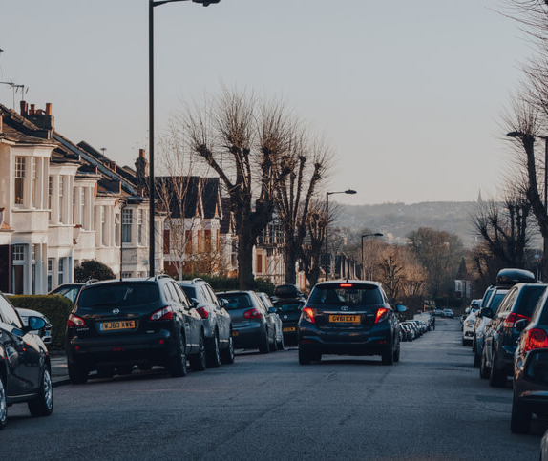
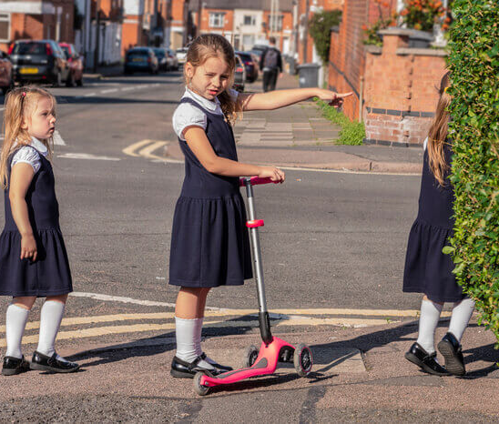
Notes:
Click and reveal each one. Pedestrians, Buses, Horses, Cyclists, Cars, Scooters.
Hands up –
Who has travelled by car?
Who has been on a bike?
Etc...

Slide 7
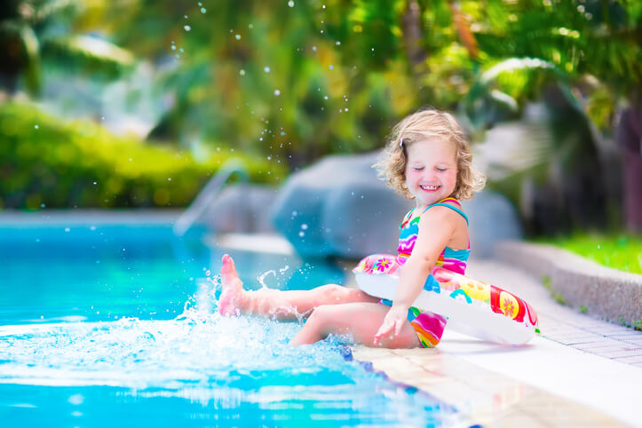

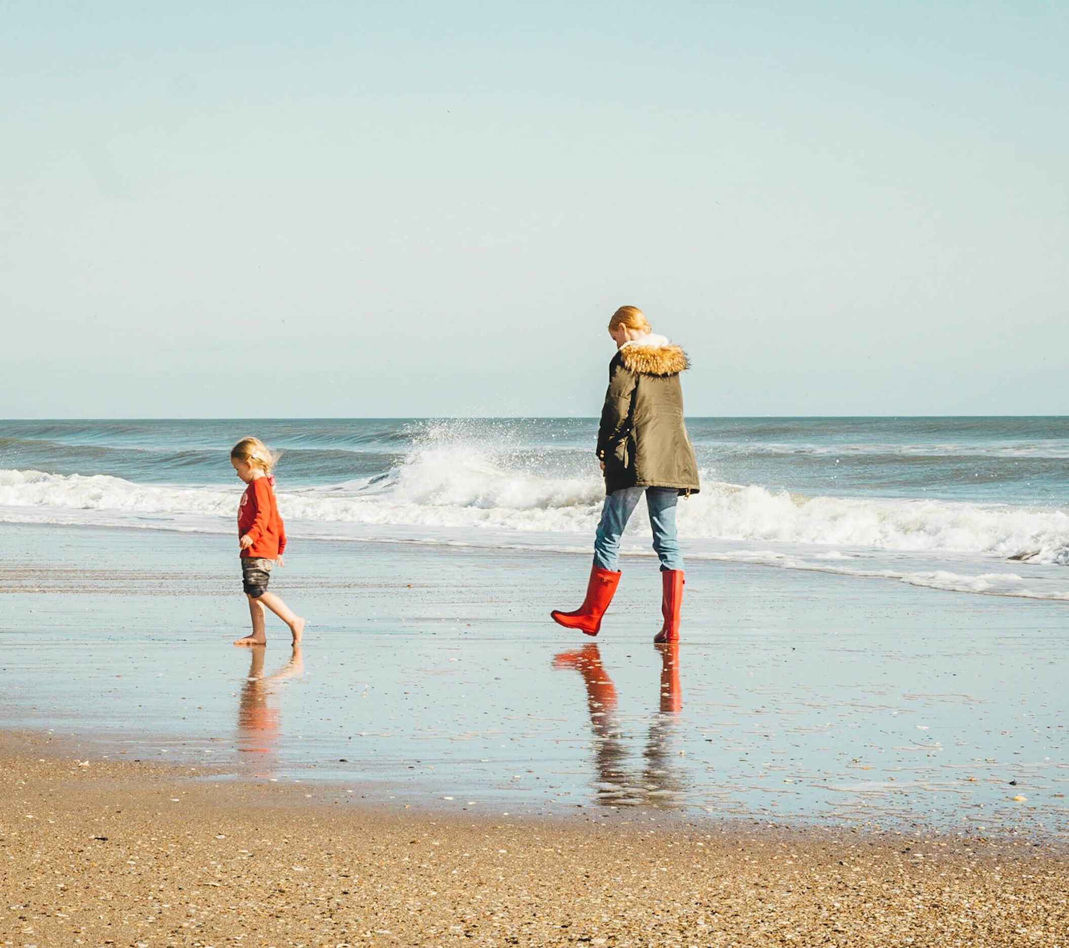
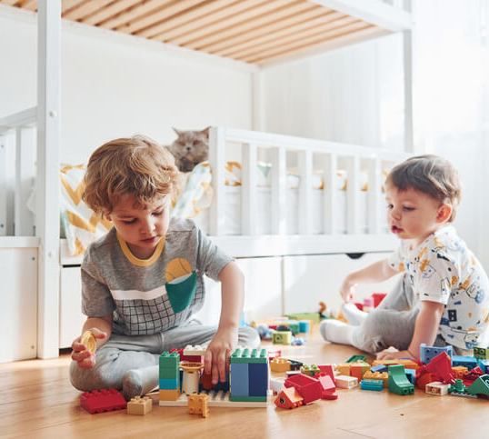
Notes:
Give pupils clues to talk about safe and non-safe places to play.
EG - beach/garden/park/forest/playground

Slide 8
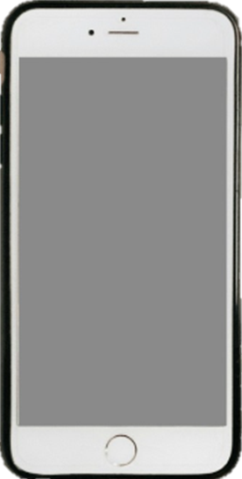

Mission 1:
Are these safe or not safe places to play?
Notes:
Click to reveal phone alert.
Thumbs up or thumbs down game for the following slides. If the children think it is a safe place to play – thumbs up.
If it is an unsafe place to play, thumbs down.
Look at answers across the class. Target key pupils to explain their choice.
Reveal the answer before moving to the next slide.

Slide 9
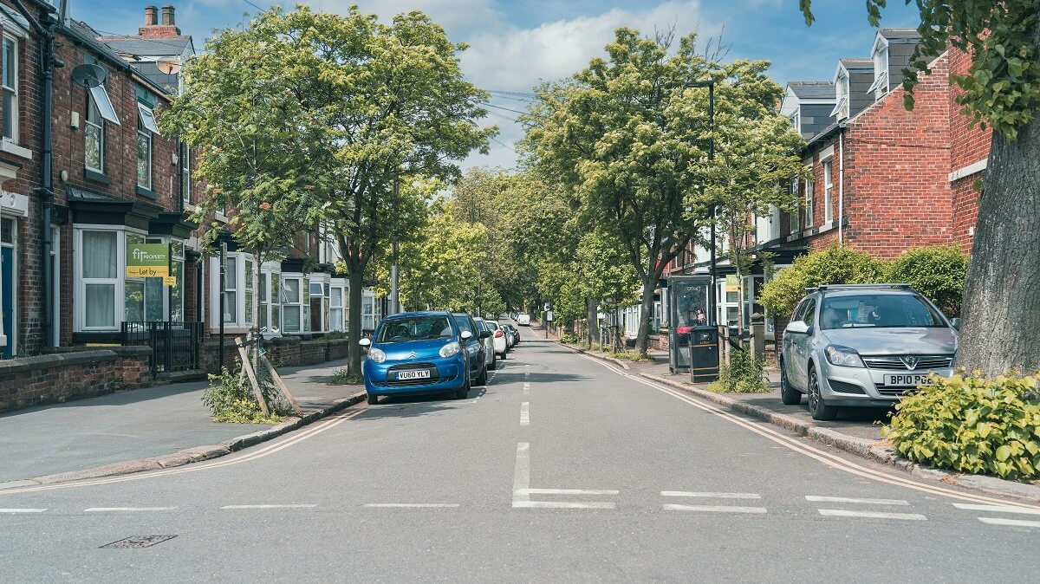
In the Road
Notes:
Thumbs up or thumbs down? Safe or not safe?
Why is this place not safe?

Slide 10
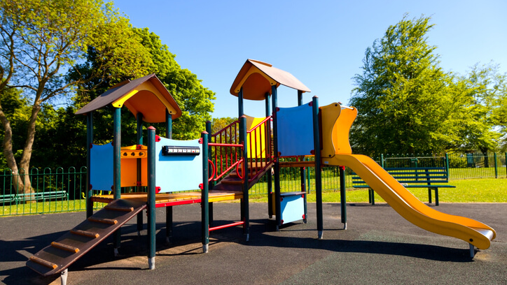
At the Park
Notes:
Double click needed.
Why is this place safe?

Slide 11
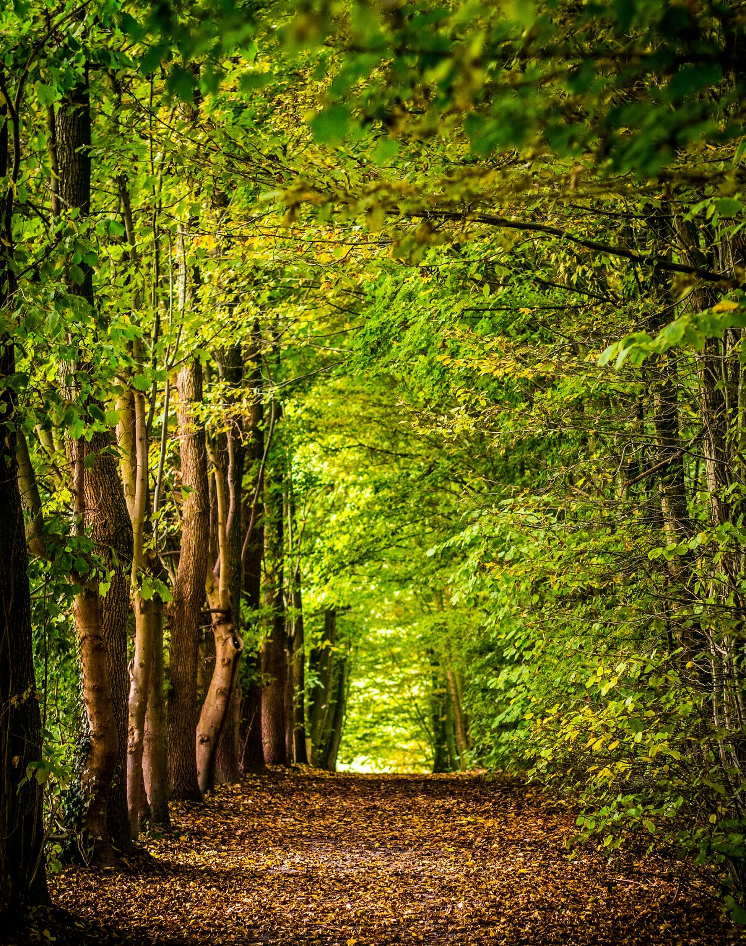
In the Forest
Notes:
Thumbs up or thumbs down? Safe or not safe?
Why is this place safe? Would it be safe on our own? Would it be safe at night?

Slide 12
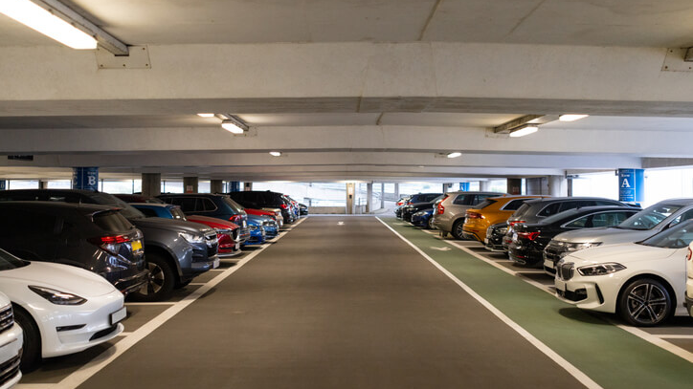
In a Car Park
Notes:
Thumbs up or thumbs down? Safe or not safe?
Why is this place not safe?

Slide 13
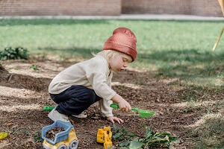
In the Garden
Notes:
Double click needed.
Thumbs up or thumbs down? Safe or not safe?
Why is this place safe?

Slide 14


Mission 2:
Learn the Road Safety Hand
Notes:
Discuss when we are wanting to cross the road safely – there are 5 important steps we need to remember.
Get children to show their Road Safety hand – talk about the 5 Road Safety Steps.
Practice the actions. Get volunteers who would like to demonstrate.
Stop = 1 palm straight out in front. Look = Finger and thumb on each hand to create glasses/binocular shape. Listen = cup one ear. Think = pretend to scratch the top of your forehead. Hold hands = clasp hands together similar to a handshake shape.
Add the props – stop sign, googly eyes,
Ask why do we think these steps are important to cross the road safely?

Slide 15

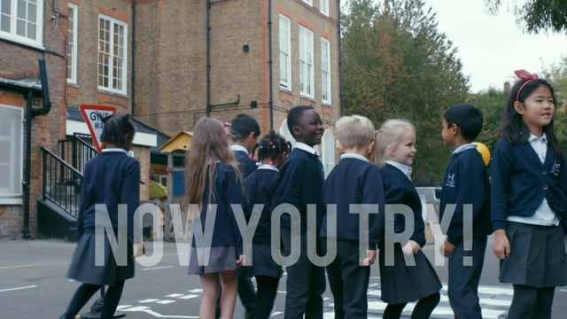
Are these children doing it right?
Dear Reception children, your task is to watch this video…
Notes:
Click the video link – takes you to https://www.think.gov.uk/resource/crossing-roads/

Slide 16

RECAP
What are the 5 steps we need to do before crossing the road?
Notes:
Ask children if they can remember the Road Safety Hand – Stop, Look, Listen, Think, Hold-Hands
Get volunteers to come up and show the class if they are confident.

Slide 17

Dear Reception,
Thank you for taking part in our secret mission today.
You are now invited to play a game of Theo says.
Ready to play?
Notes:
Introduce Theo to the class. He is our friendly Leicestershire County Council’s fox travel mascot who helps us with road safety.
Theo Says is the same as Simon Says. If ‘Theo says ’ we must follow the instruction, if it isn’t Theo saying it, we don’t follow the instruction.
Theo says:
Hold-hands/Stop/Look/Listen/Think/Fold your arms
Doesn’t say:
Nod your head
Clap
Click your fingers
Tap your nose

Slide 18
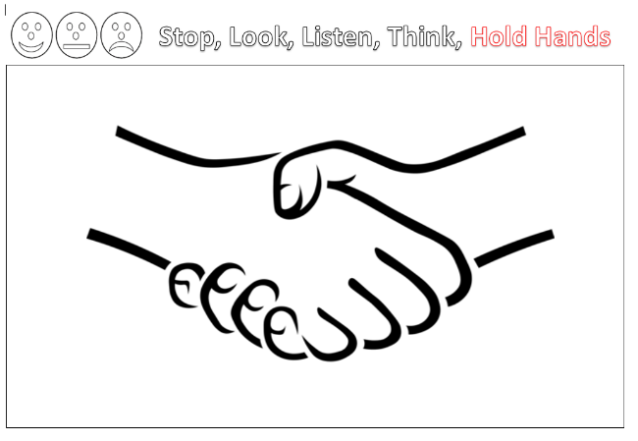
Mission 3:
Colour your holding hands sheet
Wait… Before we go to do our task…
Notes:
Click for the alert. Discuss the three face self assessment.
Smiley = fully understand and remember the 5 parts of the road safety hand
Straight face = mostly understand the 5 parts of the road safety hand
Sad face = don’t remember the road safety hand

Slide 19
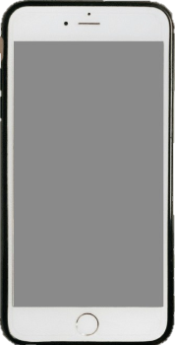
Mission 4:
Tell your grown-ups at home what you have learnt today.

Slide 20
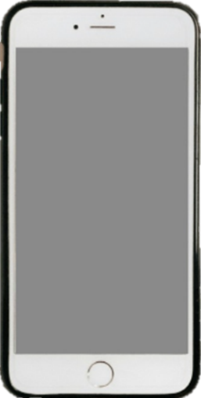
Mission 3:
Colour your holding hands sheet
Let’s go do our task…
Notes:
Stickers for the neatest colouring/best effort/super concentration – let’s take our time.

Slide 21
Thank you!

Slide 22
Credits
Phone - Photo by Benjaminrobyn Jespersen
Top Secret Logo – Photo by Tayeb Mezahdia https://pixabay.com/illustrations/top-secret-confidential-classified-2054429/
Road -Photo by Benjamin Elliott on Unsplash
Forest - Photo by David Bruyndonckx on Unsplash
Beach - Photo by Brian Gordillo on Unsplash
Message alert – By LIECIO
https://pixabay.com/sound-effects/message-notification-190034/
Spy theme – By Universefield https://pixabay.com/music/happy-childrens-tunes-joyful-spy-melody-for-lighthearted-fun-15s-232565/
Playing in garden –Photo by Allan Mas from Pexels: https://www.pexels.com/photo/little-boy-playing-with-plastic-shovel-in-backyard-5623736/
Horse in lane - Photo by liesbeth stevens from Pexels: https://www.pexels.com/photo/a-person-with-a-horse-in-winter-19945572/
Photo by Eva Bronzini from Pexels: https://www.pexels.com/photo/a-sheet-of-paper-on-top-of-a-brown-envelope-7958171/

