Slide 1




Year 1's Road Safety Mission

Slide 2

Year 1's Road Safety Mission
Notes:
Click will initiate ‘mission’ music intro.

Slide 3

Our Mission:
To be able to explain the 5 key
steps to cross a road safely.
To be able to identify safe places to cross.
Notes:
Click to reveal the lesson objectives.

Slide 4
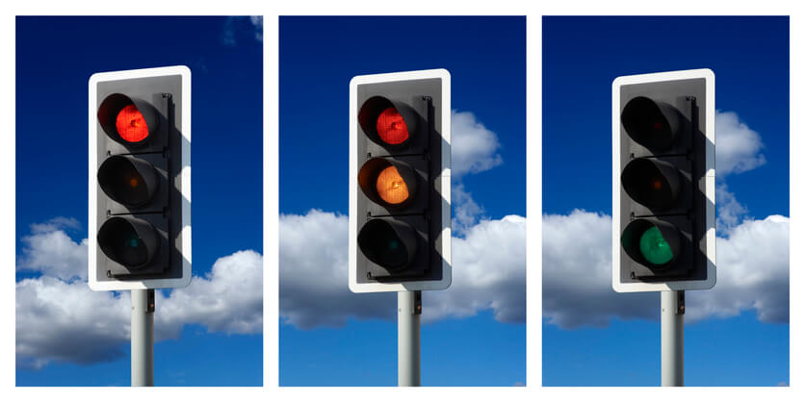
What is Road Safety?
Road Safety helps to keep everyone who uses the road safe and stops us from getting hurt.
It is important to know how to behave when we are near the road and that’s what we are going to learn today.
We are also going to learn how to cross a road safely and learn where is a good place to cross.
Notes:
Read out each bullet point.

Slide 5

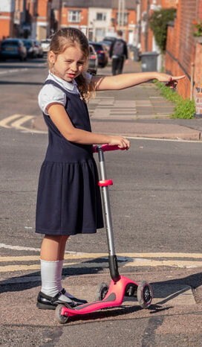
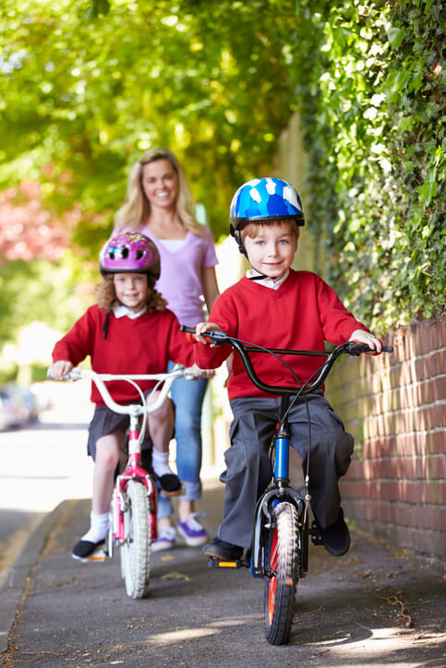
Who uses the road?
Notes:
Accept answers before we reveal.

Slide 6
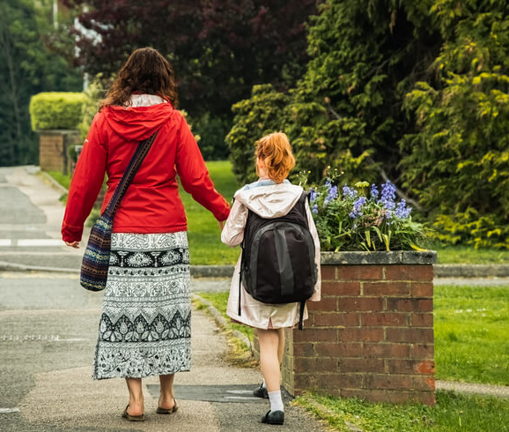
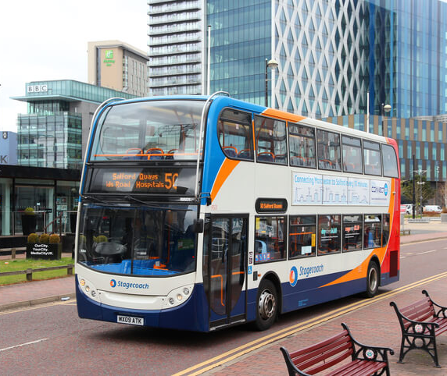
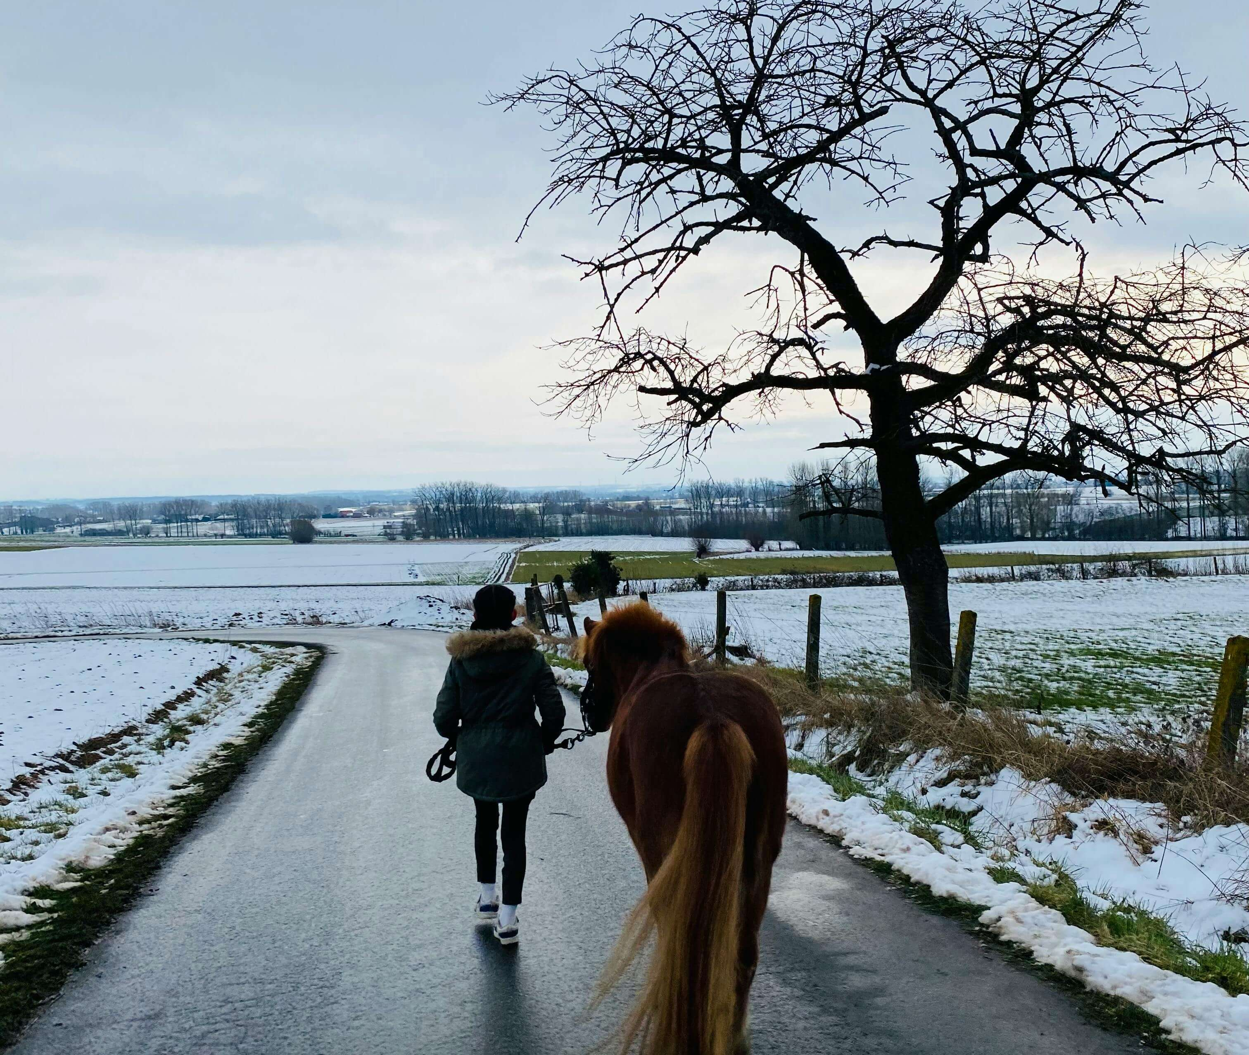
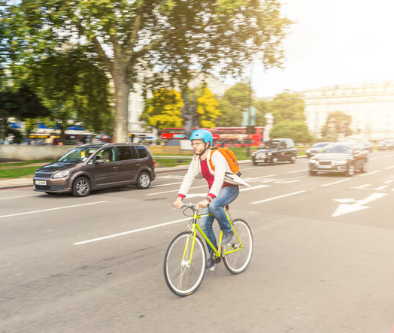
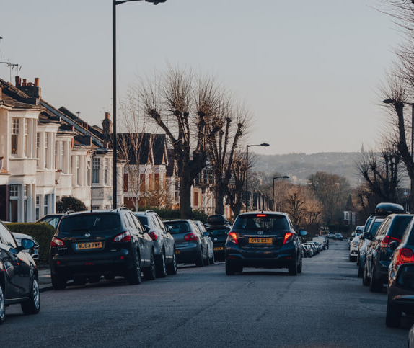

Notes:
Click and reveal each one. Pedestrians, Buses, Horses, Cyclists, Cars, Scooters.
Hands up –
Who has travelled by car?
Who has been on a bike?
Etc...

Slide 7
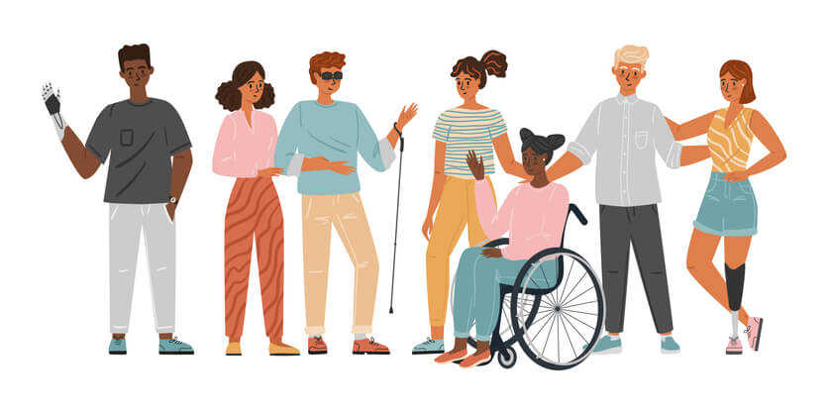
Why might it be hard for disabled people to cross the road?
Notes:
Discuss what the word disabled means if children are unsure. Look at clues in the picture.
Ask for ideas from the children about what might be difficult for these different people using the pavements, crossing the roads, and getting on transport?

Slide 8



Mission 1:
Re-cap the Road Safety Hand.
Notes:
Click to reveal mission 1 with text alert.
*Following the rollout of the trial – the Road Safety Hand will already have been covered in Reception and this will be revision. For the trial, this is NEW learning.*
Discuss when we are wanting to cross the road safely – there are 5 important steps we need to remember. Get children to show their Road Safety hand – talk about the 5 Road Safety Steps.
Practice the actions. Get volunteers who would like to demonstrate.
Stop = 1 palm straight out in front. Look = Finger and thumb on each hand to create glasses/binocular shape. Listen = cup one ear. Think = pretend to scratch the top of your forehead. Hold hands = clasp hands together similar to a handshake shape.
Ask why do we think these steps are important to cross the road safely?

Slide 9

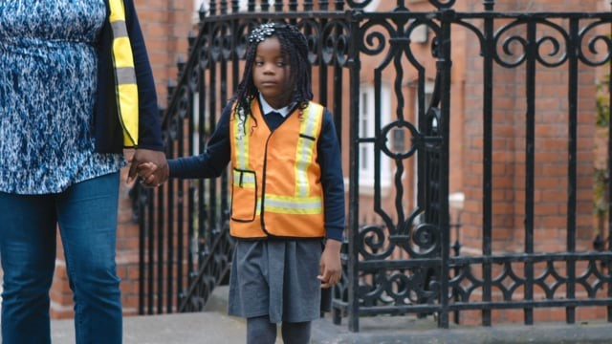
What tips can you spot about road safety?
Dear Year 1, your task is to watch this video…
Notes:
Click and reveal the mission.
Click directly on the video clip. Video should start. *Must have clicked enable content when opening the Powerpoint*
Once watched- Ask the children what top tips they spotted? (You may want to pause the video at 0.55 just before the song begins.)
Feedback.
*If hyperlink fails. Original source for video - https://www.think.gov.uk/resource/safer-journeys-anthem/

Slide 10
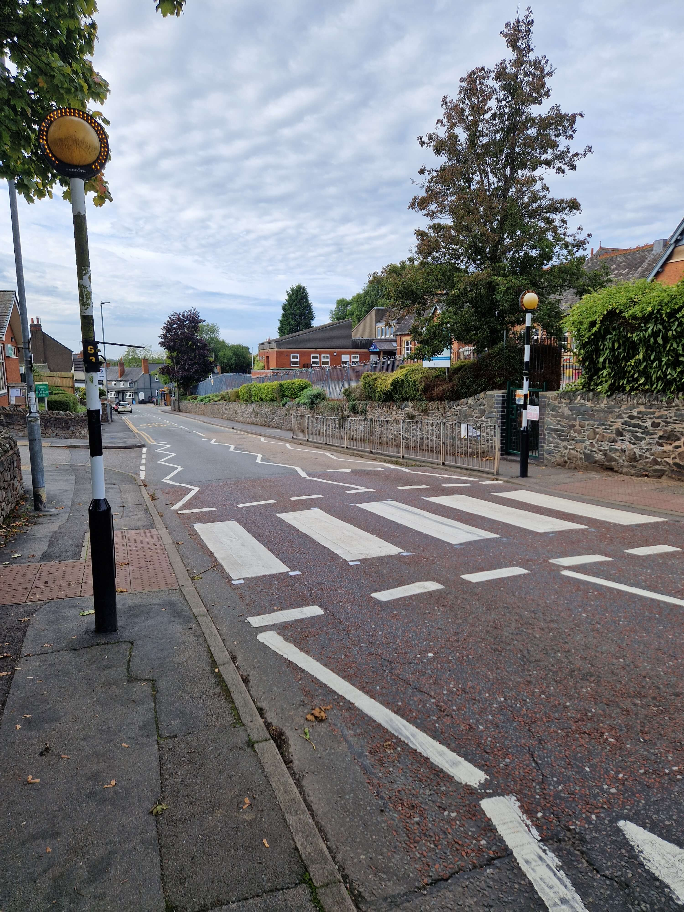
What are some safe places we can cross?
Notes:
Children to share some ideas. These will be explored across the next few slides.

Slide 11


Clue 1…
Notes:
Ask the children what animal this is.

Slide 12
Zebra Crossing
The name zebra comes from the black and white stripes on the road.
They have flashing yellow beacons on black and white striped poles.
Wait on the pavement near the kerb and give traffic plenty of time to stop.
Once the cars have stopped, use your road safety hand to: stop, look, listen, think and hold-hands. Then cross the road when it is safe.
Notes:
Hands up – who has used a zebra crossing before?

Slide 13

Clue 2…
Notes:
Ask the children what animal this is. Give them the letter ‘p’ as an extra clue.

Slide 14
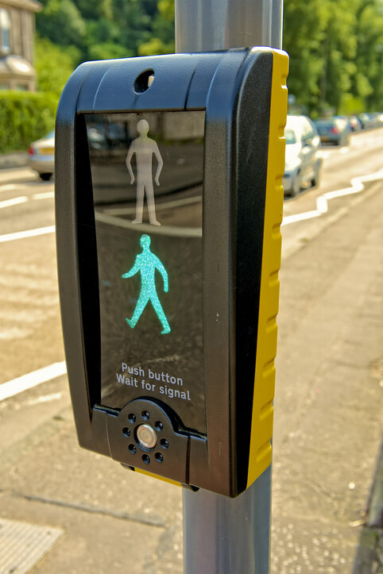
Puffin Crossing
Puffin crossings are controlled by traffic lights.
Pedestrians can press a button that changes the road traffic lights to red to stop the traffic.
You will see either:
-a red person showing you it is NOT safe to cross.
-a green walking person showing you it IS safe to cross.
Notes:
Click through each piece of information.
Discuss the term ‘Pelican Crossing’. These are very similar. They usually have the green man ACROSS the road and also have no sensors detecting traffic or pedestrians.

Slide 15
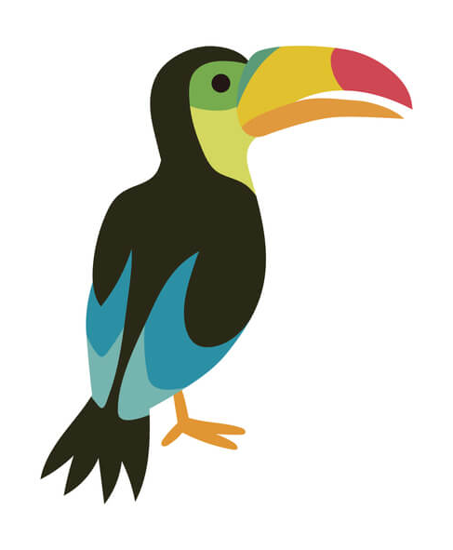
Clue 3…
Notes:
Ask the children what animal this is. Give them the letter ‘t’ as an extra clue.

Slide 16
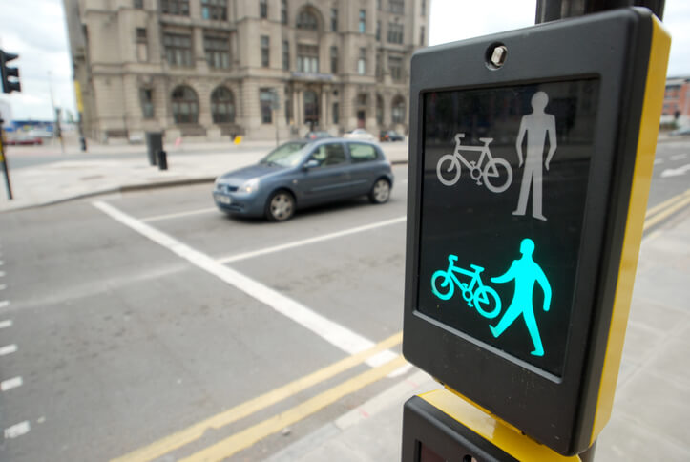
Toucan Crossing
They look a lot like a puffin crossing from a distance – but have an important difference!
They have an extra signal for bikes and are usually found on the outskirts of parks, or cycle lanes. They are also wider.
They are called a ‘Toucan Crossing’ because there are two ways you can cross.
Notes:
Click and reveal each piece of information.

Slide 17
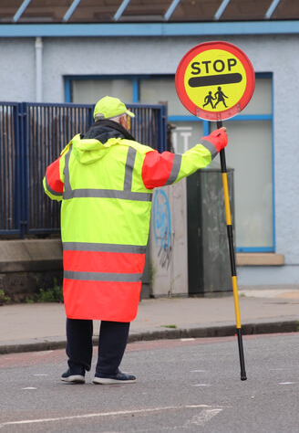
School Crossing Patrols
When school crossing patrols are controlling the traffic, wait until they signal to you to cross the road.
Always cross in front of them so they can see you.
Notes:
Click and reveal each piece of information.

Slide 18
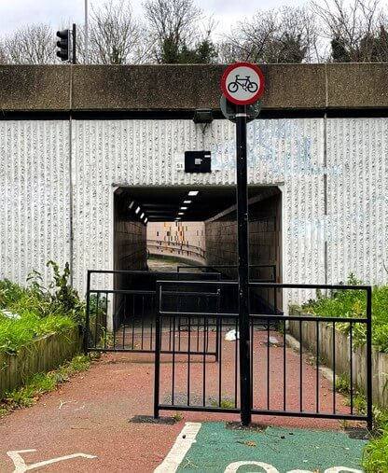
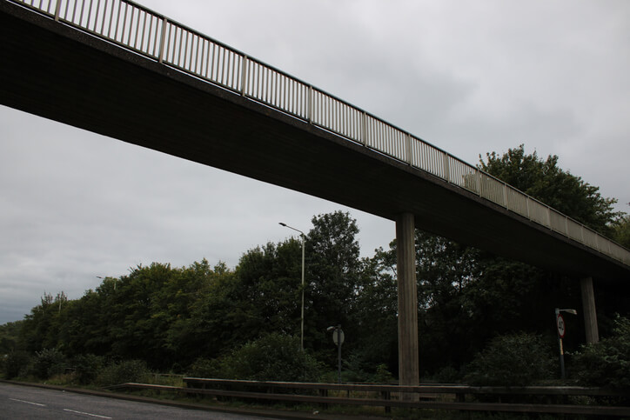
Underpasses and Overpasses
An Underpass and Overpass both help to keep us away from the traffic and give us a safe place to cross the road.
Notes:
Click and reveal each piece of information. Anyone seen or used one?

Slide 19
Did you know?
Pelican or Puffin
A Pelican crossing means that the flow of traffic is controlled by the traffic lights.
This crossing allows 6 seconds to cross the road.
A Puffin crossing has a sensor which detects when the pedestrians are safely across the road before it allows the traffic lights to change.
These are much safer for slower pedestrians, such as the elderly, or those with a disability.
Notes:
Click to reveal each piece of information.

Slide 20
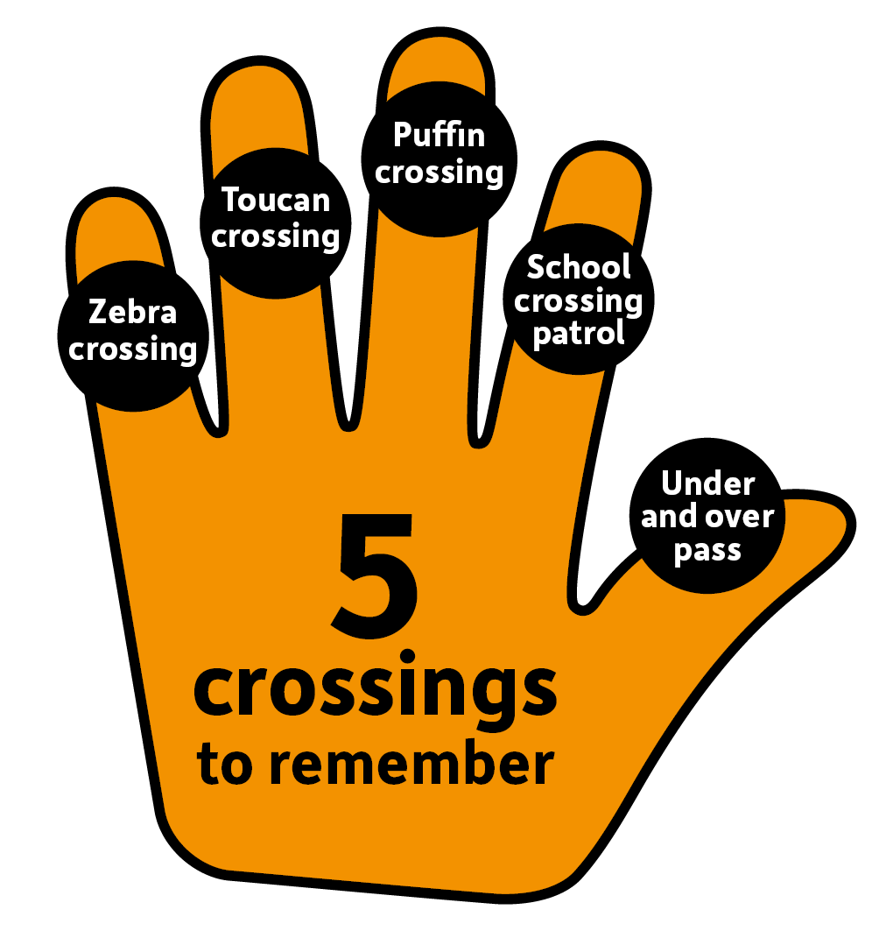
Alert:
New Learning!
Notes:
Click and reveal phone alert. Discuss how we can use our hand to remember the 5 main crossings to remember. Practise together.
Ask questions to test their memory. What was the stripy one called? What was the one where bikes and pedestrians can cross? What is the official name for a lollipop man/woman? What crossing has the red man which means you cannot cross? Which ones will take you under or over a very busy road?

Slide 21

Mission 3:
Tell Me Why? GAME
Notes:
Click and reveal phone alert. Each of the next few slides will show examples of unsafe places to cross.
Children to share why each would be an unsafe choice to cross the road?

Slide 22
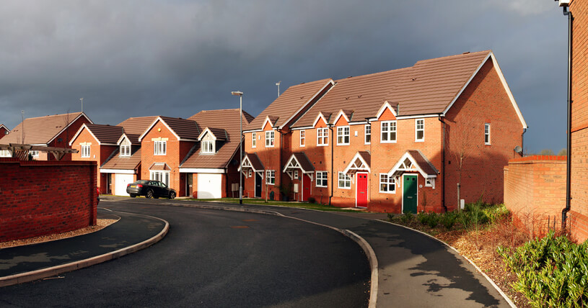
Bends
Why is it unsafe to cross here?
Notes:
Discuss.
You cannot see if there is a car coming or at what speed?
They cannot see you crossing.

Slide 23
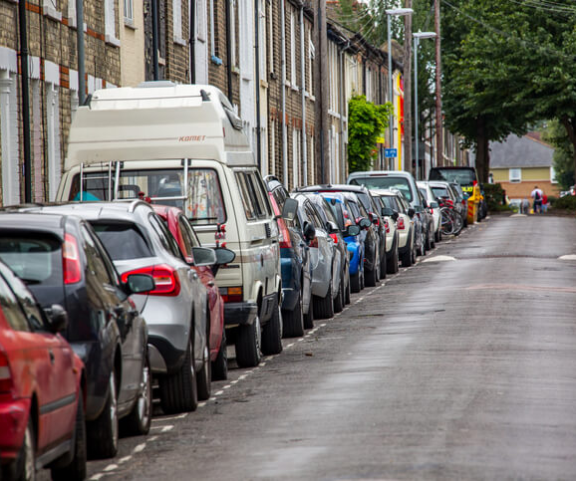
Between parked cars
Why is it unsafe to cross here?
Notes:
Discuss.
You may be smaller than the parked car height. The passing cars may not be able to see you. You may have to lean into the road to get a better look at what is coming.

Slide 24
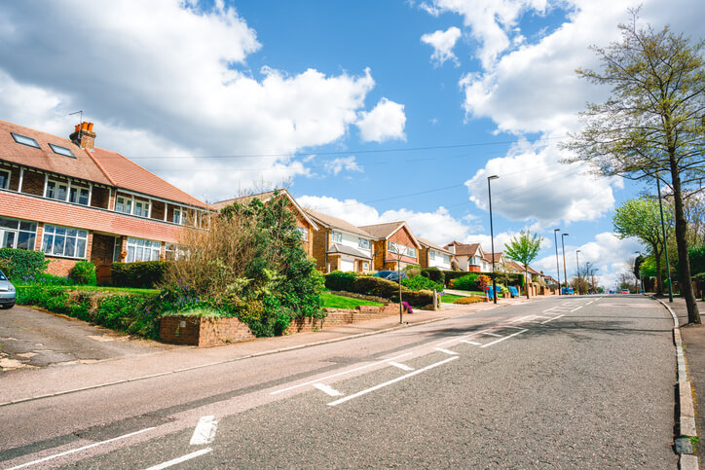

On a hill
Why is it unsafe to cross here?
Notes:
Discuss.
You cannot see over the crest of that hill so don’t know if a car is coming. They can’t see you yet. Being a hill, they may be gathering speed.

Slide 25

RECAP
What are the 5 crossing types we should be using?
Notes:
Ask children if they can remember the Crossings Hand – Zebra Crossing, Puffin Crossing, Toucan Crossing, School Crossing Patrol and Underpass/Overpass. Give clues. Starts with the letter… Give them hints about what they look like or how they work?

Slide 26
Mission 4:
Tell your grown-ups at home what you have learnt today.
Notes:
Really important message.

Slide 27
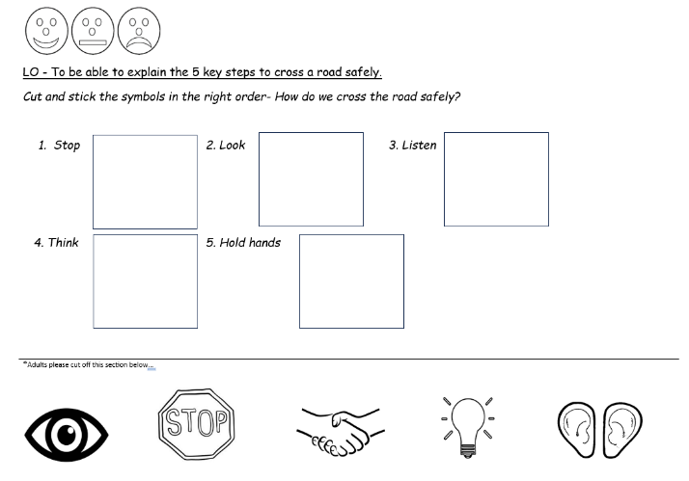
Suggested activity…
Notes:
If time allows. Pre-cut off the bottom of the sheet. Children to cut and stick in the correct order.
Discuss the self-assessment. Colour the face showing how well they have understood the lesson. Smiley – very confident. Straight face – quite confident. Sad – still need more help.

Slide 28
Thank you!

Slide 29
Credits
Phone - Photo by Benjaminrobyn Jespersen
Top Secret Logo – Photo by Tayeb Mezahdia https://pixabay.com/illustrations/top-secret-confidential-classified-2054429/
Zebra crossing – Photo by Benjamin Cheng on Unsplash
Message alert – By LIECIO
https://pixabay.com/sound-effects/message-notification-190034/
Spy theme – By Universefield https://pixabay.com/music/happy-childrens-tunes-joyful-spy-melody-for-lighthearted-fun-15s-232565/
Photo by Eva Bronzini from Pexels: https://www.pexels.com/photo/a-sheet-of-paper-on-top-of-a-brown-envelope-7958171/
Horse in lane - Photo by liesbeth stevens from Pexels: https://www.pexels.com/photo/a-person-with-a-horse-in-winter-19945572/

