Slide 1
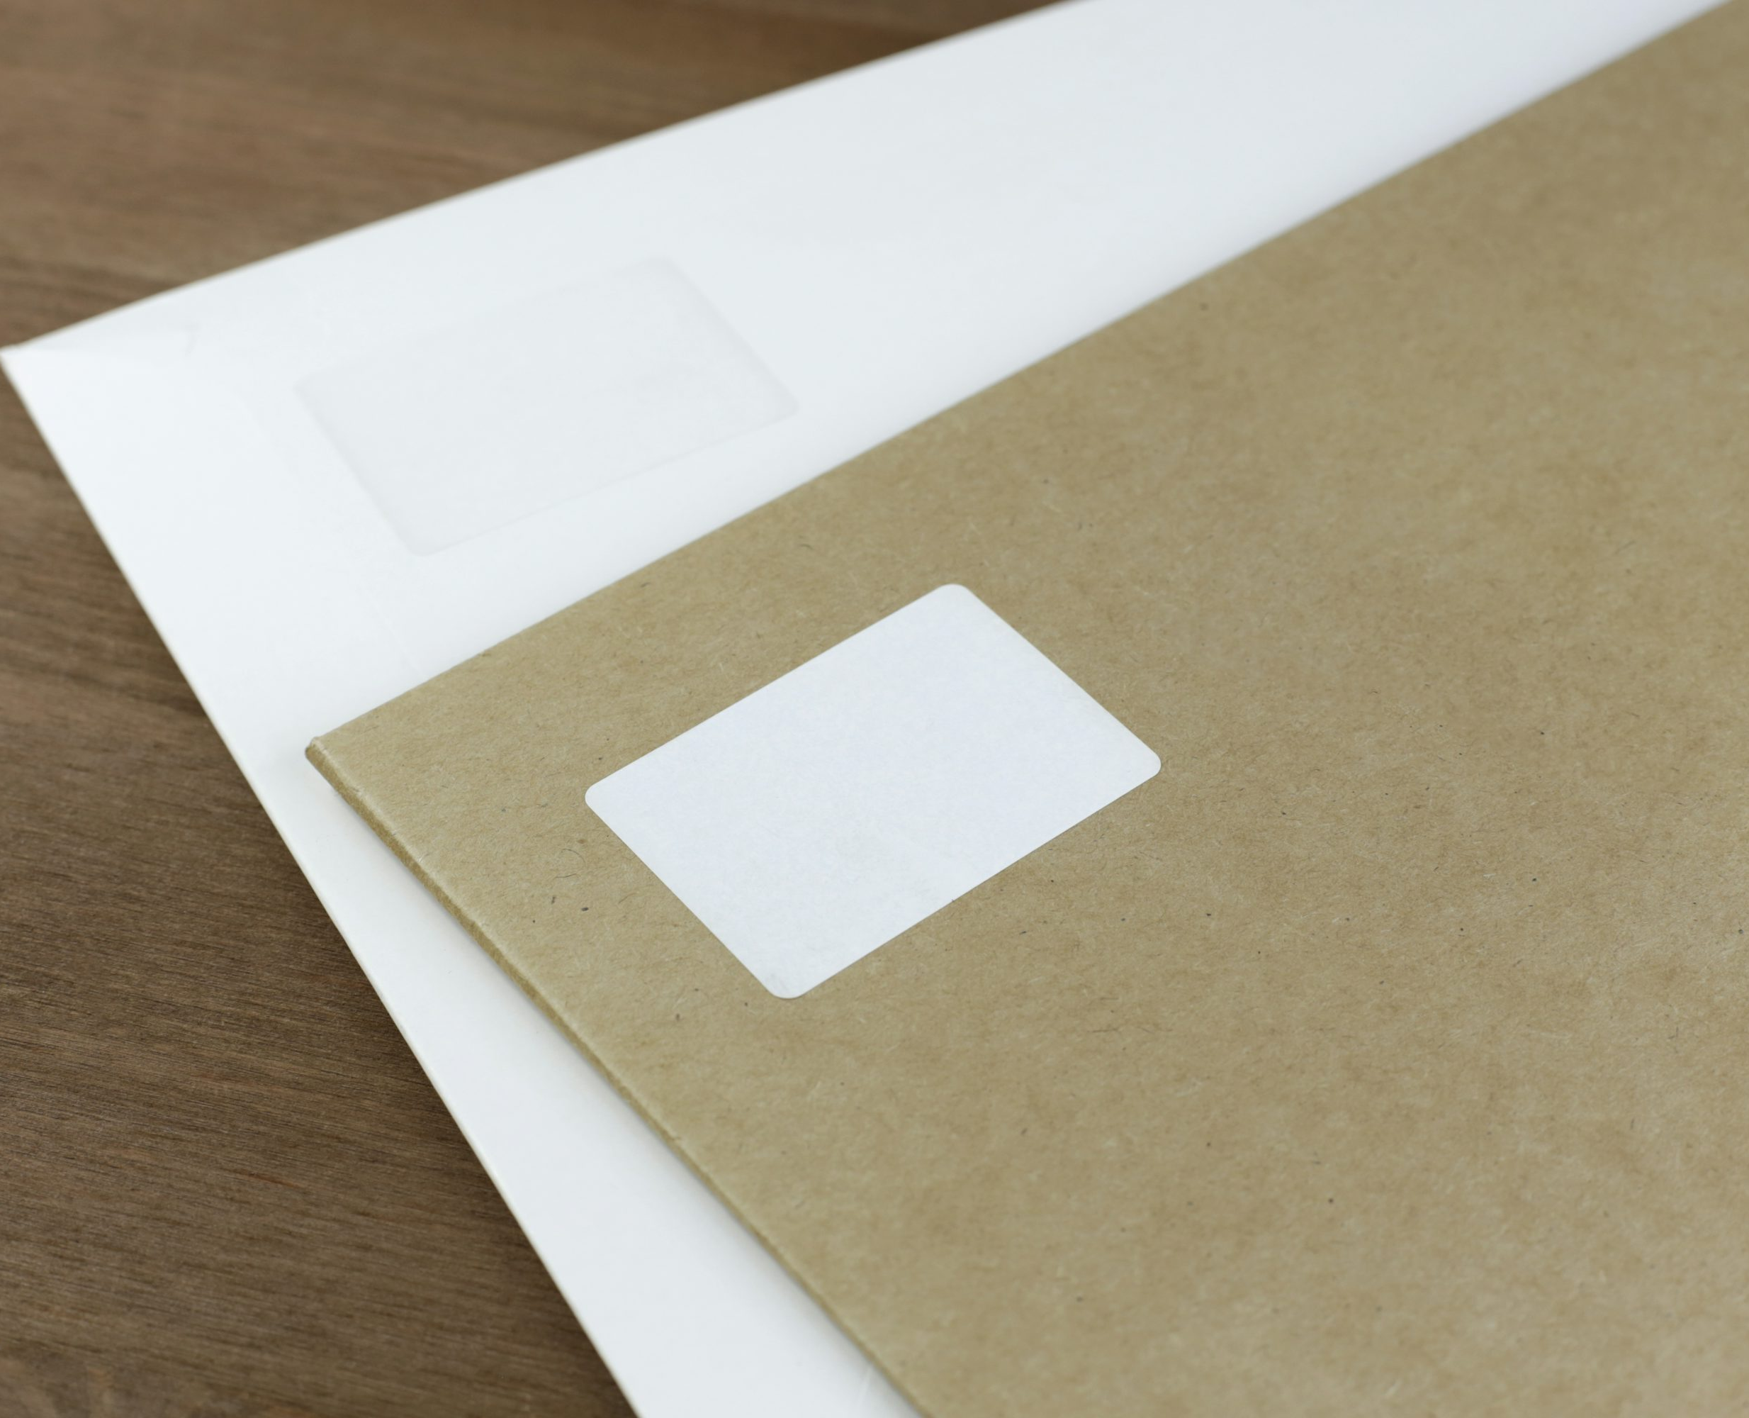



Year 2's Road Safety Mission
Notes:
Click and mission music will start.

Slide 2

Year 2's Road Safety Mission
Notes:
Click and theme music should play.

Slide 3

Our Mission:
To be able to know how to check a scooter before riding it.
To be able to discuss ways to stay safe whilst riding a scooter.
Notes:
Click to reveal the lesson objectives.

Slide 4
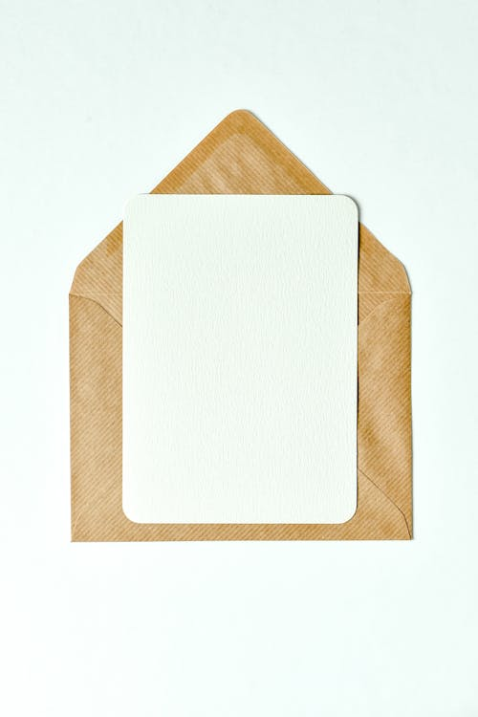
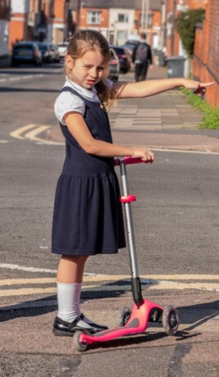
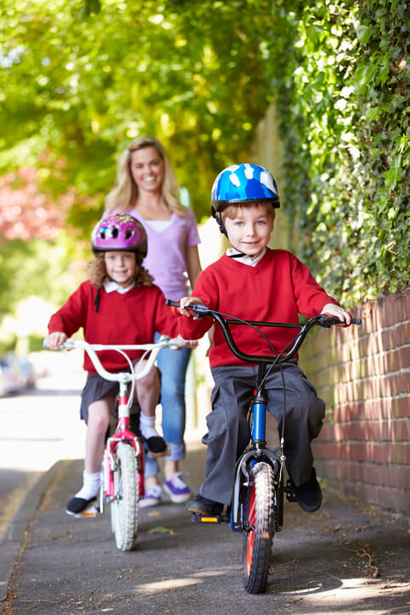
How do you travel to school?
Notes:
Accept answers.
Anyone travel by car? Park and stride? Scooter? Bike? Walk? Bus?

Slide 5

Importance of Road
Safety
A whole class of children are injured on the road, every 3 weeks.
10 children, aged 7 or under, are injured every week.
Young children are the most at-risk when using the road.
8 out 10 child road accidents, involved not looking properly.
Notes:
Click to reveal each statement.

Slide 6
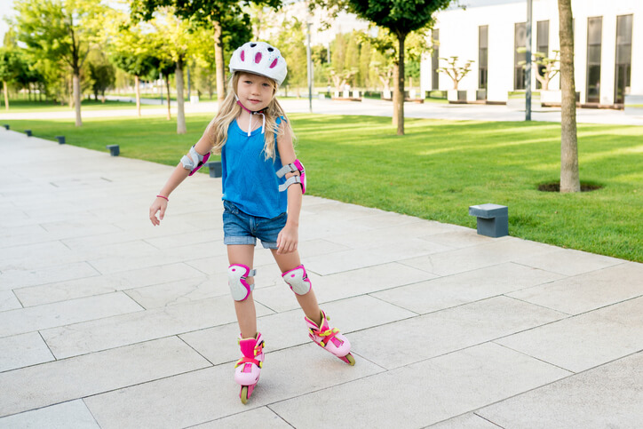
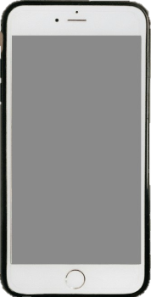
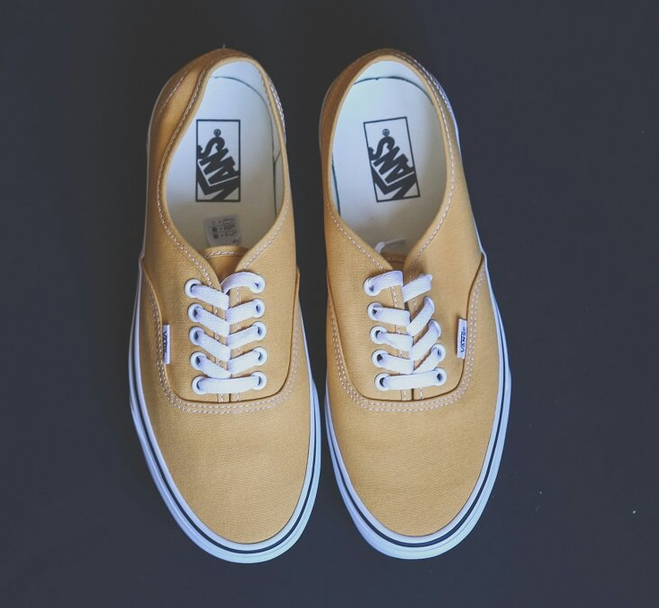
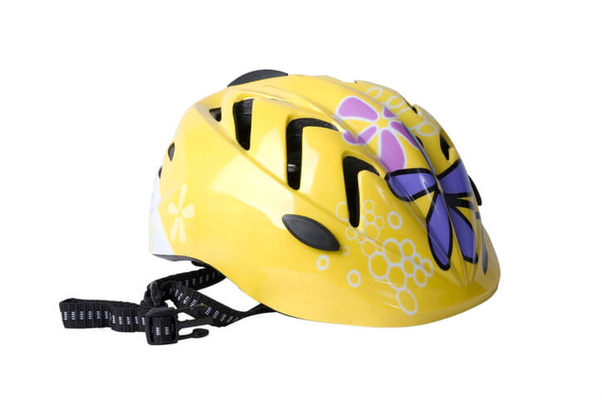
Mission 1 –
What should
you wear when scooting?
Notes:
Take some answers from the children before clicking to reveal the three main answers.
Helmet.
Knee and elbow pads.
Sensible shoes, not sandals. With trainers, make sure laces are tucked in, so they don’t get caught.

Slide 7
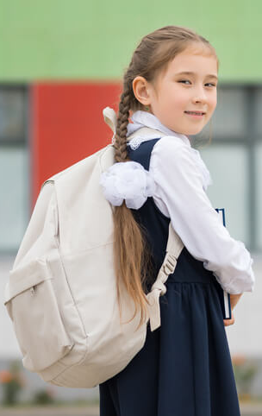
Why do you need to put your bag on your back?
Notes:
Where should we never place our backpack when scooting? The handlebars.
Why? It will affect our balance.
The BEST place for it, would be to give it to your accompanying grown up.

Slide 8
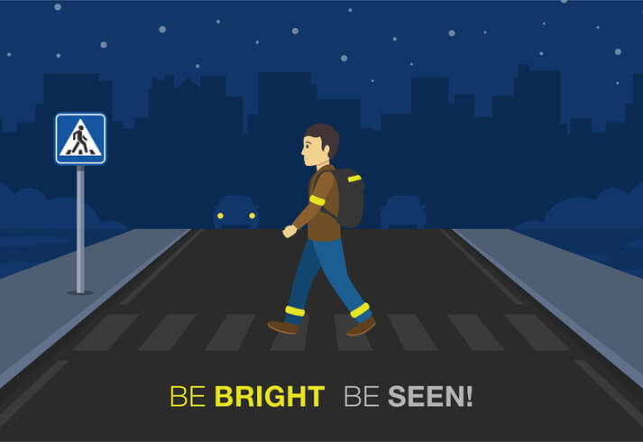
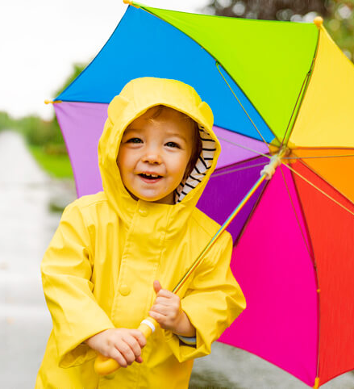
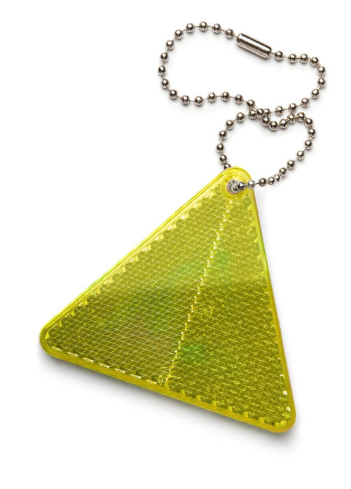
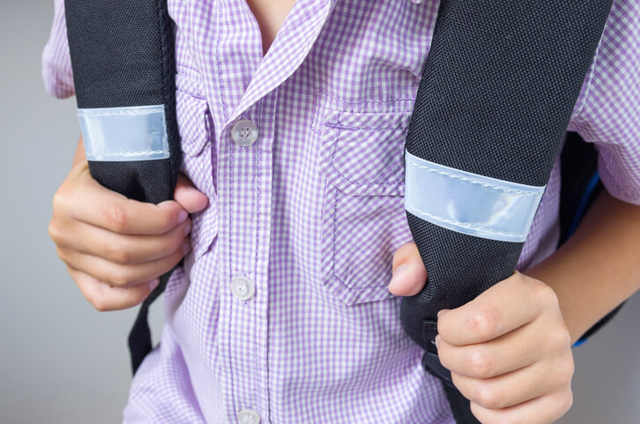
Be Bright, Be Seen!
Notes:
What does ‘Be Bright, Be seen’ mean? Look at the pictures for clues.
What time of day or time of year will this be really important? Why? When would the yellow coat be a great choice – when would it not?
We can have coats, bags, arm bands, keyrings. Whose coat/bag has this on? Look at the example products together.

Slide 9
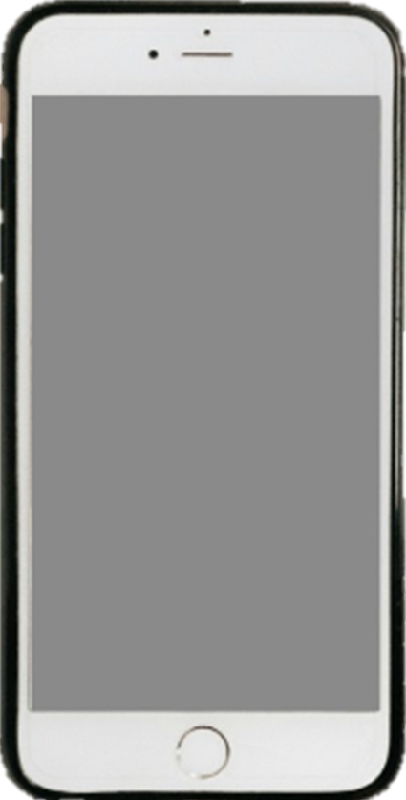
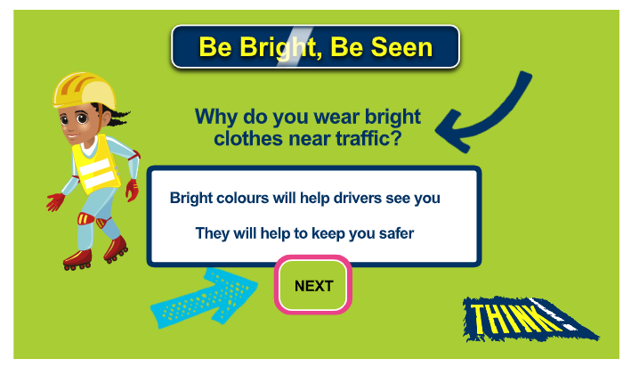
Be Bright, Be Seen Game
Mission 2 –
Click to play the game. Identify the bright clothes.
Notes:
Now we know about ‘Be Bright, Be Seen’. Play the interactive game.
Click the image to go to the website. Come back to the Powerpoint once completed.

Slide 10
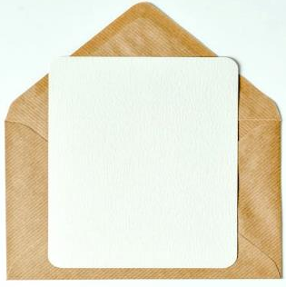

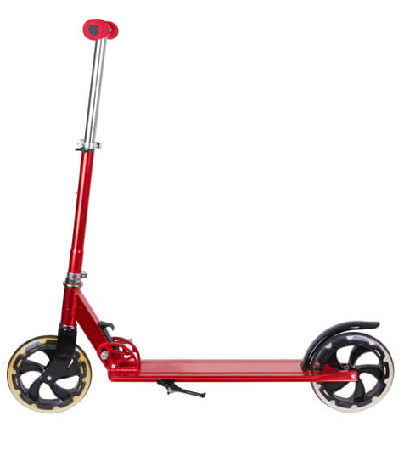
1
Check your scooters!
2
4
Check your:
1. Handlebar
2. Clamp
3. Wheels
4. Brakes
5. Helmet
3
5
Notes:
What is each numbered part of the scooter called? Click and reveal each one.

Slide 11
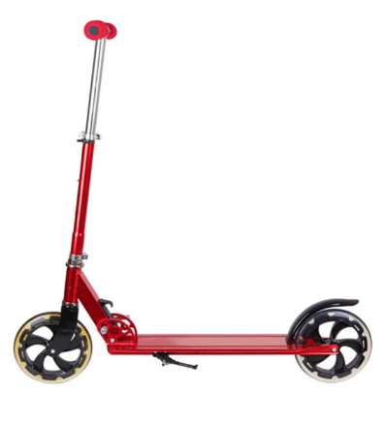
L-Check
Start at the top of the ‘L’ and work your way down and then along.
Make sure there are hand grips on the handlebars and that they are in good condition and attached securely.
With a folding scooter, you have adjustable handlebars. They should be set around waist height and the clamp holding them must be tight.
If there is a folding mechanism, check it is fully locked in the riding position. Tighten any loose bolts.
Make sure the wheels spin freely and are attached securely. Axles can come loose and cause the wheel to wobble when riding.
Brakes are important for helping stop the scooter. Make sure any bolts are secure.
Remember – you can’t check parts that aren’t there… have a look and ensure no obvious parts are missing or badly damaged.
L
Notes:
Discuss and show what is an ‘L’ check. Explain it is called an ‘L’ check because of the shape of the scooter.
Remind the children that this is best done with and adult, as tools may be needed if anything has come loose.
Demo with a real life scooter if possible.

Slide 12

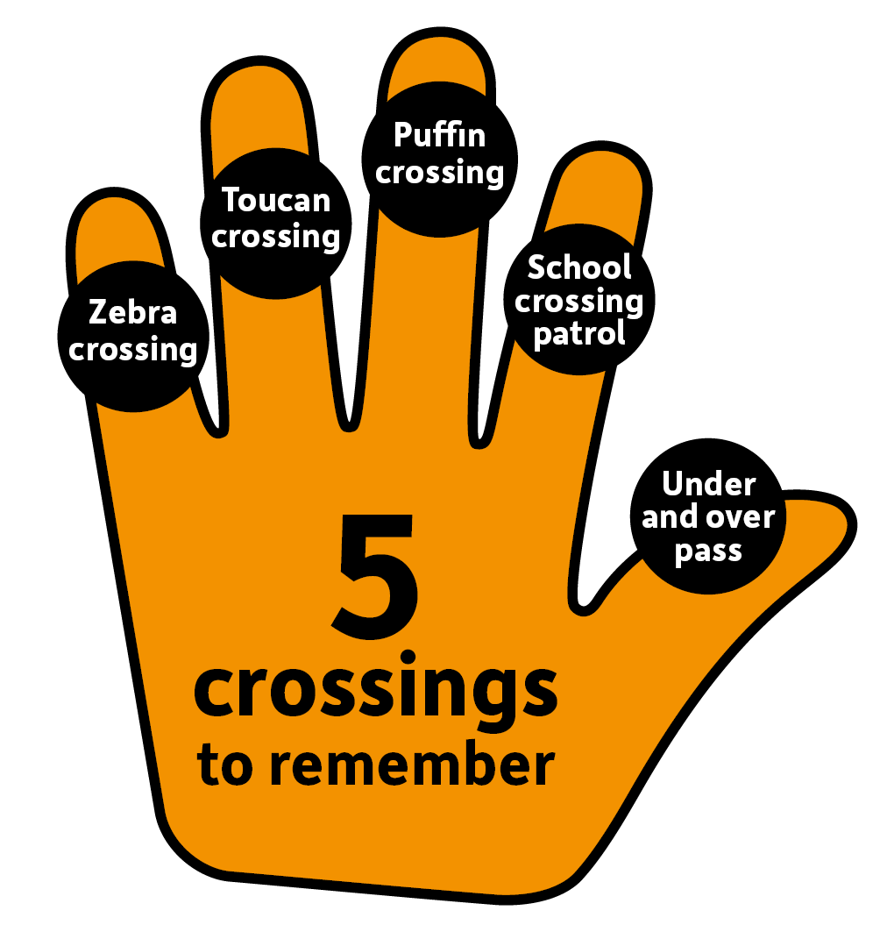
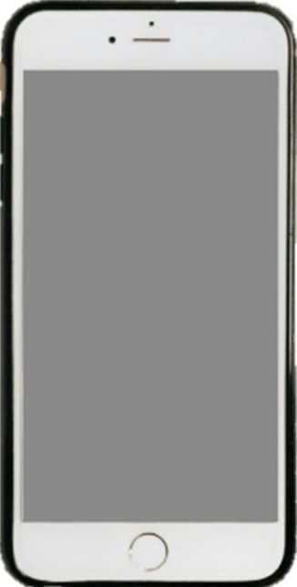
ALERT:
Where should you be crossing with your scooter?
Notes:
Click and reveal phone alert. Discuss how we can use our hand to remember the 5 main crossings to remember. Practise together.
Would we recognise any of these in real life? Let’s find out on the next slide.

Slide 13
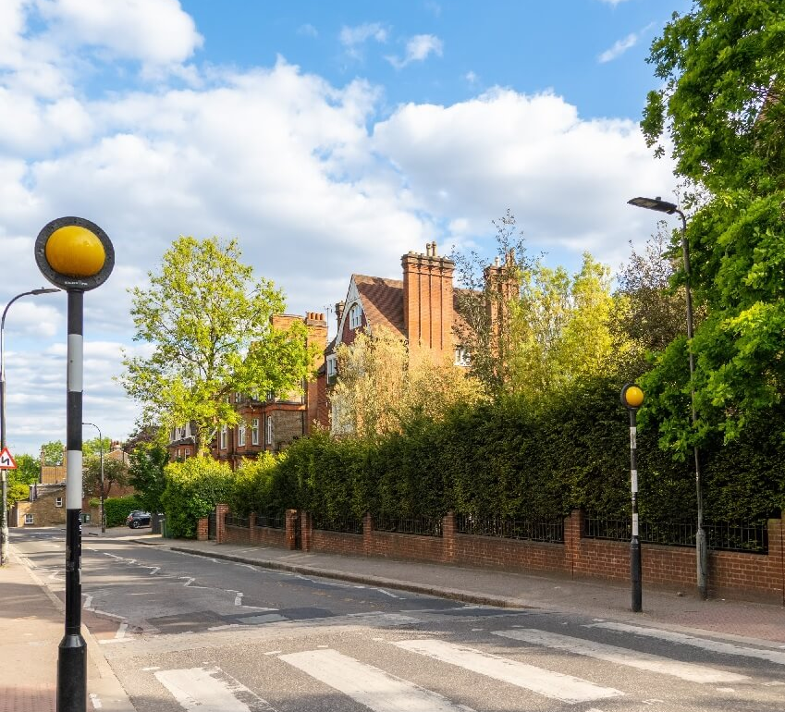
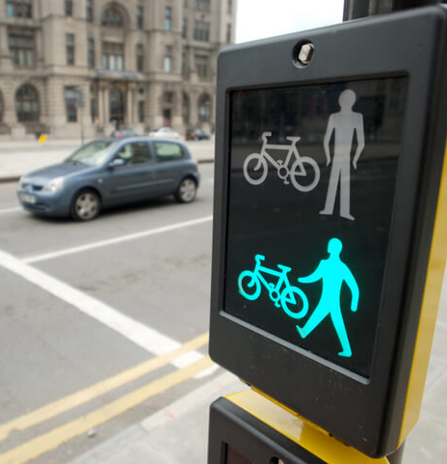
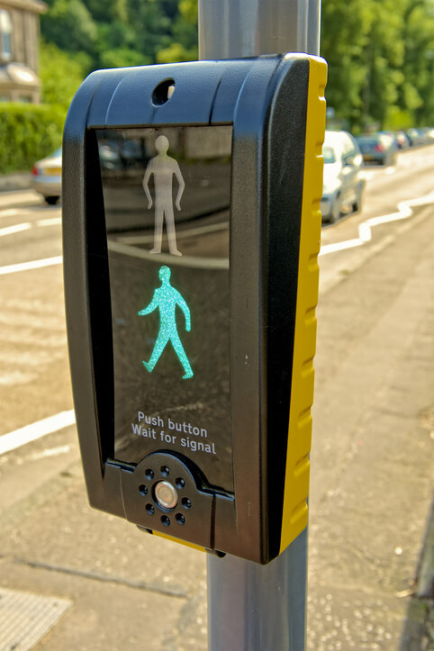
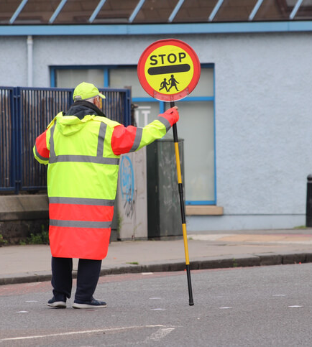
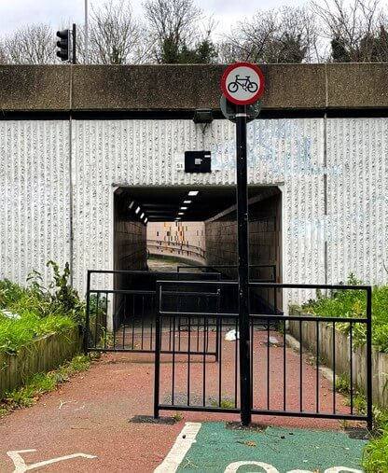

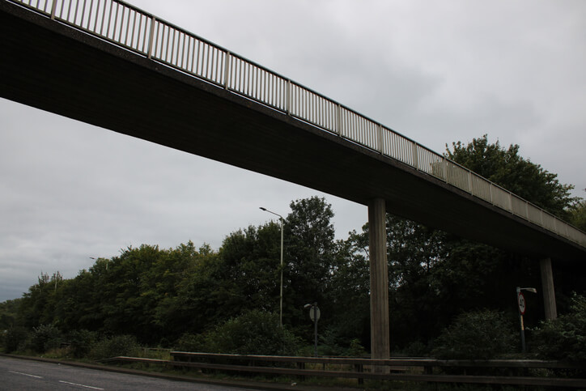
What are these safe places to cross called?
Notes:
Click and reveal each image in turn. Give children two choices on laminated flashcards. One the correct answer, one incorrect.
1st pic Zebra Crossing – flashing beacons. White and black stripes. Cars should give way.
2nd pic Toucan Crossing -’Two can cross’ for pedestrians and bikes
3rd pic Puffin Crossing – similar to a pelican crossing. Green and red man are on the same side as you with a puffin and there is also a sensor.
4th pic School Crossing Patrol – otherwise nicknamed a lollipop man/woman
5th & 6th Underpass and Overpass
Have we used any of these? Are there any near our school?

Slide 14

Did you know?
Pelican or Puffin
A Pelican crossing means that the flow of traffic is controlled by the traffic lights.
This crossing allows 6 seconds to cross the road.
A Puffin crossing has a sensor which detects when the pedestrians are safely across the road before it allows the traffic lights to change.
These are much safer for slower pedestrians, such as the elderly, or those with a disability.
Notes:
Click to reveal each piece of information.

Slide 15

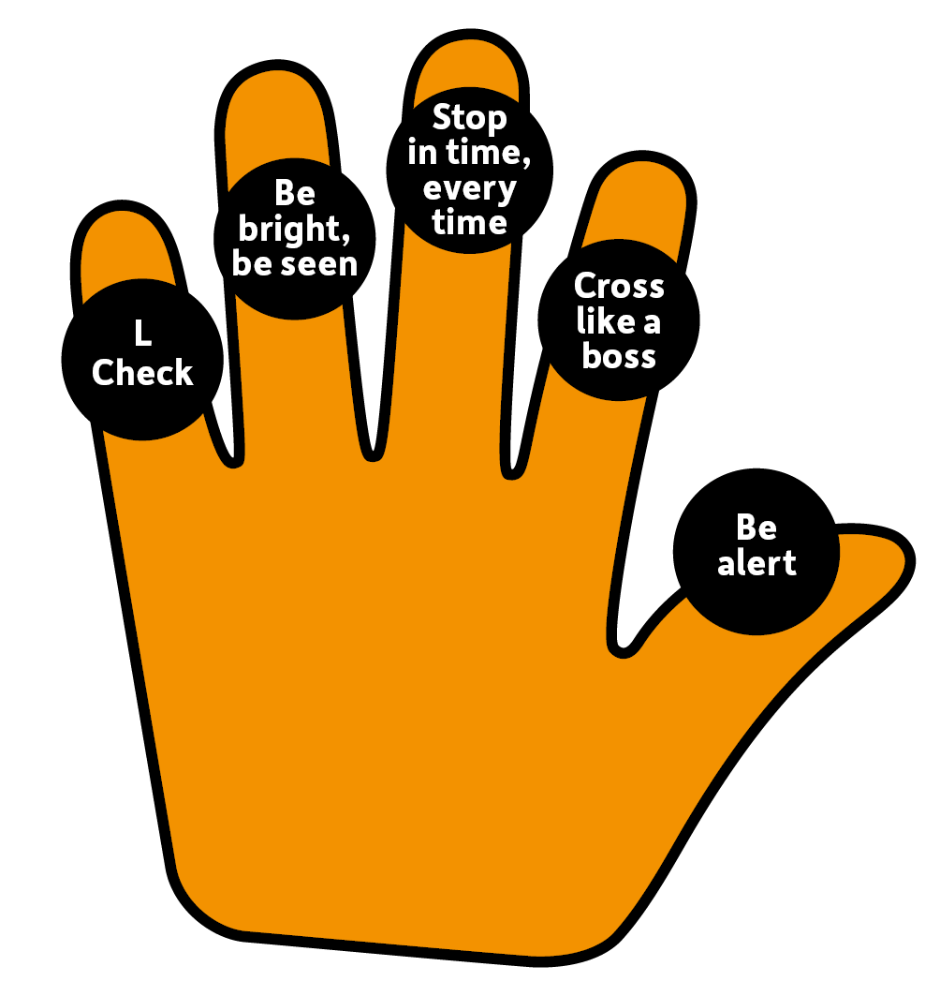
ALERT:
New Road Safety Hand!
5 rules to stay safe.
Notes:
What is an L-check?
What do we mean when we say ‘Be Bright, Be Seen’?
What do we think ‘Stop in time, Every time’ means?
What do we think we should or should not be doing to ‘Cross like a boss’?
Why do we need to ‘Be Alert?’

Slide 16


Scooter Safety Check
helmet
1. Wear a h………..., knee and elbow pads.
2. Wear b……… clothing.
3. Check your handlebars, clamp, w……….. and brakes.
4. Give your backpack to a grown up or wear on your b……….
5. Choose a safe route and try and use a c…………. if you can.
Mission 3 –
Fill in the missing words.
bright
wheels
back
crossing
Notes:
Read each sentence.
Click to reveal each missing word.

Slide 17
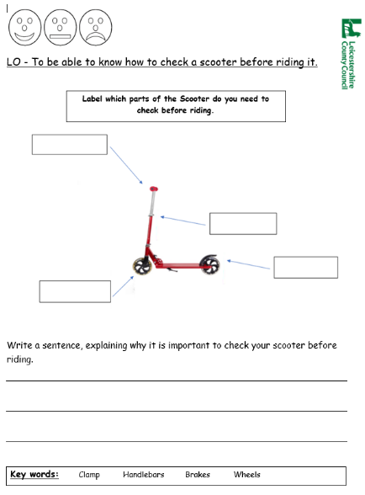
Mission 4 –
Complete the scooter worksheet.
What can you remember?
Notes:
Sheets pre-printed if possible. Discuss.
Independent task, if time allows.
Discuss the self-assessment. Colour the face showing how well they have understood the lesson. Smiley – very confident. Straight face – quite confident. Sad – still need more help.

Slide 18

Video
time...
Click the link…
Notes:
Click on image and video should launch. Originally from https://www.youtube.com/watch?v=BNyBWXwQBW8
The original version will have ads.

Slide 19
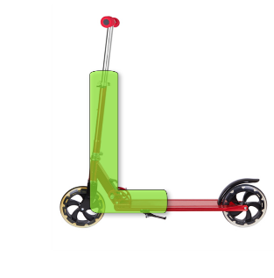
Mission 5 –
Tell your grown-ups at home what you have learnt today.
Notes:
Re-cap the key takeaways.
Suggested follow on activities:
-create a poster about scooter safety and display around school.

Slide 20
Thank you!

Slide 21
Credits
Phone - Photo by Benjaminrobyn Jespersen
Top Secret Logo – Photo by Tayeb Mezahdia https://pixabay.com/illustrations/top-secret-confidential-classified-2054429/
Lace up shoes - Photo by Mnz on Unsplash
Zebra crossing – Photo by Benjamin Cheng on Unsplash
Message alert – By LIECIO
https://pixabay.com/sound-effects/message-notification-190034/
Spy theme – By Universefield https://pixabay.com/music/happy-childrens-tunes-joyful-spy-melody-for-lighthearted-fun-15s-232565/
Photo by Eva Bronzini from Pexels: https://www.pexels.com/photo/a-sheet-of-paper-on-top-of-a-brown-envelope-7958171/

