Slide 1
Year 6's Road Safety Mission
Notes:
Click and page will change and mission music should start.

Slide 2
Year 6's Road Safety Mission
Notes:
Click and page will change and mission music should start.

Slide 3
Our Mission:
To explain 5 key steps to travelling independently to school
To be able to explain what impulse control is and strategies to help us be more mindful when using the road.
Notes:
Click to reveal each of the lesson objectives.

Slide 4
What is Road Safety?
Road safety helps to keep everyone who uses the road safe and stops us from getting hurt.
It is important to know how to behave when we are using the road and travelling solo.
Notes:
Read out each bullet point.

Slide 5
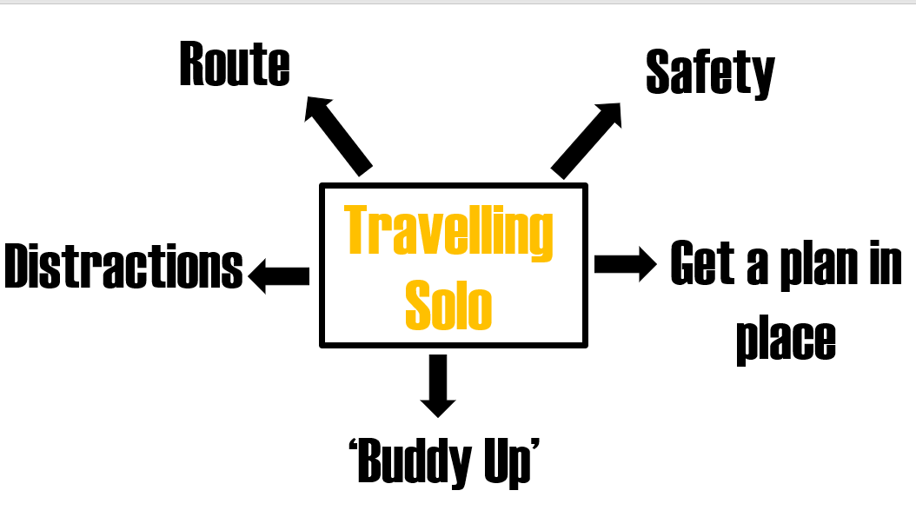
5 Tips to travelling solo
Notes:
Get a set route in place so you know which way you are walking and look an alternative in case you can access it due to roadworks/footpath
Make sure you speak to your grown up about safety, stranger danger, what will you do if you get lost – go to nearest, shop etc.
Get a plan in place – get a watch or phone and make sure you have a set-time to be back for, if you are not back by that time you parents will walk your agreed route and come looking for you
‘Buddy up; walk with friends who live nearby but be careful and do not be silly
Put your phone in your bag unless it is an emergency, put balls in a bag and carry it, talk to friends but don’t feel peer pressure to run across the road or take part in things that are unsafe

Slide 6
Mission 1:
Recap. The 5 tips to travelling solo.
Notes:
Click to reveal mission message and alert tone.
https://www.youtube.com/watch?v=d8M7Xzjy_m8
Talk about when we are younger, we act more quickly.
Often not thinking about the positives and negatives of a decision – in this case if the child had waited, she could have had two marshmallows.
When we are making decisions as a teen, for example to step into the road, run to get our ball or maybe to get our drinks bottle that may have rolled into the road. We don’t think about the consequences of what could happen.
We are only worried about the immediate item not what could happen to us.
Being aware of this can help us make informed decisions

Slide 7
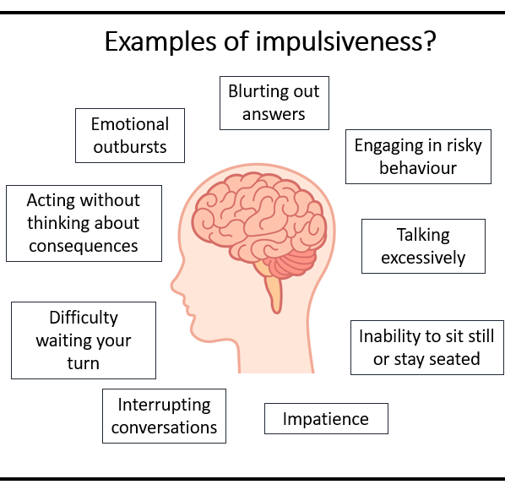
What is impulsiveness?
“Impulsive” means a sudden, quick, or hasty action without thought for consequences.
Examples;
If our ball rolls into the road we might be tempted to run after it.
If our friends run across the road, you might be tempted to run with them.
Notes:
Read through the slide.

Slide 8
Impulse control – The Brain House
Mission 2:
Watch the video. Learn about the different parts of the brain.
Notes:
Click to reveal mission message and alert tone.
https://www.youtube.com/watch?v=d8M7Xzjy_m8
Talk about when we are younger, we act more quickly.
Often not thinking about the positives and negatives of a decision – in this case if the child had waited, she could have had two marshmallows.
When we are making decisions as a teen, for example to step into the road, run to get our ball or maybe to get our drinks bottle that may have rolled into the road. We don’t think about the consequences of what could happen.
We are only worried about the immediate item not what could happen to us.
Being aware of this can help us make informed decisions

Slide 9
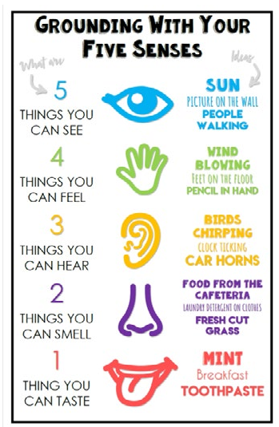
Strategies to help make better decisions
Stop before you act
Take some breaths
Be more mindful or your surroundings
Be aware of the 5 sense. What can you see, feel, hear, smell and taste. This helps us slow down.
Question yourself before you act, what could happen if I run across the road? Is it safe to go into the road to get my ball?
These strategies give us time to use our thinking brains. This will help to keep us safe and calm.
Notes:
Share the techniques that could help them stay calm and make better decisions
There are not only important for using the road safely but they are also important for everyday life with friends, parents/carers or siblings.
We all need to remind ourselves of ways to stay calm.

Slide 10
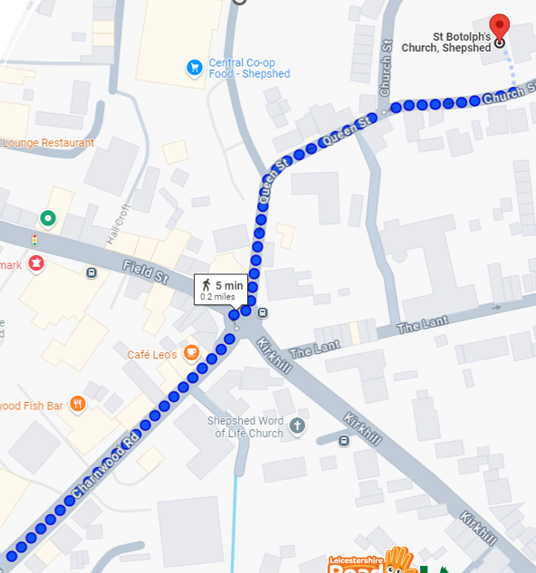
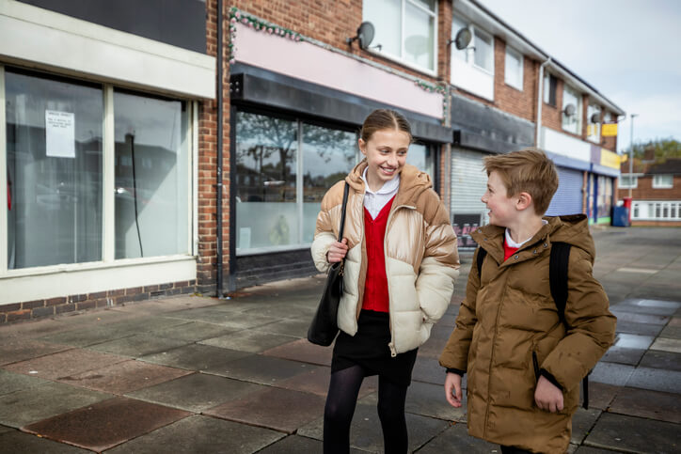
Travelling on your own
Mission 3:
When you get home talk to your grown up about…
Ask them…
Will you be allowed to travel on your own?
When will be your first journey?
Where will you be allowed to go?
How will you get to secondary school?
Notes:
Really important message! Really remind the children about talking with their adults.
Re-cap each of the sections. What can we remember?

Slide 11
Thank you!

Slide 12
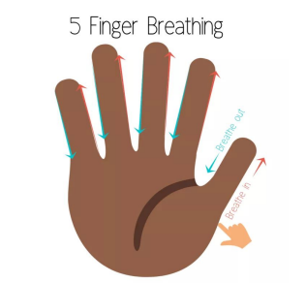
Meditation Task
Stretch your hand out like a star.
Get your pointer finger ready to trace your hand up and down.
As your slide up each finger, breathe in through your nose. As you slide down each finger, breathe out.
Keep going until you have finished tracing your hand.
Notes:
Optional to discuss.

