Slide 1
Year 6's Road Safety Mission
Notes:
Click and page will change and mission music should start.

Slide 2
Year 6's Road Safety Mission
Notes:
Click and page will change and mission music should start.

Slide 3
Our Mission:
To explain 5 key steps to travelling independently to school.
To be able to explain what impulse control is and strategies to help us be more mindful when using the road.
Notes:
Click to reveal each of the lesson objectives.

Slide 4
What is Road Safety?
Road safety helps to keep everyone who uses the road safe and stops us from getting hurt.
It is important to know how to behave when we are near the road and that’s what we are going to learn today.
Notes:
Read out each bullet point.

Slide 5
Video time :
What will your first journey be?
Notes:
Anyone in class already have any permissions from parents to walk anywhere on their own?
How far? Where to? Any rules set in place to keep us safe? Discuss.
Click on the image to open up the webpage.
If hyperlink fails, go to: https://www.think.gov.uk/resource/first-journeys/

Slide 6
Mission 1:
Discuss.
What do you need to consider before travelling on your own?
Notes:
Click and text alert should appear and sound.
Children to have a 2 minute talk with a partner or group.
Come up with 3 things you need to consider before travelling on your own to school

Slide 7
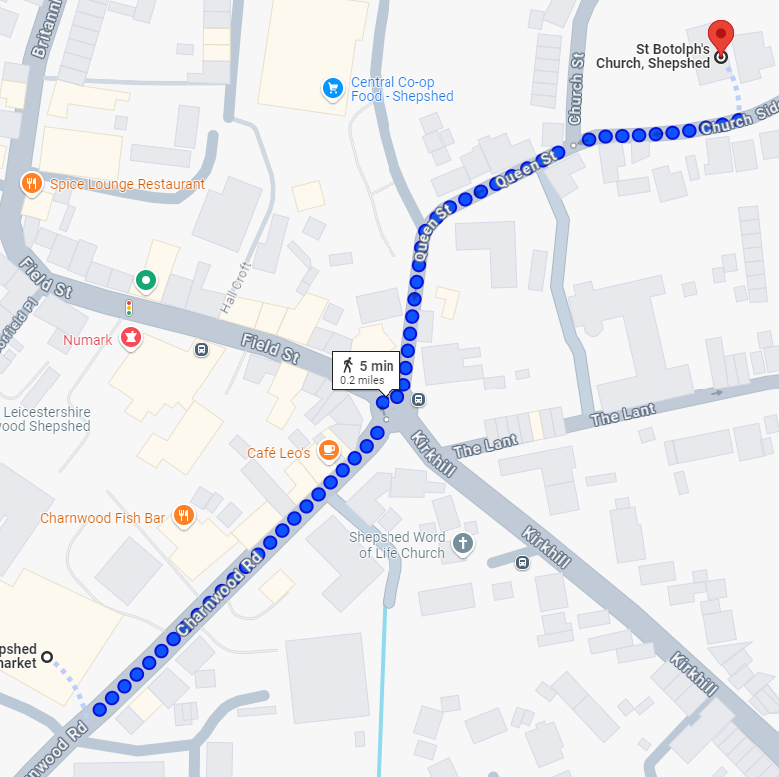
Route
Get ready to travel solo…
Choose a safe route.
The route is important, so choose one without much traffic.
If possible, walk with an adult a few times, before you start walking it alone, so you can familiarise yourself with the journey.
Notes:
Click to reveal each statement.
Discuss each point. Discuss or even demo how to use Google Maps to help select an appropriate route.
You could also use your IT session to get the children to use google maps to plot how they will get to and from their secondary school in September

Slide 8
Safety
Talk to your parents about safety;
Stranger danger.
Make sure you know how to cross the road safely.
What will you do if you get lost?
Notes:
Click to reveal each statement.
Ask who has a phone?
If they do, make sure they have emergency numbers on so they can phone parents/carers
Talk about if they need to make a call, they move away from the side of the road to a well-lit spot, so they can get their phone out of their bag and safely make a call.

Slide 9
Get a plan in place
Get a watch AND choose a set time to be home by. If you are not home by this time, your grown up can walk your pre-discussed route and find you.
Notes:
Click to reveal each statement.
Remind the children to have a watch that is appropriate. Can they tell the time or do they need a digital watch? Are they allowed a phone for this purpose instead?
Remind them to not deviate off this pre-agreed route.

Slide 10
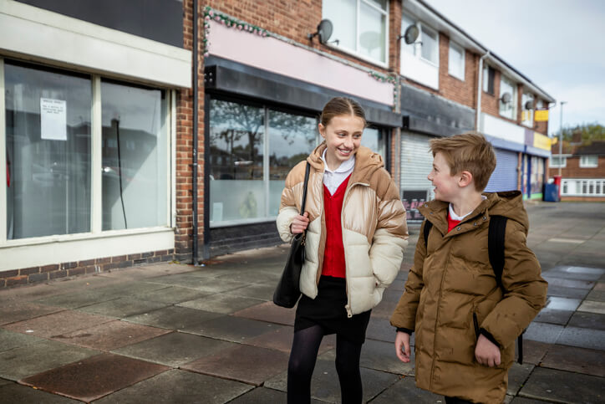
‘Buddy Up’
Walk together! See if there is another person from school, in your area, and arrange a ‘buddy’ system to walk with them to or from school.
Notes:
Click to reveal.
You could talk about arranging a meeting point so that friends could walk together
We are safer when we are together – if we are acting sensibly and following the tips from today

Slide 11
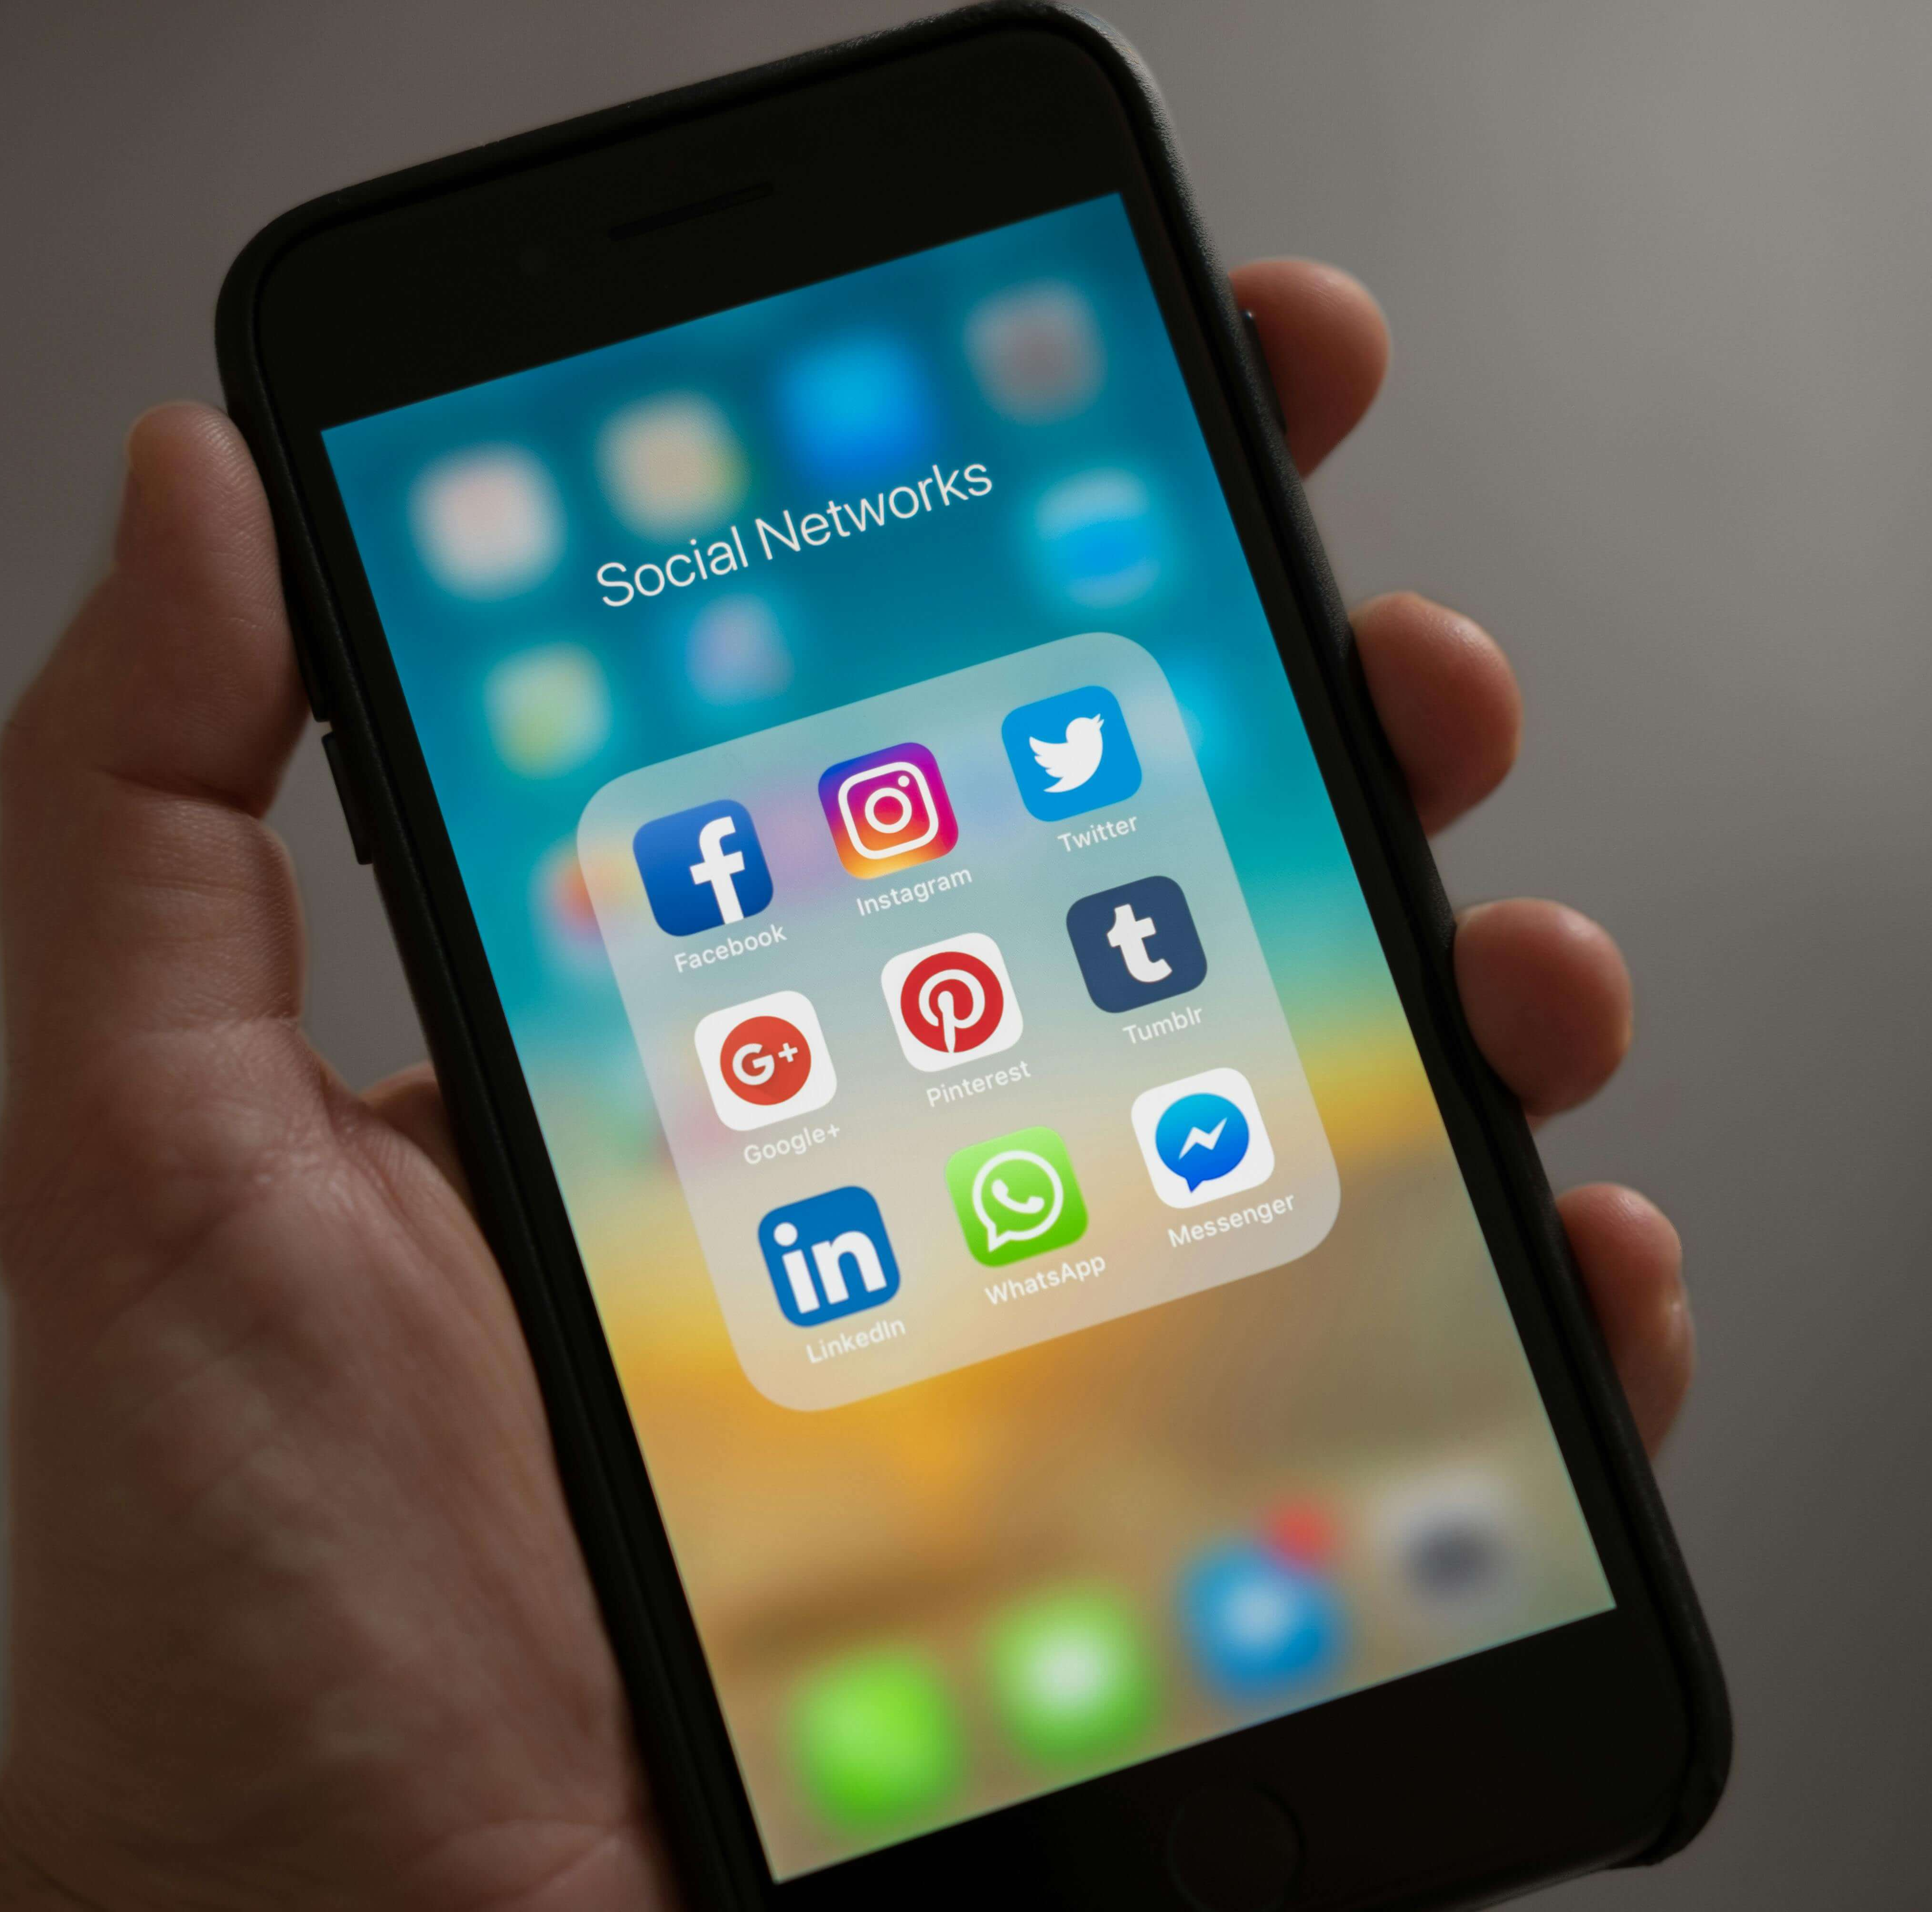
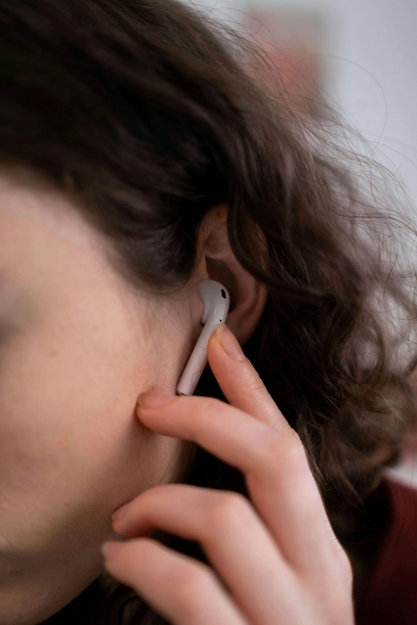
Distractions
Be observant!
Pay attention when walking to school or home.
Don’t be distracted by:
- chatting to your friends
- using your phone
- listening to music
Even dribbling a football or eating snacks could affect your concentration!
Notes:
Click to reveal each statement.

Slide 12
Mission 2:
In pairs discuss what you think impulsiveness means?
Notes:
Click to reveal mission message and alert tone.
Discuss the question together.
Definition given on the next page

Slide 13
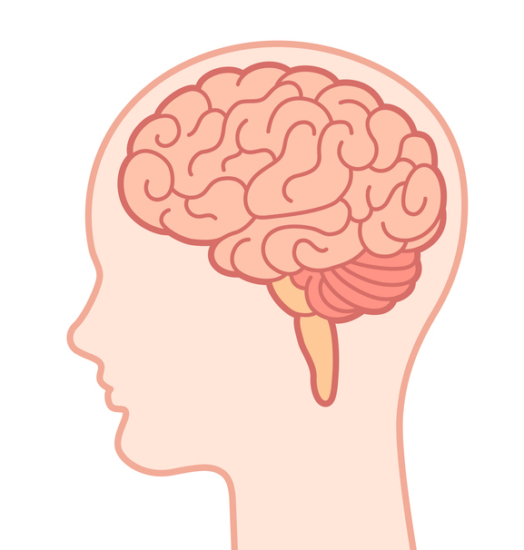
What is impulsiveness?
Examples of impulsiveness?
Blurting out answers
Emotional outbursts
Engaging in risky behaviour
“Impulsive” means a sudden, quick, or hasty action without thought for consequences.
Acting without thinking about consequences
Talking excessively
Difficulty waiting your turn
Inability to sit still or stay seated
Interrupting conversations
Impatience
Notes:
Read definition
Explain all/some of the examples in the photo
Ask the children if they have ever had any moments like this?
You could link this to SATS or Peers/Families and talk about how sometimes we impulsively act, and make the wrong choice

Slide 14
Impulse control – The Brain House
Mission 3:
Watch the video. Learn about the different parts of the brain.
Notes:
Click to reveal mission message and alert tone.
https://www.youtube.com/watch?v=d8M7Xzjy_m8
Talk about when we are younger, we act more quickly.
Often not thinking about the positives and negatives of a decision – in this case if the child had waited, she could have had two marshmallows.
When we are making decisions as a teen, for example to step into the road, run to get our ball or maybe to get our drinks bottle that may have rolled into the road. We don’t think about the consequences of what could happen.
We are only worried about the immediate item not what could happen to us.
Being aware of this can help us make informed decisions

Slide 15
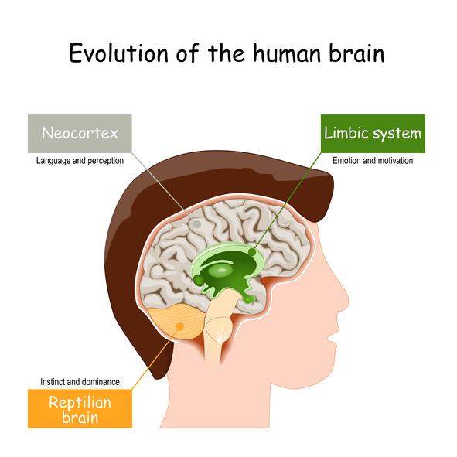
We know Impulsivity is to act without thinking…
As a pre-teen and teenager, we are mostly using ‘the feeling brain’, the downstairs part.
Example: If you were carrying a ball and it rolled into the road, the feeling part of your brain would tell you to, run and get it.
Over time, ‘the thinking brain’ or upstairs part of the brain, will develop, and this will question whether it is a good idea to run into the road and look at the consequences of this decision.
It is important to know this to help us make better decisions!
Notes:
Read bullet points
Explain to children where the (upstairs) feeling brain is the Green part of the brain.
Explain to the children that the (downstairs) thinking brain is the Orange part of the brain.

Slide 16
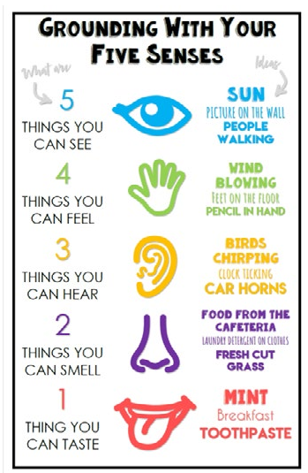
Strategies to help us be less impulsive
Stop! – Think: what are the consequences of this action?
Take some breaths –in for 3, hold for 3, out for 3.
Be more mindful or your surroundings – look and see if you can notice the different colours that surround you.
Be aware of the 5 senses. What can you see, feel, hear, smell and taste. This helps us slow down.
Use encouraging self-talk; I can do this! I am clever! I am resilient!
Stay focused – put distractions away.
These strategies give us time to use our thinking brains. This will help to keep us safe and calm.
Notes:
Share the techniques that could help them stay calm and make better decisions
There are not only important for using the road safely, but they are also important for everyday life with friends, parents/carers or siblings.
We all need to remind ourselves of ways to stay calm.
These strategies will also help the children in SATS/Peer relationships/family relationships to keep their cool and improve their wellbeing

Slide 17
Can you discuss in pairs and explain to the class 1 thing from today’s lesson?
Notes:
Prompt if they are struggling
What do we need to do before travelling solo?
What strategies could we use?
Do you remember the different parts of the brain? What are they called?

Slide 18
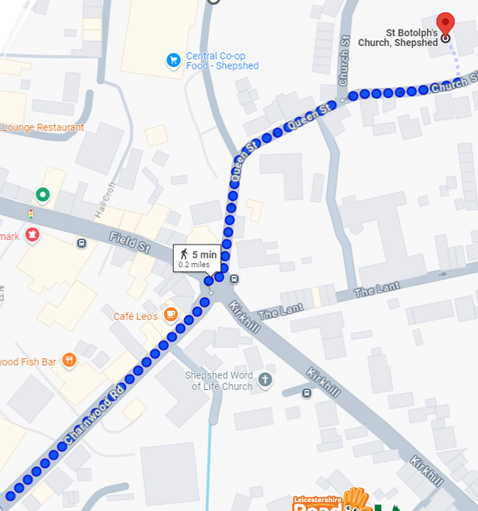
Travelling on your own
Mission 4:
When you get home talk to your grown up about…
Ask them…
Will you be allowed to travel on your own?
When will be your first journey?
Where will you be allowed to go?
How will you get to secondary school?
Notes:
Really important message! Really remind the children about talking with their adults.
Prompt them to start having discussions about transitioning to secondary school, how will they get there? Do they know what route to take?
Will they use a bus? Have they used a bus before? Will they need a bus card/ money/ debit card etc?
Could they do a practice walk over the summer holidays, walking with parents/carers to show them the way and then the next time meeting the parent at the school so they can have ago on their own?

Slide 19
Work Sheet and Meditation
Watch the video of Cookie Monster and complete the activity sheet provided.
Practice meditation to help you regulate your emotions, make better choices and help improve your wellbeing!
The more you practice, the calmer you will be, this will create space in your brain so you can think before you act, rather than just impulsively doing it.
Think of a time you could meditate. Attach it to something you do every day to create a habit, like, brushing your teeth.
Suggested activity…

Slide 20
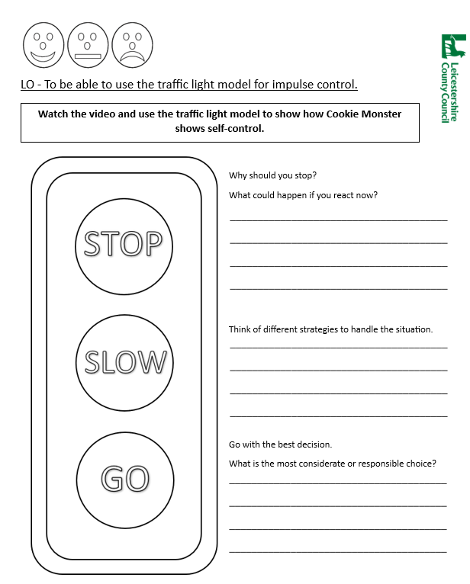
Watch the video and complete the worksheet…

Slide 21
Meditation 1
Breath in for 3 seconds
Hold for 3 seconds
Breath out for 3 seconds
Notes:
You could introduce a regular, quick, 2-minute meditation exercise after registration

Slide 22
Meditation 2
Tense each muscle group and notice how that muscle feels when it is tensed.
Hold this tension for five seconds while breathing in.
Then, release and relax that muscle.
Pay close attention to the feeling of relaxation when releasing the contracted muscle.
Notes:
https://vimeo.com/227542821

Slide 23
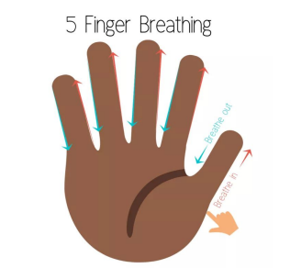
Meditation 3
Stretch your hand out like a star.
Get your pointer finger ready to trace your hand up and down.
As your slide up each finger, breathe in through your nose. As you slide down each finger, breathe out.
Keep going until you have finished tracing your hand.

Slide 24
Thank you!

