Slide 1
Reception’s Road Safety Mission

Slide 2
Reception's Road Safety Mission
Notes:
Click and ‘mission music’ should play.

Slide 3
Our Mission:
To be able to explain the 5 key steps to cross a road safely.
Notes:
Click to reveal the lesson objectives.

Slide 4
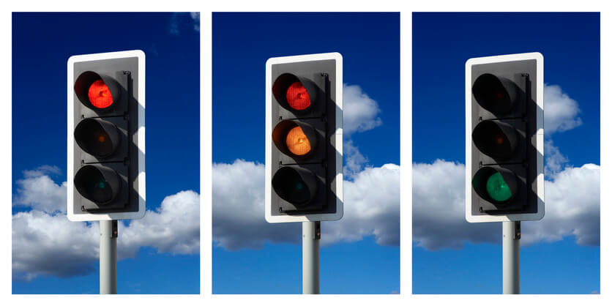
What is Road Safety?
Road Safety helps to keep everyone who uses the road safe and stops us from getting hurt.
Notes:
Read out each bullet point.

Slide 5
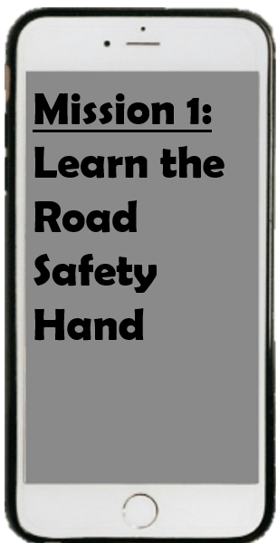
Notes:
Discuss when we are wanting to cross the road safely – there are 5 important steps we need to remember.
Get children to show their Road Safety hand – talk about the 5 Road Safety Steps.
Practice the actions. Get volunteers who would like to demonstrate.
Stop = 1 palm straight out in front. Look = Finger and thumb on each hand to create glasses/binocular shape. Listen = cup one ear. Think = pretend to scratch the top of your forehead. Hold hands = clasp hands together similar to a handshake shape.
Add the props – stop sign, googly eyes,
Ask why do we think these steps are important to cross the road safely?

Slide 6
Are these children doing it right?
Dear Reception children, your task is to watch this video…
Notes:
Click the video link – takes you to https://www.think.gov.uk/resource/crossing-roads/

Slide 7
RECAP
What are the 5 steps we need to do before crossing the road?
Notes:
Ask children if they can remember the Road Safety Hand – Stop, Look, Listen, Think, Hold-Hands
Get volunteers to come up and show the class if they are confident.

Slide 8
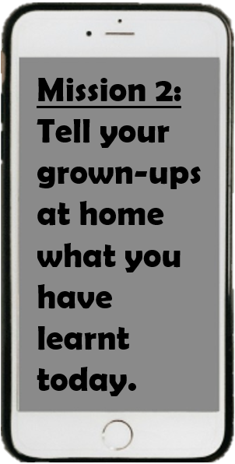

Slide 9
Thank you!

