Slide 1
Year 1's Road Safety Mission

Slide 2
Year 1's Road Safety Mission
Notes:
Click will initiate ‘mission’ music intro.

Slide 3
Our Mission:
To be able to explain the 5 key
steps to cross a road safely.
To be able to identify safe places to cross.
Notes:
Click to reveal the lesson objectives.

Slide 4
What is Road Safety?
Road Safety helps to keep everyone who uses the road safe and stops us from getting hurt.
It is important to know how and where to cross and that is what we are going to learn today.
Notes:
Read out each bullet point.

Slide 5
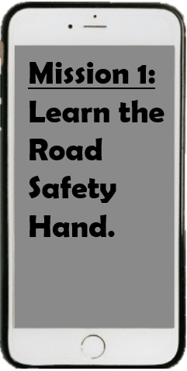

Slide 6
Notes:
Show the video – and go through the Road Safety Hand, explaining we must hold-hands with our grown ups
https://www.youtube.com/watch?v=HXCN8V5u0Fg

Slide 7
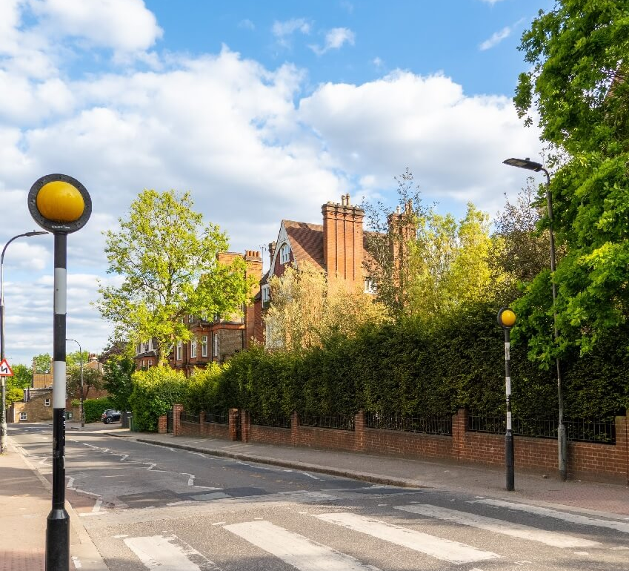
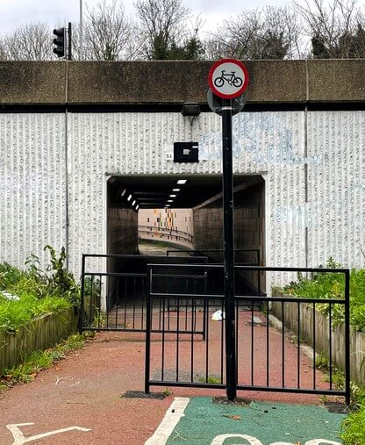
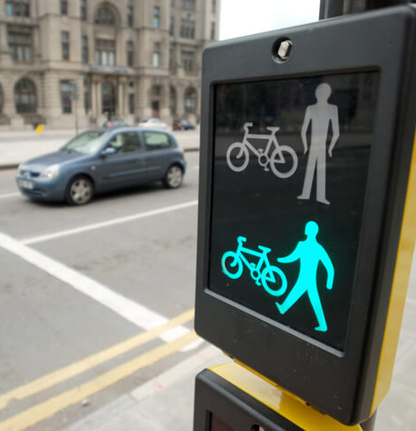
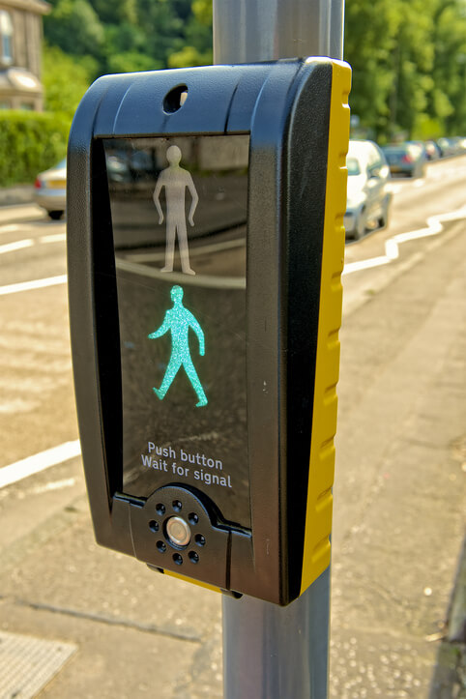
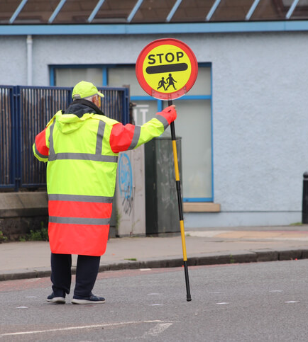
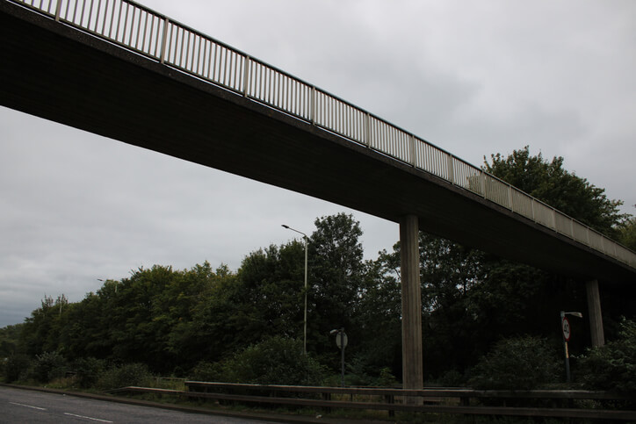
Zebra Crossing
Underpass and Overpass
What do each of the crossings look like?
School Crossing Patrol
Toucan Crossing
Puffin Crossing
AND
Notes:
Click to reveal each answer.
Were the children right?
Have they seen any of these in real life?
What might a puffin, zebra and toucan crossing look like? Anyone know?

Slide 8
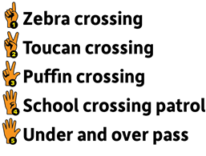
Notes:
Children to share some ideas. These will be explored across the next few slides.

Slide 9
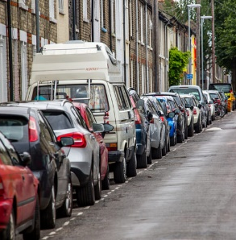
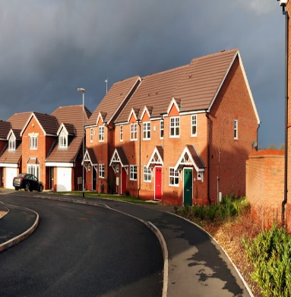
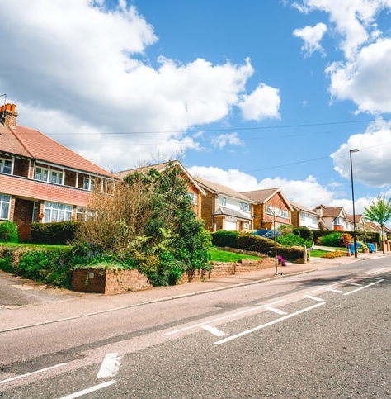
On a bend
Between parked cars
On a hill
All are not safe places to cross because you can’t see what’s coming and they can’t see you

Slide 10
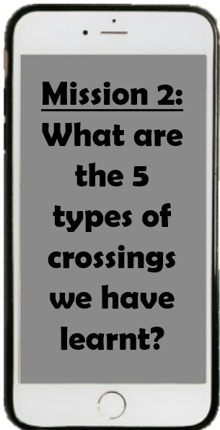
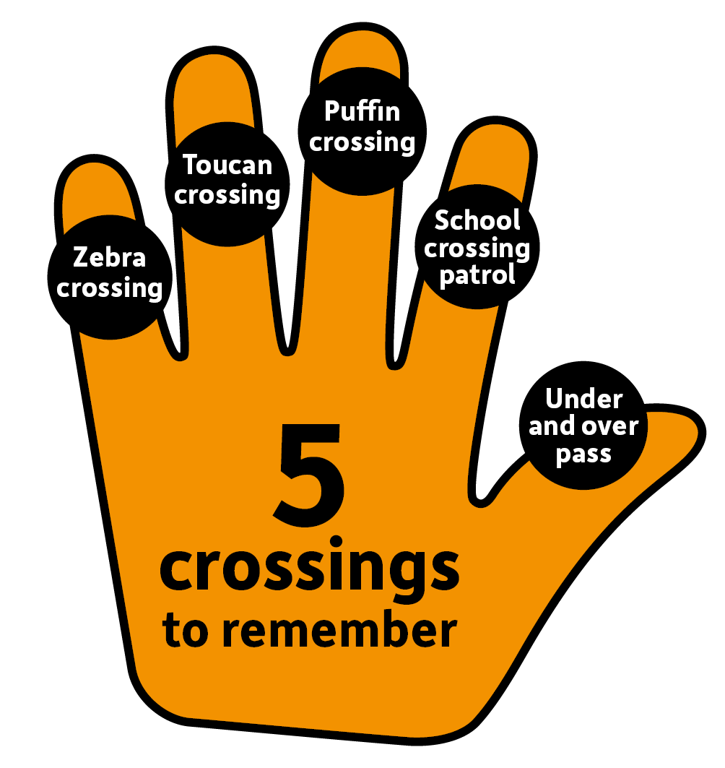
Notes:
Click and reveal phone alert. Discuss how we can use our hand to remember the 5 main crossings to remember. Practise together.
Ask questions to test their memory. What was the stripy one called? What was the one where bikes and pedestrians can cross? What is the official name for a lollipop man/woman? What crossing has the red man which means you cannot cross? Which ones will take you under or over a very busy road?

Slide 12
Thank you!

