Slide 1
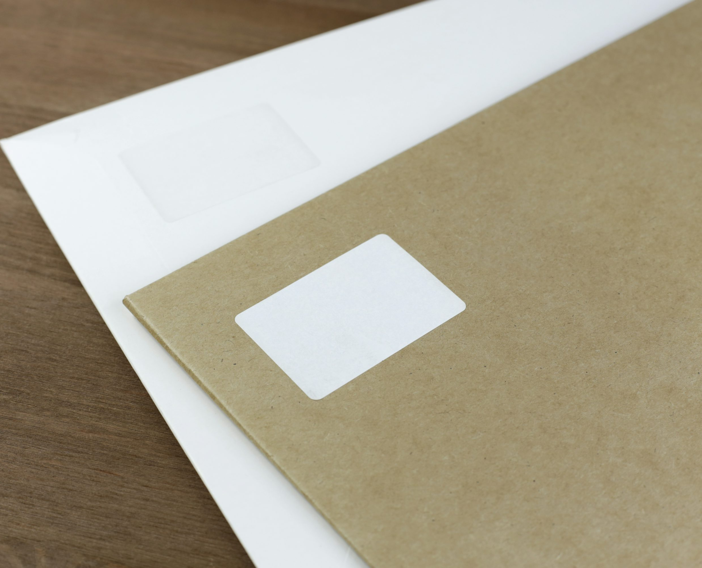
Year 2's Road Safety Mission
Notes:
Click and mission music will start.

Slide 2
Year 2's Road Safety Mission
Notes:
Click and theme music should play.

Slide 3
Our Mission:
To be able to know how to check a scooter before riding it.
To be able to discuss ways to stay safe whilst riding a scooter.
Notes:
Click to reveal the lesson objectives.

Slide 4
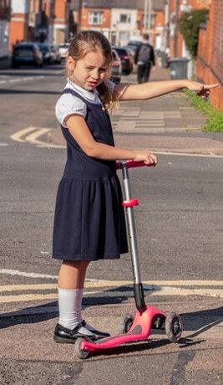
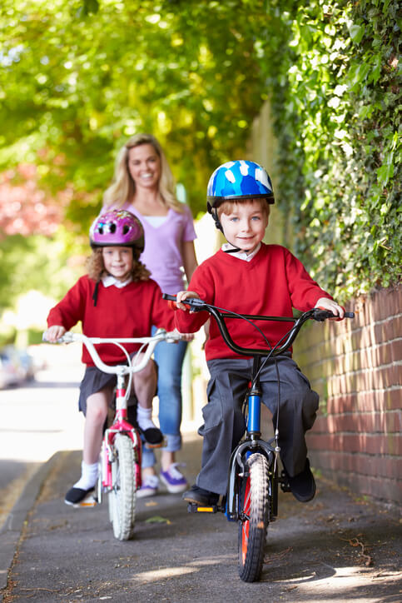
How do you travel to school?
Notes:
Accept answers.
Anyone travel by car? Park and stride? Scooter? Bike? Walk? Bus?

Slide 5
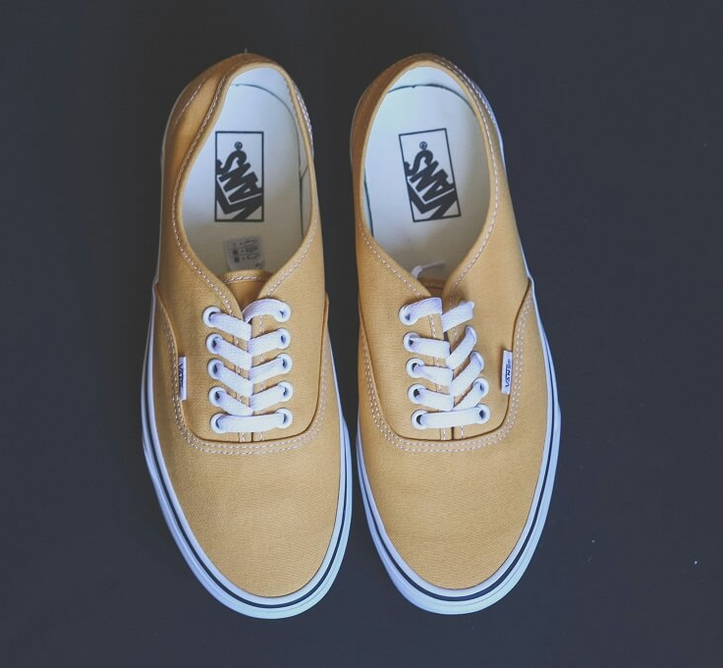
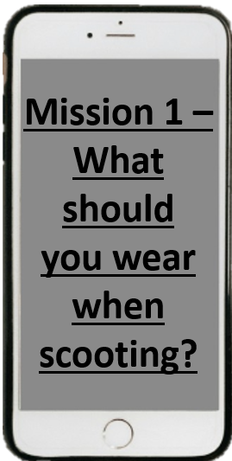
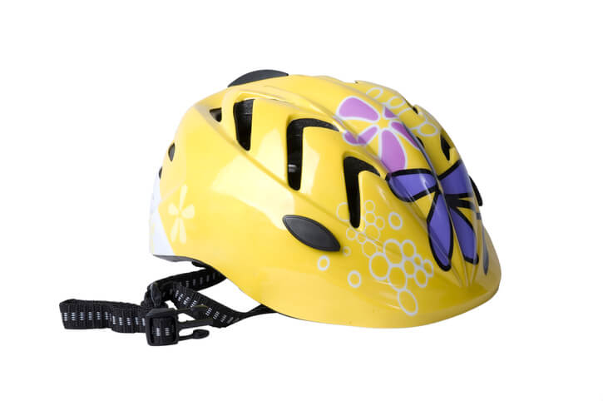
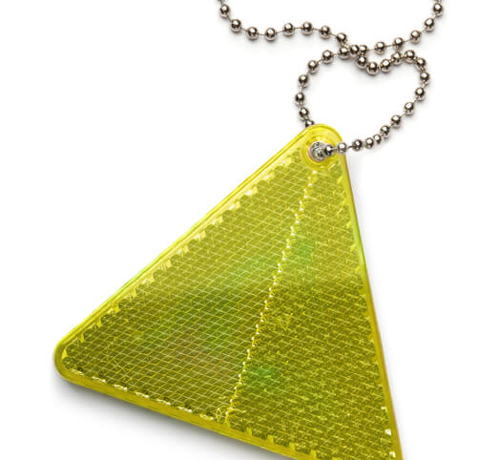
Notes:
Take some answers from the children before clicking to reveal the three main answers.
Helmet.
Knee and elbow pads.
Sensible shoes, not sandals. With trainers, make sure laces are tucked in, so they don’t get caught.

Slide 6
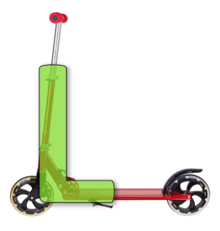
L-check
Notes:
Start at the top of the ‘L’ and work your way down and then along.
Make sure there are hand grips on the handlebars and that they are in good condition and attached securely.
With a folding scooter, you have adjustable handlebars. They should be set around waist height and the clamp holding them must be tight.
If there is a folding mechanism, check it is fully locked in the riding position. Tighten any loose bolts.
Make sure the wheels spin freely and are attached securely. Axles can come loose and cause the wheel to wobble when riding.
Brakes are important for helping stop the scooter. Make sure any bolts are secure.
Remember – you can’t check parts that aren’t there… have a look and ensure no obvious parts are missing or badly damaged.

Slide 7
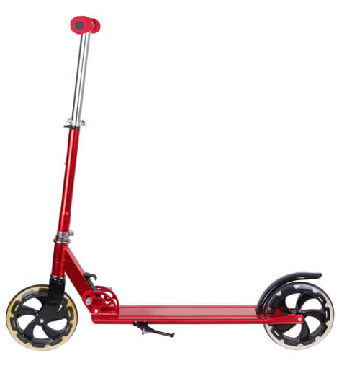
1
Check your:
1. Handlebar
2. Clamp
3. Wheels
4. Brakes
5. Helmet
2
4
3
5
Notes:
What is Start at the top of the ‘L’ and work your way down and then along.
Make sure there are hand grips on the handlebars and that they are in good condition and attached securely.
With a folding scooter, you have adjustable handlebars. They should be set around waist height and the clamp holding them must be tight.
If there is a folding mechanism, check it is fully locked in the riding position. Tighten any loose bolts.
Make sure the wheels spin freely and are attached securely. Axles can come loose and cause the wheel to wobble when riding.
Brakes are important for helping stop the scooter. Make sure any bolts are secure.
Remember – you can’t check parts that aren’t there… have a look and ensure no obvious parts are missing or badly damaged.
each numbered part of the scooter called? Click and reveal each one.

Slide 8
Scooter Safety Check
Helmet!
1. Check your scooter and wear a h…….. !
2. Wear b……… or reflective clothing, so others can see you. 3. Be aware of your surroundings and make sure you can s… quickly, in an emergency. 4. Stop, look, listen, think! Cross like a b…!.
5. B. a... , think about other road users and the weather!
bright
stop
boss!
Be alert
Notes:
Read each sentence.
Click to reveal each missing word.

Slide 9
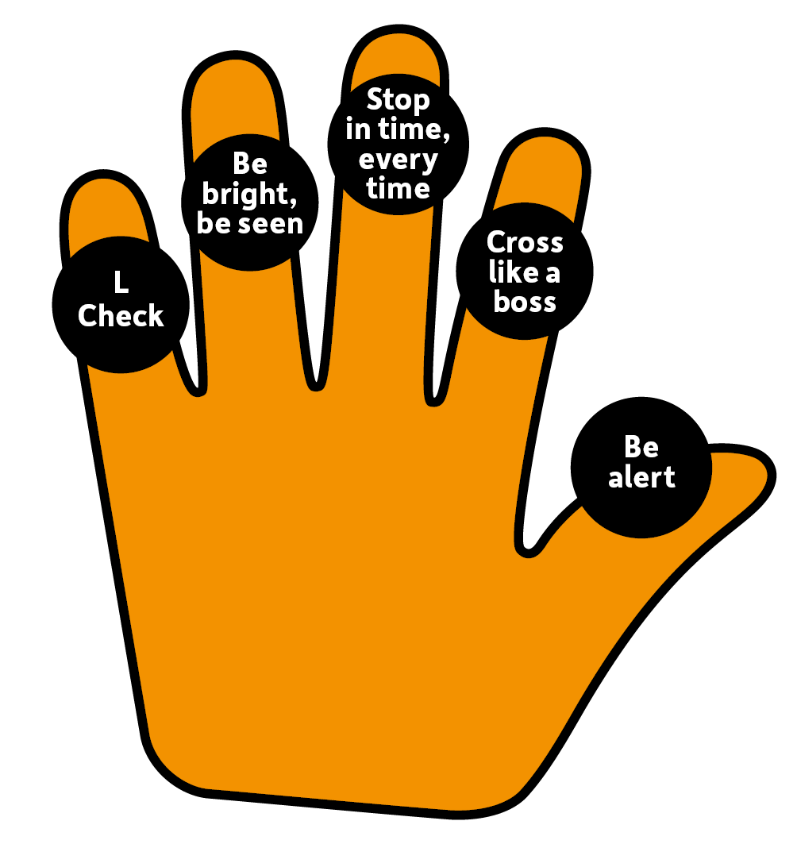
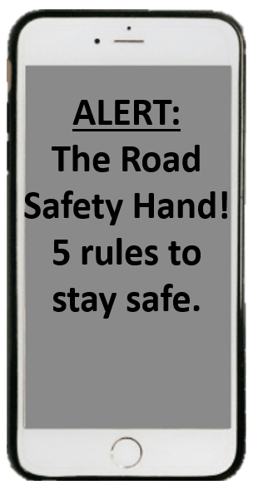
Notes:
What is an L-check?
What do we mean when we say ‘Be Bright, Be Seen’?
What do we think ‘Stop in time, Every time’ means?
What do we think we should or should not be doing to ‘Cross like a boss’?
Why do we need to ‘Be Alert?’

Slide 10
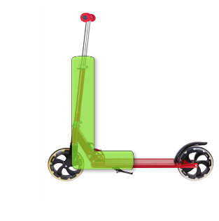
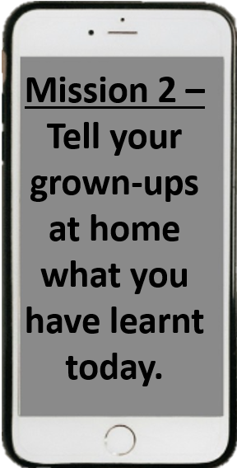
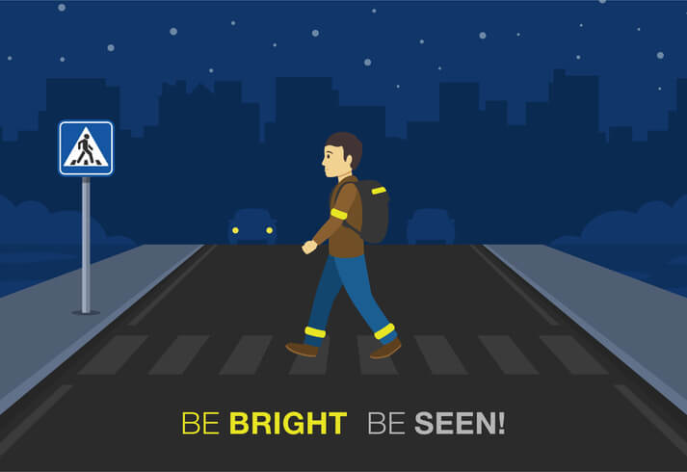
Notes:
Re-cap the key takeaways.
Suggested follow on activities:
-create a poster about scooter safety and display around school.

Slide 11
Thank you!

Slide 12
Video
time...
Click the link…
Notes:
Click on image and video should launch. Originally from https://www.youtube.com/watch?v=BNyBWXwQBW8
The original version will have ads.

