Slide 1
Year 3's Road Safety Mission
Notes:
Click and page will change and mission music should start.

Slide 2
Year 3's Road Safety Mission
Notes:
Click and page will change and mission music should start.

Slide 3
Our Mission:
To be able to recall the 5 steps to crossing a road.
To state 5 safe places to cross the road.
To be able to tell your grown up the rules for car seats.
Notes:
Click to reveal each of the lesson objectives.

Slide 4
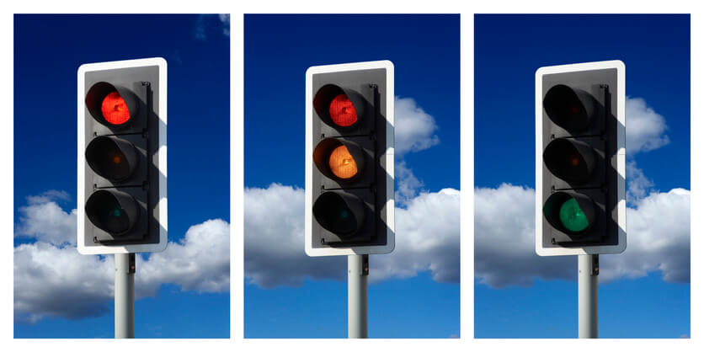
What is Road Safety?
Road safety helps to keep everyone who uses the road safe and stops us from getting hurt.
It is important to know how and where to cross. This is what we are going to learn today.
Notes:
Read out each bullet point.

Slide 5
Watch this video and let’s find out…
Mission 1:
What is- The Green Cross Code?
Notes:
Click to get the text alert – sound and info.
Take suggestions from the children. Anyone heard of it? What might they already know?
Click the photo image which has a hyperlink. Should open up the YouTube link – no ads.
**Original source if hyperlink fails – will have ads. https://www.youtube.com/watch?v=-RMQCVIrF9U**

Slide 6
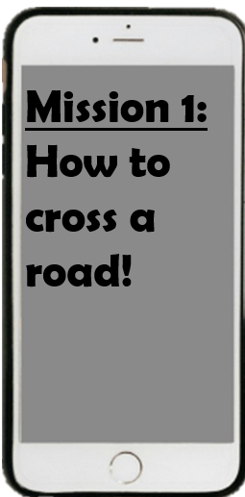
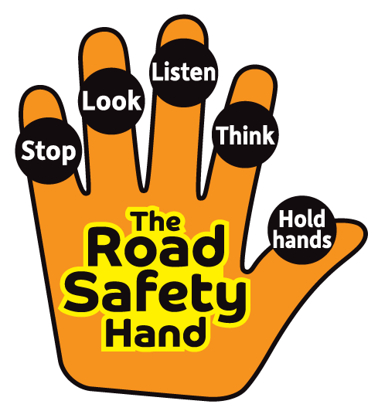
Notes:
Discuss when we are wanting to cross the road safely – there are 5 important steps we need to remember.
Get children to show their Road Safety hand – talk about the 5 Road Safety Steps.
Practice the actions. Get volunteers who would like to demonstrate.
Stop = 1 palm straight out in front. Look = Finger and thumb on each hand to create glasses/binocular shape. Listen = cup one ear. Think = pretend to scratch the top of your forehead. Hold hands = clasp hands together similar to a handshake shape.
Add the props – stop sign, googly eyes,
Ask why do we think these steps are important to cross the road safely?

Slide 7
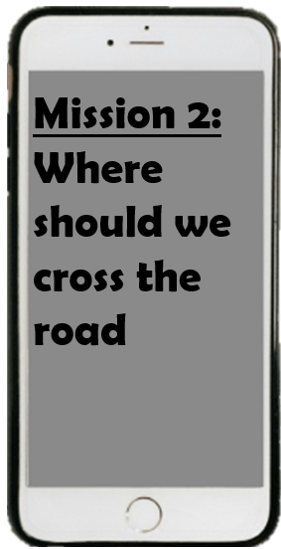
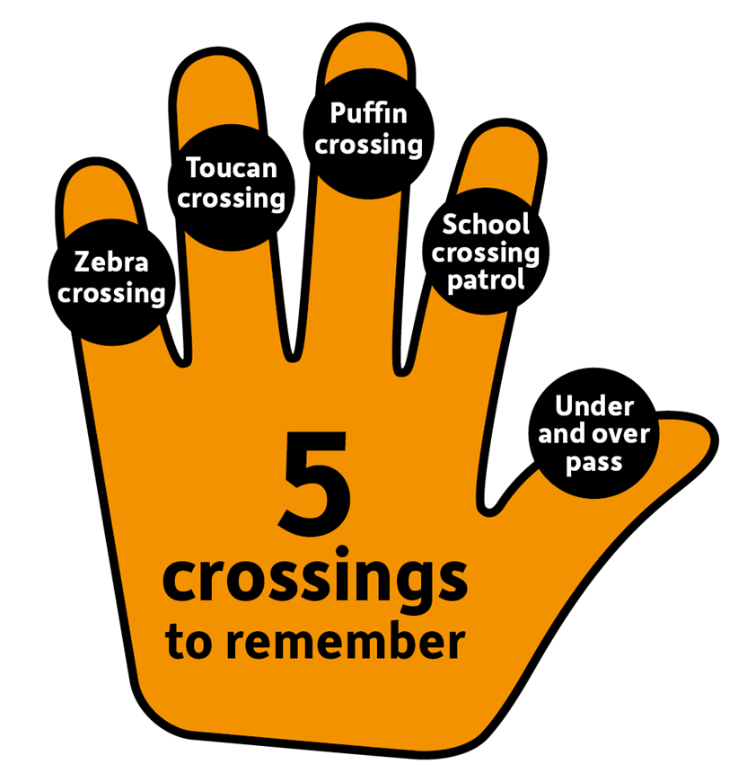
Notes:
Recap the 5 Crossing Types. Do they know what they all are? The next slide will go into detail.

Slide 8
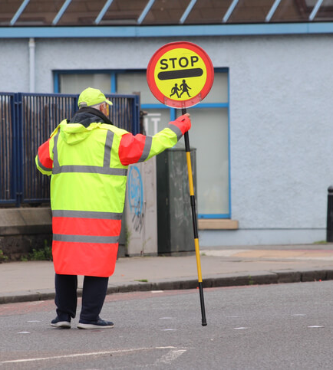
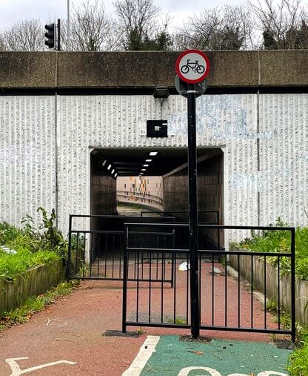
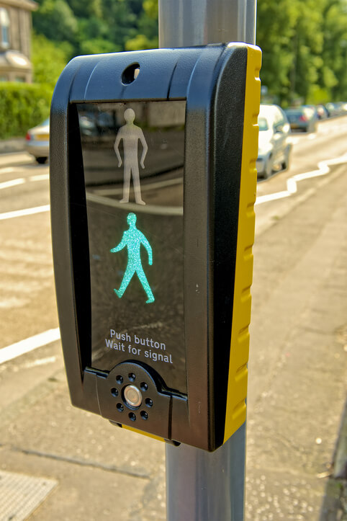
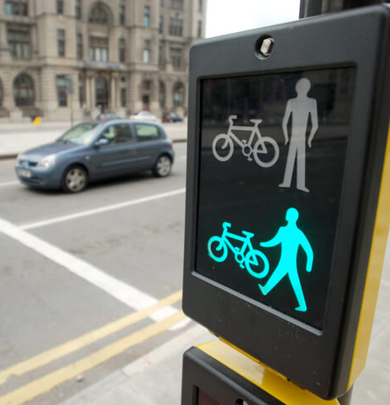
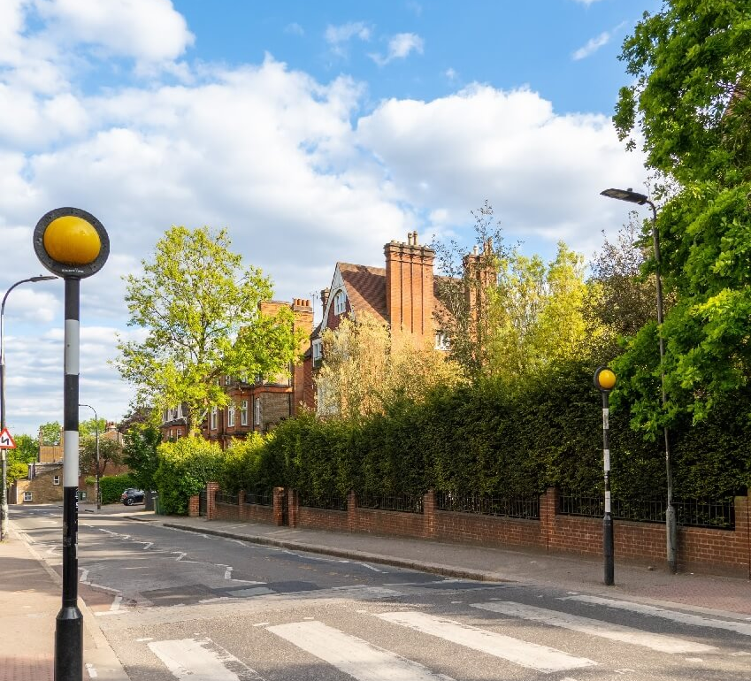
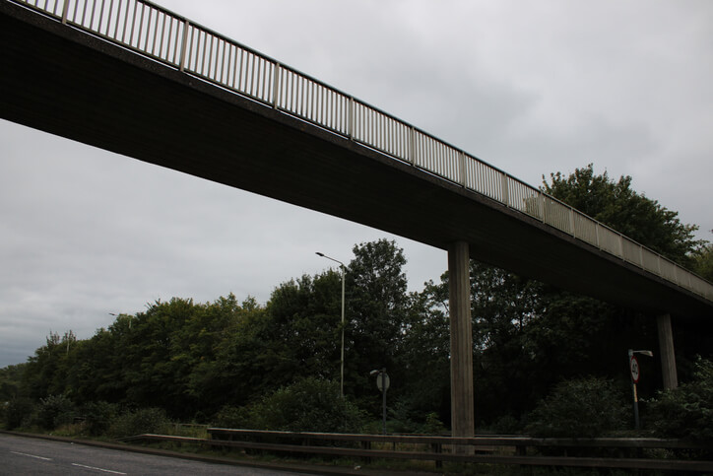
School Crossing Patrol
Underpass and Overpass
What do each of the crossings look like?
Puffin Crossing
Zebra Crossing
Toucan Crossing
AND
Notes:
Click to reveal each answer.
Were the children right?
Have they seen any of these in real life?
What might a puffin, zebra and toucan crossing look like? Anyone know?

Slide 9
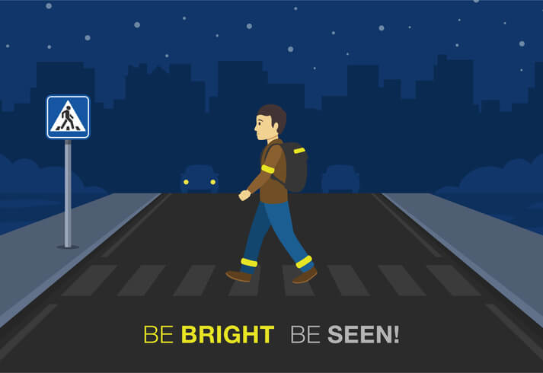
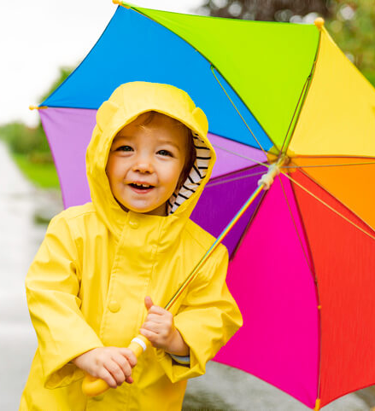
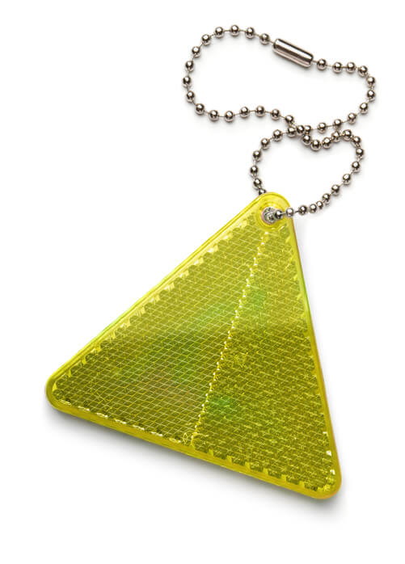
Notes:
What does ‘Be Bright, Be seen’ mean?
**Click each picture in turn. Look at the pictures for clues.**
Pic 1 – What is the pedestrian wearing? Why? What might the slogan mean?
Pic 2 – What is good about the little boy’s clothing choices? When might this still not be enough?
Pic 3 – What is this? What does it do? Where could you put it?
Pic 4 – What do we notice on the straps? Anyone have these?
**If possible share real life examples of reflective strips**

Slide 10
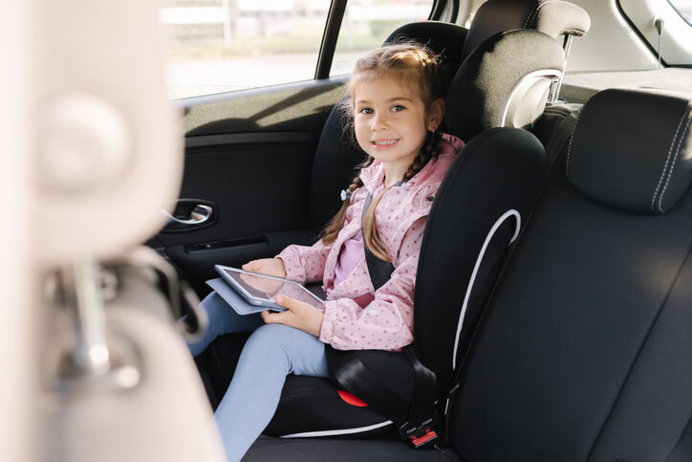
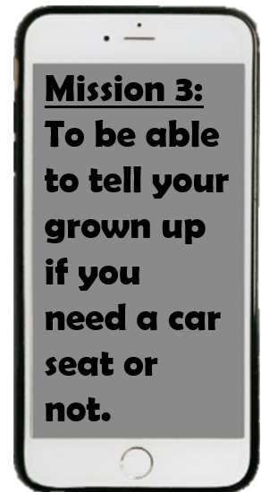
Notes:
Discuss.

Slide 11
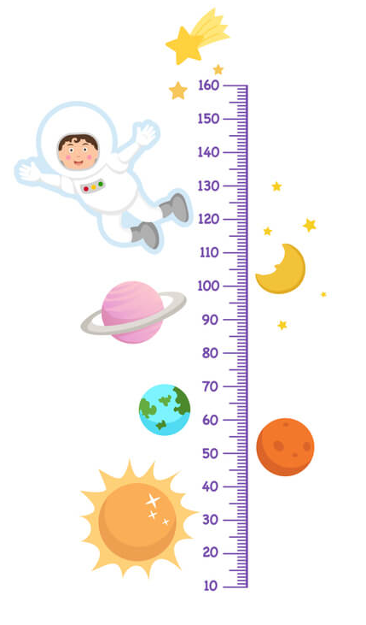
Children must use a child car booster seat until they are 12 years old or 135 centimetres tall, whichever comes first.
Sitting in the back of the car in your car seat is the safest, as there is likely to be less impact.
Notes:
Discuss.
Possible questions – are there any exceptions? Only in minicabs, taxis, coaches or vans there may be no option of a car seat. Must wear a seatbelt and must be sat in the rear. Also, children can travel without a car seat if the journey is ‘unexpected, necessary or short distance’.
Extension activity – children could measure each other. Who is 135cm or taller in our class?

Slide 12
Task for home
Ask parents to measure you.
If you are 135cm tall or above, you no longer need to be in a car seat.
Although it is good practice to be in a car seat as long as possible.

Slide 13
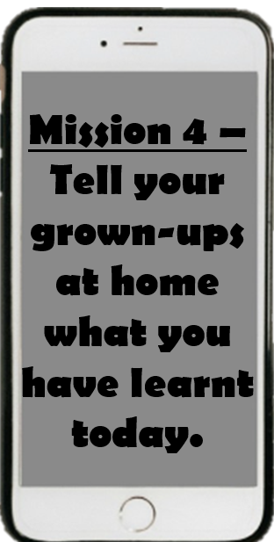
Notes:
Click to reveal text alert.
Re-cap the key takeaways.
1 – Green cross code. Stop, look and listen. Always wait for traffic to stop. Choose a safe place to cross.
2 – The main crossing types
3 – Be Bright, Be Seen – bright clothing and reflective clothing/strips in darker mornings and evenings.
4 – You should be in a car seat until 135cm OR when you turn 12. Whichever comes first.

