Slide 1
Year 3's Road Safety Mission
Notes:
Click and page will change and mission music should start.

Slide 2
Year 3's Road Safety Mission
Notes:
Click and page will change and mission music should start.

Slide 3
Our Mission:
To understand the importance of: The Green Cross Code
To understand the rules for car seats.
Notes:
Click to reveal each of the lesson objectives.

Slide 4
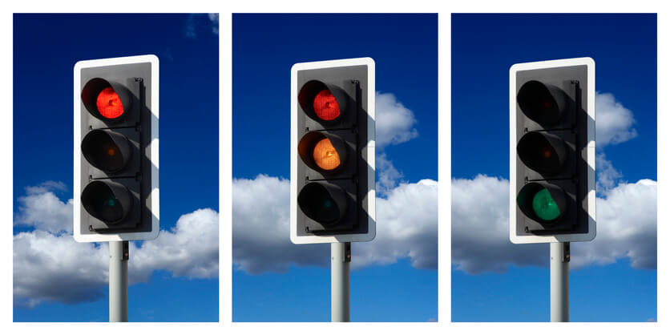
What is Road Safety?
Road safety helps to keep everyone who uses the road safe and stops us from getting hurt.
It is important to know how to behave when we are near the road and that’s what we are going to learn today.
Notes:
Read out each bullet point.

Slide 5
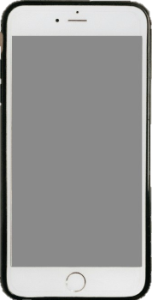
Watch this video and let’s find out…
Mission 1:
What is- The Green Cross Code?
Notes:
Click to get the text alert – sound and info.
Take suggestions from the children. Anyone heard of it? What might they already know?
Click the photo image which has a hyperlink. Should open up the YouTube link – no ads.
**Original source if hyperlink fails – will have ads. https://www.youtube.com/watch?v=-RMQCVIrF9U**

Slide 6
What did you find out?
Mission 1:
What is The Green Cross Code?
Notes:
Original source if hyperlink fails – will have ads. https://www.youtube.com/watch?v=-RMQCVIrF9U
Discuss the content from the video.

Slide 7
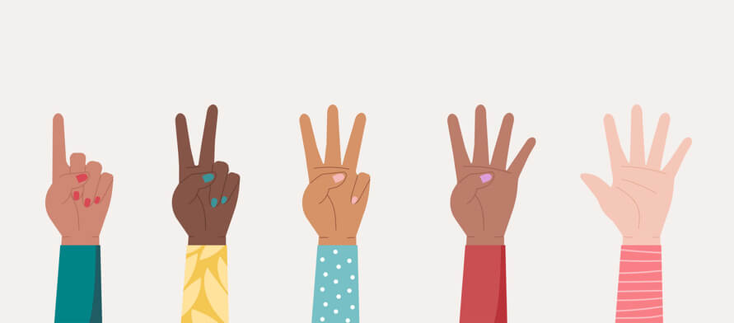
Mission 2:
Name 5 SAFE places to cross…
Don’t worry – on the next slide, we have some clues…
Notes:
Click to reveal text alert.
Take suggestions from the children.
Click again and the offer of clues will come up.

Slide 8
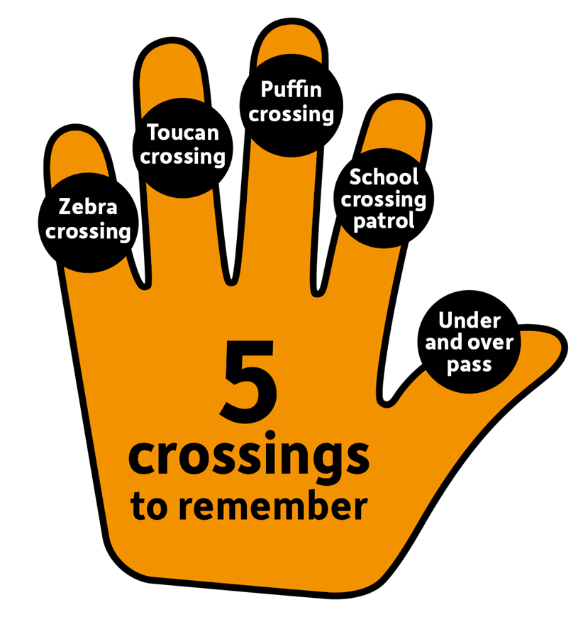
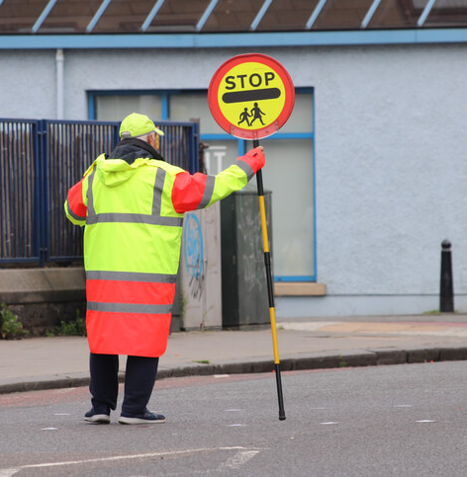
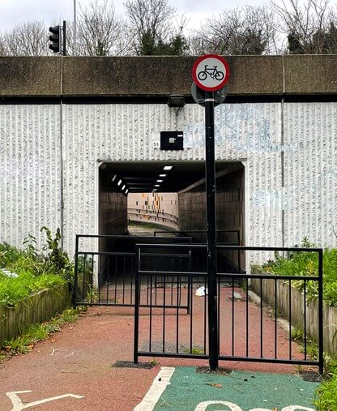
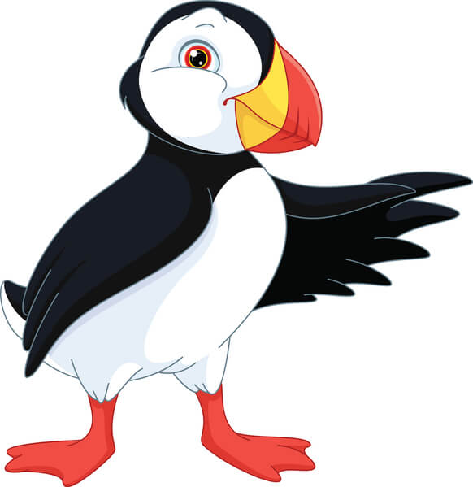
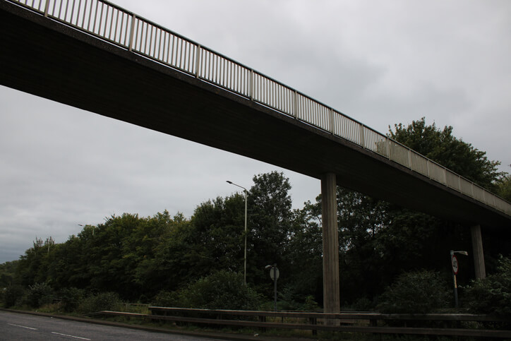
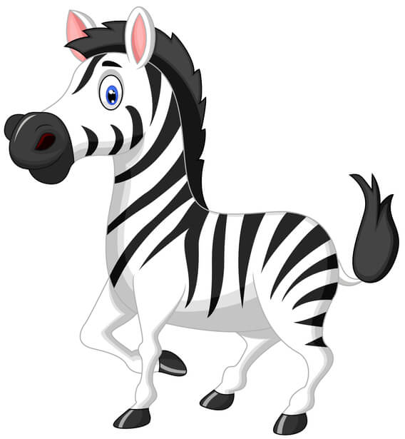
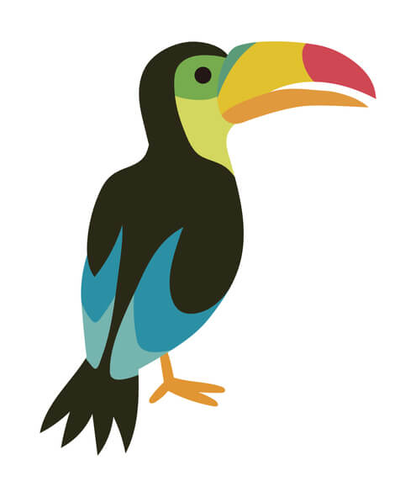
U…….. AND O…….
S…..C…….P…..
AND
Z….C…….
T…..C…….
P…..C…….
Notes:
**Do not click and reveal the hand yet. **
What might the pictures be? What might the letters stand for? What do the children already know?
Click and reveal the hand. This is our Road Safety Hand which will help us remember the main safe crossing types.

Slide 9
Underpass and Overpass
School Crossing Patrol
AND
Zebra Crossing
Toucan Crossing
Puffin Crossing
Notes:
Click to reveal each answer.
Were the children right?
Have they seen any of these in real life?
What might a puffin, zebra and toucan crossing look like? Anyone know?

Slide 10
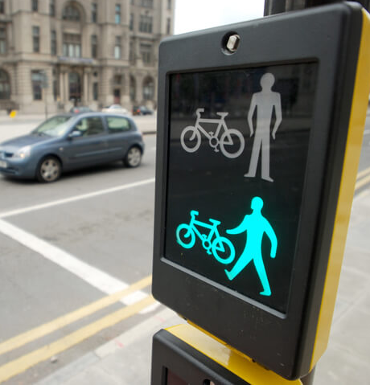
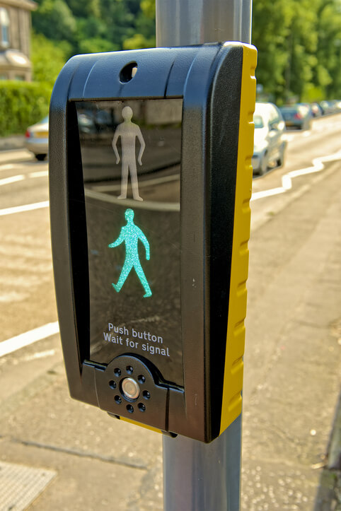
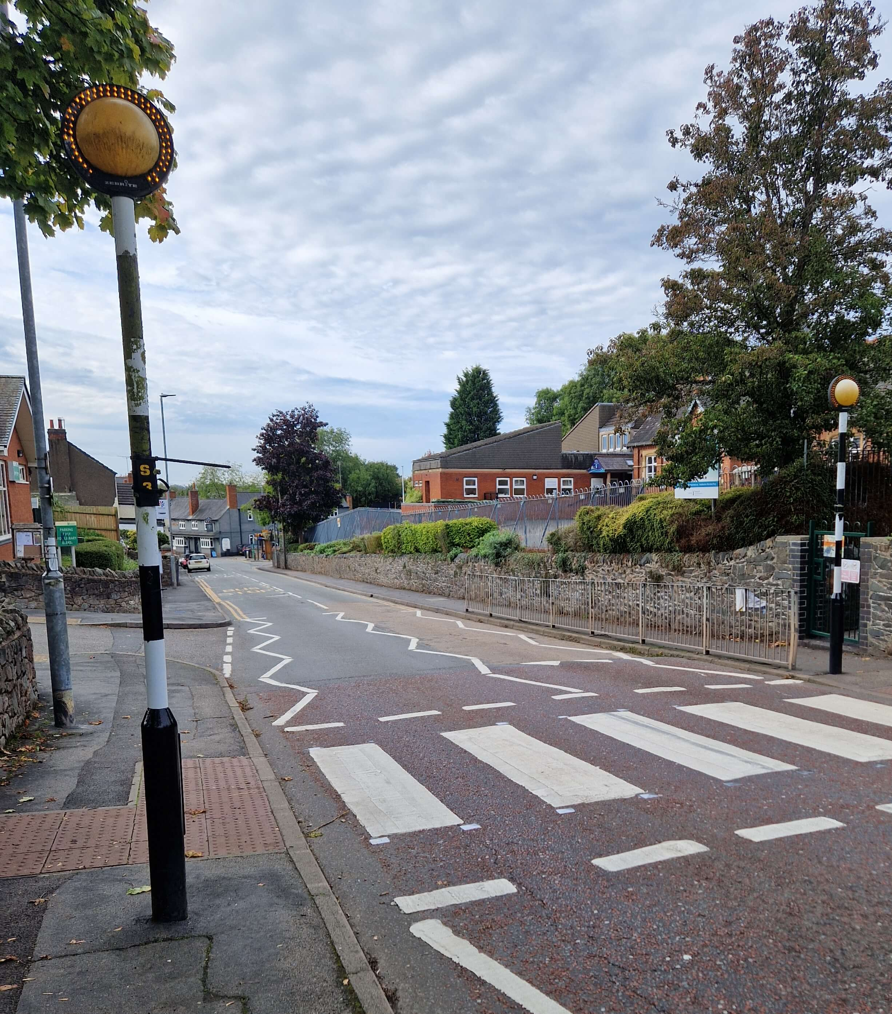
What do we know about these crossing types?
Notes:
Click to reveal each image in turn. What is each crossing name? How does that crossing work? What makes it unique?
*This will be KS1 revision once the trial is complete. During the trial, this may be new learning**
If children seem unsure, give them two possible answers for each.
Image 1 – Zebra Crossing. Recognisable from the black and white painted stripes on the road. Two yellow flashing beacons (lights) each side. Cars SHOULD stop for pedestrians ready to cross. ALWAYS wait for cars to fully stop before beginning to cross.
Image 2 – Puffing Crossing. May get mis-named as a Pelican Crossing. They look very similar. A Puffin Crossing has the green and red man on the SAME side, next to the pedestrian. Red means stop. Green man means go. Often will have accompanying beeping. They also have sensors monitoring if pedestrians are still crossing or have even walked away. Pelican crossings only allow 6 seconds to cross before the traffic lights change back to green.
Image 3 – Often found on the outskirts of parks or near cycle lanes. They are wider than a Puffin Crossing and designed for pedestrians and bicycles. Toucan = Two types of people can cross.

Slide 11
Mission 3:
Tell Me Why? GAME
Notes:
Click and reveal phone alert. Each of the next few slides will show examples of unsafe places to cross.
Children to share why each would be an unsafe choice to cross the road?

Slide 12
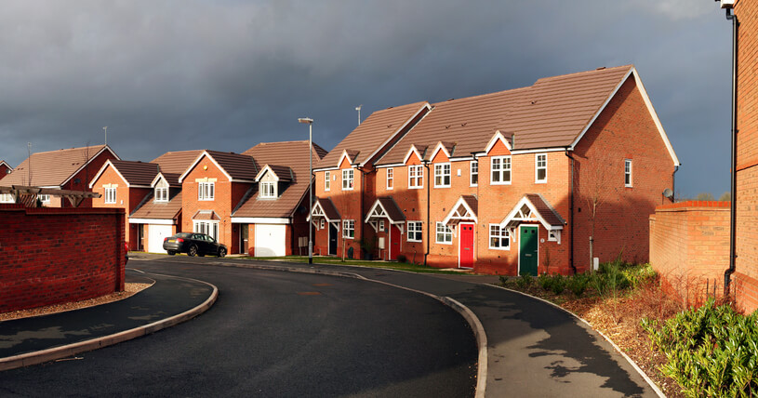
On the bend
Why is it unsafe to cross here?
Notes:
Discuss.
You can’t see what is coming. You can’t know what speed they might be travelling. The driver who may be approaching cannot see you.
Where would be a better place to cross if a formal crossing wasn’t available – on a straight, clear road.

Slide 13
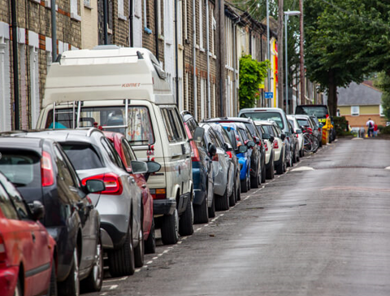
Between parked cars
Notes:
Discuss that moving cars cannot see you between the parked cars.
Also, you cannot see moving cars when you are between the parked cars.
The parked cars may also start moving to pull off either forwards or backwards.
Where would be a better place to cross?

Slide 14
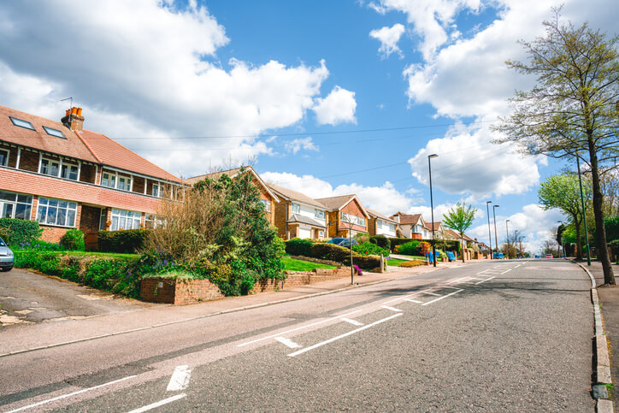
On a hill
Why is it unsafe to cross here?
Notes:
Discuss.
You cannot see over the crest of the hill and know if anything is coming, or at what speed.
Cars coming downhill may be gathering speed.
It would be best to move to the top of the hill so you can see cars coming from either side or to the bottom of the hill.

Slide 15
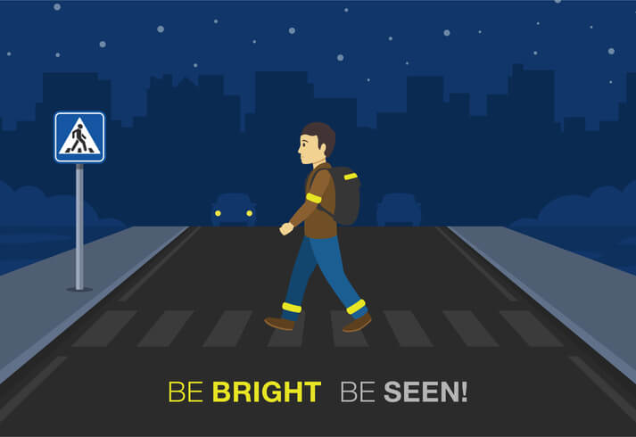
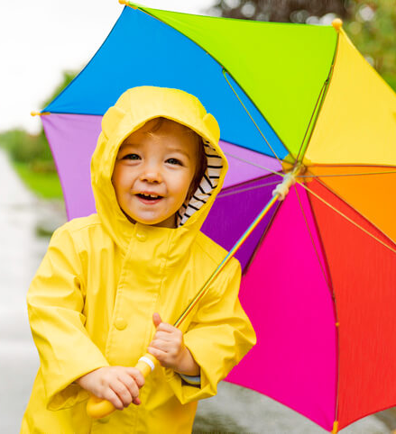
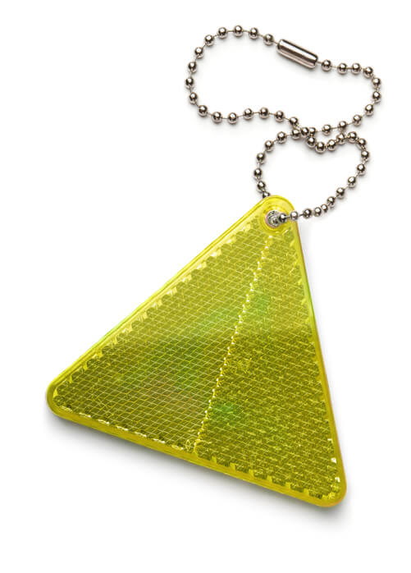
Be Bright, Be Seen!
Notes:
What does ‘Be Bright, Be seen’ mean?
**Click each picture in turn. Look at the pictures for clues.**
Pic 1 – What is the pedestrian wearing? Why? What might the slogan mean?
Pic 2 – What is good about the little boy’s clothing choices? When might this still not be enough?
Pic 3 – What is this? What does it do? Where could you put it?
Pic 4 – What do we notice on the straps? Anyone have these?
**If possible share real life examples of reflective strips**

Slide 16
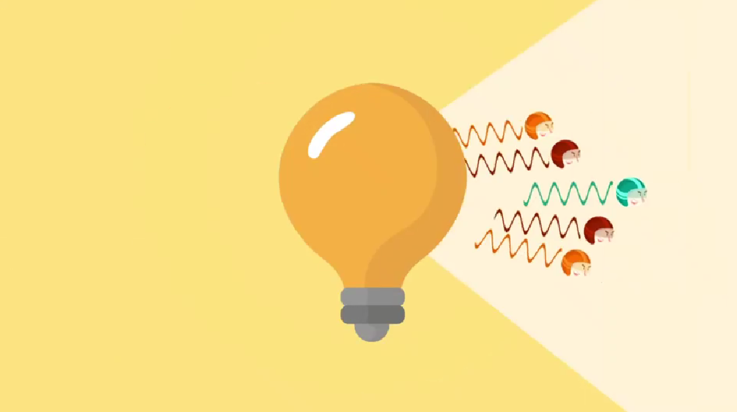
Mission 4:
How do reflective strips work?
Video time…
Notes:
Ask the question – how does reflection work?
Watch the video. Click on the yellow image and the hyperlink should take you to the BBC website.
If hyperlink doesn’t work - https://www.bbc.co.uk/bitesize/articles/zqdxb82
What do we know now? How are our reflective strips working?

Slide 17
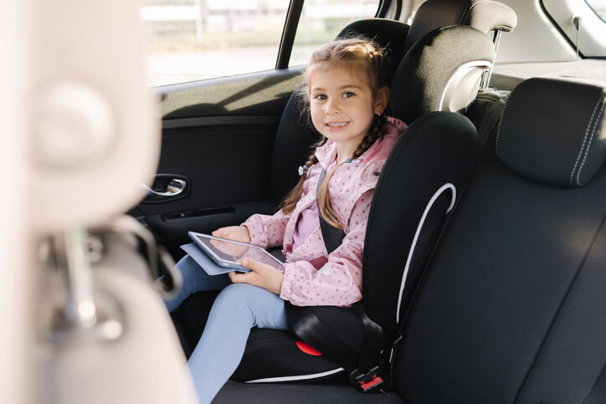
Are you tall enough to NOT be in a car booster seat?
Notes:
Ask the question.
Discuss – What do children THINK the rule is?
Is this law? (Yes. It can be a fixed penalty fine and points on the driver’s licence.)
Who in the class has a seat like the picture?

Slide 18
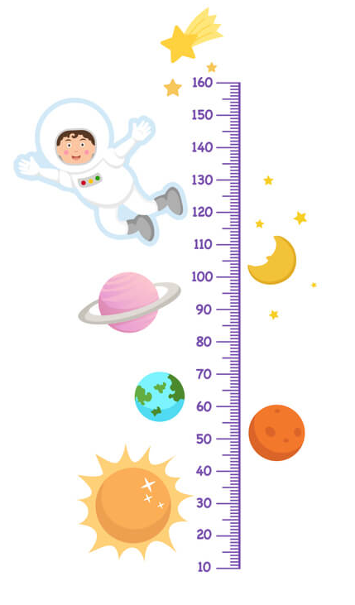
Children must use a child car booster seat until they are 12 years old or 135 centimetres tall, whichever comes first.
Sitting in the back of the car in your car seat is the safest, as there is likely to be less impact.
Notes:
Discuss.
Possible questions – are there any exceptions? Only in minicabs, taxis, coaches or vans there may be no option of a car seat. Must wear a seatbelt and must be sat in the rear. Also, children can travel without a car seat if the journey is ‘unexpected, necessary or short distance’.
Extension activity – children could measure each other. Who is 135cm or taller in our class?

Slide 19
136cm
137cm
128cm
130cm
129cm
125cm
Mission 4:
Do any of these children need to be in a car seat?
119cm
Notes:
Discuss.
Answer – Only the middle two are tall enough to not use a booster seat/car seat. They are all in Year 3 so under 12 years old and the middle two are the only ones over 135cm tall.

Slide 20
Create a poster about something you have learnt today.
You could do a poster about:
- The Green Cross Code
-Types of crossings
-The car seat rules
The choice is yours…
Suggested activity…

Slide 21
Mission 5 –
Tell your grown-ups at home what you have learnt today.
Notes:
Click to reveal text alert.
Re-cap the key takeaways.
1 – Green cross code. Stop, look and listen. Always wait for traffic to stop. Choose a safe place to cross.
2 – The main crossing types
3 – Be Bright, Be Seen – bright clothing and reflective clothing/strips in darker mornings and evenings.
4 – You should be in a car seat until 135cm OR when you turn 12. Whichever comes first.

Slide 22
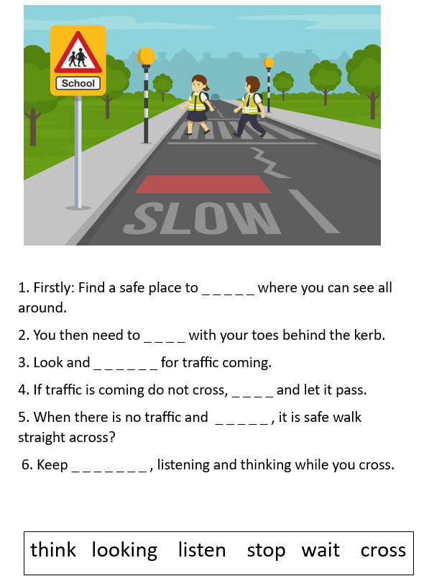
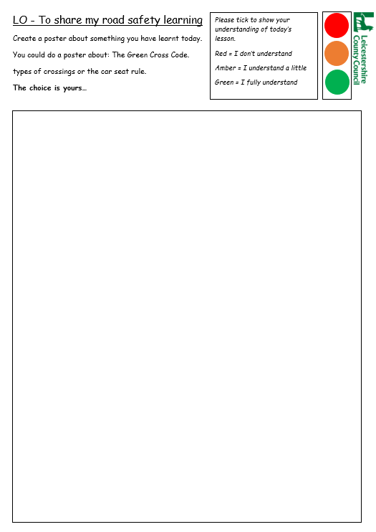
Suggested Activities

Slide 23
Thank you!

Slide 24
Credits
Phone - Photo by Benjaminrobyn Jespersen
Top Secret Logo – Photo by Tayeb Mezahdia https://pixabay.com/illustrations/top-secret-confidential-classified-2054429/
Message alert – By LIECIO https://pixabay.com/sound-effects/message-notification-190034/
Spy theme – By Universefield https://pixabay.com/music/happy-childrens-tunes-joyful-spy-melody-for-lighthearted-fun-15s-232565/
Photo by Eva Bronzini from Pexels: https://www.pexels.com/photo/a-sheet-of-paper-on-top-of-a-brown-envelope-7958171/

