Slide 1
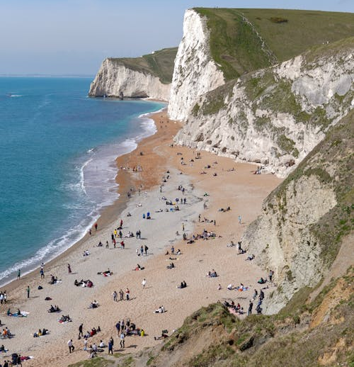
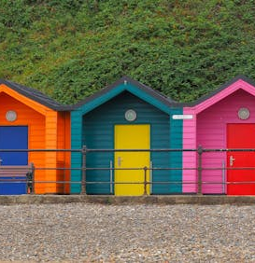
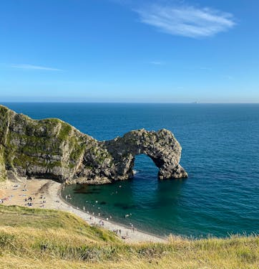
Safe places to play in the summer holidays
Objective: To be able to highlight safe and fun places for children to play.

Slide 2
Let’s play a game of; the next few slides will have pictures of safe and unsafe places to play. Can you tell me where it is safe?

Slide 3
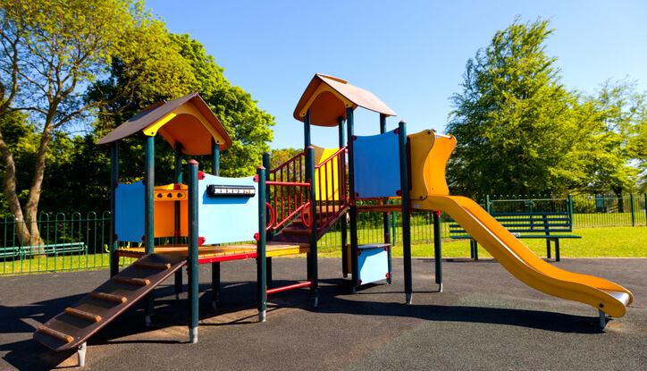
Parks?
Yes, parks are a great place to play, safe from traffic and other road users.
They can be great places to;
Climb
Run
Meet up with friends

Slide 4
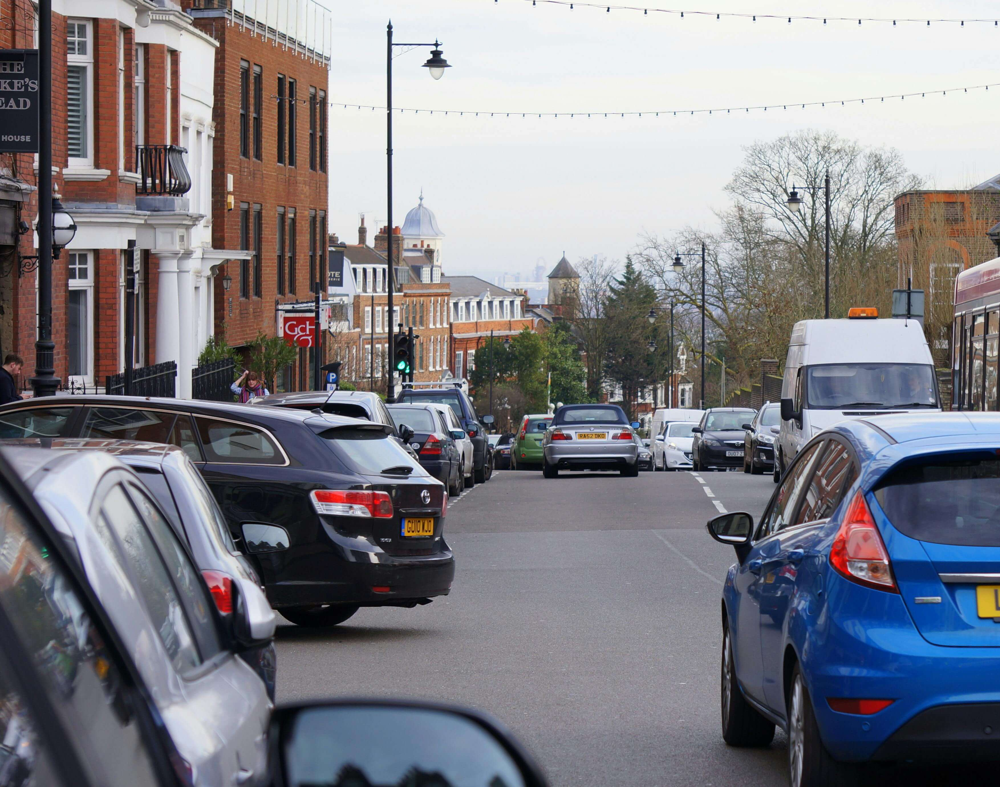
Near the road?
No, playing near the road is not a safe place to play, there will be lots of different types of road users and it is always best to go to a big open space to play.

Slide 5
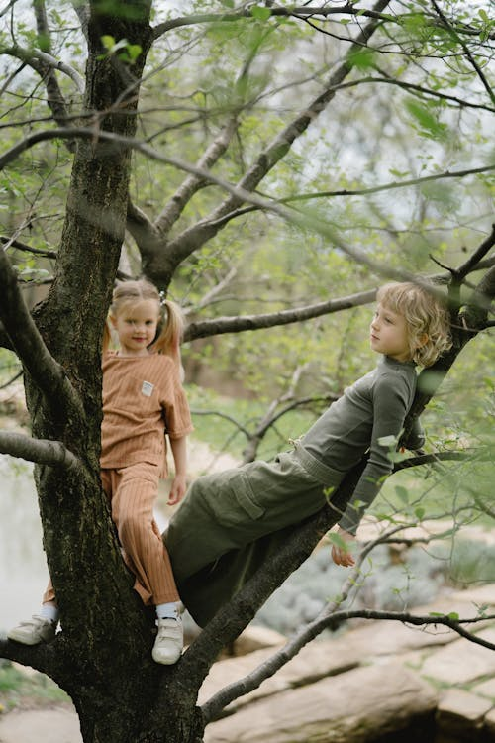
In the Garden?
Yes, the garden is a fantastic place to play, they are often secure, so you can’t get out and free from traffic, but most importantly; they are close to snacks and the toilet!

Slide 6
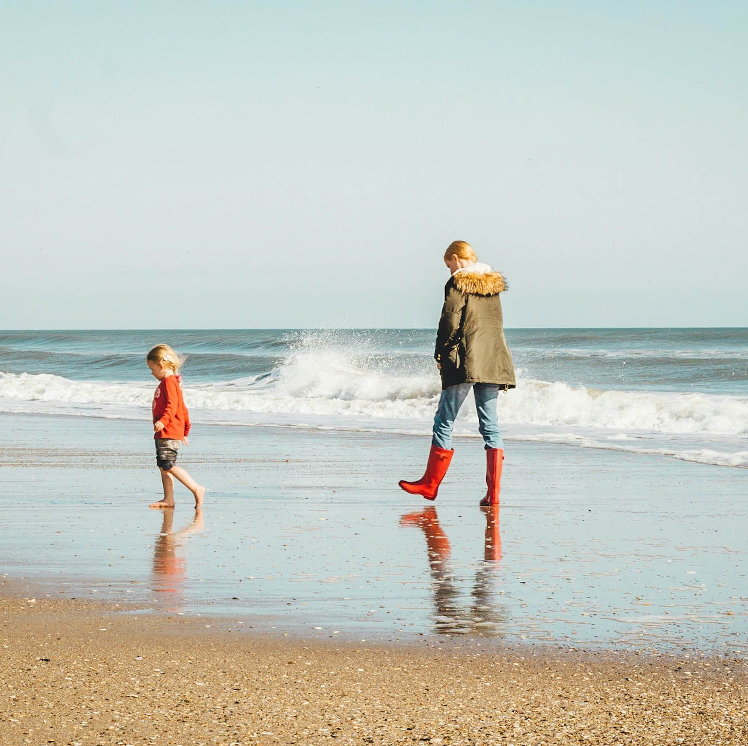
The Beach?
Yes, the beach is a great place to play free from traffic and other road users. The roads tend to be very busy during the summer holidays so are not safe to play near.
We still need to be careful of the water and listen to lifeguards' instructions about where is safe to swim at the beach.

Slide 7
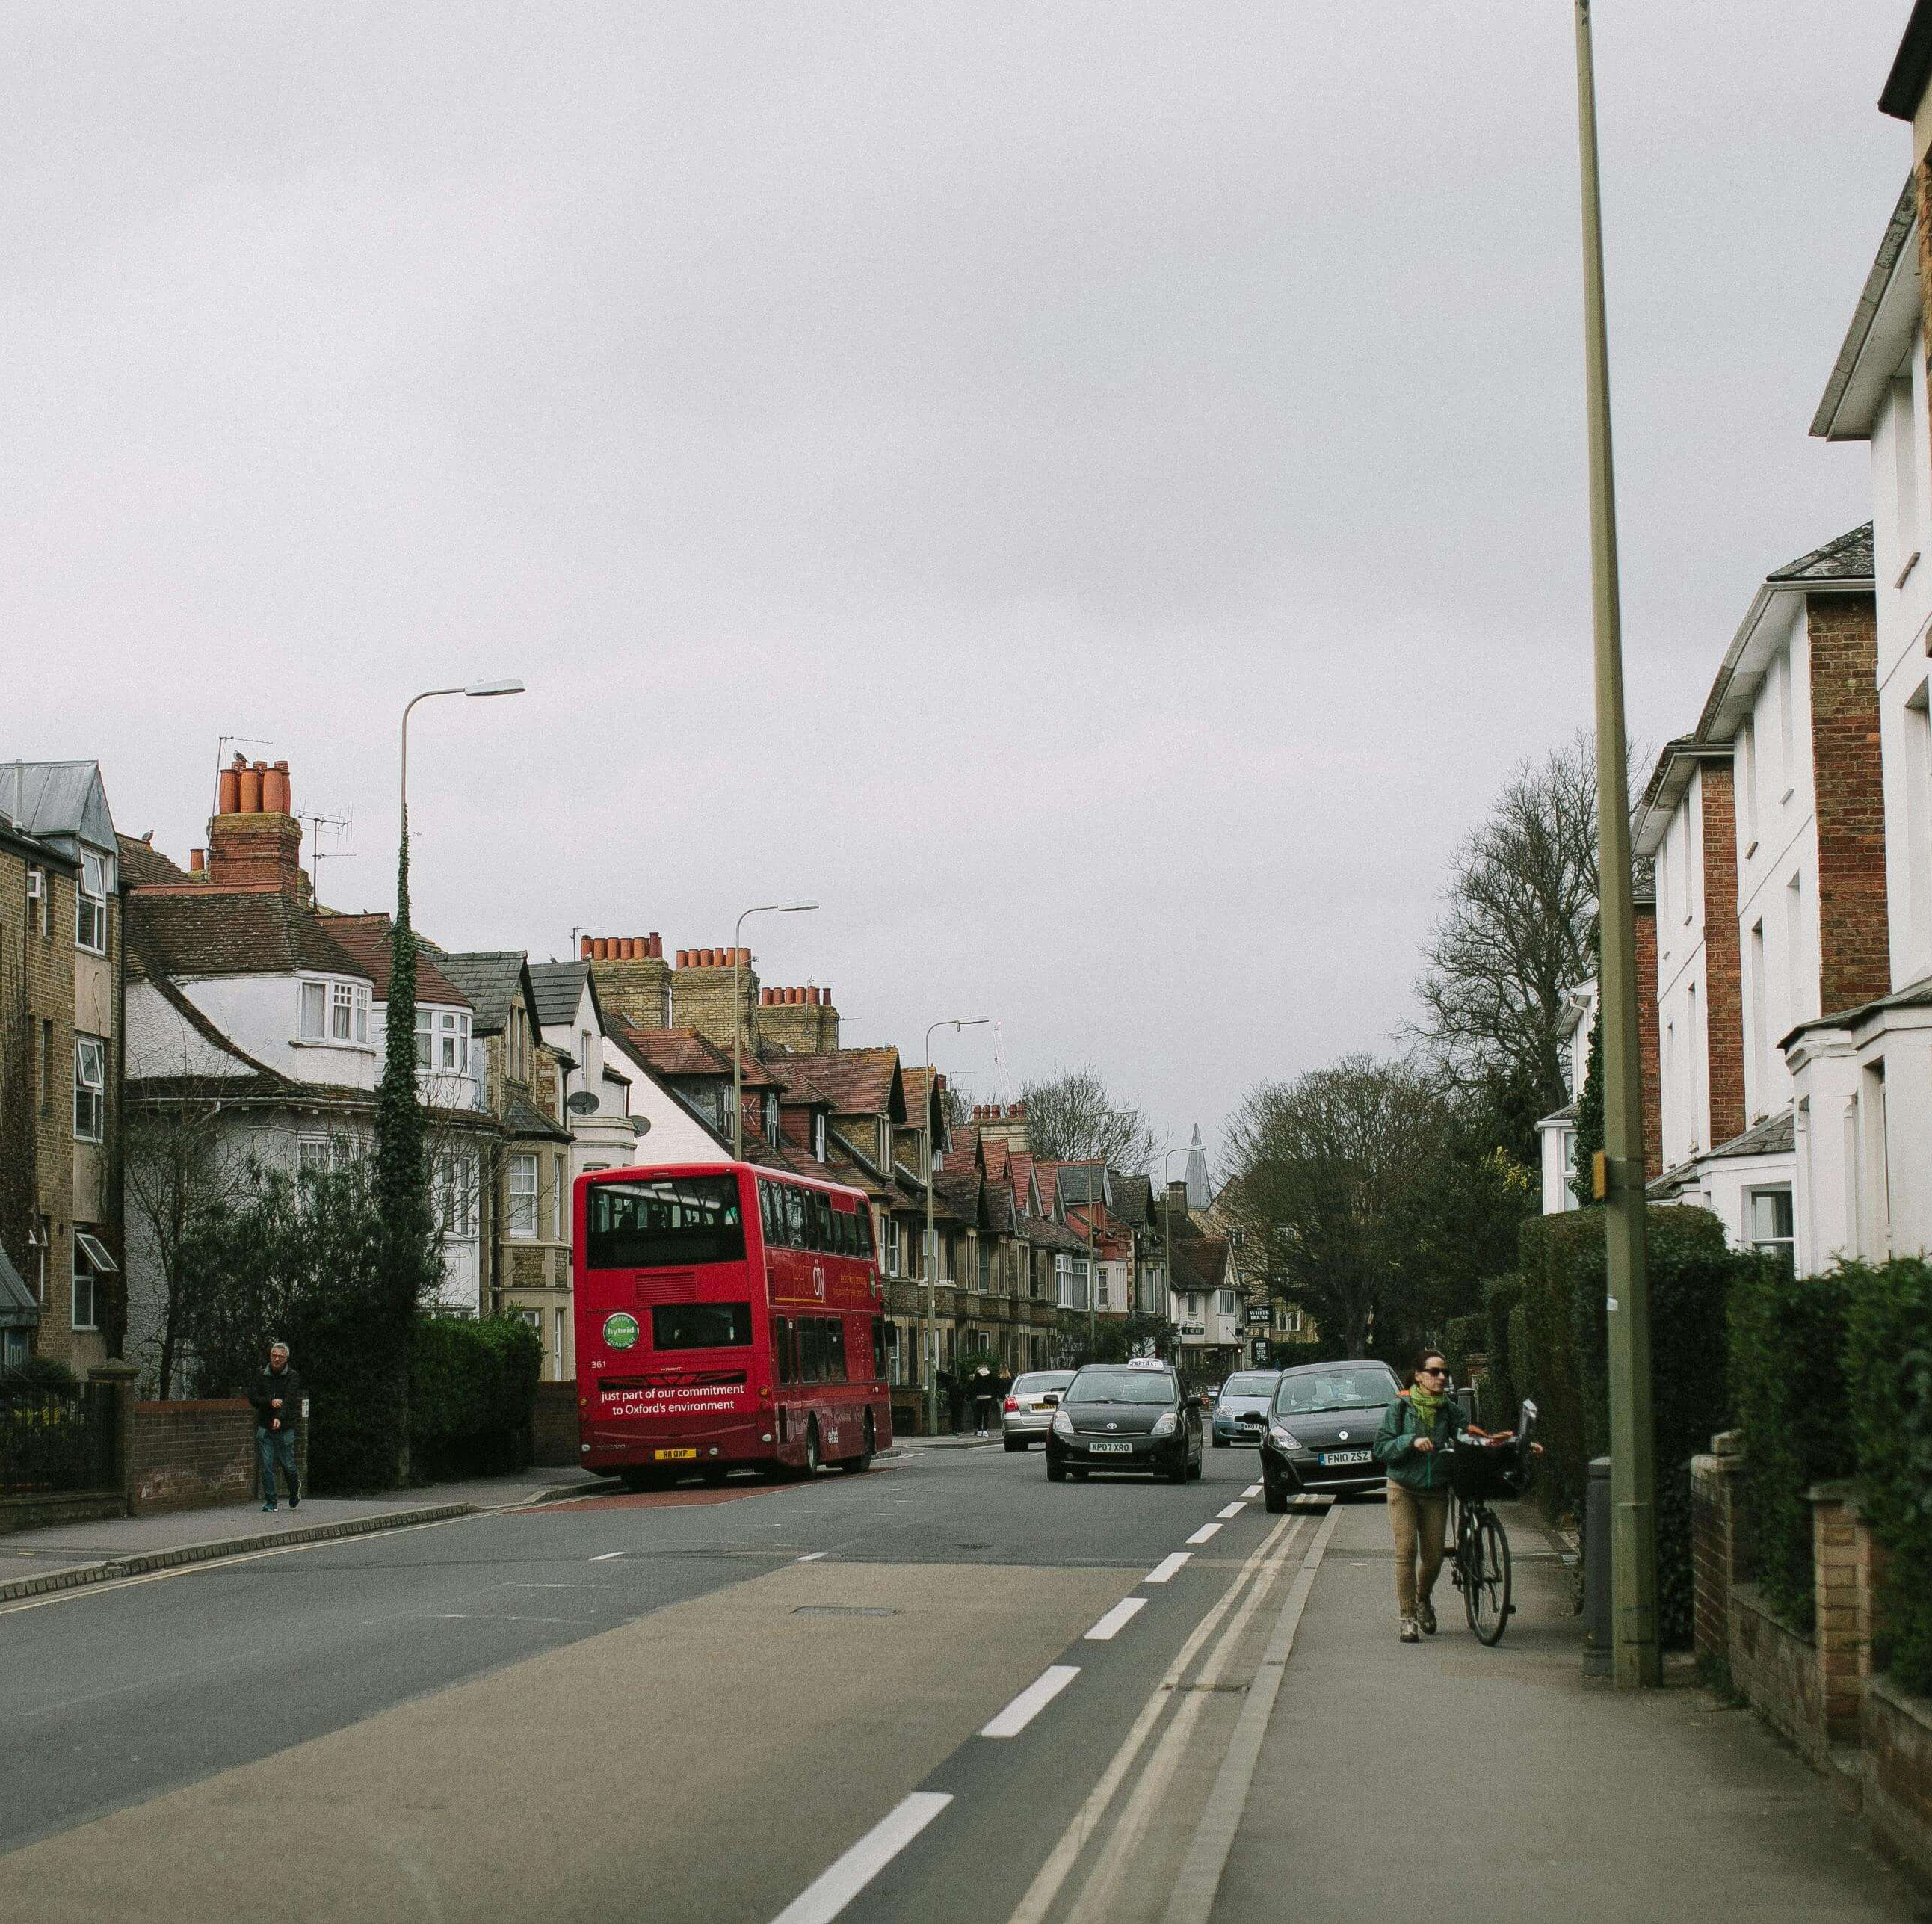
In the road?
No, this is not a safe place to play, it is very dangerous for us to be in the road, and we must only be in it when we are crossing safely.
If you drop your ball or other item, leave it and get to the other side quickly and safely.

Slide 8
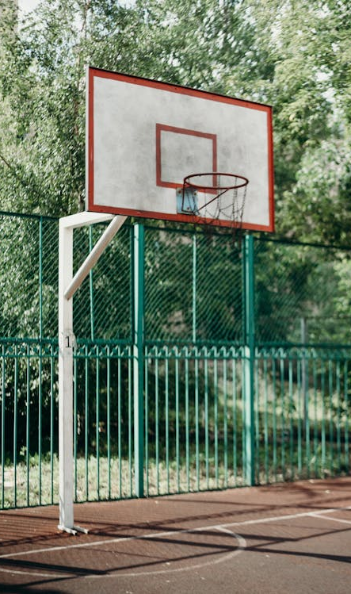
Multi Use Game Area or MUGA?
Yes, these are very safe areas to use. You can cycle, scoot or play ball games. They often have high sides so your ball can’t escape.

Slide 9
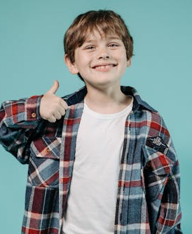
Well done! How many did you get right?

Slide 10
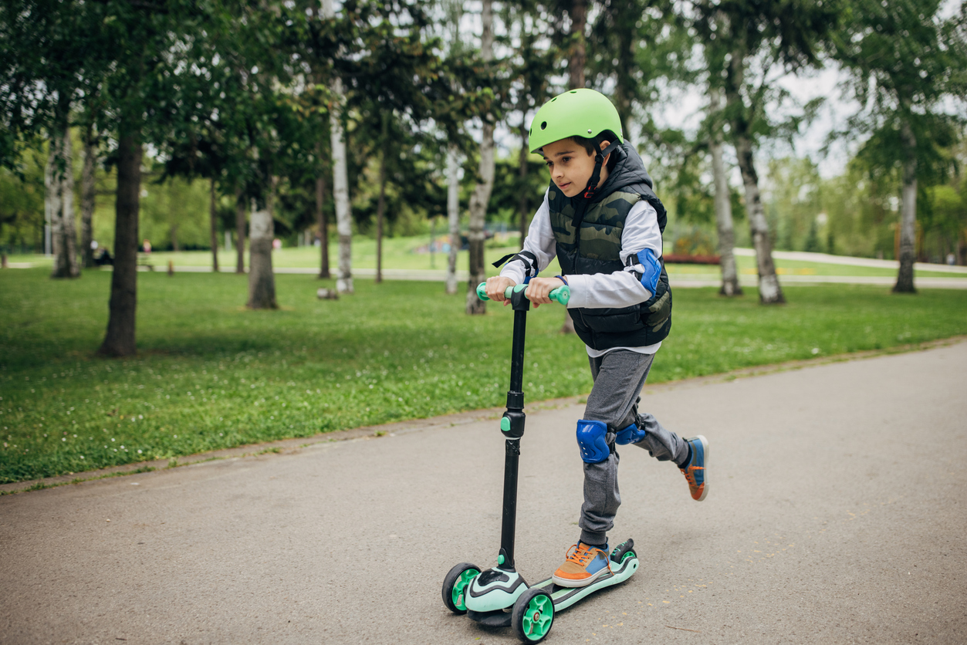
Where is a safe place to play with your Scooters and Bikes?

Slide 11
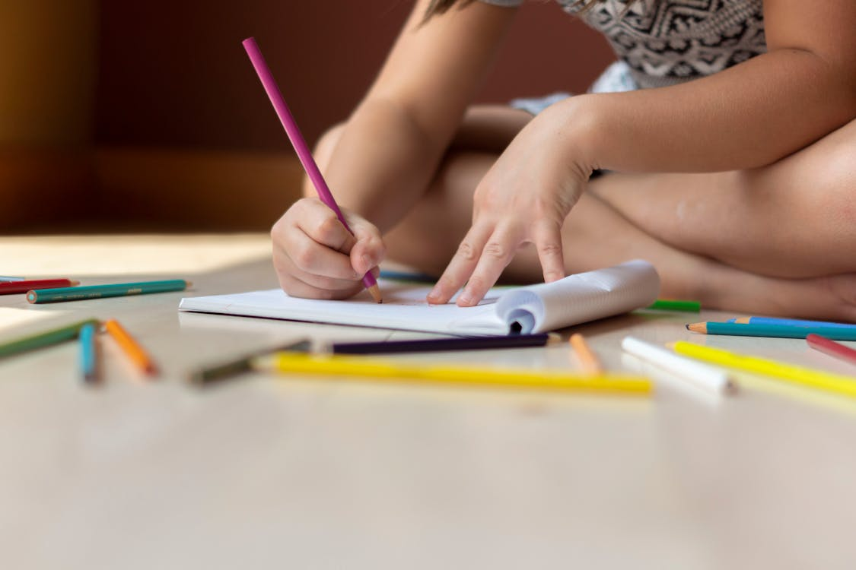
Activity – end of term display board
Can you draw yourself playing or scooting in a safe place to help encourage others to do the same.

Slide 12
Remember…

Slide 13
Photo Credit
Photo by Ricky Esquivel: https://www.pexels.com/photo/low-angle-photography-of-basketball-hoop-2529383/
Photo by Ksenia Chernaya: https://www.pexels.com/photo/boy-sliding-down-on-playground-8535668/
Photo by Allan Mas: https://www.pexels.com/photo/cute-stylish-child-playing-with-chalks-in-the-garden-t-5624229/
Photo by Anastasia Shuraeva: https://www.pexels.com/photo/kids-resting-in-tree-branches-7671273/
Photo by Sarah Dietz: https://www.pexels.com/photo/person-drawing-3855554/

