Slide 1
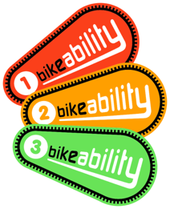
Welcome
Bikeability is coming to our school!

Slide 2
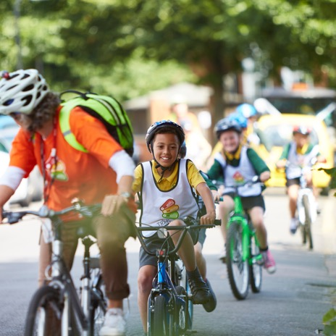
What is Bikeability?
Bikeability is a cycle training programme.
It will provide your children with the skills, knowledge understanding to cycle safely on the roads.
Bikeability will provide them with the confidence for all kinds of cycling in the future.

Slide 3
Why are we providing this in school?
PHYSICAL BENEFITS
Helps children to develop and use the largest muscle groups. This helps with concentration and focus in school too!
Cycling helps them to develop good balance and spatial awareness
HEALTH
Cycling is good for your children’s health & fitness
It can help to increase their
physical activity levels in a fun
and enjoyable way
It is better for the environment, and us, than a car journey (reduces CO2 and air pollution)
SOCIAL
Cycling can provide opportunities for our pupils to develop their social skills
It can help them to visit new places in our community
Cycling can help them to develop some independence
THINKING
There are many skills Bikeability can
help with, including:
Developing decision making skills
Planning & organisation
Independent thinking

Slide 4
Level 1
Be taught in the playground
Prepare children for a journey
Help children to check their bicycle
is ready for a journey
Help children to set off, pedal, slow down and stop (including looking behind, cycling one handed, turning and controlling speed)

Slide 5
Level 2
Be taught on quiet local roads
Help children to cycle safely and responsibly
Help children identify and respond to hazards
Help children to start and stop on-road journeys and maintain suitable riding positions
Show children how to share the road and communicate with other road users
Help children to understand signals, signs and road markings
Help children to understand how to manage risk when cycling
Help children negotiate
junctions (pass side
roads, turn at
T junctions, and
crossroads and
roundabouts)

Slide 6
Level 3
Be taught on busy and more challenging roads
Help children to plan a journey
Help children to plan and ride assertively everywhere cycling is permitted
Support children to maintain suitable riding positions
Help children to cooperate with, and respect other road users (including avoiding driver blind spots and riding with others)
Give children the skills to
pass queuing traffic and
use junctions controlled
by traffic lights

Slide 7
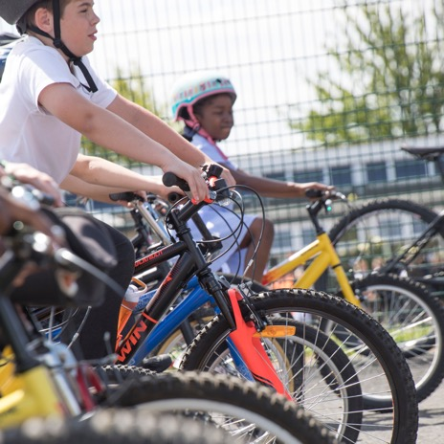
Who delivers the training?
Bikeability instructors will come to the school to deliver the training.
They are all trained to deliver National Standard cycle training.
They are all DBS checked.
They work in schools all over
the country and will provide
a really enjoyable opportunity
for our pupils!

Slide 8
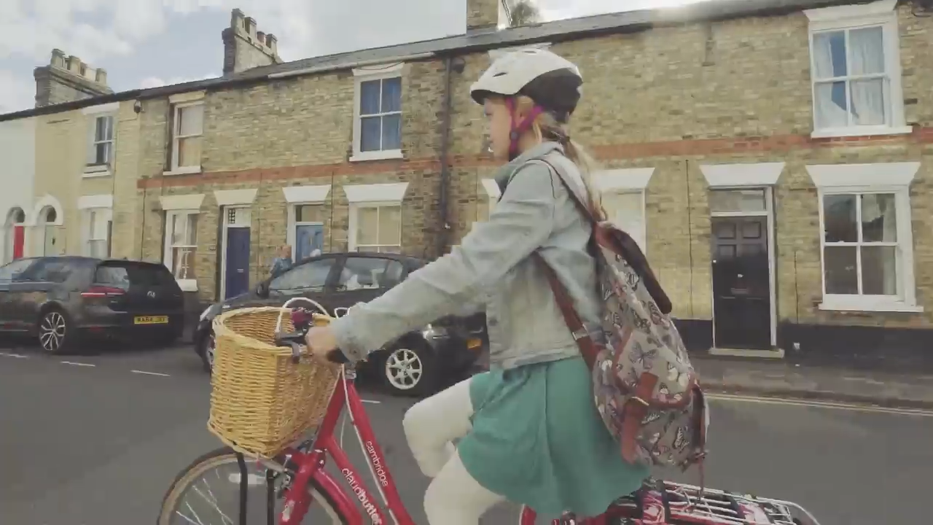
A Bikeability Journey
Watch our short video
Notes:
Can the video be embedded? Needs to be ina format that schools can down load and can show in school- not all very hi-tech facilities in schools?

Slide 9
What happens next?
We have a letter with details for you
There is a consent form that needs to be signed to allow your child to take part
[schools add in here about access to bikes & helmets- do pupils need their own, do you have some you can lend them, does the Bikeability provider have any the school can borrow. We are aiming to make Bikeability as accessible as possible]
If you would like to cycle, but don’t feel confident enough to cycle on the roads yourself, do contact the training provider to get some training for yourself too.
Visit www.bikeability.org.uk to sign up to the Bikeability Club
(advice, competitions, special offers, newsletter etc)

Slide 10
Any questions?

