Slide 1
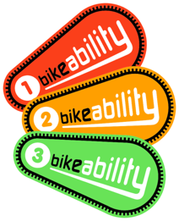
Bikeability is coming to our school!

Slide 2
Bikeability is coming to our school!

Slide 3
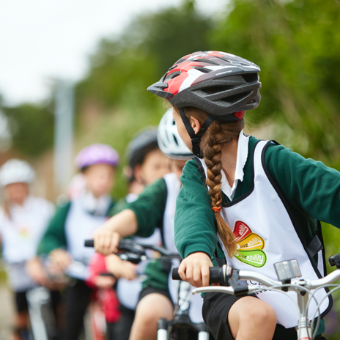
What is Bikeability?
Bikeability is a cycle training programme.
It will help us to gain the skills, knowledge and understanding to cycle safely on the roads.
Bikeability will give us the confidence for all kinds of cycling in the future.

Slide 4
Why is cycling good for us?
HEALTH
It is good for our hearts and lungs
It can increase our physical activity levels
Cycling rather than being in a car can reduce air pollution and carbon emissions
SOCIAL
We can spend time with friends
We can explore new, different places independently

Slide 5
Why are we providing this in school?
THINKING
Improves our decision making
Helps us with planning & organisation
Increases our independence
PHYSICAL BENEFITS
Helps us to develop strong muscles (including our largest muscles)
Helps with our balancing skills and spatial awareness

Slide 6
There are 3 levels of Bikeability
Be taught in the playground
Prepare you for a journey
Help you to check your bicycle is ready for a journey
Help you to set off, pedal, slow down and stop (including looking behind, cycling one handed, turning and controlling speed)

Slide 7
There are 3 levels of Bikeability
Be taught on quiet local roads
Help you to cycle safely and responsibly
Help you identify and respond to hazards
Help you to start and stop on-road journeys and maintain suitable riding positions
Show you how to share the road and communicate with other road users
Help you to understand signals, signs and road markings
Help you to understand how to manage risk when cycling and help you negotiate junctions (pass side roads,
turn at T junctions, and
crossroads and
roundabouts)

Slide 8
There are 3 levels of Bikeability
Be taught on busy and more challenging roads
Help you to plan a journey
Help you to plan and ride assertively everywhere cycling is permitted
Support you to maintain suitable riding positions
Help you to cooperate with, and respect other road users (including avoiding driver blind spots and riding with others)
Give you the skills to pass
queuing traffic and use
junctions controlled
by traffic lights

Slide 9
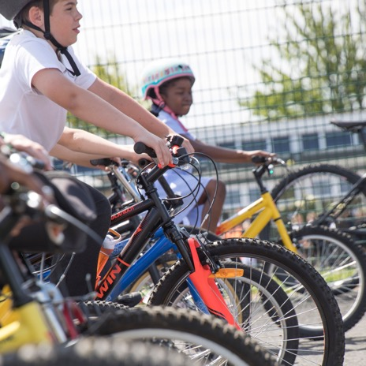
Who delivers the training?
Bikeability instructors will come to school to deliver the training
They work in schools all over the country and will provide a really enjoyable opportunity for you!

Slide 10
What happens next?
We will provide a letter for your parents/carers.
This will explain Bikeability training to them
They will need to sign the consent form to allow you to take part
[schools add in here about access to bikes and helmets - do pupils need their own, do you have some you can lend them, does the Bikeability provider have any the school can borrow. We are aiming to make Bikeability as accessible as possible]
At the end of your course you will be given a certificate and badge, for the Bikeability Level you took part in.

Slide 11
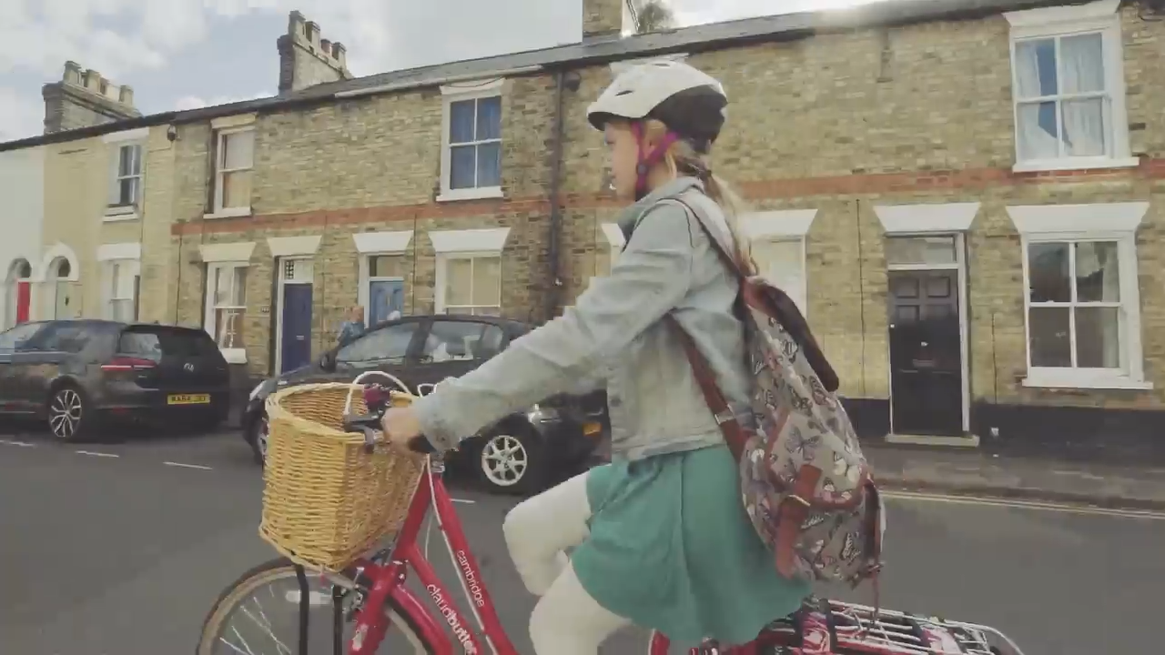
A Bikeability Journey
Watch our short video

