Slide 1




Year 5's Road Safety Mission
Notes:
Click and page will change and mission music should start.

Slide 2

Year 5's Road Safety Mission
Notes:
Click and page will change and mission music should start.

Slide 3

Our Mission:
To be able to explain how distractions can have an impact on using the road safely.
Notes:
Click to reveal each of the lesson objectives.

Slide 4


What is Road Safety?
Road safety helps to keep everyone who uses the road safe and stops us from getting hurt.
It is important to know how to behave when we are near the road and that’s what we are going to learn today.
Notes:
Read out each bullet point.

Slide 5

What do we need to think about when walking to school?
How to cross
the road
Using
pedestrian
Crossings
Be Bright,
Be Seen
Distractions
Notes:
Click to reveal each statement. These will be what we will cover this session.

Slide 6




Remember you are never too old to…
Stop
Look
Listen
Think
Notes:
What does this phrase mean?
Why do we stop? Where should we stop?
What are we looking for? Where are we looking?
What are we listening for?
What should we be thinking before making the decision to cross?

Slide 7
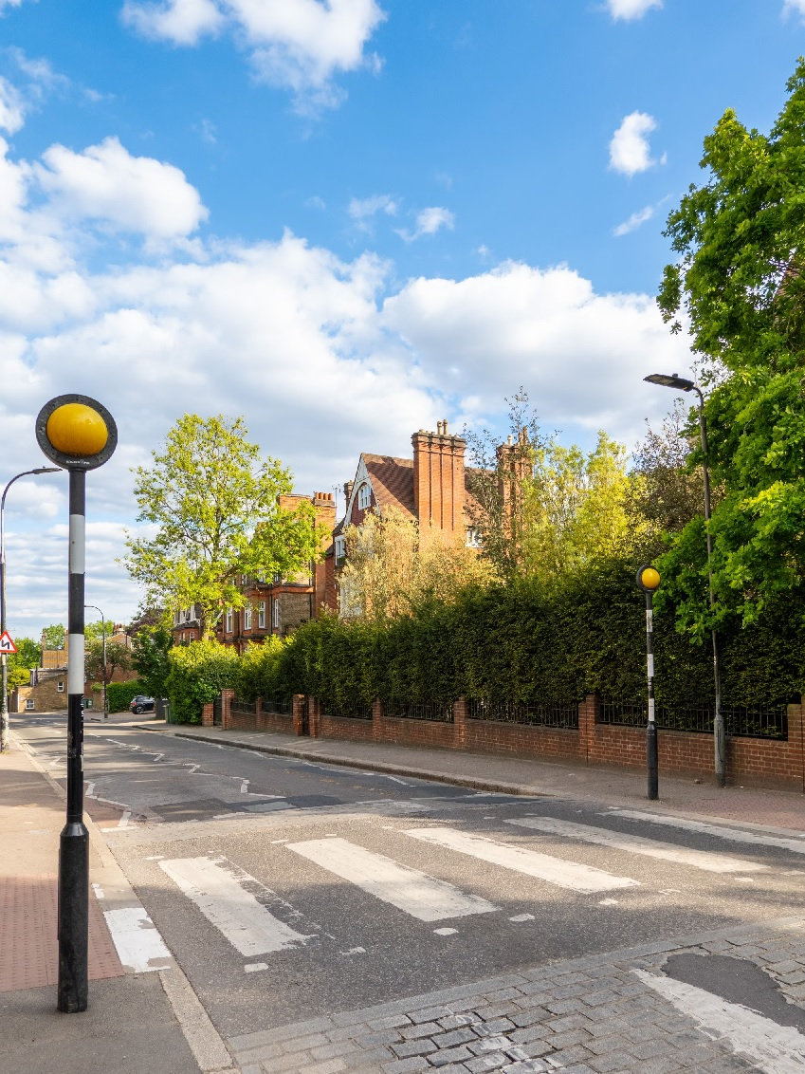
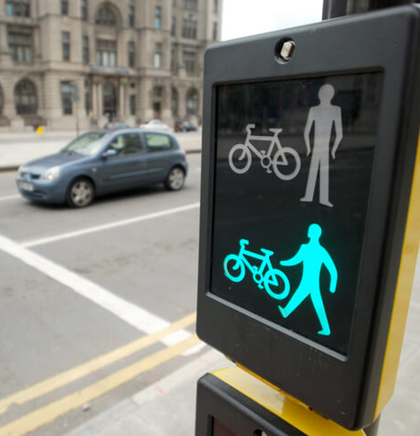
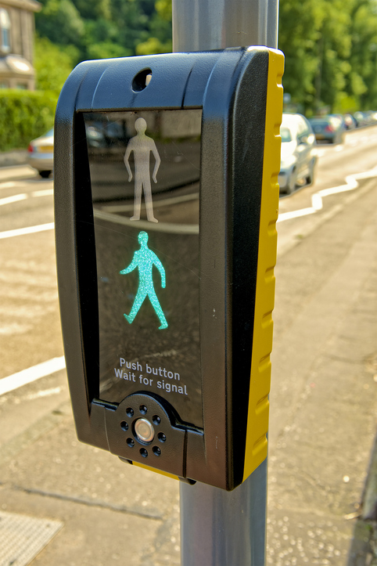
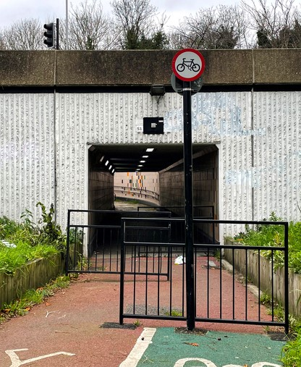
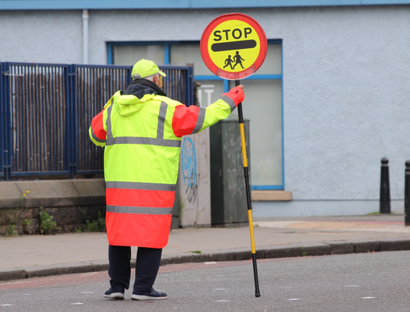
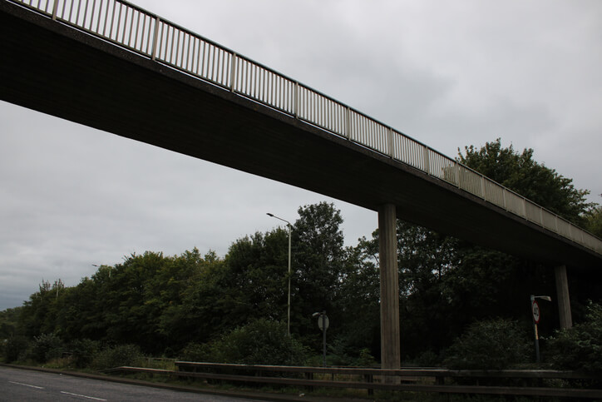
Pedestrian Crossings
Zebra Crossing
Puffin Crossing
Toucan Crossing
School Crossing Patrol
Underpass and overpass
2
1
&
3
4
5
Notes:
Anyone know the name of any of these crossings? Do you know of any local to our school? How do each work? What are the rules?
Click to reveal each answer.
1 – Zebra crossing. Black and white stripes. Yellow flashing beacons. Drivers SHOULD stop if you are waiting next to one.
2 – Pelican crossing. Used to be a lot more common. Press the button and red light will stop the traffic. Red man/Green walking man displays across the road, often accompanied by a beeping sound for a set period of time.
3 – Puffin crossing. Similar to a pelican crossing. Red man/green walking man displayed on same side. Sensors built in detecting traffic and pedestrians. This will not change the traffic light to green until the crossing is clear of pedestrians.
4 – Toucan crossing. ‘Two can’ cross. Designed for bikes and pedestrians. Usually wider and on outskirts of towns.
5 – Underpass. Tunnel built in for pedestrians to walk under wider, busier roads.
6 – School Crossing Patrol. Often referred to as lollipop man or lollipop lady. They tell you when it is safe to cross.

Slide 8

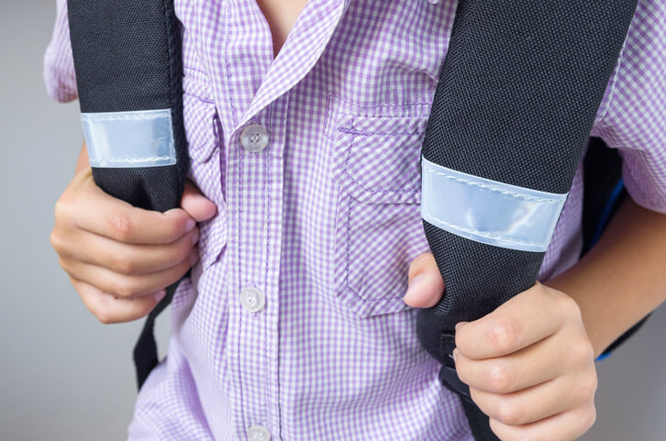
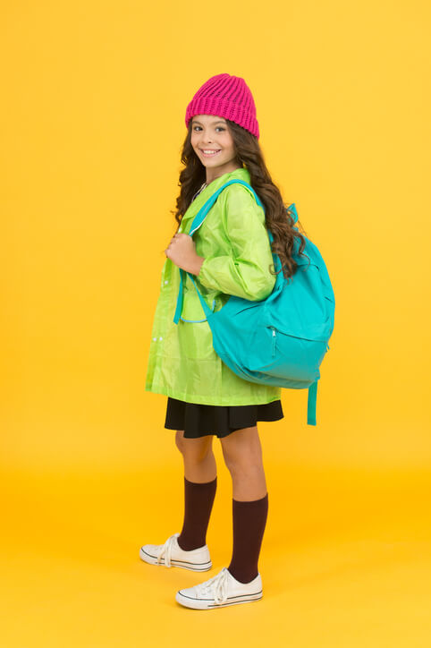
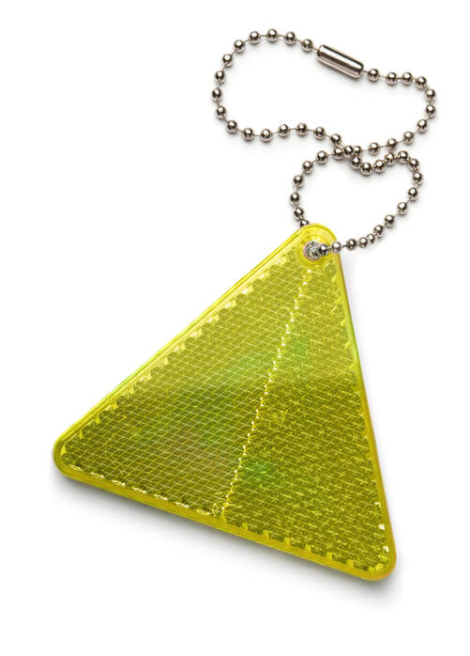
Be Bright, Be Seen
When walking to and from school sometimes it can be dark, especially when the clocks have changed in Autumn.
Consider wearing items of clothing such as a coat that is brightly coloured.
Think about getting a bag with reflective strips or putting a reflective keyring on your bag so it reflects the light off it, letting drivers know you are there.
Notes:
What do we think ‘Be Bright, Be Seen’ means?
Click to read each top tip.

Slide 9
Distractions
Road accidents are one of the main reasons that young people die.
Government figures show that 88 children aged 15 and under were hurt on UK roads every week in 2023.
26 of the 88 children were either killed or left with serious, life-changing injuries.
Most of these injuries take place between 8 am and 9 am and between 3 pm and 7 pm.
Why is
it so important?
We want you to be safe!
Notes:
Read through each statistic.
Talk about 8-9am and 3-7pm being the times that we are walking to and from school or attending clubs/going out with friends

Slide 10


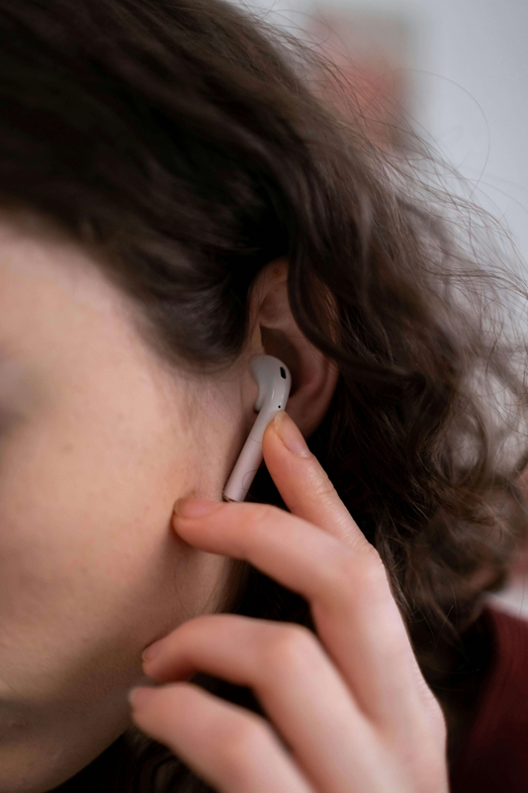
Distractions
Be observant!
Pay attention when walking to school or home.
Don’t be distracted by:
- chatting to your friends
- using your phone
- listening to music
Even dribbling a football or eating snacks could affect your concentration!
Notes:
Click to reveal each statement.

Slide 11

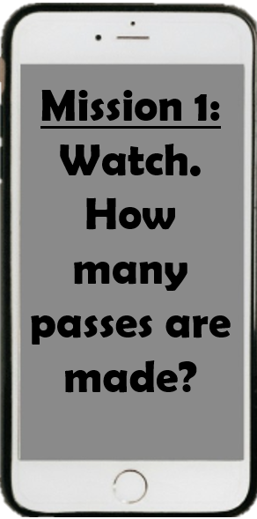
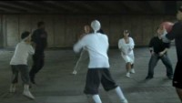
Notes:
Play video **PAUSE at 24 seconds.**
Discuss how many passes were made? Reveal 13 being the answer
Why didn’t we all see the bear? Why was the counting so difficult? What was distracting us? The black team’s passes. The constant movement. The number of people.
This is similar to how when we are distracted by something we don’t see dangers – so it is important to walk safely and sensibly – looking all around us when using the road.

Slide 12
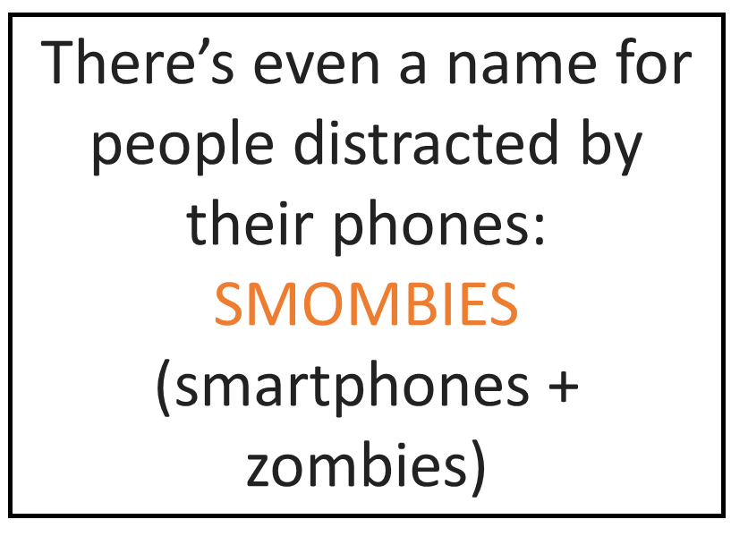
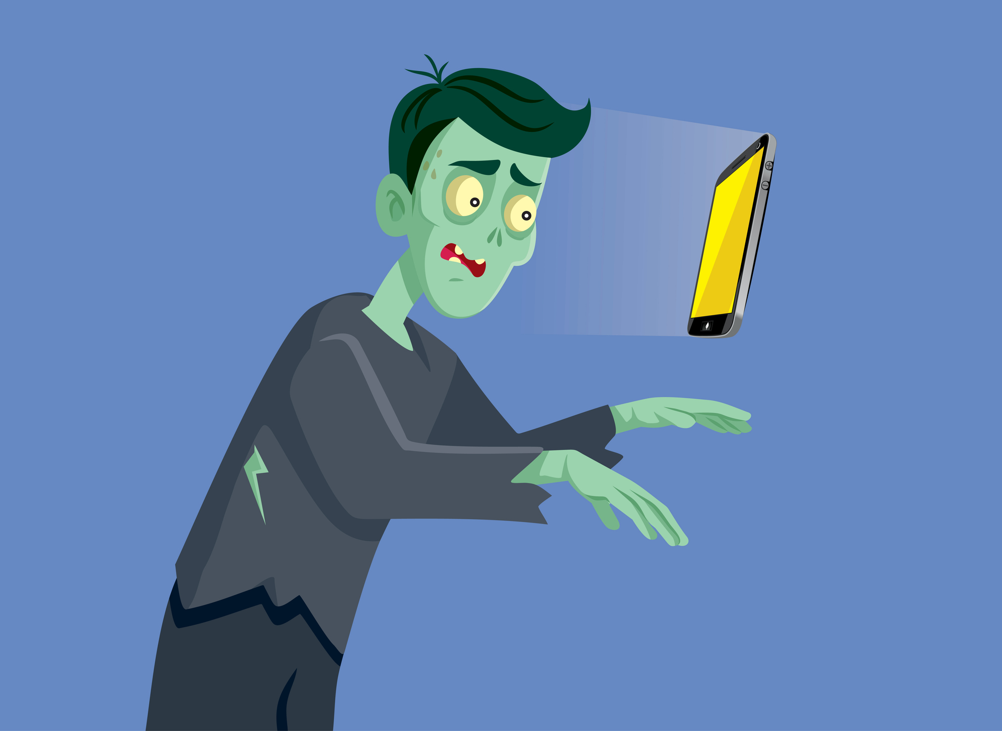
Don’t be a
SMOMBIE!
Notes:
Talk to them about putting the phone away
Or producing a plan which means they don’t need a phone, choosing a route they know, only using this route, having a set time to get home by
Thinking of a plan in an emergency

Slide 13
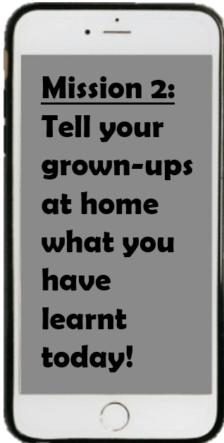

Distractions
Notes:
Really important message! Really remind the children about talking with their adults.
Re-cap each of the sections. What can we remember?

Slide 14
Thank you!

