Slide 1
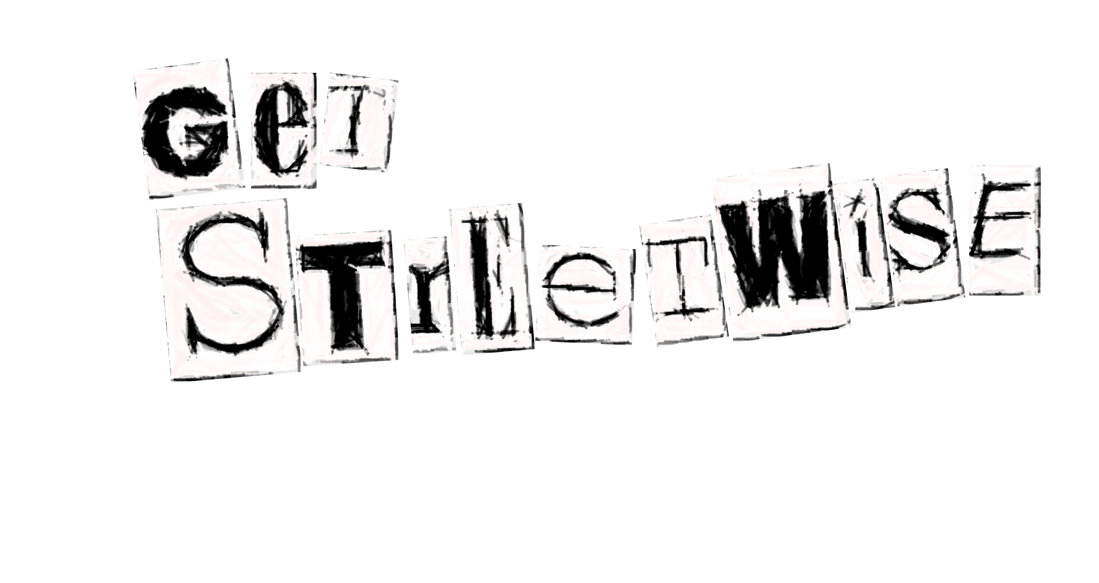
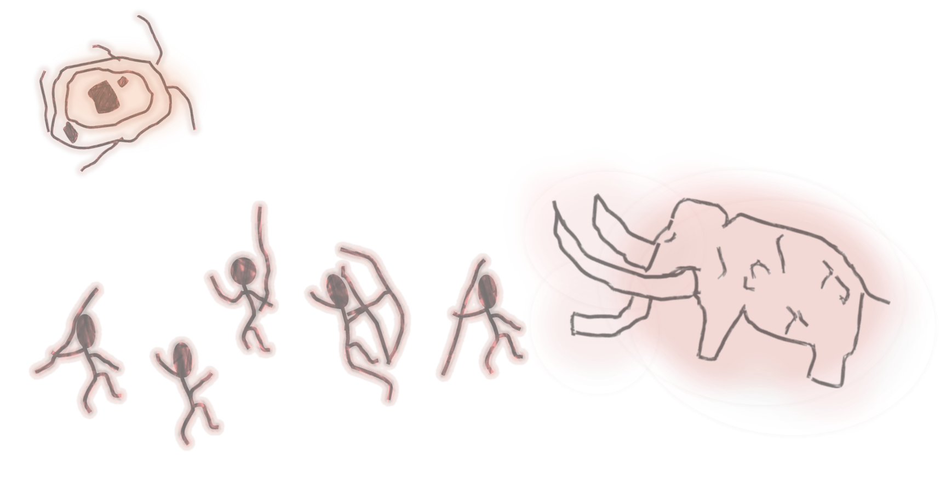
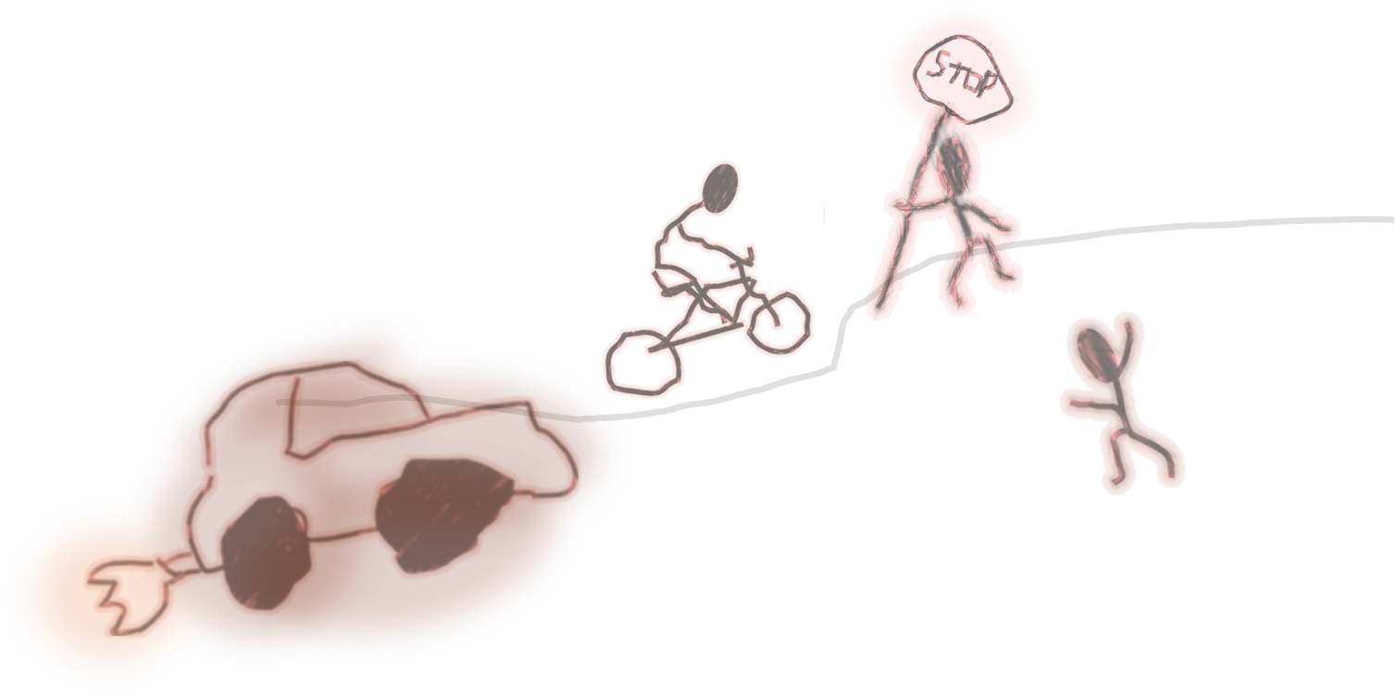


Ice Age to My Age
Evolving our Caveman Brains for Modern Roads

Slide 2
Learning Objectives
By the end of our lesson:
I will understand, and be able to recall our brains’ limitations, and the risks these pose when travelling independently. These include:
    Our reaction times
    Our weakness to distractions
    Our impulsivity
I understand, and will be able to practice strategies that help to strengthen our brains’ ability to process information, when travelling independently.
I will be able to demonstrate awareness of my surroundings when travelling independently.

Slide 3

Our Reaction Times
Understanding our reaction times is key to understanding how effectively our brains process information, whilst travelling independently.
What are the benefits of our brains being able to quickly and accurately process information?
Notes:
[Teacher’s Notes] Short, hands-up activity. Take a couple of answers. Prompt students towards answers concerning independent travel.

Slide 4
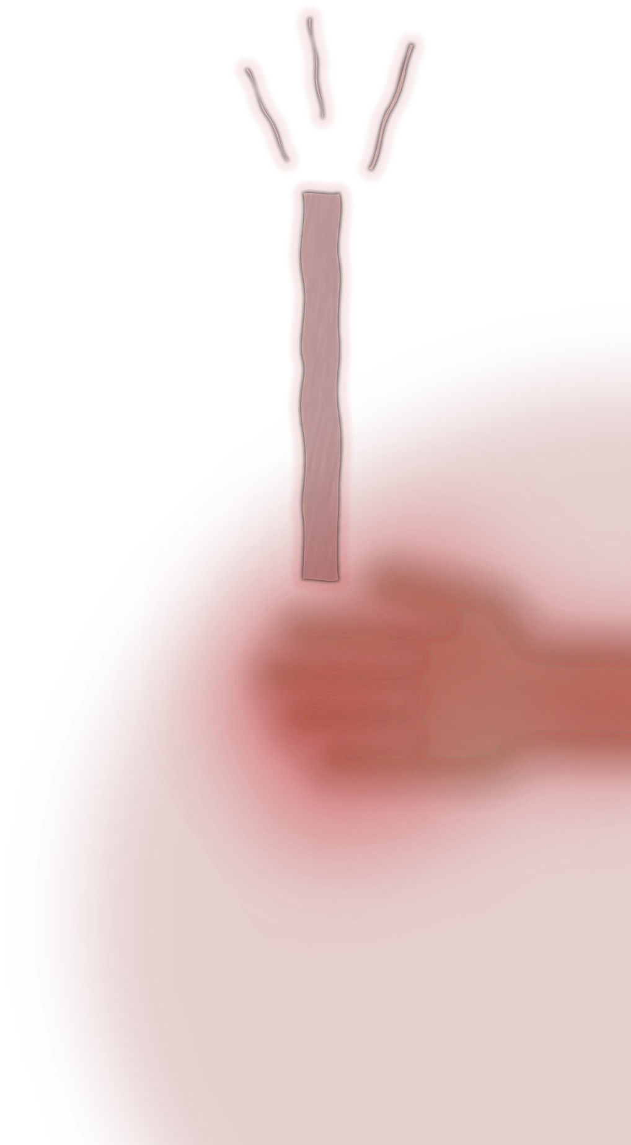
Our Reaction Times - Practical
Let’s test our reaction times.
Get into pairs.
Person A should pinch their fingers together, whilst Person B holds a ruler (with the 1cm marking pointing towards the ground) just above their thumb.
The ruler will be dropped without warning, and Person A should catch the ruler as soon as they see it drop.
Record which centimetre Person A’s thumb is covering.
Swap roles and do this until you get three scores each.
Create a mean average of your scores.
Notes:
[Teacher’s Notes] Teacher to hand out worksheets, if printed (see Teacher’s Resources pack). Mean average = Result A + Result B + Result C ÷ 3.

Slide 5
Ruler Reading (cm) | Reaction Time (s) | Ruler Reading (cm) | Reaction Time (s) | Ruler Reading (cm) | Reaction Time (s)
1 | 0.05 | 11 | 0.15 | 21 | 0.21
2 | 0.06 | 12 | 0.16 | 22 | 0.22
3 | 0.08 | 13 | 0.16 | 23 | 0.22
4 | 0.09 | 14 | 0.17 | 24 | 0.22
5 | 0.10 | 15 | 0.18 | 25 | 0.23
6 | 0.11 | 16 | 0.18 | 26 | 0.23
7 | 0.12 | 17 | 0.19 | 27 | 0.23
8 | 0.13 | 18 | 0.19 | 28 | 0.24
9 | 0.14 | 19 | 0.20 | 29 | 0.24
10 | 0.14 | 20 | 0.21 | 30 | 0.25
Notes:
[Teacher’s Notes] Take some reaction time results from the class.

Slide 6
The average human reaction time is
0.22s
Good… but not great…
Notes:
[Teacher’s Notes] Quickly note how this compares to the students’ results

Slide 7
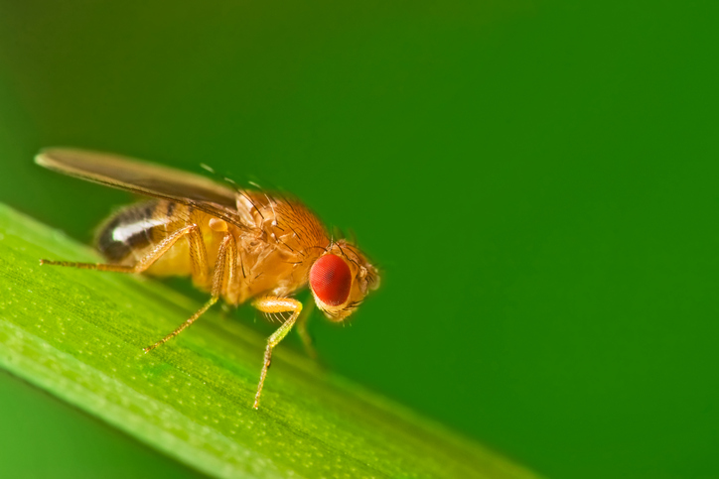
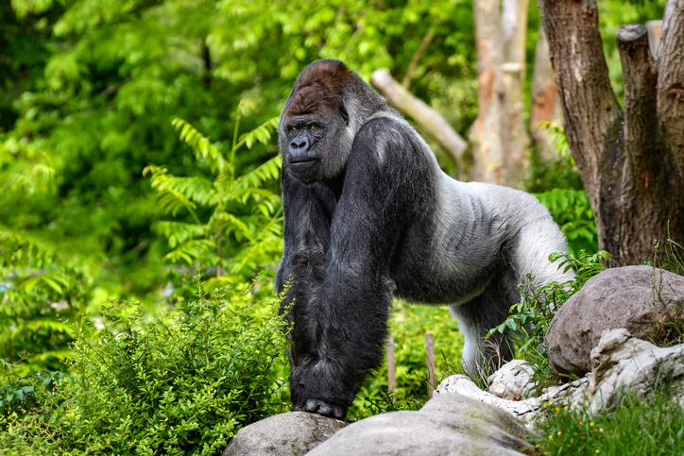
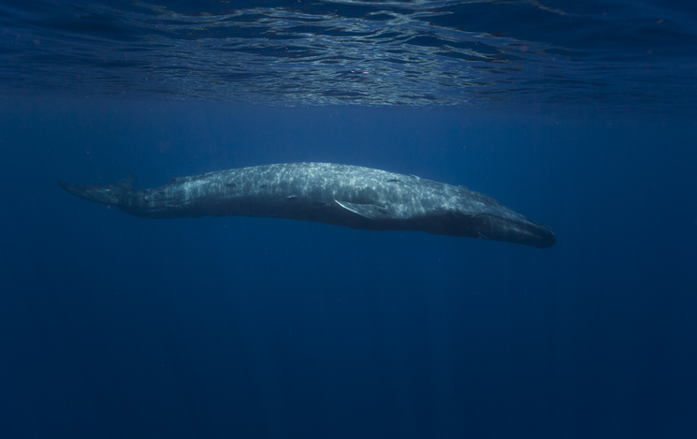
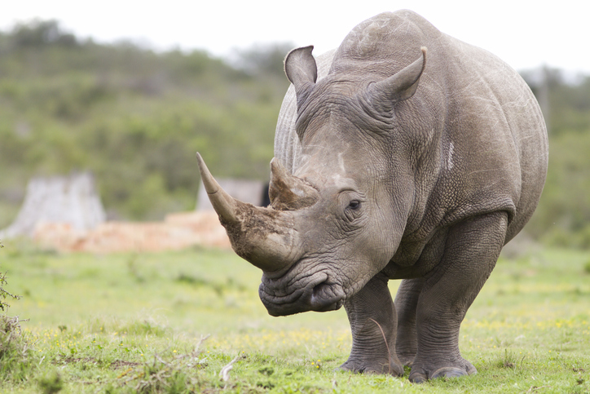
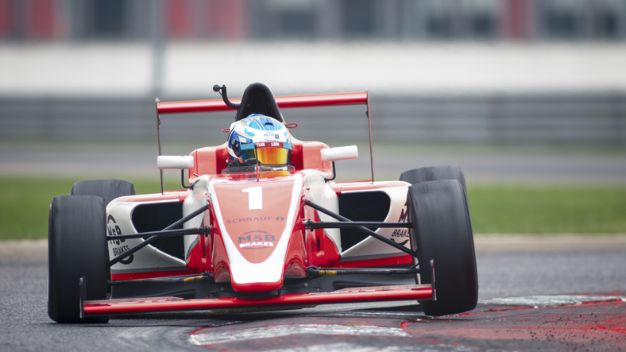
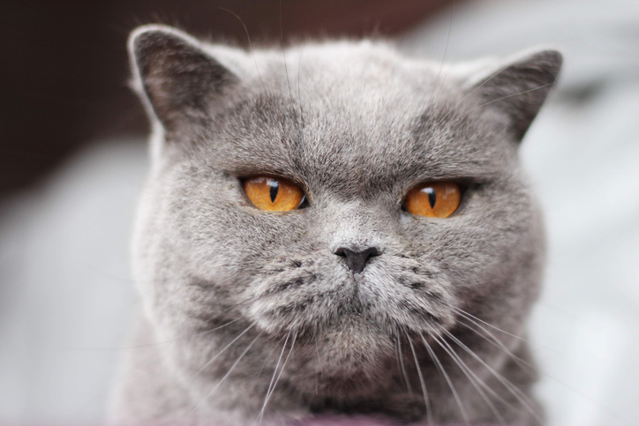
Reaction Time (s) | Animal
0.36
0.23
0.22 | Average Human
0.17
0.09
0.03
0.005
Notes:
[Teacher’s Notes] State that this table shows us that the human reaction time is relatively average, when compared to other animals. Take answers as to where students think each animal sits on the table. When ready, click to reveal which animal has which reaction time speed – starting from the top. (The picture of the race car driver represents Formula One Drivers – the reaction time is that of, F1 champion, Max Verstappen).

Slide 8
Our Reaction Times - Practical
So, what about when we’re distracted?
In your pairs, repeat the test, but this time read off the phone on the screen (on a later slide).
Person A must attempt to read the entire text and Person B may drop the ruler at any time, as before.
Repeat the test until everyone has three results, and once again, work out the average ruler score.
Notes:
[Teacher’s Notes] Get students to each write down their 3 lots of 10 items, prior to this part of the practical. Students now to fill out rest of worksheet, if printed. Not forgetting to do their hypotheses. Next slide reminds student to do this as well.

Slide 9

What do you predict will happen?
Notes:
[Teacher’s Notes] Take a couple answers from the class, the rest to write down their hypothesis.

Slide 10


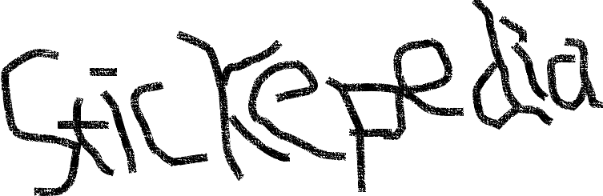

Woolly Mammoth
The woolly mammoth (Mammuthus Primigenius) roamed the cold tundra of North America, Europe, and Asia. These ancient elephants were grazing on shrubs and grasses from about 300,000 B.C.. Most woolly mammoths had disappeared by 8000 B.C. (though the last known group of woolly mammoths survived until about 1650 B.C. – that’s over a thousand years after the Pyramids of Giza were constructed!)
Woolly mammoths were 13 feet tall, with tusks up to 15 feet long. Living in tundra, they were well adapted to cold environments. As their name suggests, they were covered in two layers of fur – the shaggy out layer could be 20 inches long.

Slide 11
Ruler Reading (cm) | Reaction Time (s) | Ruler Reading (cm) | Reaction Time (s) | Ruler Reading (cm) | Reaction Time (s)
1 | 0.05 | 11 | 0.15 | 21 | 0.21
2 | 0.06 | 12 | 0.16 | 22 | 0.22
3 | 0.08 | 13 | 0.16 | 23 | 0.22
4 | 0.09 | 14 | 0.17 | 24 | 0.22
5 | 0.10 | 15 | 0.18 | 25 | 0.23
6 | 0.11 | 16 | 0.18 | 26 | 0.23
7 | 0.12 | 17 | 0.19 | 27 | 0.23
8 | 0.13 | 18 | 0.19 | 28 | 0.24
9 | 0.14 | 19 | 0.20 | 29 | 0.24
10 | 0.14 | 20 | 0.21 | 30 | 0.25
Notes:
[Teacher’s Notes] Students to work out their second reaction time. Quick hands-up activity, to show who’s reaction time increased.

Slide 12
Distractions
So why do distractions affect our reaction times?
Our brains have limited processing resources, meaning that we can’t simultaneously accurately process all of the information being fed to us.
This means that our attention can only be held on one complex task at a time.
Therefore, when trying to focus on two, or more, complex tasks, at least one of the tasks is guaranteed to be completed to a lesser quality – humans struggle to multitask!

Slide 13
When using the roads, the hazards present mean that we should focus all our attention on travelling.
Getting to and from school safely should be our only focus.

Slide 14
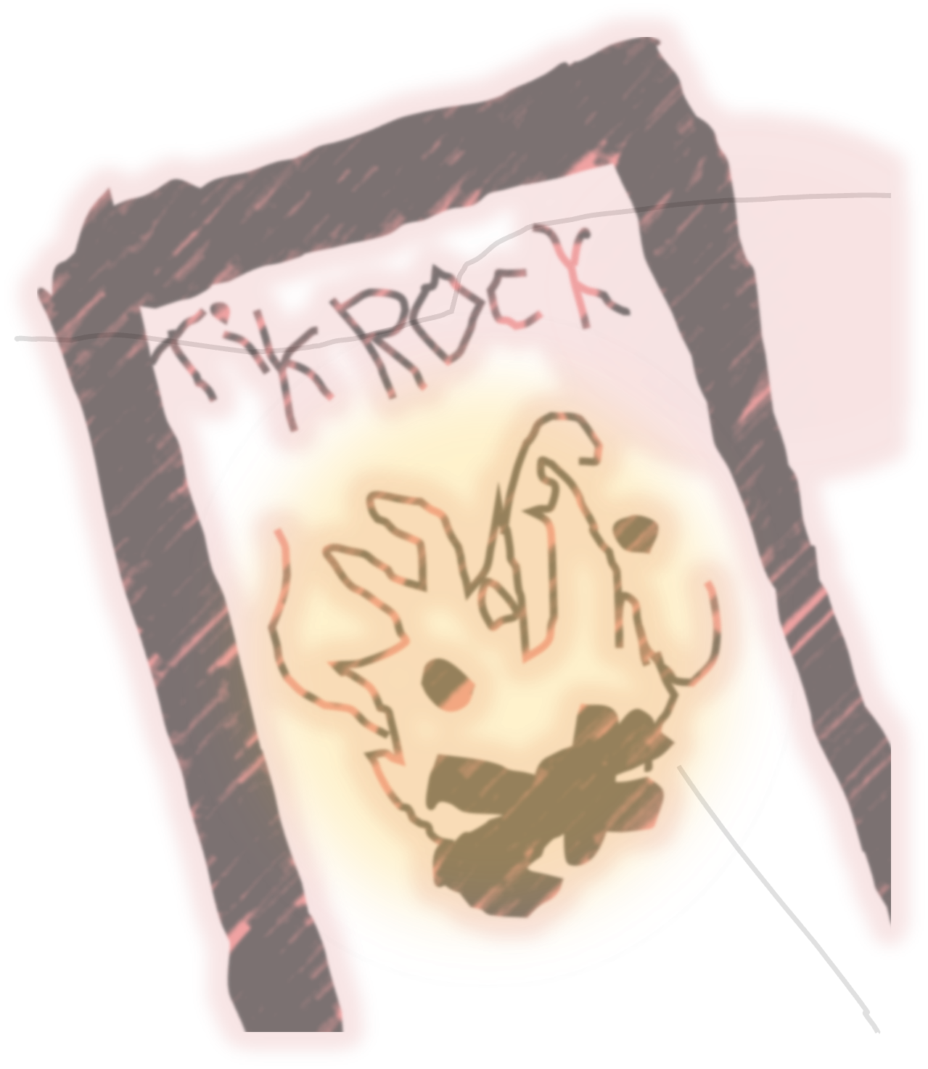
Can you name some common distractions that would take our focus away from the road?
Notes:
[Teacher’s Notes] Five-minute group discussion, followed by taking examples from the class.

Slide 15
Impulsivity
Another thing that can negatively affect our brain’s processing power is impulsivity.
Impulsivity is the tendency to act without thinking. We all deal with impulsive tendencies – it’s why Simon Says can catch a few of us out.
Our brains, whilst being fantastic, are out of date – our inclination to be impulsive is a relic from our ancestors in the Stone Age.
Impulsive thinking comes from the part of our brain called the Amygdala. It’s our Caveman Brain.

Slide 16
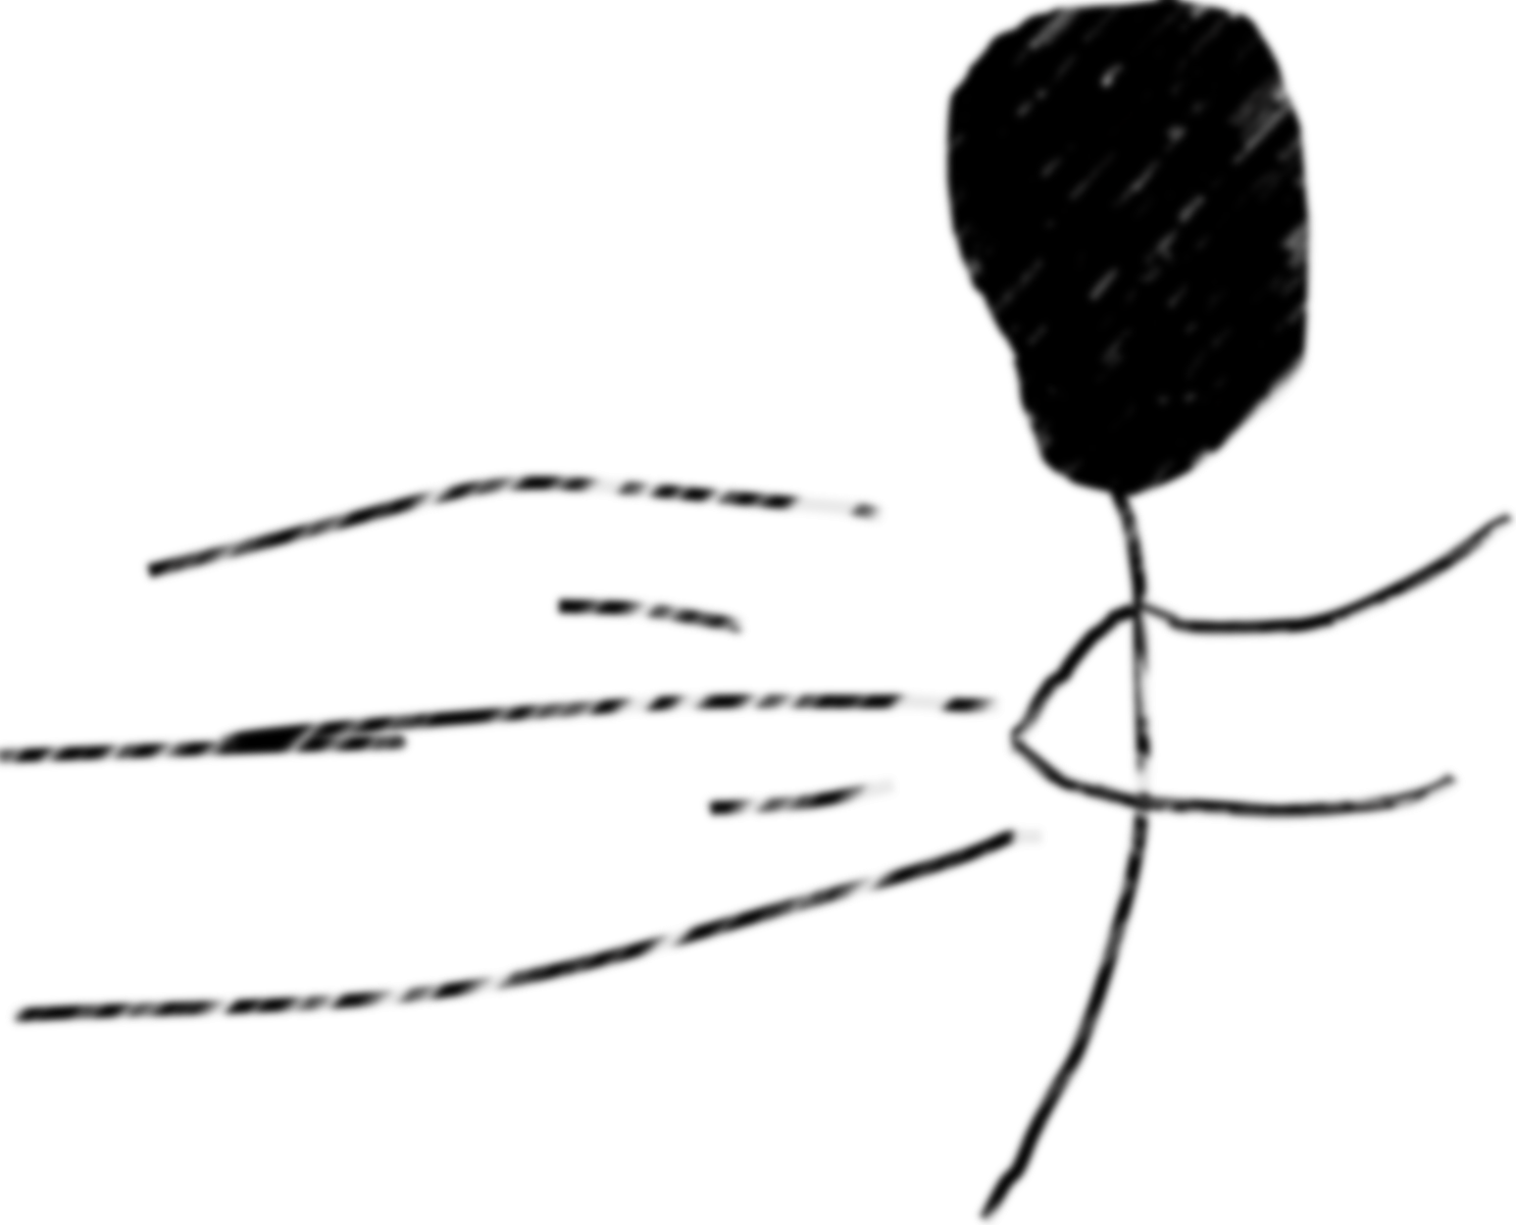
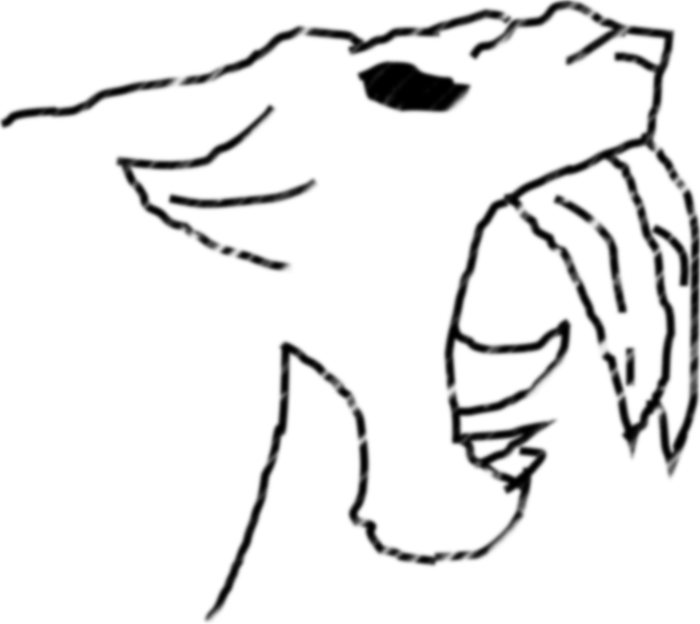
Our Caveman Brain’s lack of impulse control was probably useful when it came to survival in the wild.
We would act immediately on our hunger…
and run away from sabre tooth tigers earlier.

Slide 17
Today, however, our Caveman Brain can lead us to make poor, impulsive decisions.
Can you think of any impulsive decisions, that could endanger us when on the road? Have you made any impulsive mistakes on the road?
Notes:
[Teacher’s Notes] Five-minute group discussion, followed by taking examples from the class. Try to adopt an understanding tone – it’s about students admitting how they may have made mistakes in the past – rather than telling them off for it.

Slide 18
It’s okay to have a slower reaction time, or get distracted easily, or even make impulsive decisions – our brains aren’t perfect.
There are ways, however, to train a brain to act smarter when we’re travelling independently.

Slide 19
Mindfulness
Mindfulness is allowing your brain to be aware of your surroundings – this improves its information processing abilities.
By practicing mindfulness on a daily basis, we can train our brain to help keep us safe.

Slide 20
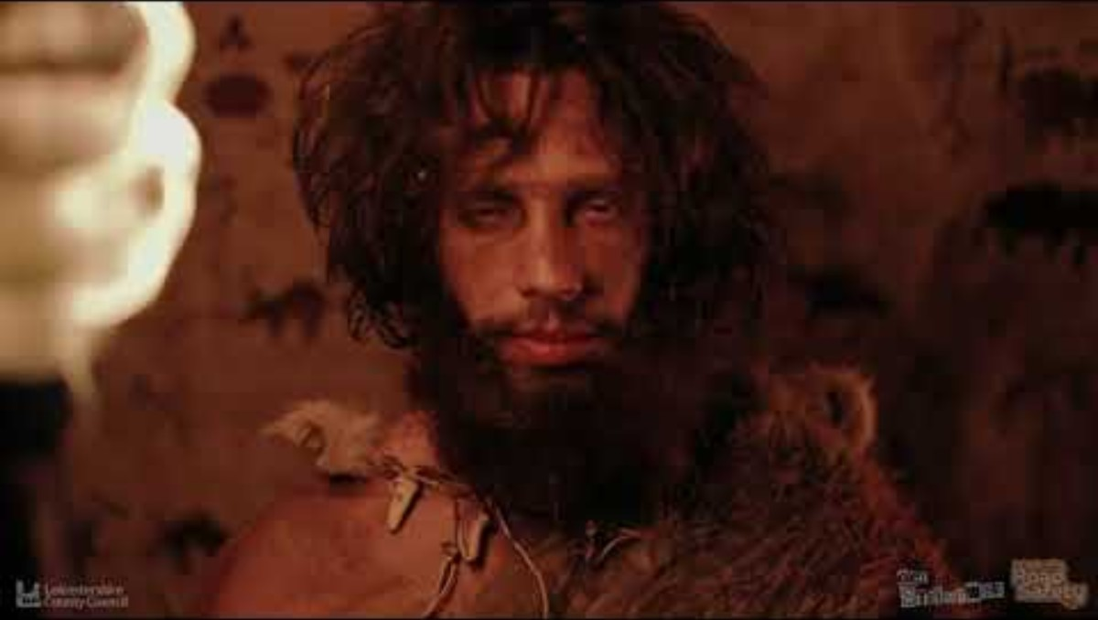
Notes:
[Teacher’s Notes] Video accessible here: https://youtu.be/q9BOi4apMTQ

Slide 21
Summary
Today we’ve talked about some of the weaknesses within our, otherwise brilliant, brains.
We discussed our reaction times, our weakness to distractions, and our prehistoric inclination towards impulsivity – and how all three of these can endanger us when travelling independently.
However, we looked at how practicing mindfulness can improve our decision-making process, when travelling independently.
When will you put aside your five minutes? When would be best placed to keep you safe when travelling independently?
Notes:
[Teacher’s Notes] Mindfulness: Teachers can either set up 5 minutes, during each form time, for this, or could take answers from students, as to when they will put aside time for mindfulness.

Slide 22

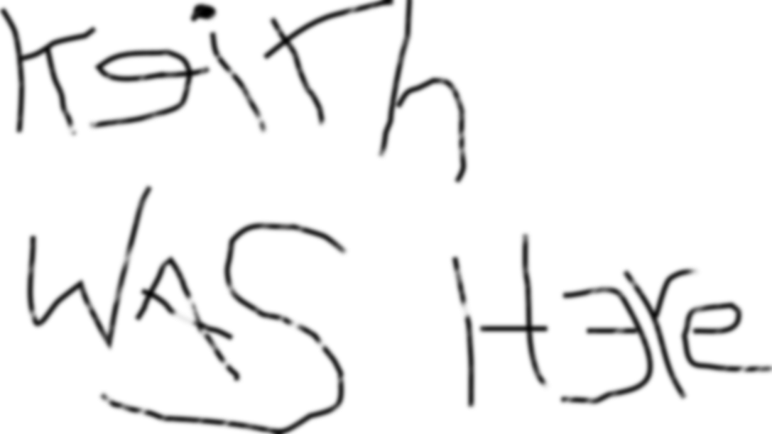
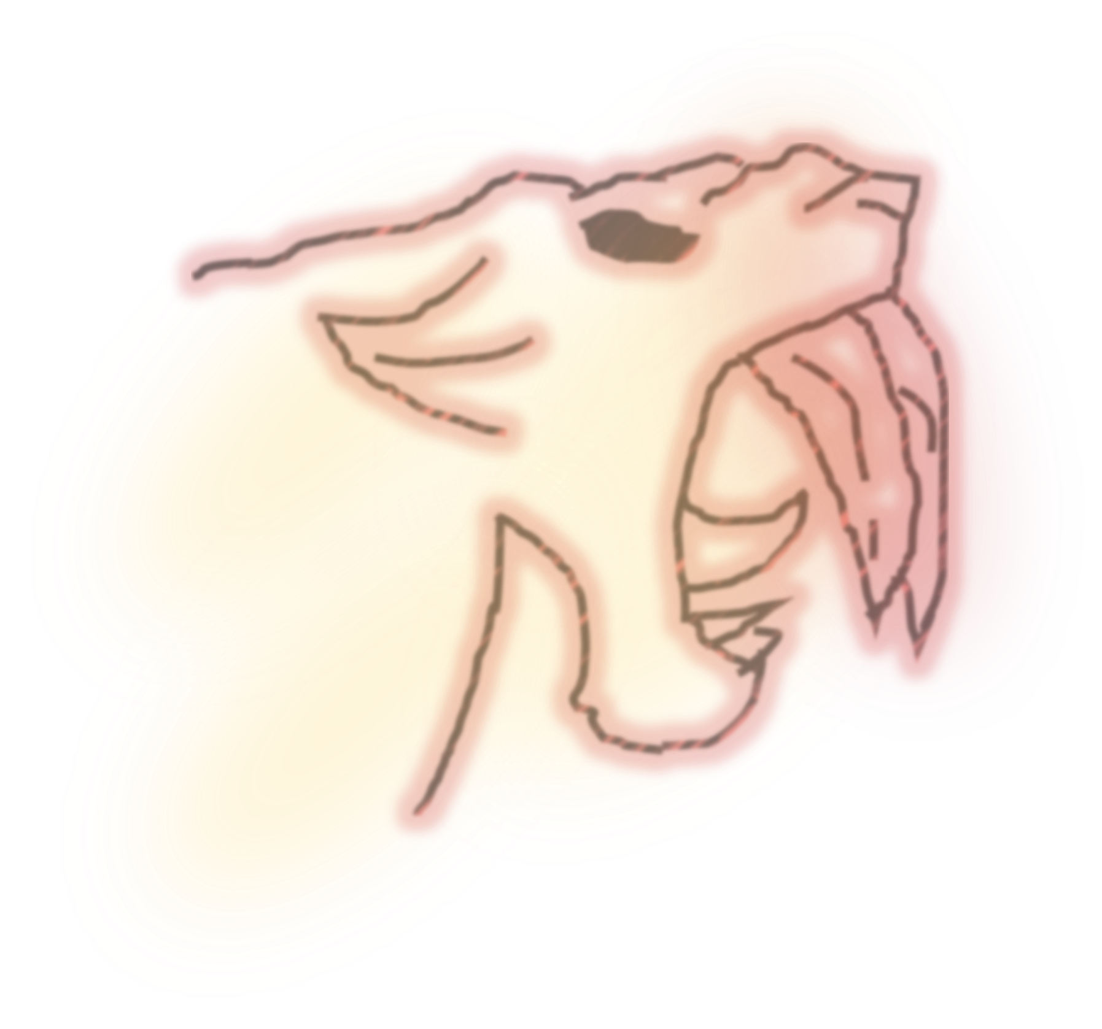
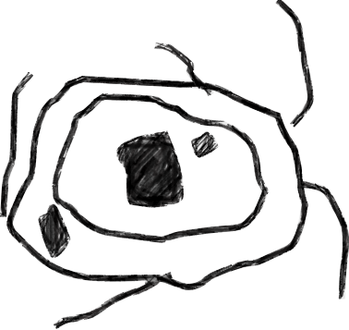
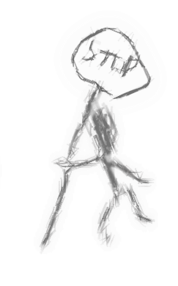
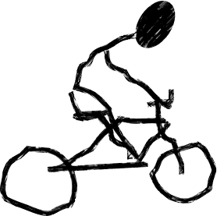
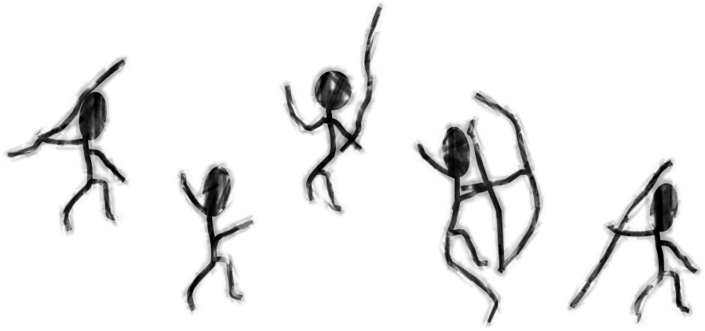
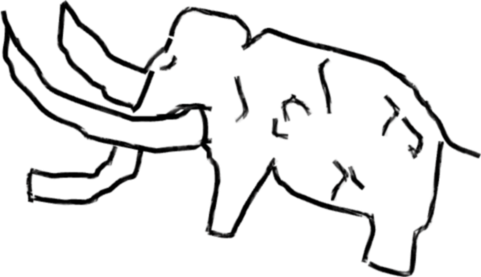
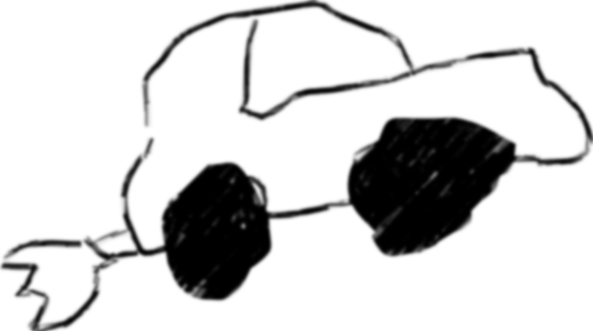
Let’s train those brains!

Slide 23
Credits
‘Reaction Time Conversion Sheet’, TES. 23rd January 2020. https://www.tes.com/teaching-resource/reaction-time-conversion-sheet-12219615. [Accessed 17th September 2025].
‘Reaction Time’, BioNumbers. https://bionumbers.hms.harvard.edu/bionumber.aspx?s=n&v=2&id=110799. [Accessed 17th September 2025].
WatchData, ‘Comparison: Animal Reaction Speed’, YouTube. 4th January 2021. https://www.youtube.com/watch?v=i4Hey5mShEA. [Accessed 17th September 2025].
Oracle Red Bull Racing, ‘Almost as fast as a cat’, Instagram. 21st November 2023. https://www.instagram.com/reel/Cz6tPBgMNuu/. [Accessed 17th September 2025].
Bloomberg Originals, ‘Why Your Brain Can’t Fight Distraction’, YouTube. 3rd June 2020. https://www.youtube.com/watch?v=i4Hey5mShEA. [Accessed 17th September 2025].
‘Reaction Time Conversion Sheet’, TES. 23rd January 2020. https://www.tes.com/teaching-resource/reaction-time-conversion-sheet-12219615. [Accessed 17th September 2025].
BBC The Social, ‘Asten's ADHD Survival Guide- Impulse Control’, YouTube. 21st February 2016. https://www.youtube.com/watch?v=SnZCuhRcBo4. [Accessed 17th September 2025].
MindSciences, ‘How Your "Caveman" Brain Creates Your Bad Habits’, YouTube. 16th April 2018. https://www.youtube.com/watch?v=SnZCuhRcBo4. [Accessed 17th September 2025].
Bupa Health, ‘Does mindfulness change how your brain and body works?’, YouTube. 7th October 2016. https://www.youtube.com/watch?v=PVC-ugf6ypk&t=1s. [Accessed 17th September 2025].
Sentis, ‘Neuroplasticity’, YouTube. 7th November 2012. https://www.youtube.com/watch?v=ELpfYCZa87g. [Accessed 17th September 2025].
Smiling Mind, ‘How to practice mindfulness’, YouTube. 8th November 2018. https://www.youtube.com/watch?v=Ck7zKz3b7t0&t=1s. [Accessed 17th September 2025].

