Slide 1









Training Your Caveman Brain
Road Safety 101
The Chicken who Crossed the Road
The Lord of The Crossings
The Emperor’s New High-Visibility Clothes
Theo
Fox
Keith C. Mann
ANDERson
C. Belvoir

Slide 2




Once upon a time…
By the end of the lesson:
I understand the importance of the choices we make when travelling independently.
I can recall, write about, and take the safest actions when travelling independently.
on a road not so far away…

Slide 3
When using the road, as with many things in life, we are making a string of choices – whether we are aware of this or not.
The inherent dangers present, when we travel independently, mean that we should always try to be mindful of these choices.

Slide 4

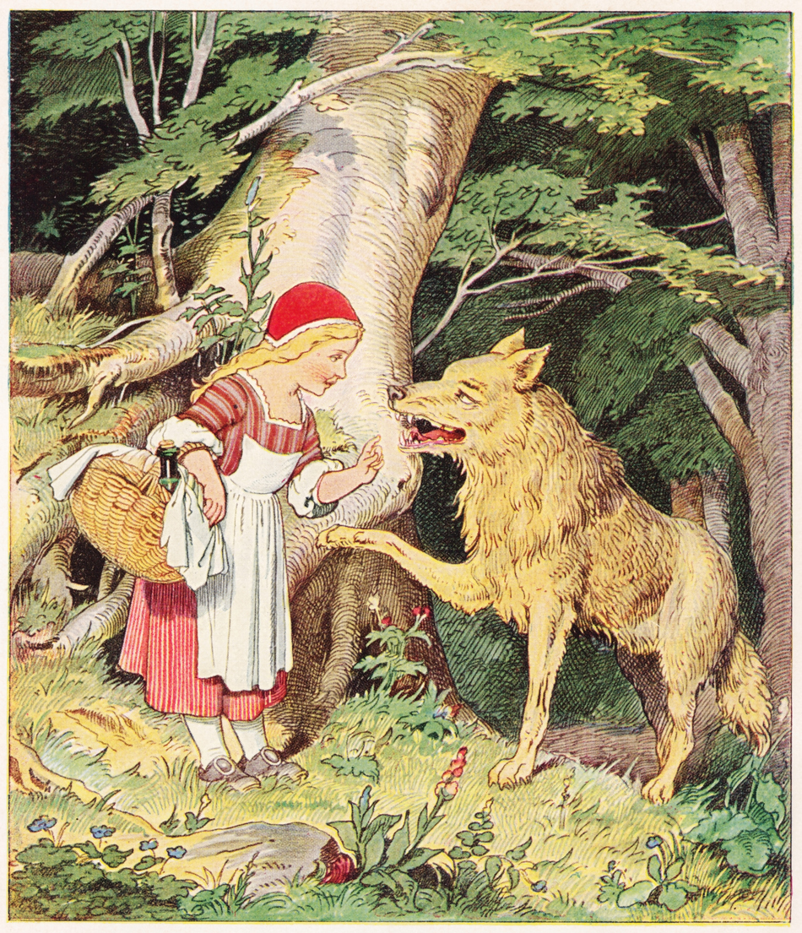
What choices do we make everyday, when travelling independently?
~
Do these have a positive or negative outcome?
bad choice example #1: chatting with the local wolf, whilst travelling independently
Notes:
[Teacher’s Notes] 5-minute group discussion, followed by hands up. Examples to be found on next slide.

Slide 5


Cycling with a helmet
Crossing between parked cars
Leaving the house with enough time to get to school
Waking up late and rushing to school
Putting your phone in your bag
Texting whilst walking
Carrying your football under your arm
Walking with immature, risk-taking friends
Walking with sensible friends
Putting both of your headphones in
Wearing your uncool, bright yellow jacket in the dark
Storming out of the door after an argument
Using pedestrian crossings
Cycling without a helmet, because you look cooler

Slide 6

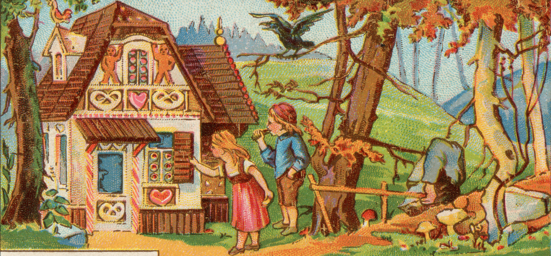
You can now:
Write a short Choose Your Own Adventure Story.
This will be based around the choices you make, getting to, or from school.
Your teachers will choose the two best stories to send to the Road Safety Team at Leicestershire County Council.
A panel will then judge the stories, from across Leicestershire, and select the top three.
The authors of these stories will then win a prize.
bad choice example #2: getting distracted by the house made entirely out of confectionary
Notes:
[Teacher’s Notes] At this point, teacher to outline whether students will be doing the shorter or longer format of the lesson. If doing the shorter format, teacher to let students know that they can complete and submit their story, in their own time. More details can be found on Teacher’s Notes sheet in lesson pack.

Slide 7
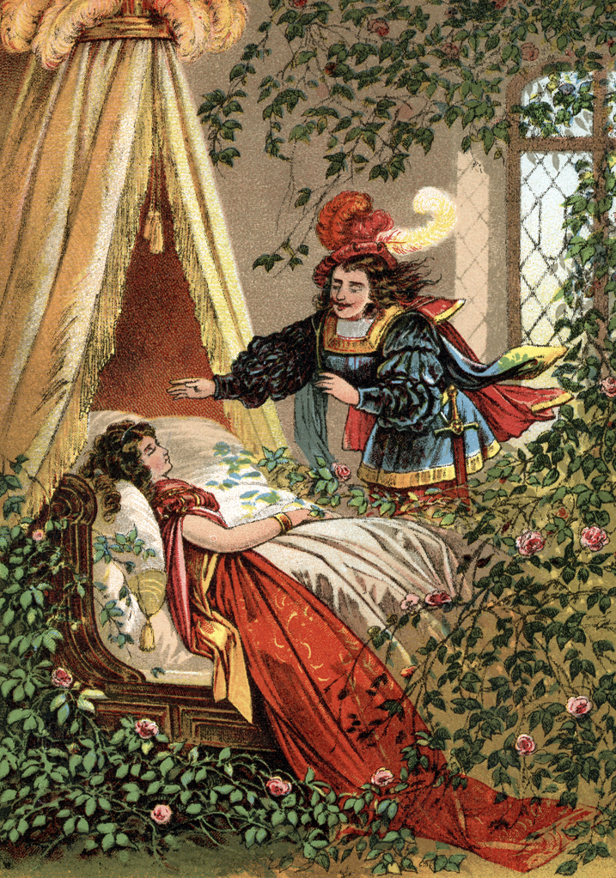
Your story could be about:
~ A person getting to school on a bike, who can choose whether to wear a helmet, and whether they should wear their earphones.
~ A person who may, or may not, wake up late for their bus – they then have to decide how to get to school.
~ Any of the choices we have already discussed.
bad choice example #3: sleeping through your alarm – nobody likes to rush in the morning!

Slide 8
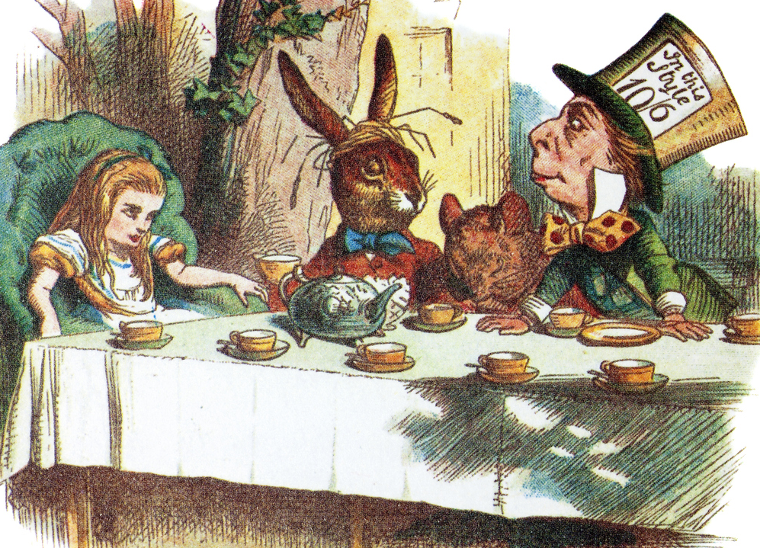

1
Story Plan Example
Argument at home – calm down or storm out the house?
How to write a choose your own adventure story:
You should first decide what your story is going to be about.
You should then map and number all the choices and consequences that you can take in your story. There is a plan template to help you do this, and an example on the next slide.
You should then write out your numbered sections, into your printed booklet template. You only need a few sentences or a paragraph per each section.
Feel free to decorate the front with a nice front cover page!
Once you’ve finished your story, cut your book template along the dotted lines, and discard the instructions at the top of each page.
Collate the story together.
Positive Choice 1: Calm down
Negative Choice 1: Storm out
Positive Choice 2B: Apologise
2A
2B
Excited to sleep round your friends’ tonight. They start texting you. Do you text them back?
Not thinking straight, you walk out of door and straight into road, a car has to brake harshly for you and starts beeping at you – apologise to the driver or start shouting back at him?
Negative Choice 2A: Text
Positive Choice 2A: Don’t text
Negative Choice 2B: Shout back
3A
3B
3C
Walking along texting, you are unable to see where you are stepping. You step out into the cycle lane, right in front of a cyclist who is unable to stop.
You get to the main road outside of school. You’ve got minutes before school starts, and you can’t be late again. Do you walk 30 seconds down the road to the crossing, or try and cross here?
Car speeds off, you are angry the whole way towards school. You approach a busy road and step out in front of the school bus, This time they can’t stop.
Positive Choice 3B: Crossing
Negative Choice 3B: Cross here
4A
4B
You cross at the crossing, and the cars stop for you. You cross the road, and just make it to class in time.
You wait for ages trying to cross the road, waiting for it to be safe. You eventually get to school, but are a few minutes late.
bad choice example #4: playing out with your slightly less sensible friends
Notes:
[Teacher’s Notes] Click once to bring up example plan. This has been attached in the resources pack, if the teacher chooses to print out the example and distribute amongst the class.

Slide 9
How to write a choose your own adventure story:
You should first decide what your story is going to be about.
You should then map and number all the choices and consequences that you can take in your story. There is a plan template to help you do this, and an example on the next slide.
You should then write out your numbered sections, into your printed booklet template. You only need a few sentences or a paragraph per each section.
Feel free to decorate the front with a nice front cover page!
Once you’ve finished your story, cut your book template along the dotted lines, and discard the instructions at the top of each page.
Collate the story together.
bad choice example #4: playing out with your slightly less sensible friends
Notes:
[Teacher’s Notes] Teacher to hand out plan template. If choosing longer format lesson, teacher to hand out booklet template once students have finished their plan.

Slide 10



The
Let’s get started…
Choose Your Own Adventure
Challenge

