Slide 1
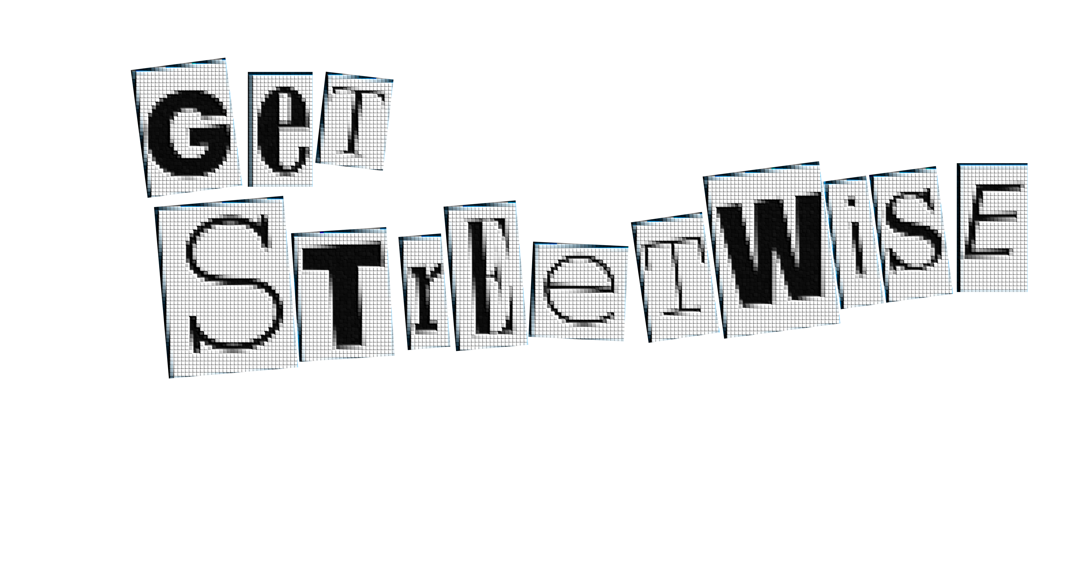


Protecting the Future You
Travelling safely, and looking after our ambitions and loved ones.

Slide 2
Learning Objectives
By the end of the lesson:
I will be able to describe the risks of the road, and how they can affect others around me and myself.
I can explain and chart the significance of making the correct decisions, when travelling independently.
I can evaluate the impact of allowing distractions, peer pressure, and poor headspace into my journeys.

Slide 3
Actions have Consequences
Every decision you make has a consequence.
This is no different when it comes to travelling independently.
Choosing not to put your helmet on, before heading to school on your bike, may not seem like a big decision. However, in a second, that could become one of the most consequential decisions of your life.
You are now approaching young adulthood, where the decisions that you take have more and more importance.

Slide 4
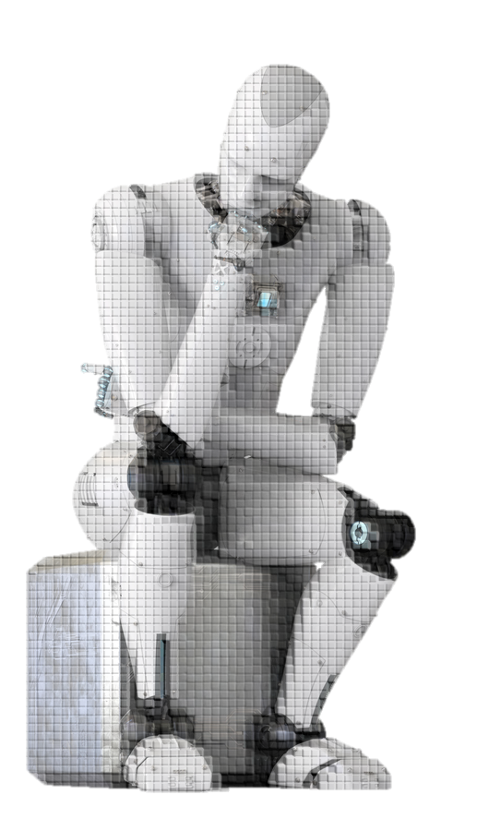
When travelling independently, we need to make the right choices.

Slide 5
It’s not just about you in the present.
Making better, safer, choices protects the Future You, and the futures of those who care about you.

Slide 6
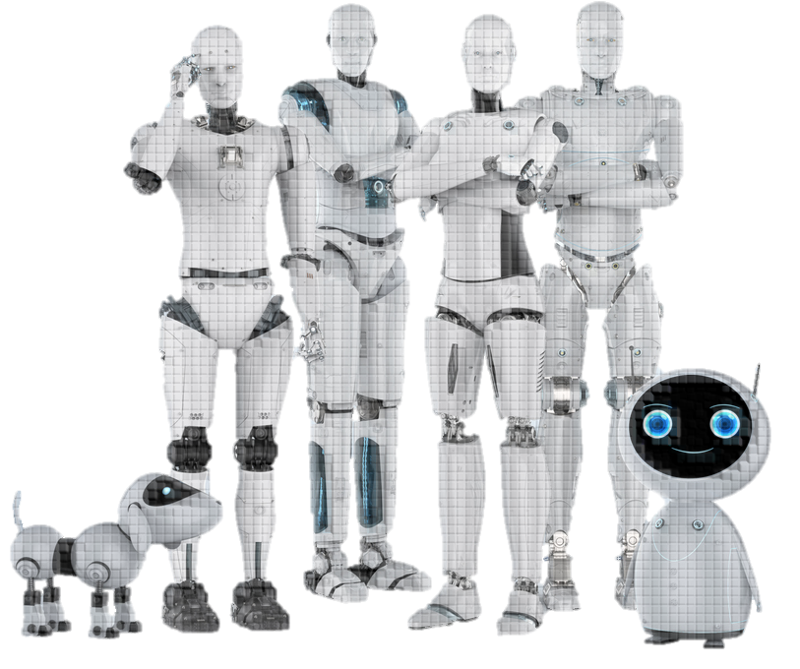
Who cares about you?
How would they be affected if something happened to you?
Notes:
[Teacher’s Notes] 5-minute group discussion, followed by hands-up. Prompts: parents, siblings, friends.

Slide 7
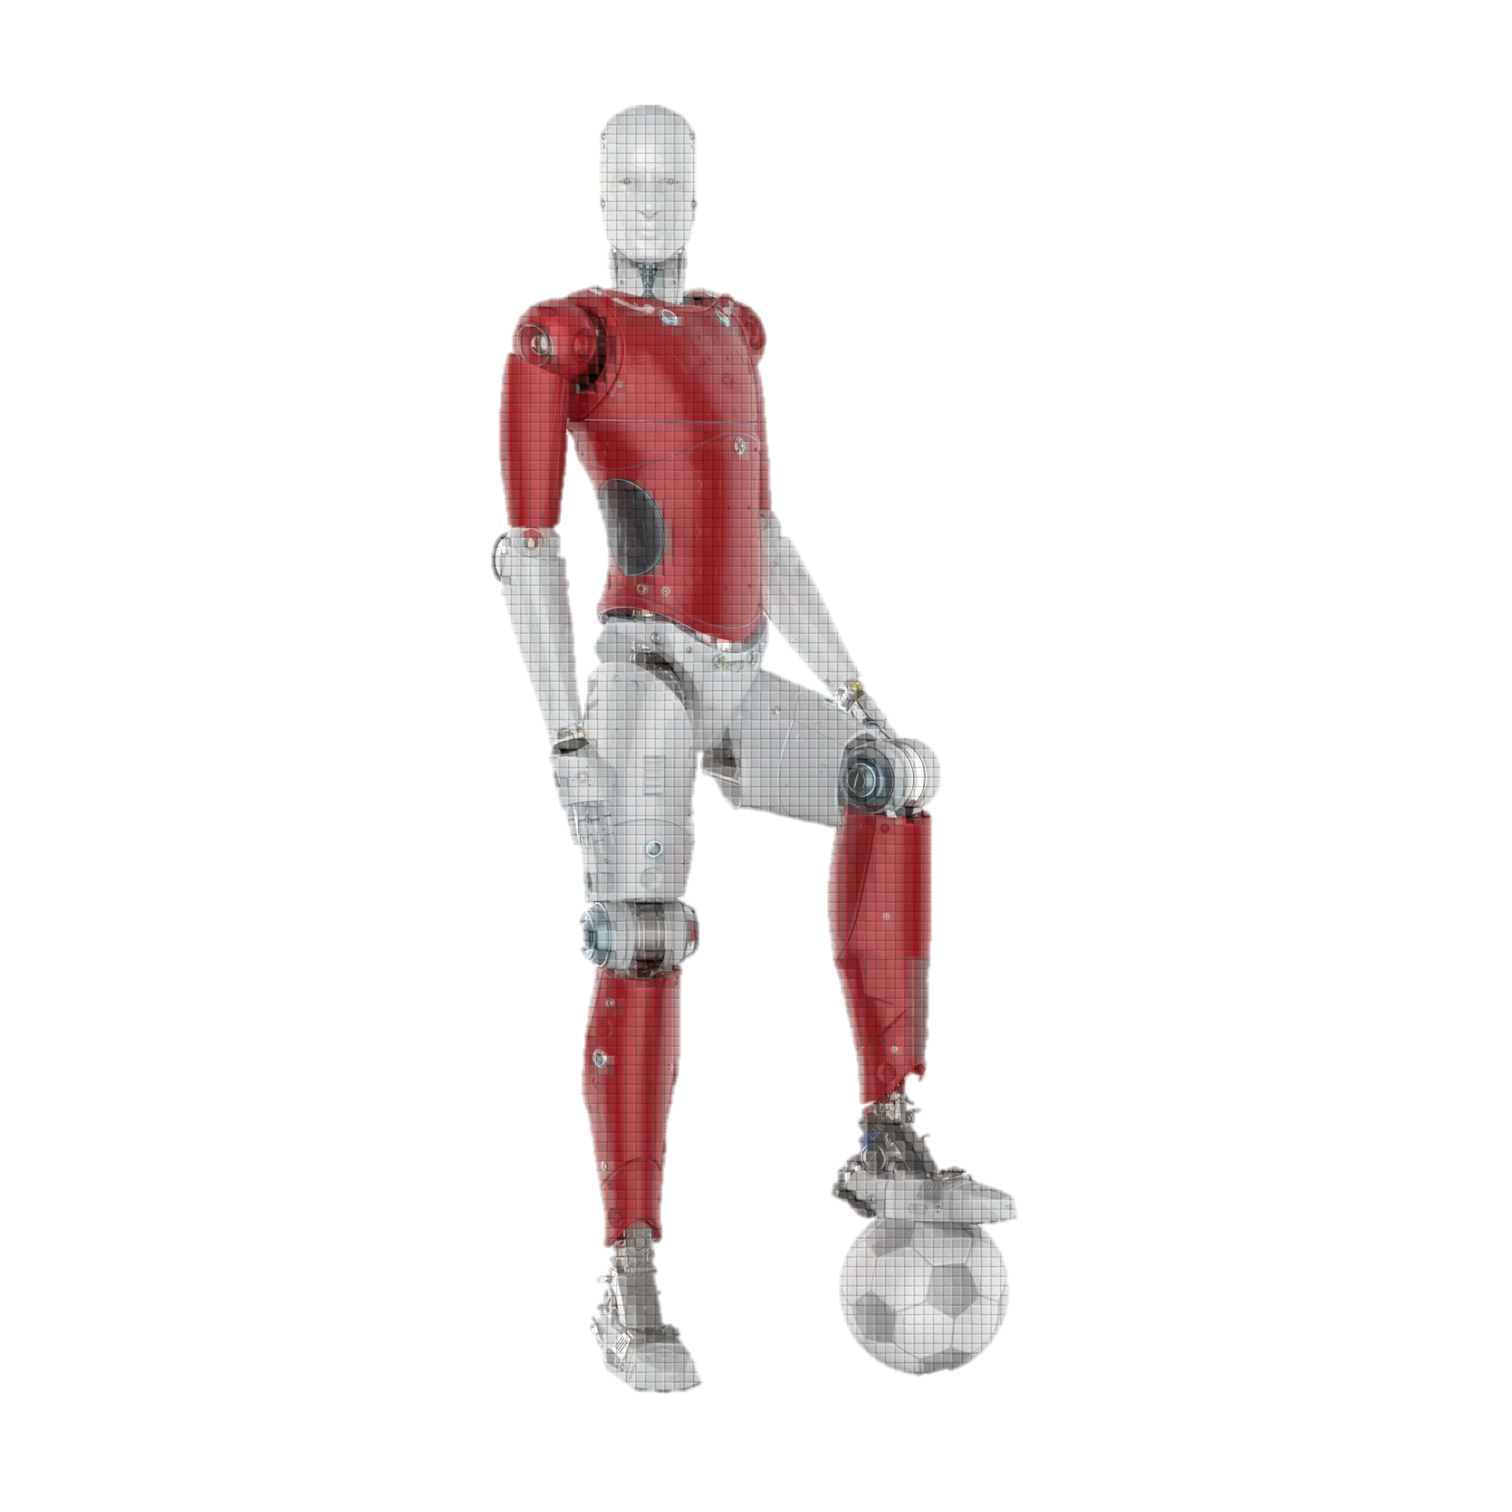
What about Future You?
How could an injury affect your aspirations?
Notes:
[Teacher’s Notes] Give students two minutes to jot down ideas. Pick students to give individual answers. Ask them what they’re choosing for GCSE subjects, what they’d like to do in the future, and how a car collision could affect their future.

Slide 8
Introducing…
Project t22
A.K.A.
The Time Window

Slide 9
The Time Window allows us to view potential futures, following any event taking place in the present.

Slide 10
Let’s use the time window to view the aftermath of three events…

Slide 11
EVENT ONE
EVENT TWO
EVENT THREE
Georgia is having a terrible morning. She hasn’t taken her dog, Buster, out on a walk all week. Her dad had already been on at her about this for the past couple of nights – but she’d just been too busy! To make matters worse, Dad asked her to unload the dishwasher last night, but she was too wrapped up in her Design project and couldn’t – it’s due in this week and the best work gets exhibited in London! Georgia woke up this morning; trying to sneak out the house, Dad catches her and they get into another roaring argument.
Alice is looking forward to playing a football match tonight. She plays for a Premier League club’s academy, and has been offered a contract starting next year. Her best friend, Millie, who is a talented goalkeeper in the same academy, has been texting her all morning, whilst they both got ready for school. Alice has just left for school, but her phone keeps vibrating in her bag.
Ollie has recently moved to Leicestershire, with his mum. Having been at this new school for a couple of weeks, he finds a group that he wants to hang out with. Ollie has even found a girl in the group that he quite likes, Scarlet. Ollie has arranged to walk to school with the group. Around five minutes away from school, they start playing “Chicken”. Ollie knows his mum would be angry if he plays, but he really wants to prove himself. They’re cheering him on to run in front of the next car. Scarlet is watching quietly, behind him.
Alice takes her phone out – Millie is talking about how the opposition striker has a weaker left foot. Interesting, Alice knows how to exploit that – she texts Millie back whilst stepping out into the road. The next thing she knows she is on her back – she went over the bonnet of a car which couldn’t brake fast enough. Her legs feel like they are on fire. She knows they are broken.
Georgia storms out the door – giving Dad a final piece of her mind, as she leaves. Georgia can’t think straight -she crosses roads carelessly, rushing to get to school on time. Stepping into the traffic she realises there is a car coming right at her. Her Caveman Brain kicks in – RUN! She runs to the other side, into the cycle lane, where she collides with a cyclist. The cyclist shoots over his handlebars, headfirst into the pavement. His helmet cracks in two and he looks concussed.
Ollie gives in to the peer pressure and dashes out in front of the car. The car brakes sharply, beeps at him, and the driver starts swearing at him. Ollie’s new friends swear back at the driver, who speeds off. Scarlet, on the other side, now knows that she has to impress the guys, especially Ollie (who she quite likes). In all the excitement, she jumps out, in front of a lorry. The lorry driver can’t stop in time.
Notes:
[Teacher’s Notes] 15-minute activity. Teacher to divide class into three and hand out A3 Time Window worksheets. Worksheet takes three characters from each scenario. Tables/groups to plot the future of each character on the worksheet (worksheet/Time Window divided into several time periods). At the end of activity, groups to present for a few minutes each, on their Time Windows.

Slide 12
time window closed

Slide 13
We have just seen the potential impact of three small decisions:
Using your phone whilst walking
Bowing to peer pressure
Travelling stressed
But small mistakes can be easily avoided.

Slide 14
Imagine the scenarios that would have instead played out, if:
Alice just kept her phone in her bag for 20 minutes, whilst she walked to school.
Ollie had taken a second to realise that it wasn’t worth the risk, just to play a silly game.
Georgia had taken five minutes to calm down, before leaving home.

Slide 15
By making tiny positive readjustments in our behaviour, when travelling independently, we can help to protect the futures of ourselves and others
But how can these small changes impact the bigger picture…

Slide 16
Every week, 26 children aged under 15 are killed or seriously injured.
That’s around 50 grieving or distressed parents a week, 100 grieving or distressed grandparents.
Approximately 50 siblings, 100 aunts and uncles.
26 friend groups, around 130 pupils, whose lives have been shaken up.
26 police officers who have to knock on the door.
100 paramedics and members of the fire service, each week, who are the first to arrive on the scene.
260 teachers.

Slide 17
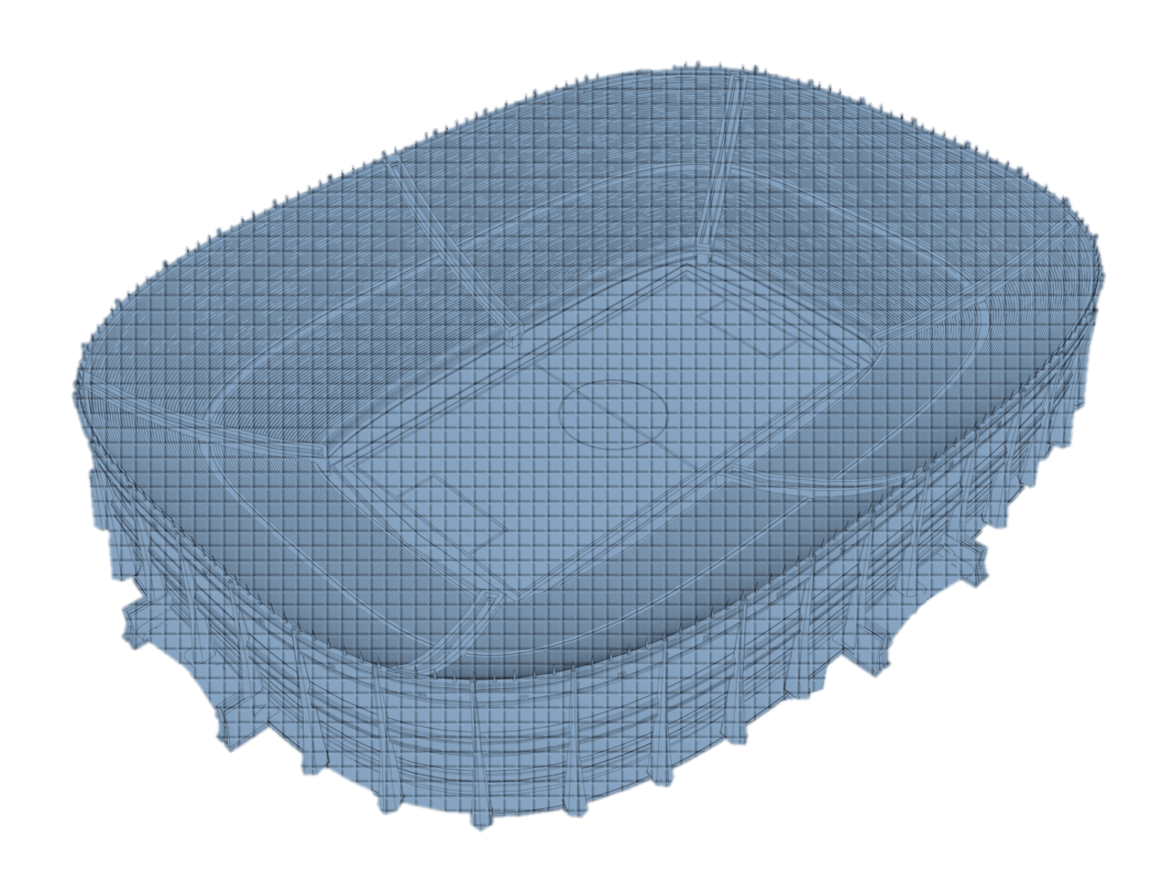
A stadium full of people, per year, in grief or distress, as the result of a collision.
That’s 850 people per week.
44,200 people per year.

Slide 18
But, you don’t have to sit in this stadium!
By making the tiniest positive choices, when travelling independently, you can help protect Future You, and your friends and family.

Slide 19
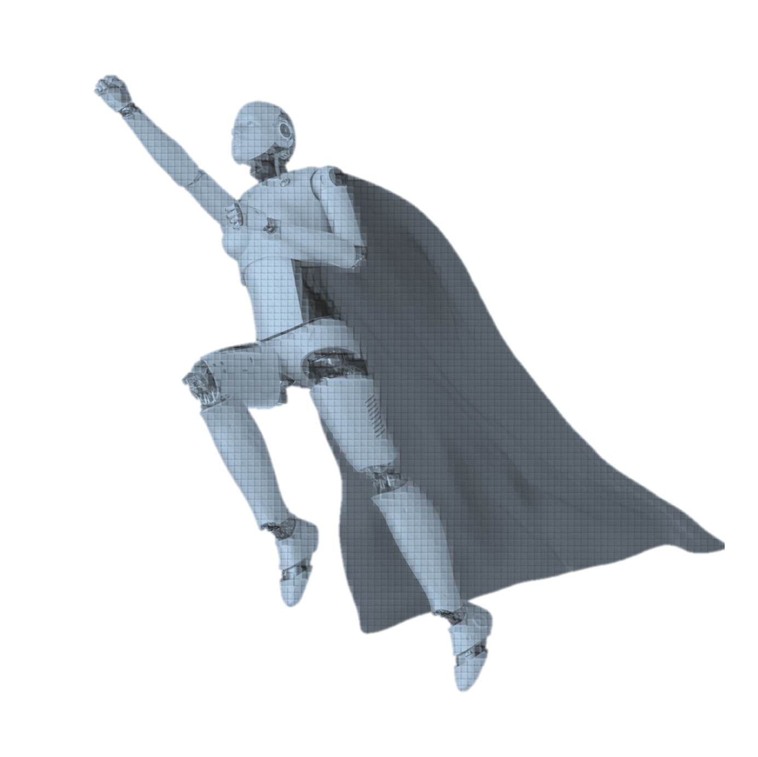
Time to be a hero…
What will you do to protect Future You?
Notes:
[Teacher’s Notes] Teacher to take examples from a few students, on how they will protect their Future Yous. Prompts: strategies, better choices, distraction avoidance.

Slide 20
You don’t have to be a time traveller to save the futures of you and your loved ones.
Let’s make those positive choices!

Slide 21
Credits
‘Reported road casualties Great Britain, annual report: 2023’, GOV.UK. 26th September 2024. https://subjectguides.york.ac.uk/referencing-style-guides/chicago. [Accessed 17th September].

