Slide 1

Road Safety Education Reception
Learning outcome:
To be able to use the Road Safety Hand to cross the road safely.

Slide 2
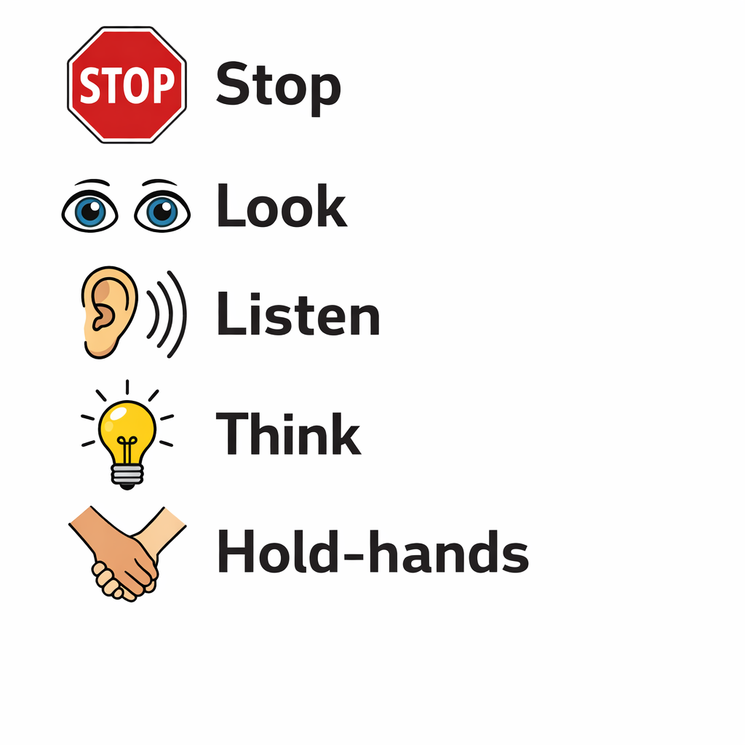
Who are we and why are we here! We are Road Safety Education Officers and we here to teach you how to stay safe when using the road! by the end of the lesson, we hope we can complete our Road Safety Checklist!
Checklist;

Slide 3
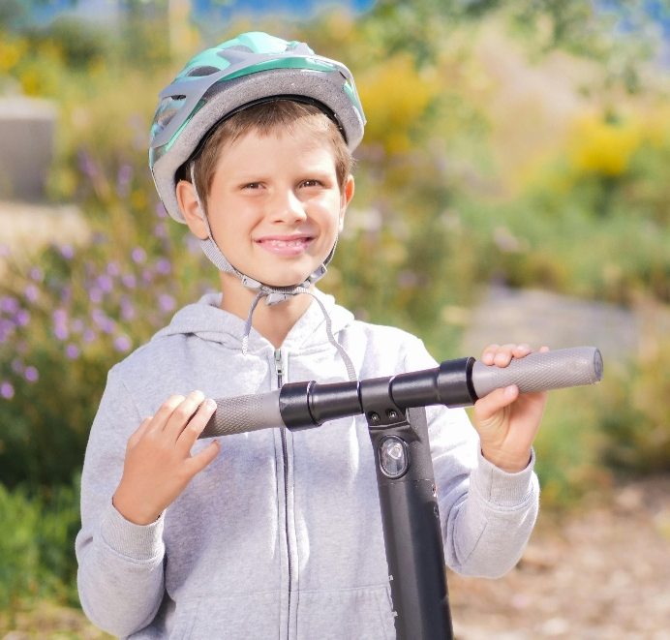
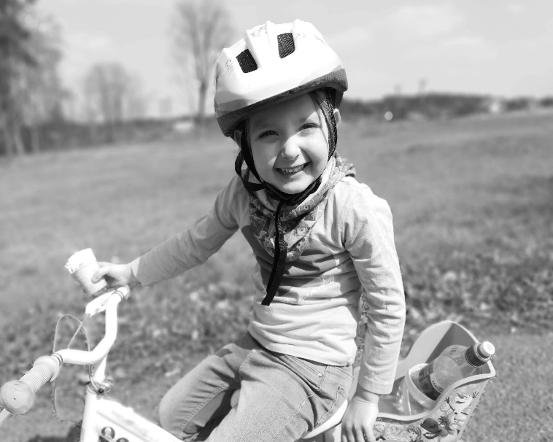
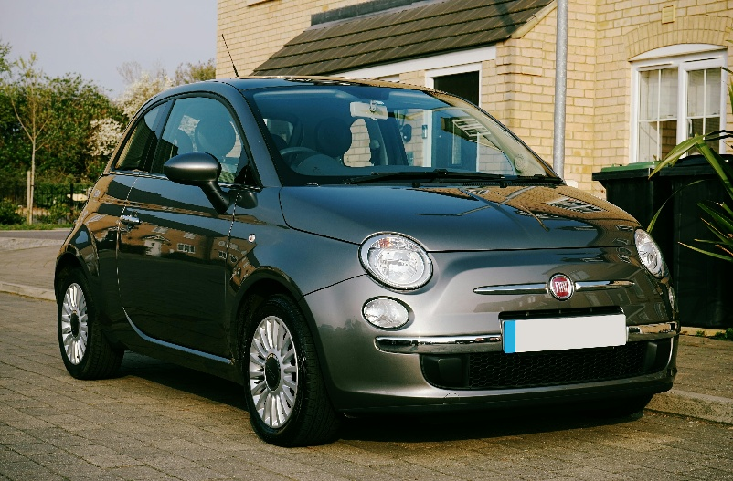
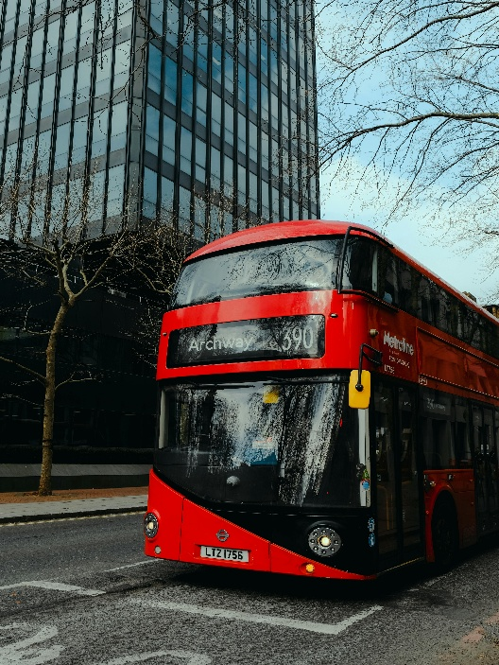
How do you travel to school?
B3LT UP

Slide 4

The road safety hand!

Slide 5

5 volunteers to try on the props!

Slide 6
What can help us cross the road?

Slide 7
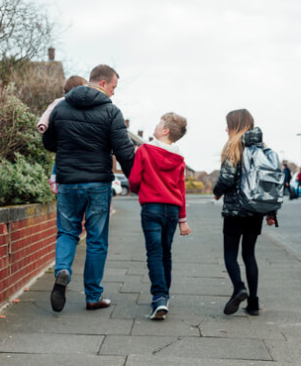
Our grown ups!
We need to hold-hands with our grown-ups, but we still must still: STOP, LOOK, LISTEN, THINK!

Slide 8
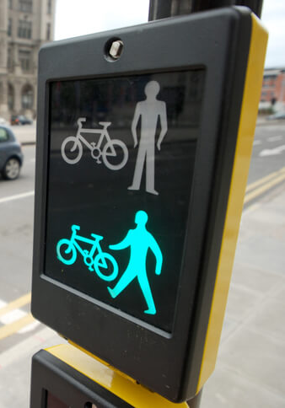

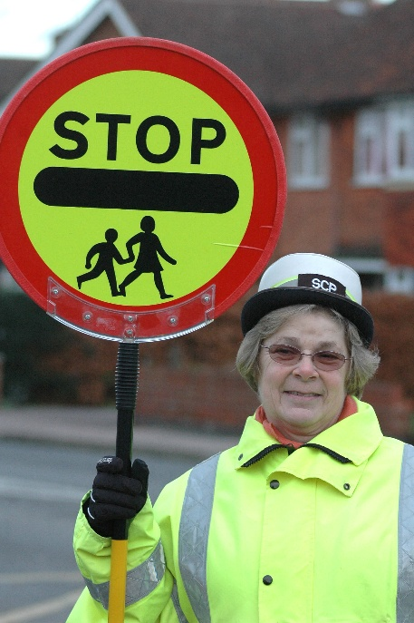
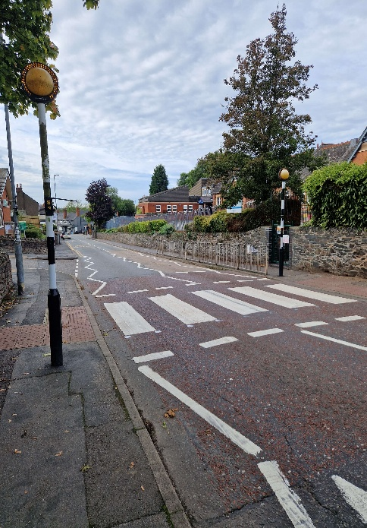
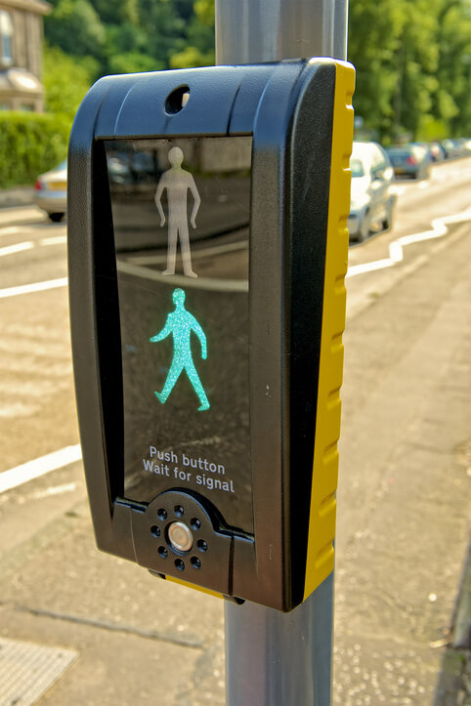
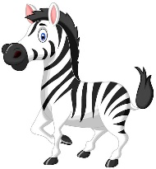
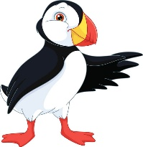
Crossing point!
Crossing points help us to cross the road as they stop the traffic.
But we must use the
Road Safety Hand

Slide 9
Our Road safety hand!
Every time we cross the road, no matter who we are with or where we cross, we need to use our Road Safety Hand.

Slide 10





Freeze game
STOP - HAND OUT
LOOK – HAND ABOVE EYES
LISTEN – CUP BOTH YOUR EARS
THINK – POINT TO YOUR HEAD
HOLD-HANDS – FIND A PARTNER
Notes:
PLAY THE MUSIC – THE STOP IT AND SAY ONE OF THE ROAD SAFETY RULES

Slide 11
Road Safety story Time

Slide 12

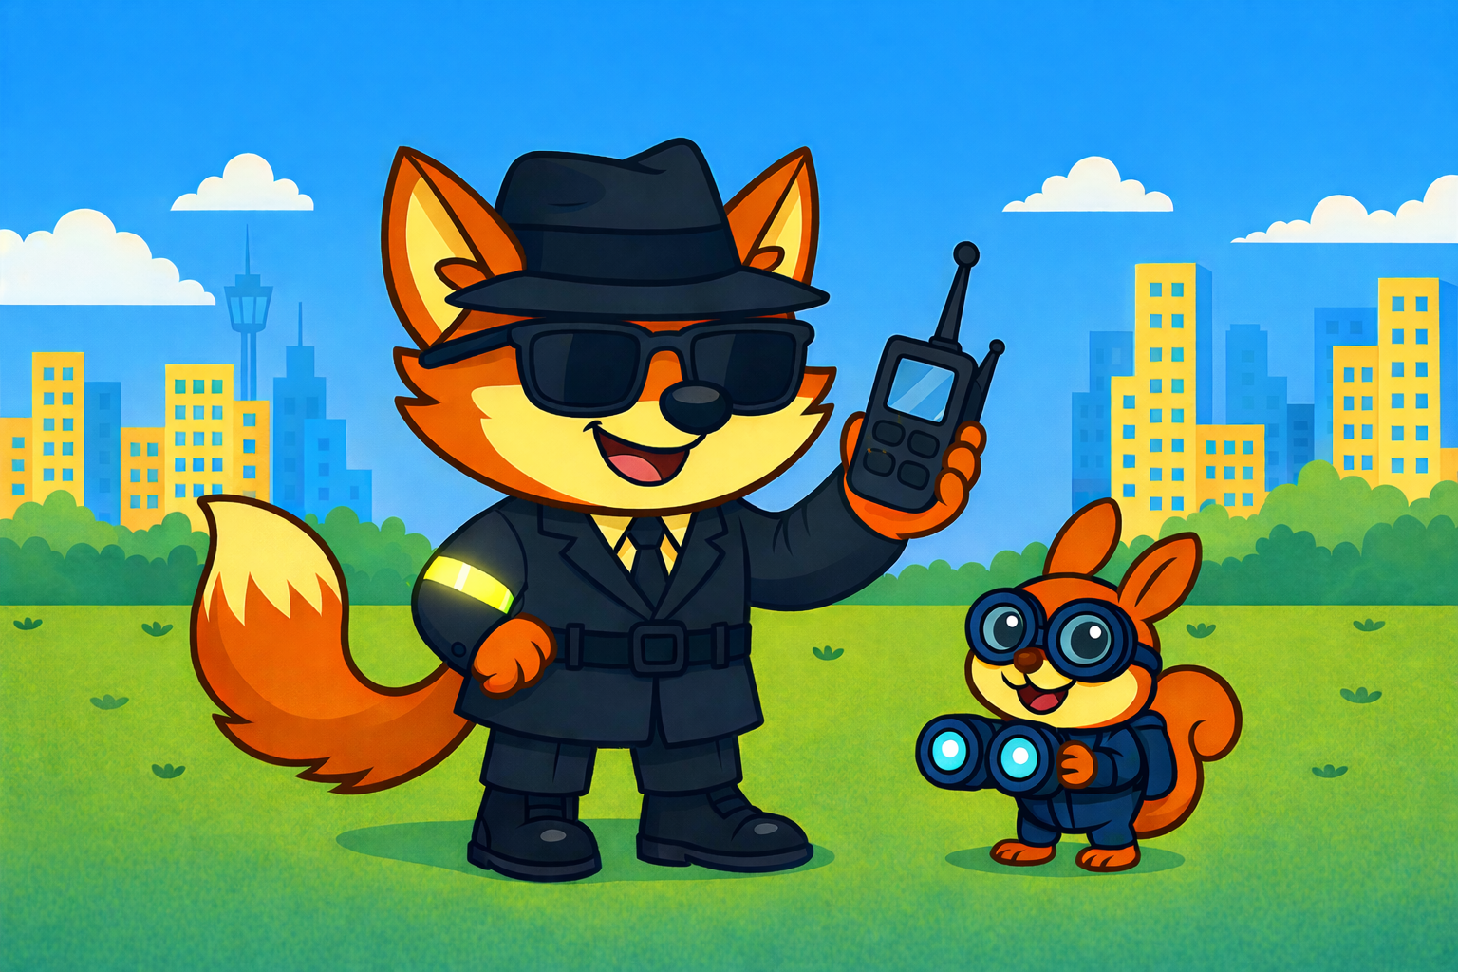



Theo and Cyril’s Road Safety Mission

Slide 13
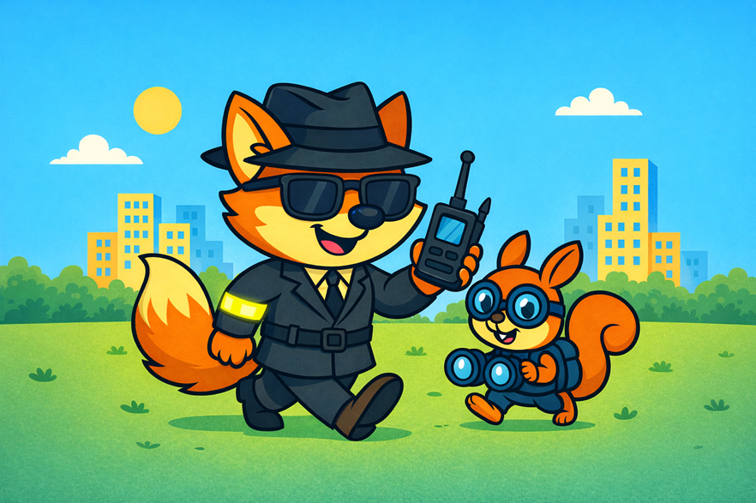
Theo the Fox is no ordinary spy,
He’s super‑secret and always nearby.
Each day he has an important role to play –
A Road Safety Spy, helping children look each way.
Cyril the squirrel wants to help too
He watches and looks and learns what to do.
He spots the dangers, big and small—
On streets and paths and parks and all!
But first, says Theo, with a wag of his tail,
Cyril must spot dangers without fail,
Anytime, anywhere, quick as can be…
Do you think Cyril’s ready? Well… wait and see!

Slide 14
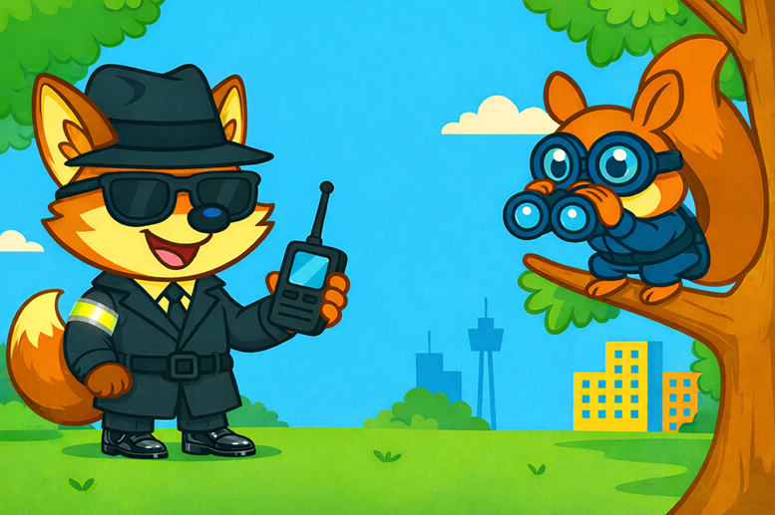
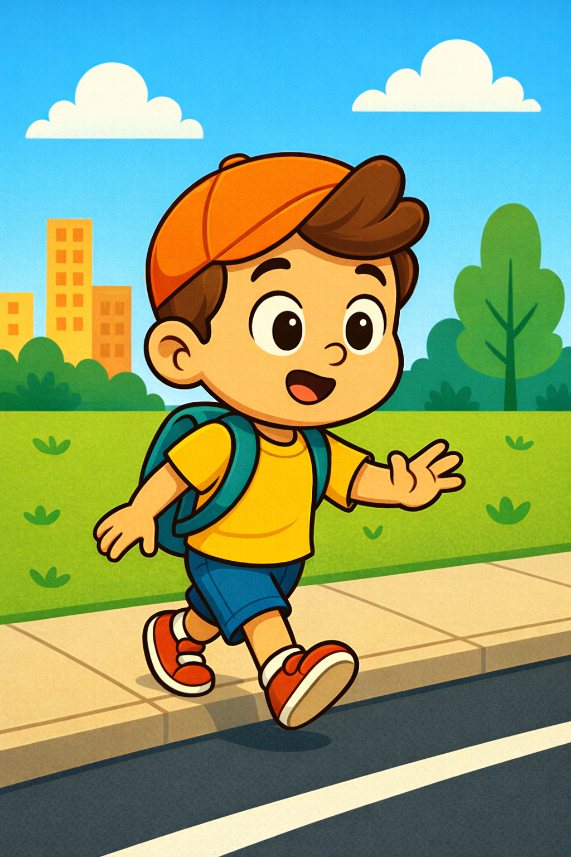
One bright, buzzy morning, with a swish and a snap,
Cyril peered through his binoculars looking through a gap.
He blinked and he gasped, and he gave them a shake.
“Oh Theo!” he squeaked, “There’s a mission to take!”
A Road Safety mission! Spotted clear as could be.
“We’ve got work to do, you and me!”
Cyril called out, with a hop and a cheer.
“Look, Theo! It’s urgent a mission is here!”
“Well done clever Cyril, you’ll make a brilliant spy.”

Slide 15
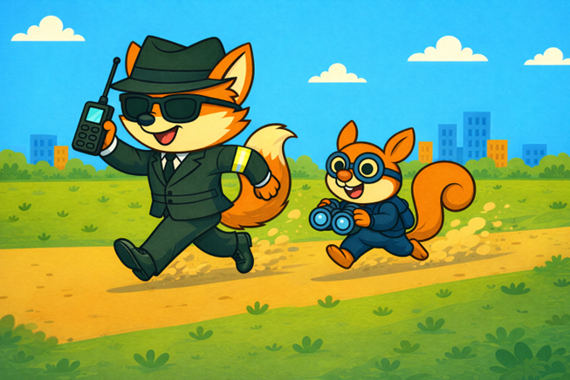
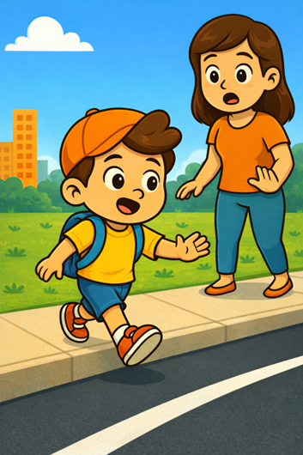
Theo and Cyril raced through the park,
A fox and a squirrel- both clever and sharp.
A little boy, really fast on his feet,
pretended to be a rocket, running down the street.
He heard someone call, “Stop! Take Care”
So, he skidded, he slid, and he stopped right there!

Slide 16
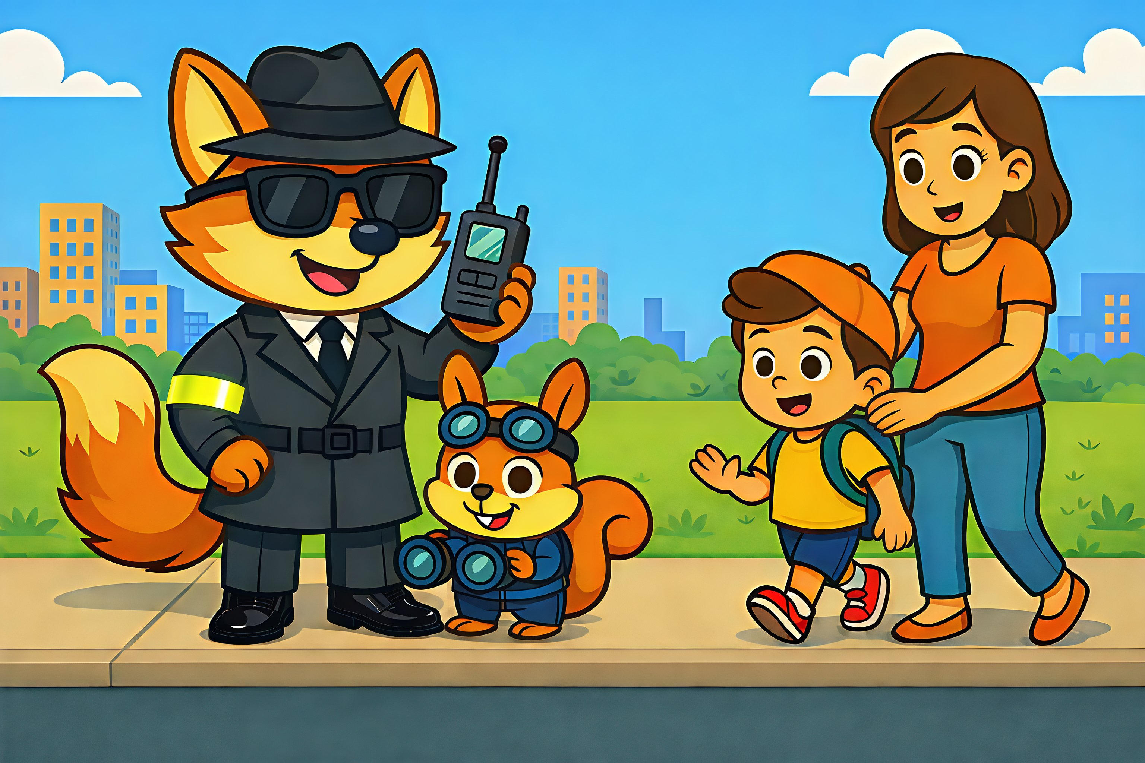
“Joe you can’t run across the road, you see, you must use your Road Safety hand just like me”.
Joe slowed down, his shoulders dropped.
“I’m sorry, Theo I should’ve stopped”.
Theo smiled softly. “No need to fret.
It’s my job to teach you, are you ready yet?”
But first, he said, with a smile on his face,
“Let’s find a safer crossing place.”
So off they walked, side by side,
No rushing feet, no giant stride.
Joe, ready now, as safe as can be,
To learn the Road Safety Hand from Cyril and me.

Slide 17
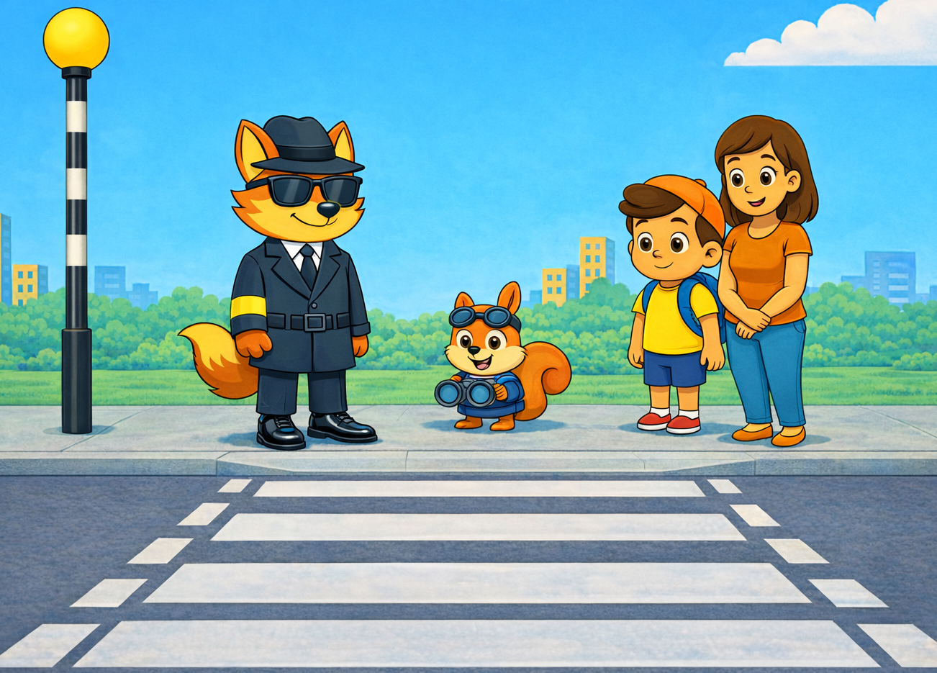

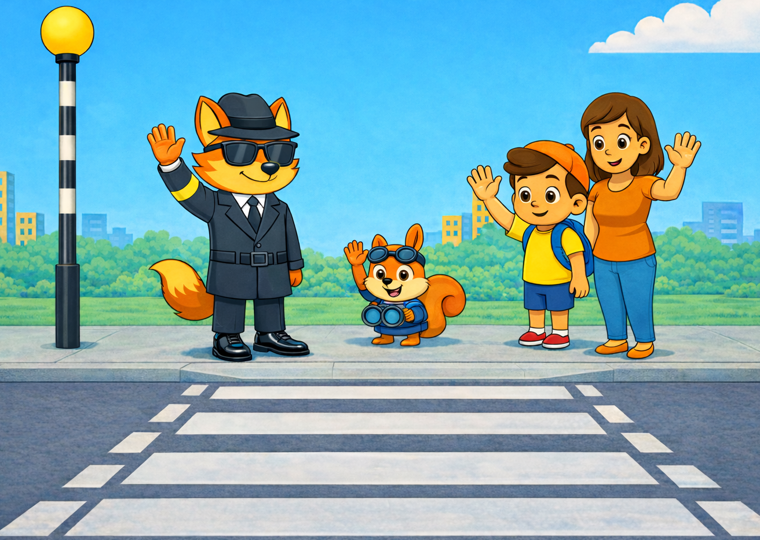
“A zebra crossing, a perfect place to cross!
Cyril lets teach Joe, how to cross like a boss!”
Theo said, “Show FIVE!
We STOP,
We LOOK,
We LISTEN,
We THINK and HOLD HANDS
Joe smiled wide. “I’ve got it!
I know just what to do!
Your Road Safety Hand is clever.
I’ll use it through and through!”
Cyril squeaked, “Great job there, Joe!
You’re learning every part.
Use your Road Safety Hand each time you cross, and you’ll be off to a brilliant start!”

Slide 18
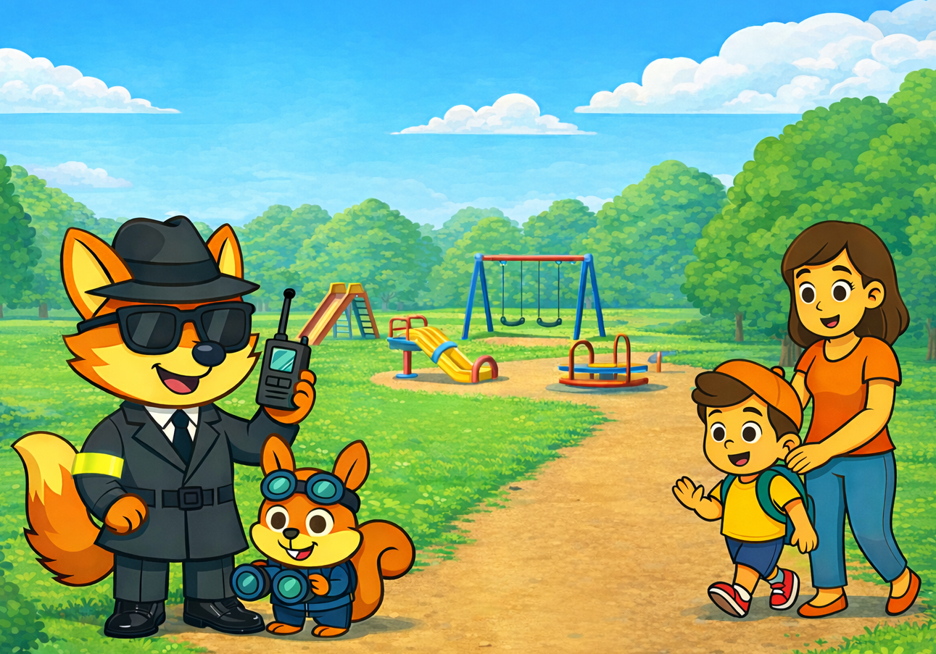
“Thank you, Theo and Cyril for keeping me safe.
I’ll use my Road Safety hand every time, every place!”
Theo nodded proudly, his whiskers all neat,
“Remember it, Joe, on every busy street.
Hold it up high as you stop and you stand—there’s magic tucked into your road‑safety hand!”
Cyril spun in a circle and squeaked, “Hip Hip‑hooray! Keep safe on the road, every day!”

Slide 19
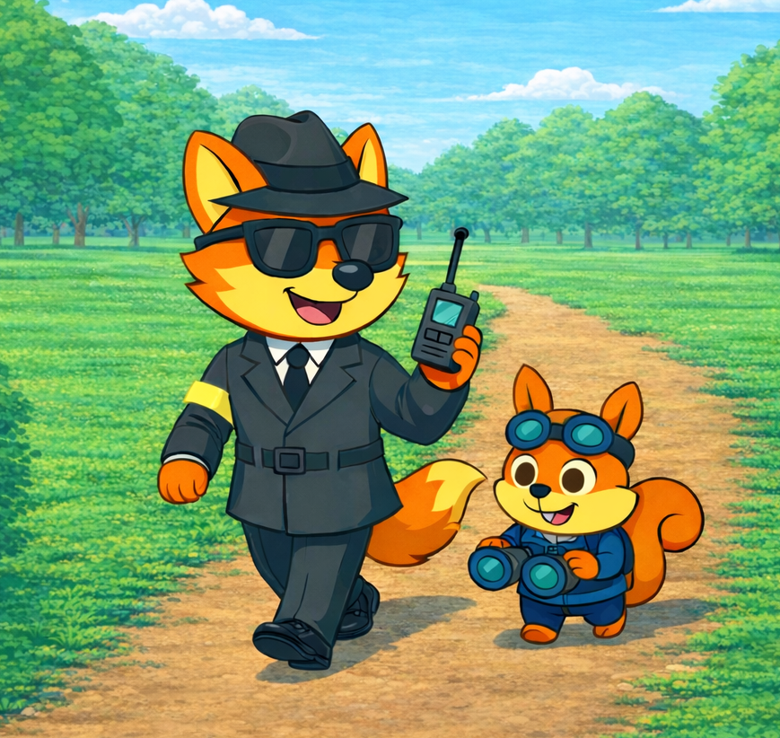
“Well done, clever Cyril!” said Theo with glee,
“You spotted the danger as quick as can be.
Another young road‑user safe on their way,
All thanks to your sharp lookout skills today.”
Cyril grinned proudly, his eyes shining bright.
“So, tell me, please, Theo am I doing it right?”
Theo nodded and gave a wink.
“You might just be the missing link!”
Cyril asked keenly, “Am I now a Road Safety Spy?”
Theo beamed and Cyril was on cloud nine!

Slide 20
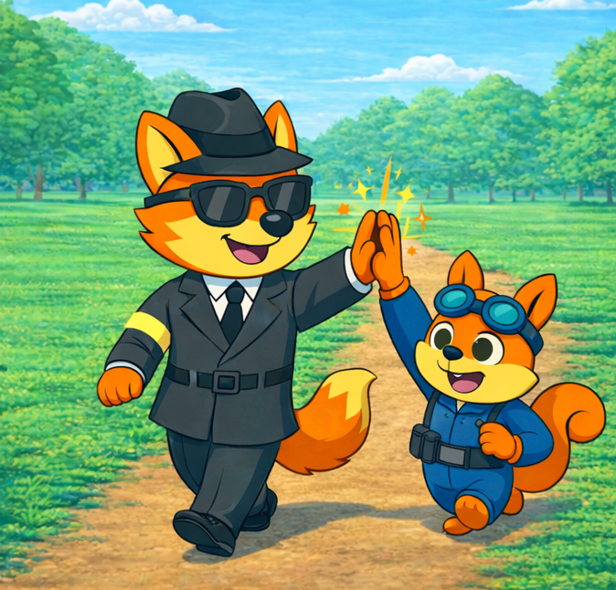
So, Theo and Cyril are done for today.
With lessons all learned and adventures at bay.
Heading home proudly, in their own safe way.
Maybe they’ll tell you about another mission one day!

Slide 21
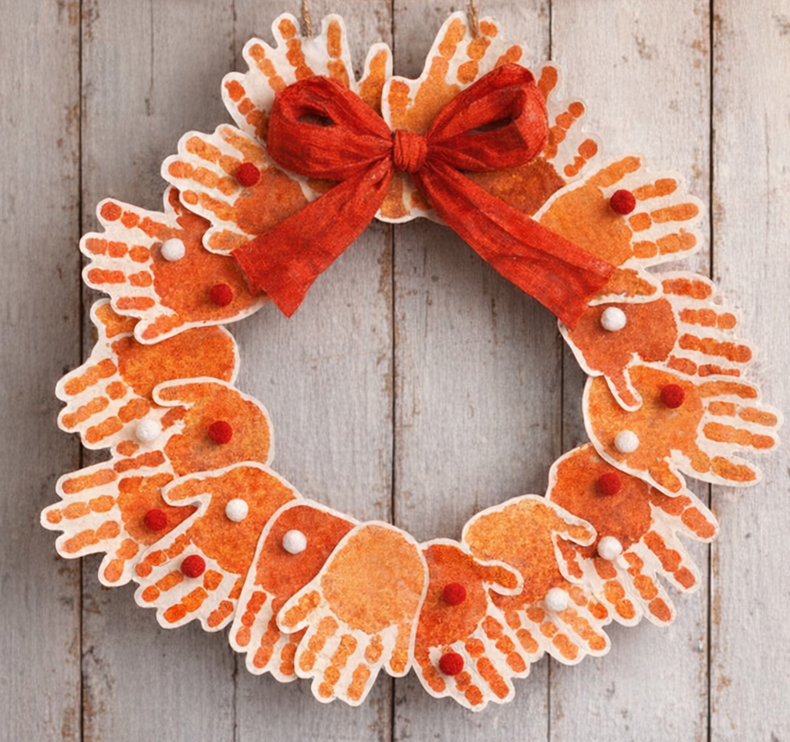
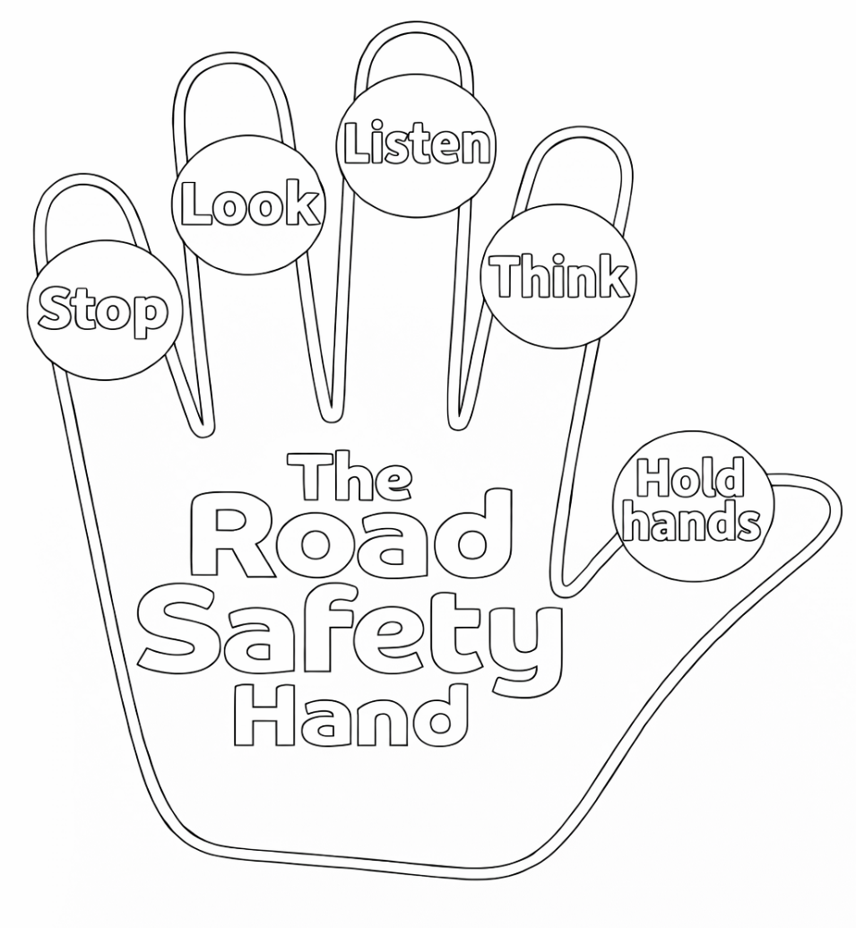
Colour in the Road Safety hand
If you have time, you could even cut your hands out and turn them into a Road Safety Wreath to put on your display board!

Slide 22

Have we completed our Road safety Check list?
Do we know how to;
Before we cross the road?

Slide 23

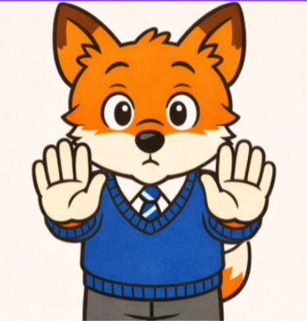
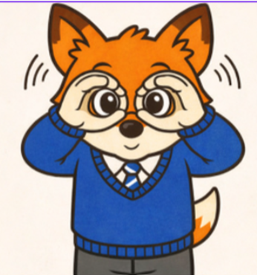

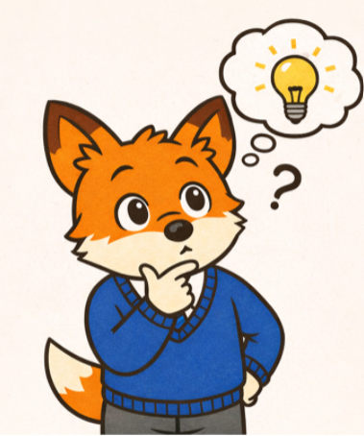
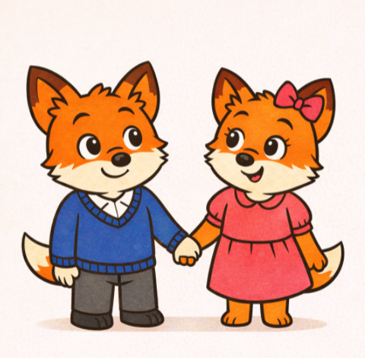
Thank you!
STOP LOOK LISTEN THINK HOLDHANDS
Leicestershire County Council | Traffic and Safety Team | Roadsafety@leics.gov.uk

Slide 24
Reference: Photo by Kindel Media: https://www.pexels.com/photo/man-people-summer-park-7715062/ Photo by Elvijs Korolovs: https://www.pexels.com/photo/grayscale-photo-of-a-child-riding-bicycle-8290740/ Photo by Mike Bird: https://www.pexels.com/photo/a-black-hatchback-car-parked-outside-7459481/ Photo by Mathias Reding: https://www.pexels.com/photo/red-bus-in-london-16124548/ Music by <a href="https://pixabay.com/users/nastelbom-48128234/?utm_source=link-attribution&utm_medium=referral&utm_campaign=music&utm_content=451590">Dmitrii Spis</a> from <a href="https://pixabay.com/music//?utm_source=link-attribution&utm_medium=referral&utm_campaign=music&utm_content=451590">Pixabay</a>Music by <a href="https://pixabay.com/users/tunetank-50201703/?utm_source=link-attribution&utm_medium=referral&utm_campaign=music&utm_content=347455">Tunetank</a> from <a href="https://pixabay.com//?utm_source=link-attribution&utm_medium=referral&utm_campaign=music&utm_content=347455">Pixabay</a>

