Slide 1

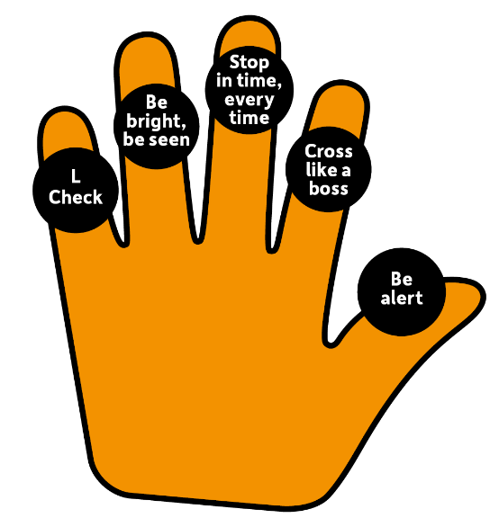



Road Safety
Education Year 2

Slide 2
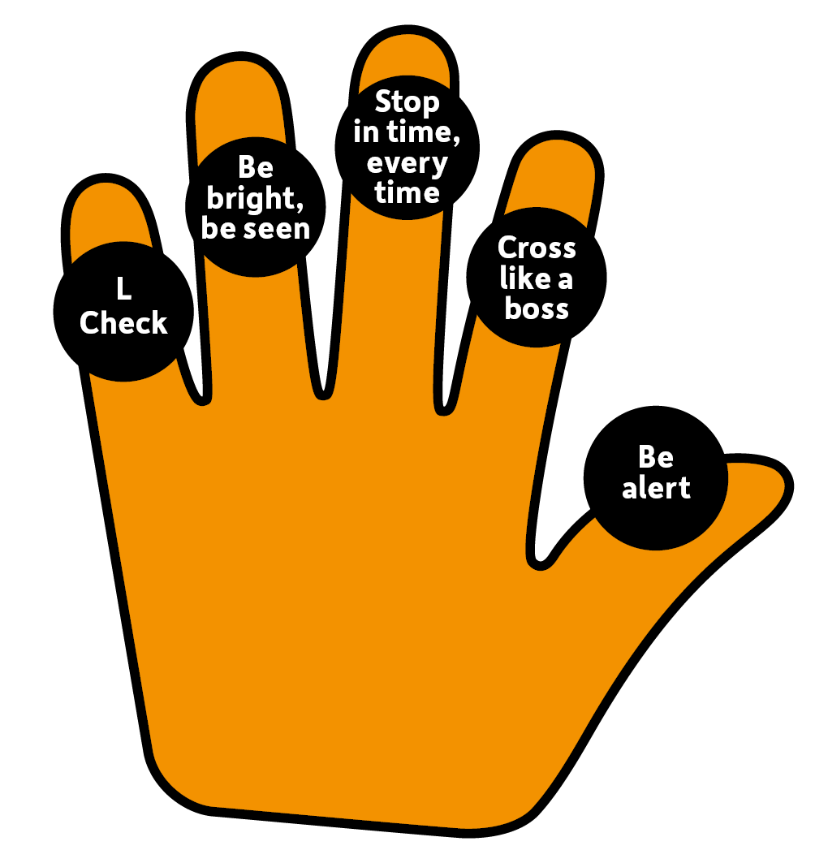

Learning outcome:
To be able to use the Road Safety Hand, to stop in time every time, be alert and cross like a boss!
To be able to identify if I am dressed ready to ride and if my scooter is safe to ride.

Slide 3
Let’s learn the road Safety hand!
Notes:
Could we use props and or actions
Get the children up and do each action
Then get them to say them in the correct order

Slide 4
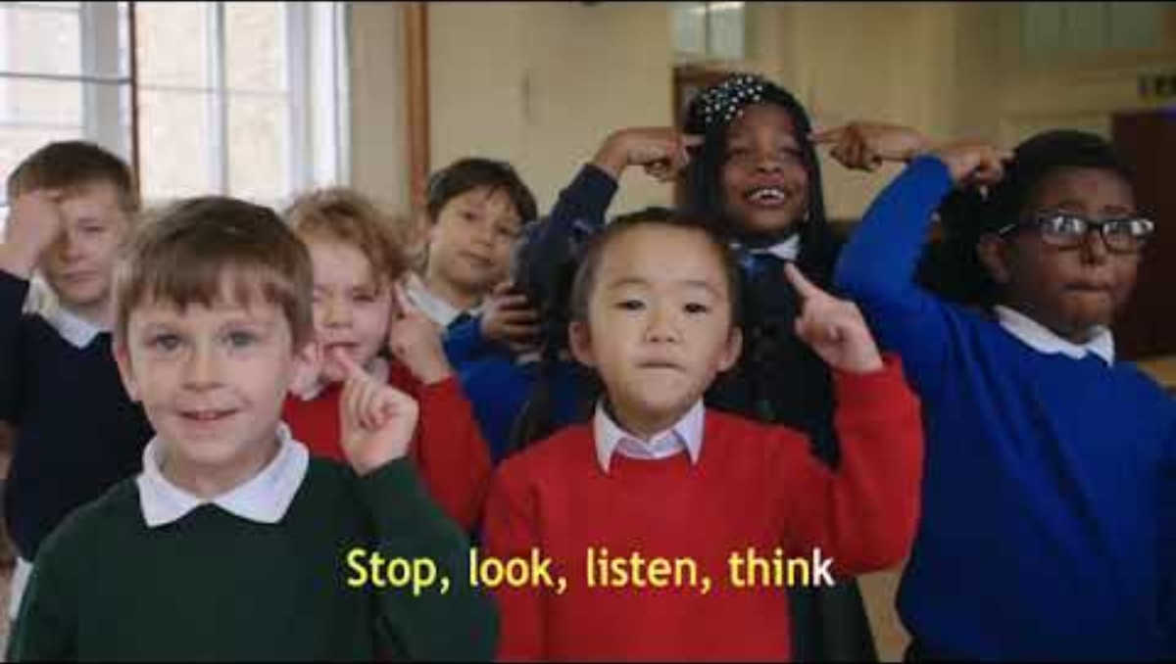
Notes:
https://www.youtube.com/watch?v=HXCN8V5u0Fg

Slide 5
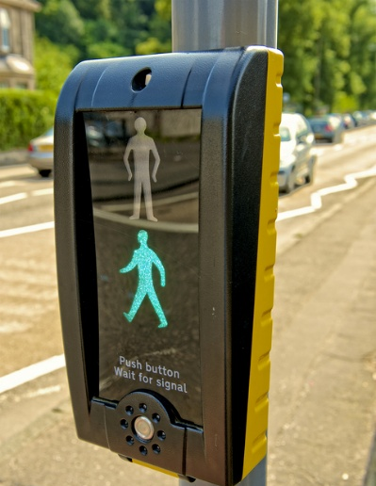
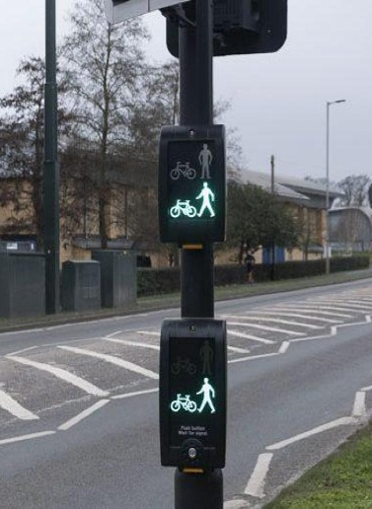
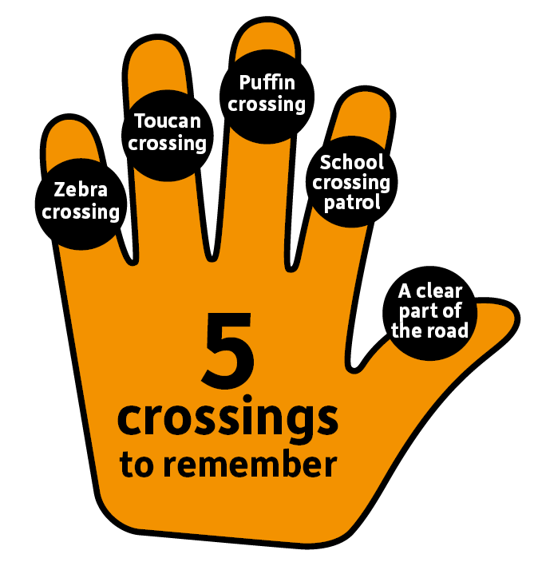
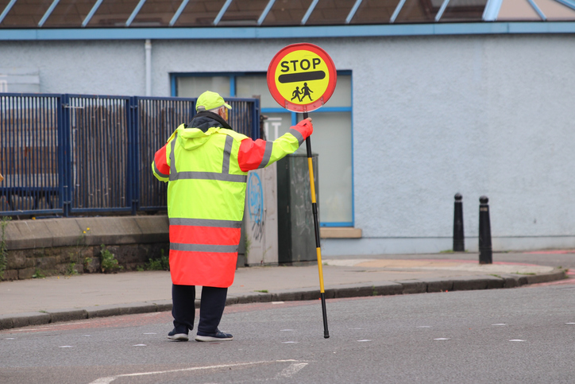

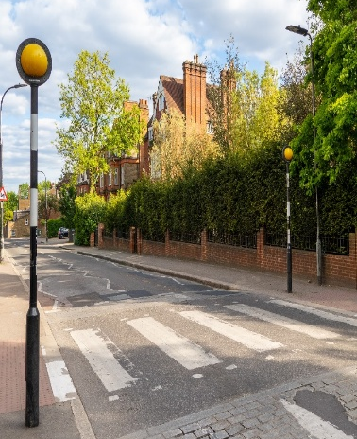
Safe places to cross
Can you match the crossings to their name?
Puffin Crossing
Toucan Crossing
School Crossing Patrol
A clear part of the road
Zebra Crossing

Slide 6
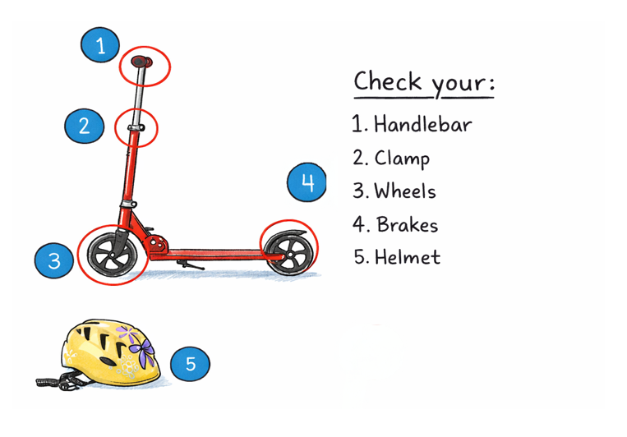
Scooter L-Check

Slide 7
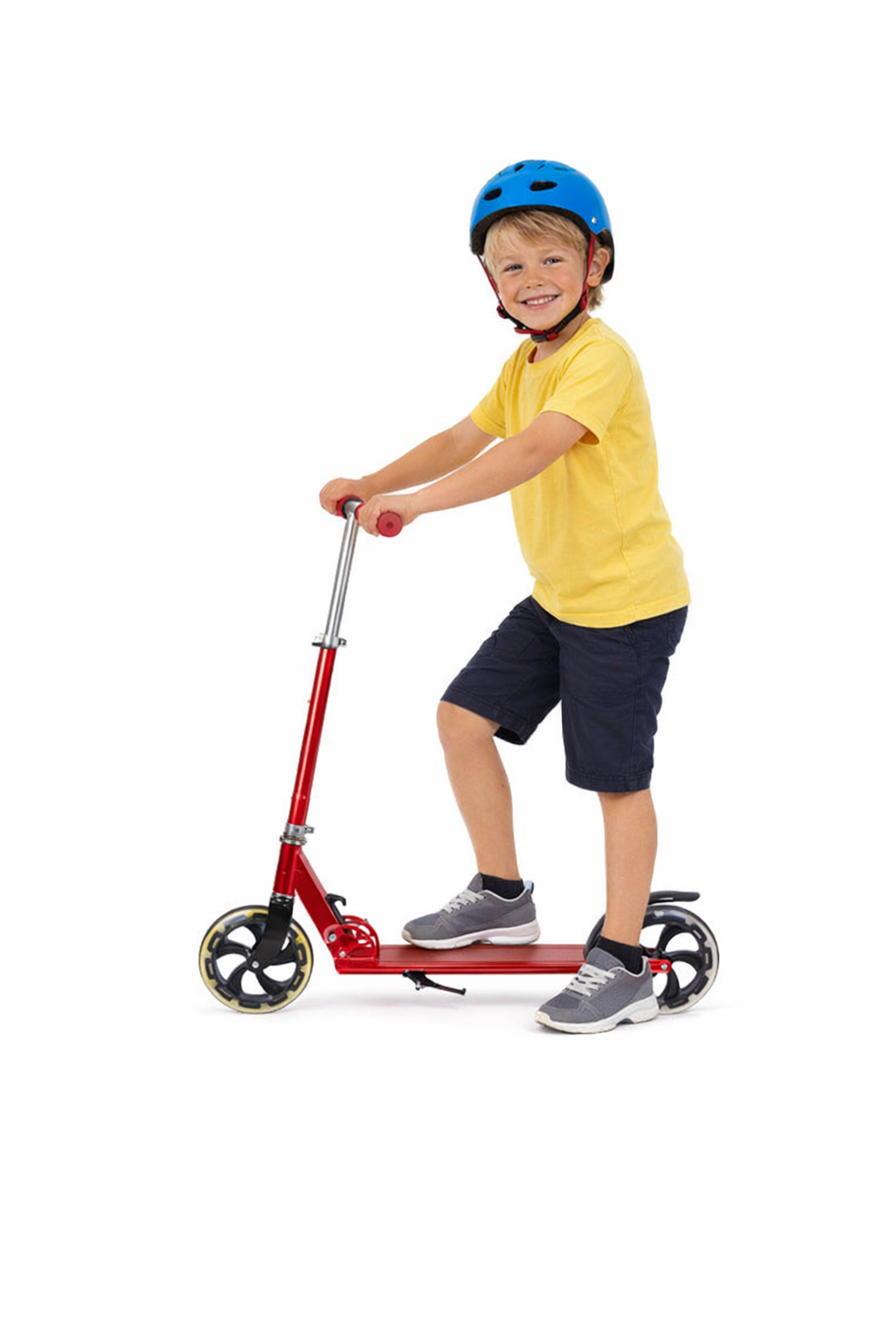

Activity:
Who’s dressed ready to ride?

Slide 8

Now you know:
How to cross
Where to cross
How to make sure you are dressed ready to ride
How to check your scooter is safe
You are a part of the scooter crew!
Notes:
https://www.youtube.com/watch?v=BNyBWXwQBW8

Slide 9

Remember to always…

Slide 10
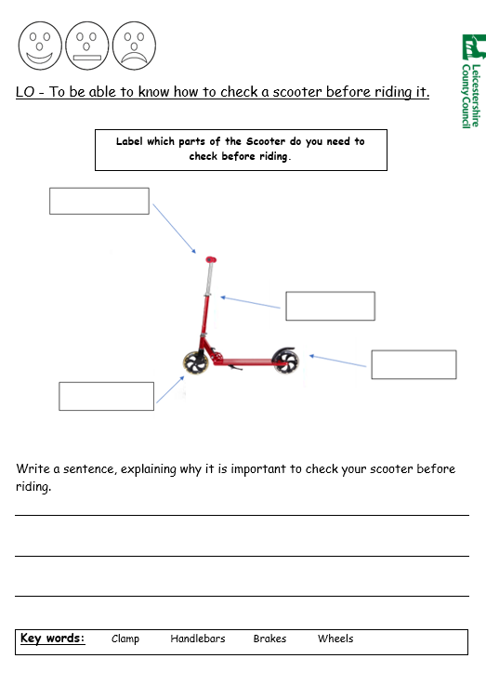
Worksheet
L-Check Scooter

Slide 11

Thank you!
Leicestershire County Council | Traffic and Safety Team | RoadSafety@leics.gov.uk

