Slide 1

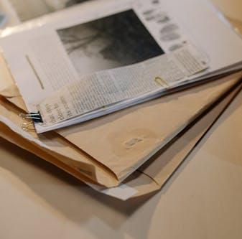

Road Safety Education Year 5 – Collision Detectives

Slide 2
Learning Objectives
By the end of the lesson:
I will be able to analyse a road traffic collision and make suggestions for travelling more safely.
I will be able to identify responsible behaviour, for when I start travelling independently.

Slide 3


Whenever you see these emoji’s there is a clue or hint on the page
A hint to help you solve the case
A clue to help you solve the case!

Slide 4
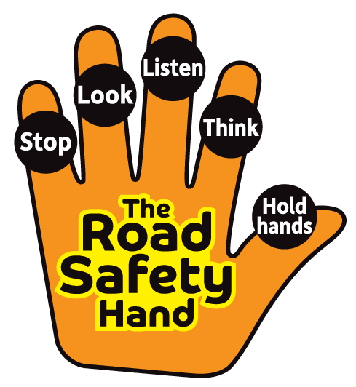
For younger children
Clue

Slide 5
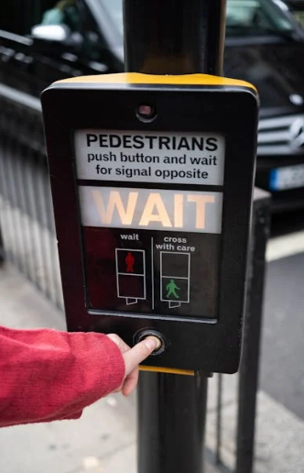
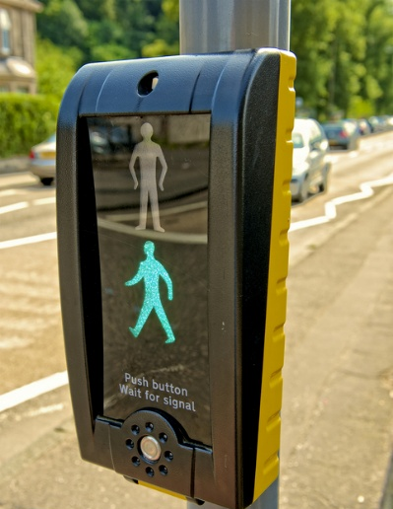
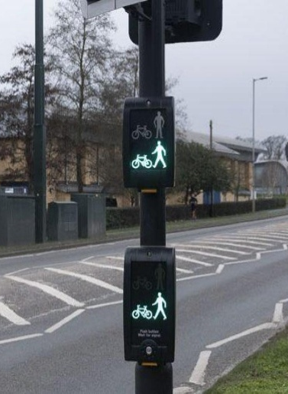
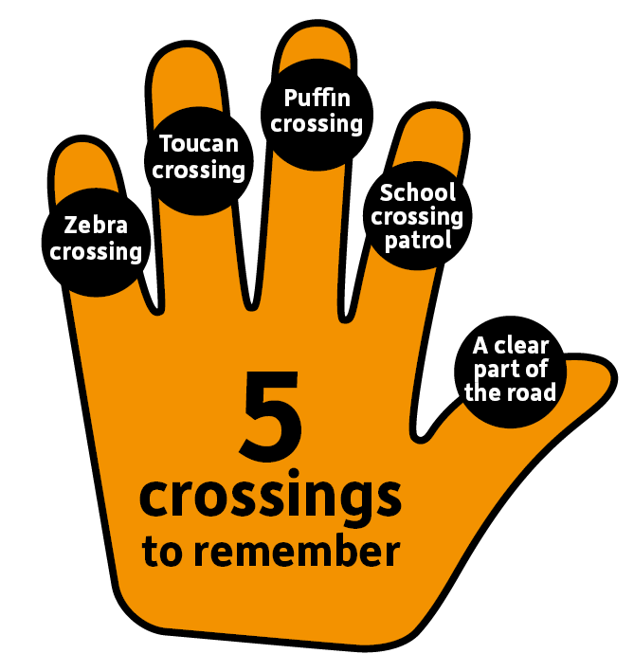
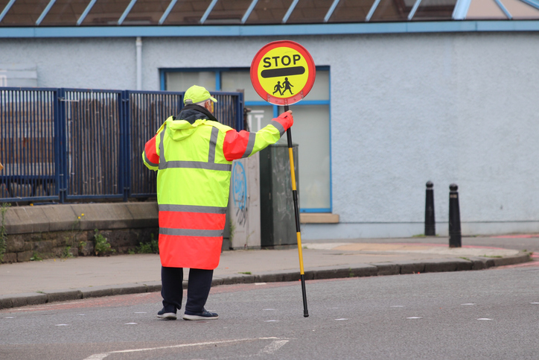
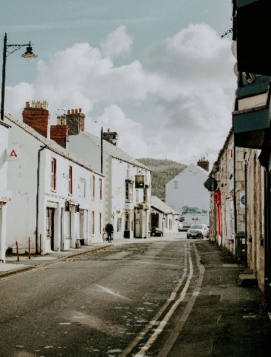
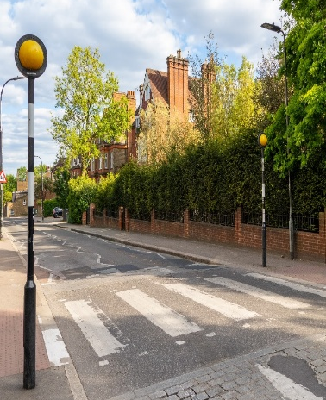
A quick game… Can you remember the names of Safe places to cross?
Pelican Crossing
Puffin Crossing
Toucan Crossing
School Crossing Patrol
A clear part of the road
Zebra Crossing

Slide 6
Clue

Slide 7

Clue

Slide 8

Clue

Slide 9

Personal Responsibility
Now you are getting older, staying Safe on the
Road is your responsibility, especially As you will
be travelling independently soon.
Look up, not down — avoid phones or headphones
Wear bright coloured clothing – so you can be seen
Watch traffic in all directions, even on quiet roads
Cross at formalised crossings – where they are present, or cross on a clear part of the road, so cars can see you and you can see them
Speed and stopping – young people aren’t very good at judging speed, so it’s best to wait until it is clear or use a crossing point. The larger the vehicle, the longer it takes to stop.
Be extra careful near junctions, driveways, and parked cars, in the dark
Eye contact - Make sure to make eye contact with the driver, to show you have seen each them

Slide 10

Task:
You are going to spend the next 20 minutes doing some detective work. Imagine you’re a collision investigator, working for the Police. You have been handed this case file. It is up to you to determine who was at fault for the collision.
Using the evidence available, your table will answer a set of questions. The class will come back together, and you should share your conclusions.

Slide 11


LOCATION: WIGSTON ROAD
DATE: 18/11/2025
CRN: 16255687425
Casefile Contents
This casefile contains:
Crime Scene Maps
Crime Scene Positioning
Photographic Evidence
Witness Statements
COLLISION CASEFILE

Slide 12
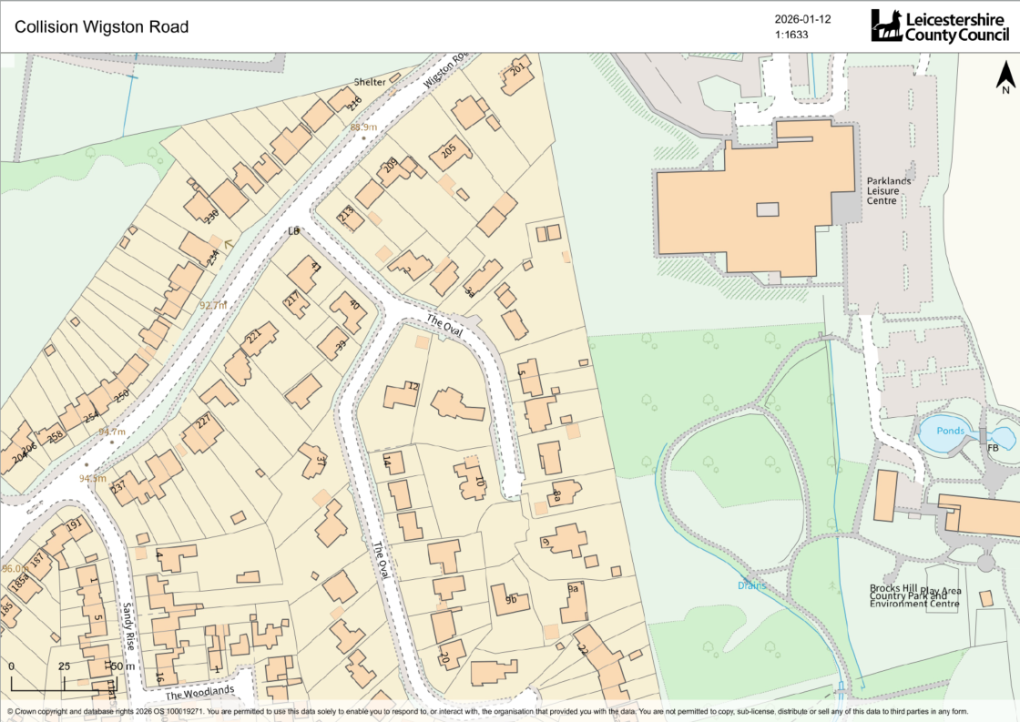
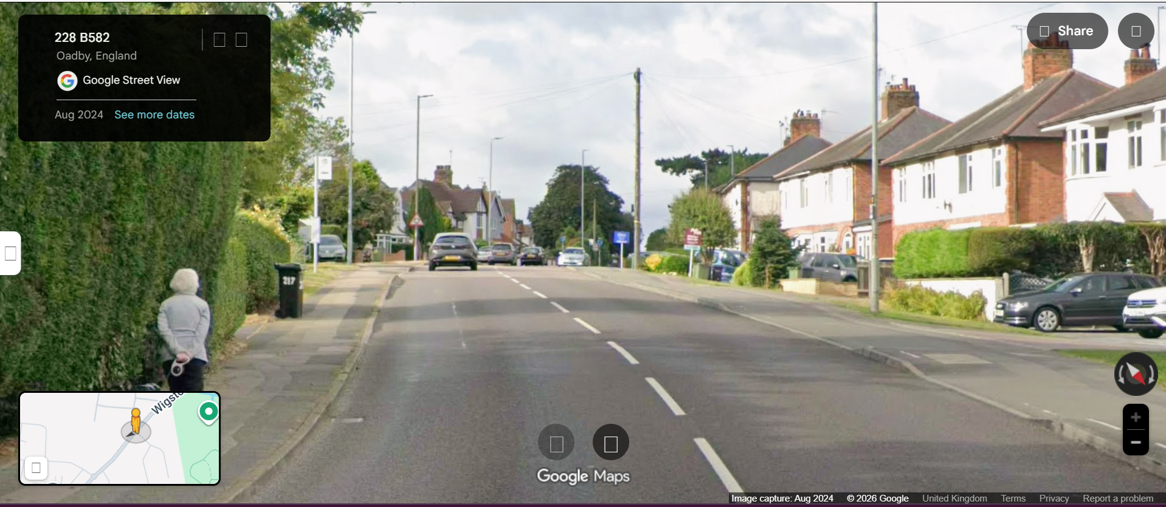

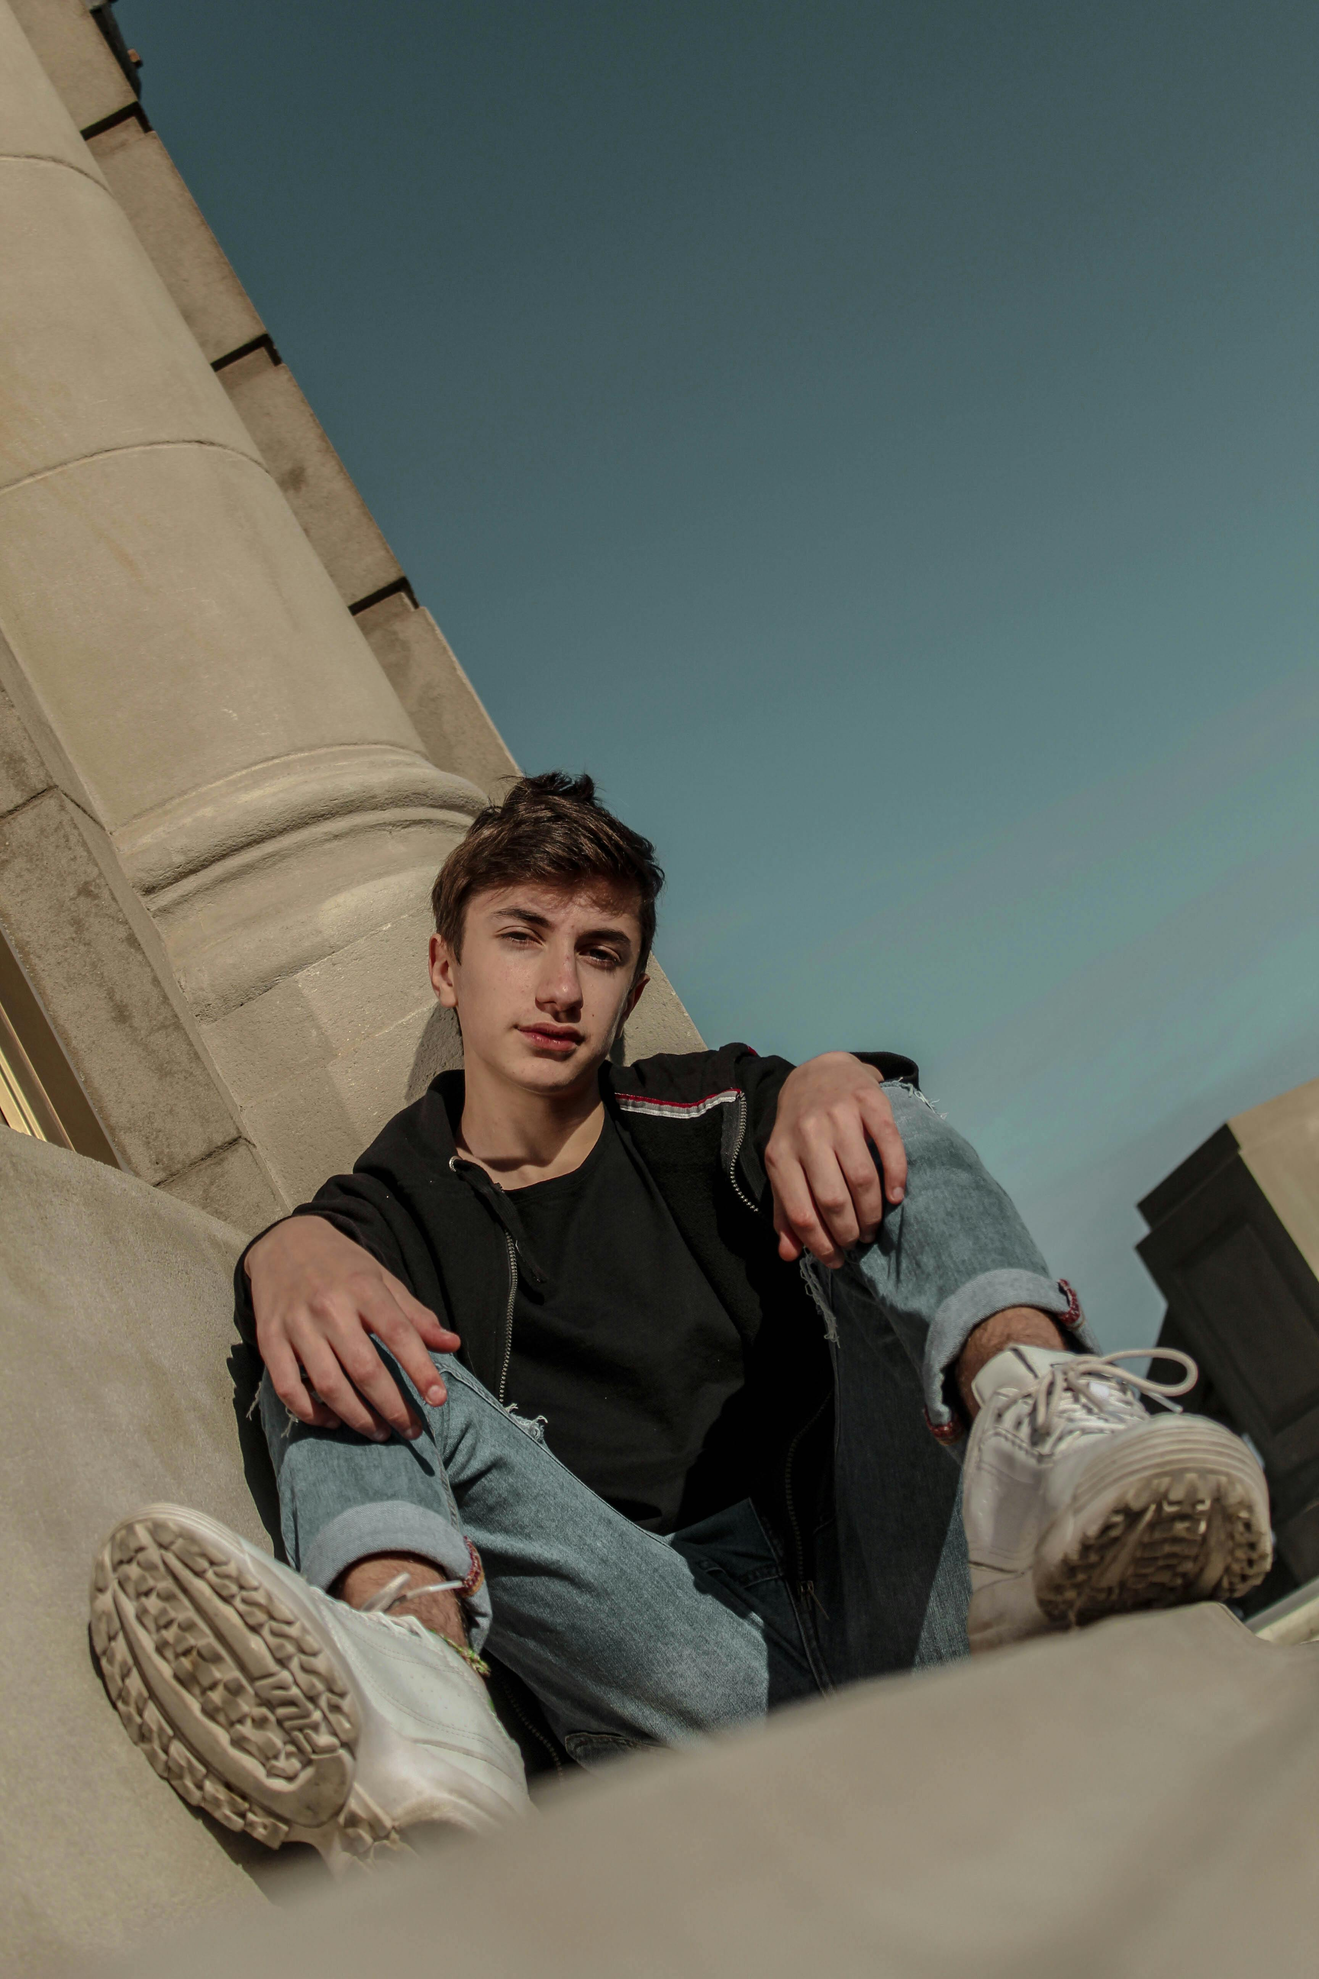
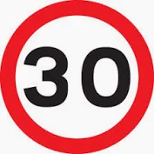


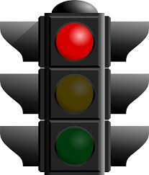




N
Dylan’s friend’s house
S
Daniel driving South-West
Dylan walking West
Conditions: Dry
Light/Dark: Dark
Street lighting: Yes
CP65 ANJ
Google Street View –Wigston Road
Hint: Look at the speed limit, lighting and weather!

Slide 13
Crime Scene Positioning
Collision Location:
Pedestrian [D. Birch] and Vehicle collided on Wigston Road.
Vehicle Direction of Travel:
Vehicle travelling southbound, down Wigston Road, prior to collision.
Pedestrian Direction of Travel:
Pedestrian [D. Birch] travelling southbound down Wigston Road, on east side pavement, moved from East to West pavement, to visit his friends who lives at No.250 Wigston Road.
Clue

Slide 14
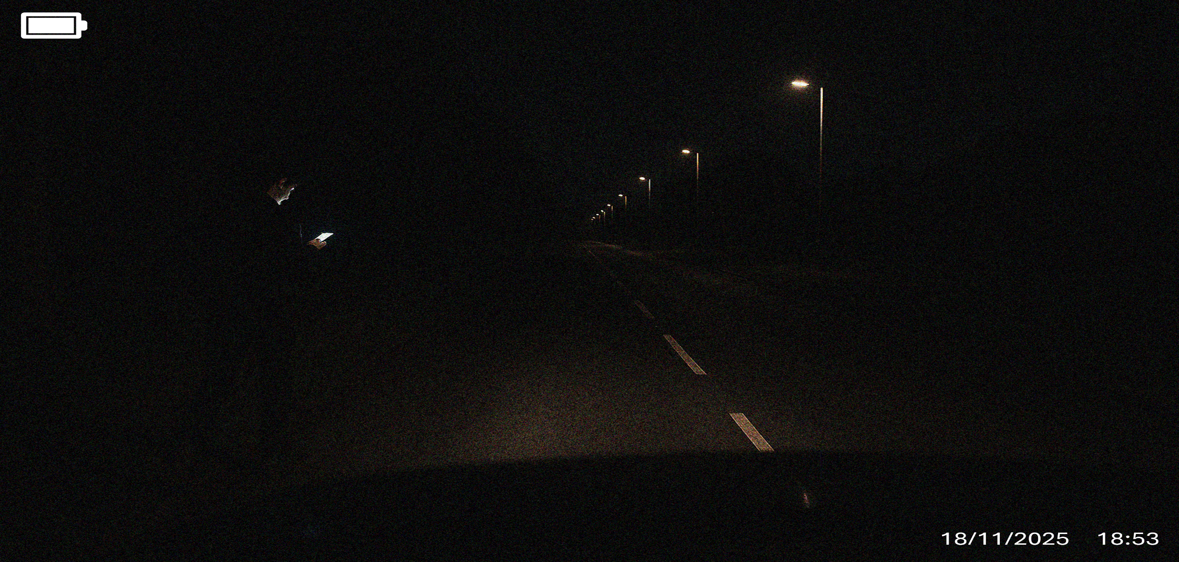
Dashcam footage – captured by R. Simm. Depicts D. Birch two minutes before collision
Clue

Slide 15
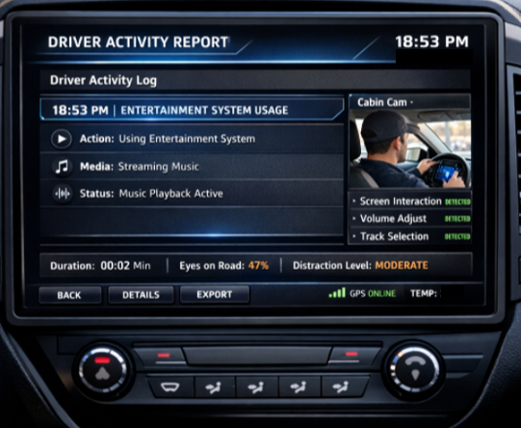
Photo of driver activity report from in car computer system
Hint: Can you find the speed? (mph)
Hint: Look at what the driver was doing before he crashed!
45 mph

Slide 16
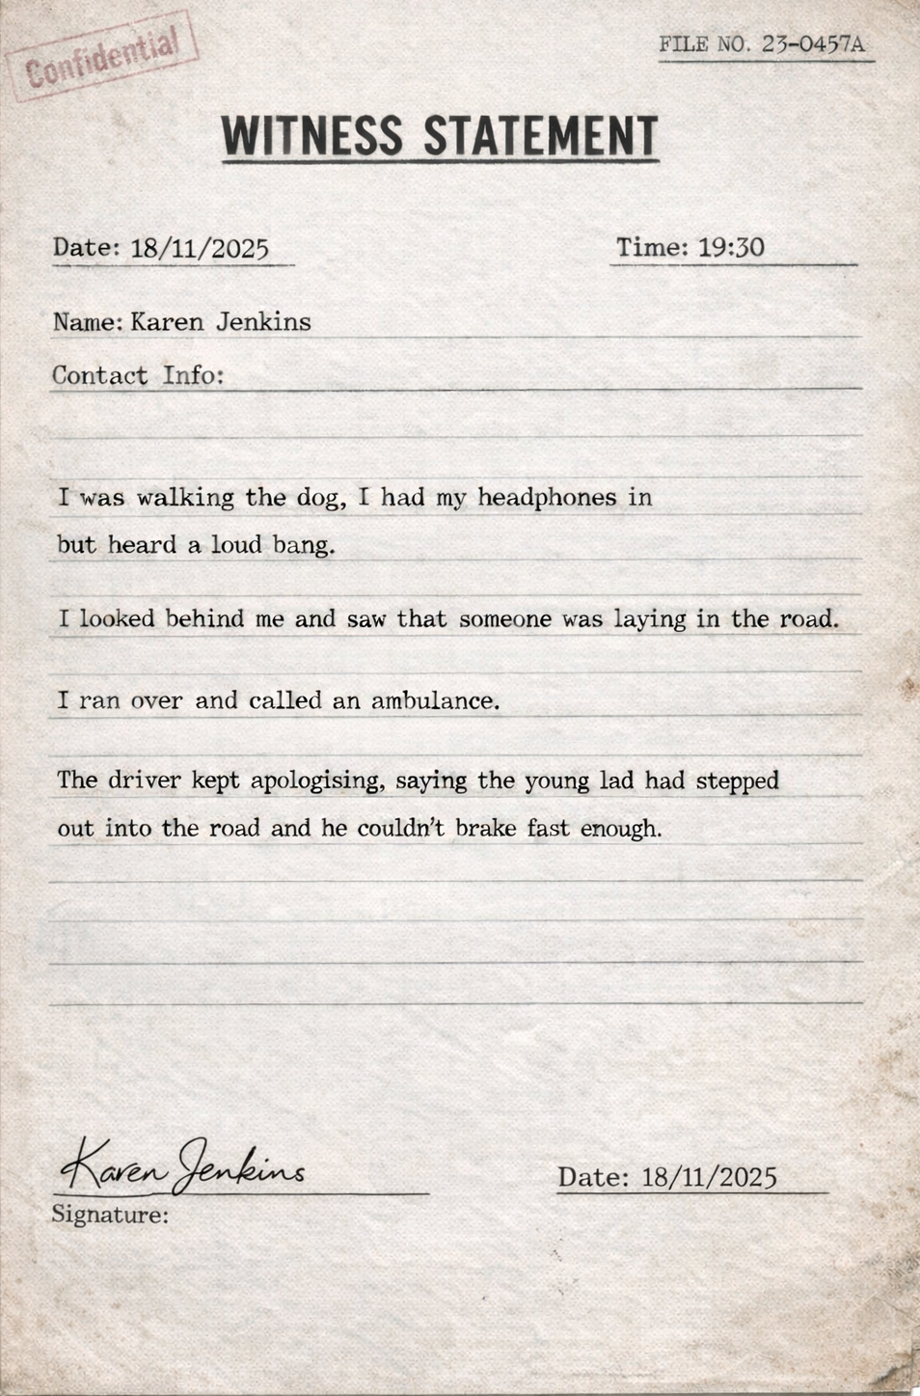
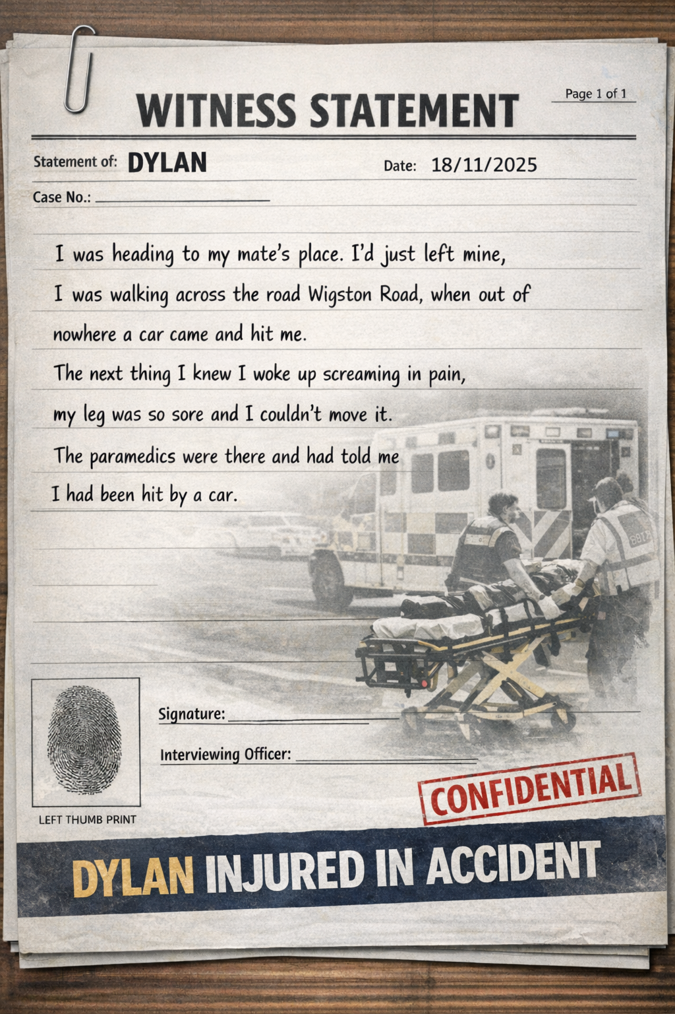
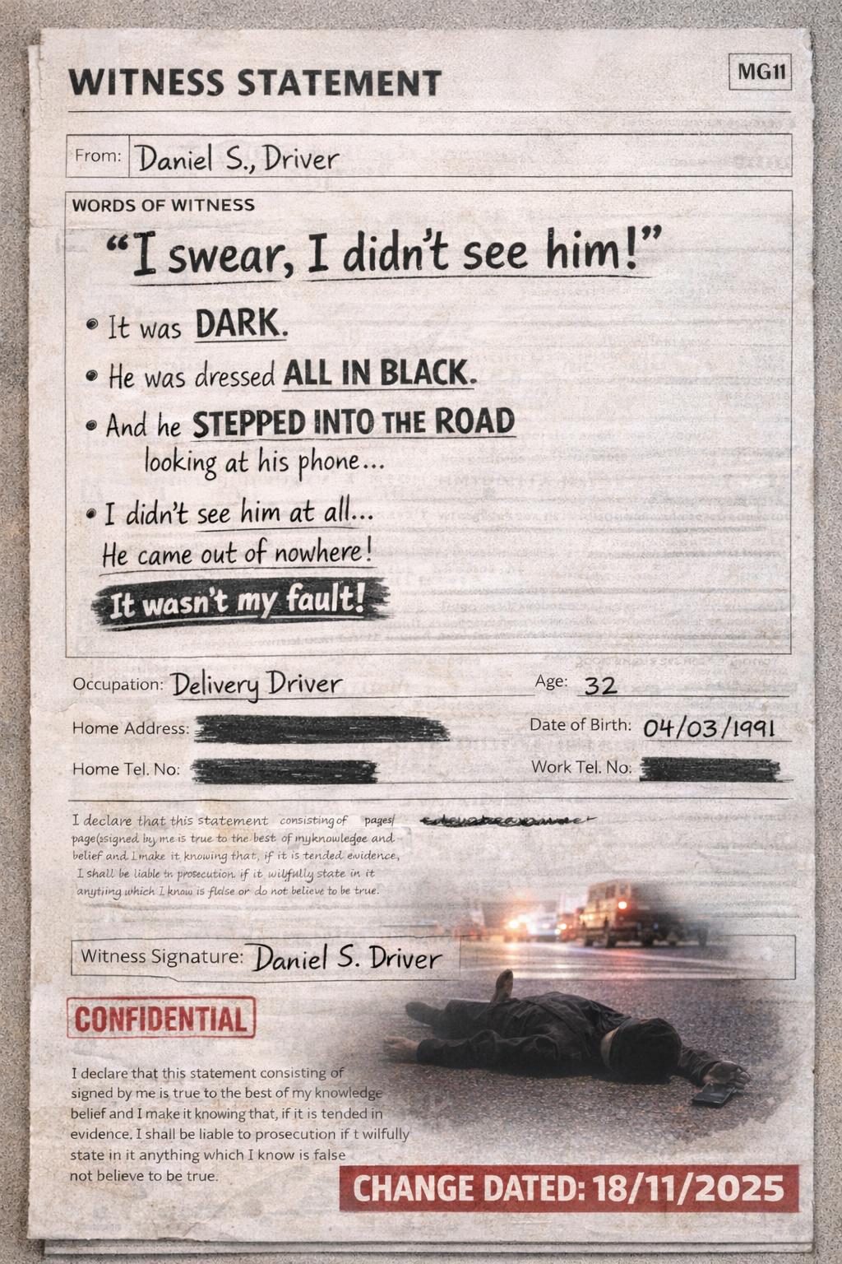
Witness Statements
Clue

Slide 17
Task:
Detectives, using the road safety hands, the evidence in the police report and your own knowledge of road safety, you have 20 minutes to answer the questions your table has been given!

Slide 18
Responsibility Questions
Prevention Questions
Each table will have different questions to answer!
Creative Thinking / Impact Questions
Analysis of the scene!
Cause and effect

Slide 19

https://www.youtube.com/watch?v=5rU-lkoz-_w

Slide 20
Responsibility Questions
Prevention Questions
Feedback
Creative Thinking / Impact Questions
Analysis of the scene!
Cause and effect

Slide 21
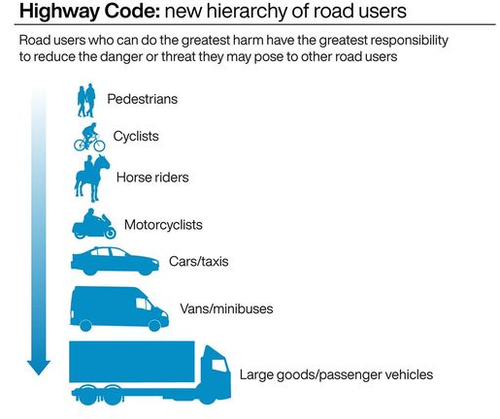
Daniel
Daniel was driving at 45mph
Most vulnerable road users at the top.
Vehicles that can do the most damage at the bottom.
Daniel was in a car, so he had the legal responsibility to keep other vulnerable road users safe.
The speed limit was 30mph
Daniel was using the in-car entertainment screen at time of collision
Didn’t use a formal crossing point
It is important ALL road users play a part in keeping themselves and others safe whilst using the road!
Wore all black
Dylan
Didn’t stop, look, listen, think!
Was using mobile phone whilst crossing the road
Notes:
Talk about the fact that Dylan could have been distracted by a number of other things, talking to friends, kicking a ball

Slide 22
Answers
You will have found that Daniel was to blame. You may have also found that Dylan could have done more to keep himself safe. So, what happened next?
Daniel was found to be guilty of causing serious injury by careless driving because he was driving at 45mph in a 30mhp zone– and using the in-car computer screen. He was sentenced to one year in prison, and a two-year driving ban.
Dylan was hospitalised for 2 days, before being able to go home. Dylan suffered a broken leg and bruising. He had to attend physiotherapy for the next 3 months.

Slide 23
Don’t be a statistic like a Dylan!
Road accidents are one of the main reasons that young people die.
20 Pedestrian children under 16, died in 2024 on UK roads.
A total of 1176 were seriously injured.
That equates to 23 children killed or left with serious, life-changing injuries each week in 2024. That’s a small class a week!
Most of these injuries take place between 8 am and 9 am and between 3 pm and 7 pm.

Slide 24
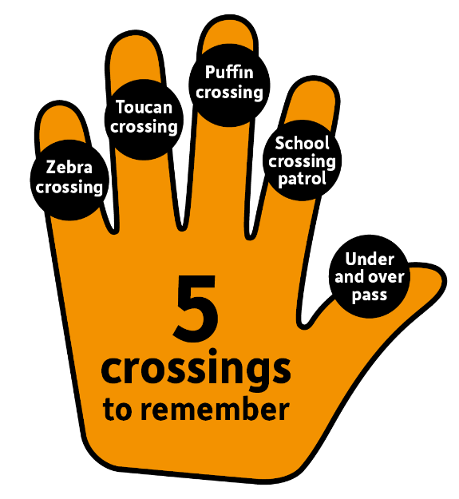


Key road safety tips to travelling independently…
Crossings - Cross at a formalised crossing if possible or where the road is clear, so you can see the cars coming and they can see you.
Look up, look around, put your phone down
You are never too old to:
STOP, LOOK, LISTEN, THINK!
Be bright, be seen!

Slide 25


Have you signed up to Bikeability?
Bikeability Level 1 – Core Outline
Purpose: To develop basic cycle‑handling skills in a traffic‑free environment in the playground.
Year Group: Year 5 and 6
What Level 1 Covers
Stop/Start
Use breaks
Ride with one hand
Look over their shoulder whilst riding
If you can do all of this and pass, you can go onto Level 2.
Bikeability Level 2 – Core Outline
Purpose: To prepare riders for cycling on real roads with light to moderate traffic.
Year Group: Year 5 and 6 – Delivered on the local roads
What Level 2 Covers
Starting and stopping safely on the road.
Riding on quiet local roads with real traffic.
Negotiating simple junctions (e.g., T‑junctions, crossroads).
Understanding road signs and priorities.
Improving road positioning for safety and visibility.

Slide 26

Thank you!
Leicestershire County Council | Traffic and Safety Team | Roadsafety@leics.gov.uk

