Slide 1



Year 10
The Collision Casefile Challenge
The hierarchy of road users and behaving responsibly.

Slide 2

By the end of the lesson:
I will be aware of The Highway Code.
I will be able to apply the rules of the road to a scenario.
I will be able identify when I could take personal responsibility to keep safe when using the road.

Slide 3
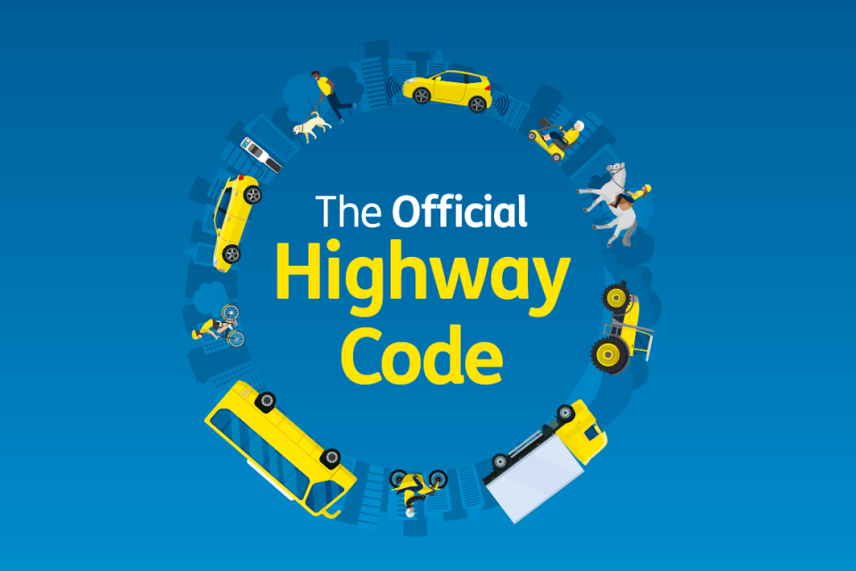

The Highway Code
The Highway Code is an official set of laws, rules, advice and guidelines, designed to keep us safe. Today’s lesson will reference just a few extracts from this comprehensive document.
Many of you may be learning to drive within the next couple of years, and will undoubtedly come across the Highway Code, when you practice for your theory test.
However, the Highway Code applies to every road user – even if you don’t drive, you should be aware of what the code expects of you as a pedestrian, or cyclist.

Slide 4
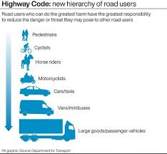
The Hierarchy of Road Users
In 2022, changes were made to the Highway Code, to clarify who holds the most responsibility when using the road. This system is called the hierarchy of road users. This means that the people who are most likely to be hurt on the road are given the most protection.
At the top are:
Pedestrians
Cyclists
Horse riders
Motorcyclists
These people have little or no protection if there is a crash.
Lower down are people driving:
Cars
Vans
Buses
Large lorries (HGVs)
Because larger vehicles can cause more serious injuries, their drivers have a bigger responsibility to keep others safe.

Slide 5

other changes were also made to the Highway Code that it is important to be aware of…

Slide 6




A new hierarchy of road users - People who can cause the most harm have the greatest responsibility to reduce danger. Drivers of larger vehicles must take extra care around more vulnerable road users such as pedestrians, cyclists, and horse riders.
Pedestrians have priority at junctions - Drivers and cyclists should give way to pedestrians who are crossing or waiting to cross at a junction, including side roads.
Cyclists can ride in the centre of the lane - Cyclists are allowed to ride in the middle of the lane on quieter roads, in slow traffic, or when approaching junctions, to improve visibility and safety.
Drivers must give more space when overtaking cyclists - When overtaking a cyclist, drivers should leave at least 1.5 metres at speeds up to 30 mph, and more space when travelling faster.

Slide 7



Drivers should not cut across cyclists when turning - When turning at junctions, drivers should not turn across the path of a cyclist going straight ahead. Cyclists should be given time and space to pass safely.
‘Dutch Reach’ encouraged to avoid dooring - Drivers and passengers are encouraged to use the hand furthest from the door to open it, helping them to look behind for cyclists before opening.
Cyclists may ride two abreast - Cyclists are allowed to ride two‑abreast, especially on quieter roads or in groups, and should move into single file only when it’s safer to do so.
Shared responsibility for safety All road users are expected to act responsibly, but those operating vehicles capable of causing more harm are expected to anticipate mistakes by others and act to prevent injury.

Slide 8
Personal Responsibility
Although The Hierarchy of Road Users gives pedestrians right of way, it is not an excuse for us to act irresponsibly.
Staying Safe on the Road is your responsibility
Even though the Highway Code protects the most vulnerable people, everyone still has a responsibility to keep themselves safe.
That means:
Paying attention to what’s happening around you
Thinking ahead
Never assuming a driver has seen you
When you’re near roads:
Look up, not down — avoid phones or headphones
Watch traffic in all directions, even on quiet roads
Be extra careful near junctions, driveways, and parked cars

Slide 9
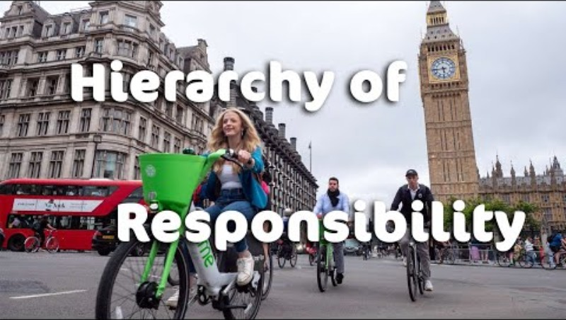
Hierarchy of Road Users Explained

Slide 10

Task:
You are going to spend the next half an hour doing some detective work. Imagine you’re a collision investigator, working for the Police. You have been handed this case file. It is up to you to determine who was at fault for the collision detailed in the casefile. Using the evidence available to you. After half an hour, the class will come back together, and you should share your conclusions. You should be able to say: A) Who was at fault. B) Who should have acted more responsibly

Slide 11


Casefile Contents
This casefile contains:
Crime Scene Maps
Crime Scene Positioning
At Scene Incident Reports
Photographic Evidence
Witness Statements
Highway Code Extracts
LOCATION: WIGSTON ROAD
DATE: 18/11/2025
CRN: 16255687425
COLLISION CASEFILE
Report Page 1

Slide 12
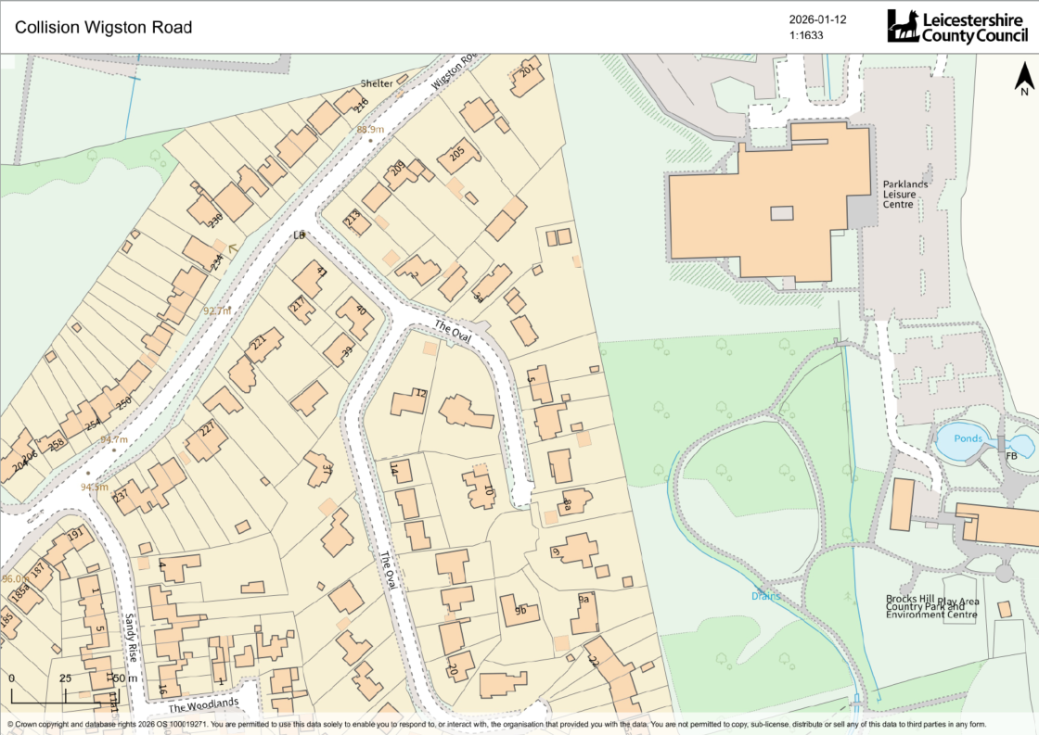
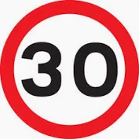

Conditions: Dry
Light/Dark: Dark
Street lighting: Yes
Daniel driving Southbound
30 MPH zone
Dylan walking southbound from
Formal crossing point
Report Page 2
Notes:
Traffic lights further down the road Dylan could have used
Speed limit is 30mph

Slide 13
Crime Scene Positioning
Collision Location:
Pedestrian [D. Birch] and Vehicle collided on Wigston Road.
Vehicle Direction of Travel:
Vehicle travelling southbound, down Wigston Road, prior to collision.
Pedestrian Direction of Travel:
Pedestrian [D. Birch] travelling southbound down Wigston Road, on east side pavement, moved from East to West pavement, to visit his friends who lives at No.250 Wigston Road.
Report Page 3

Slide 14
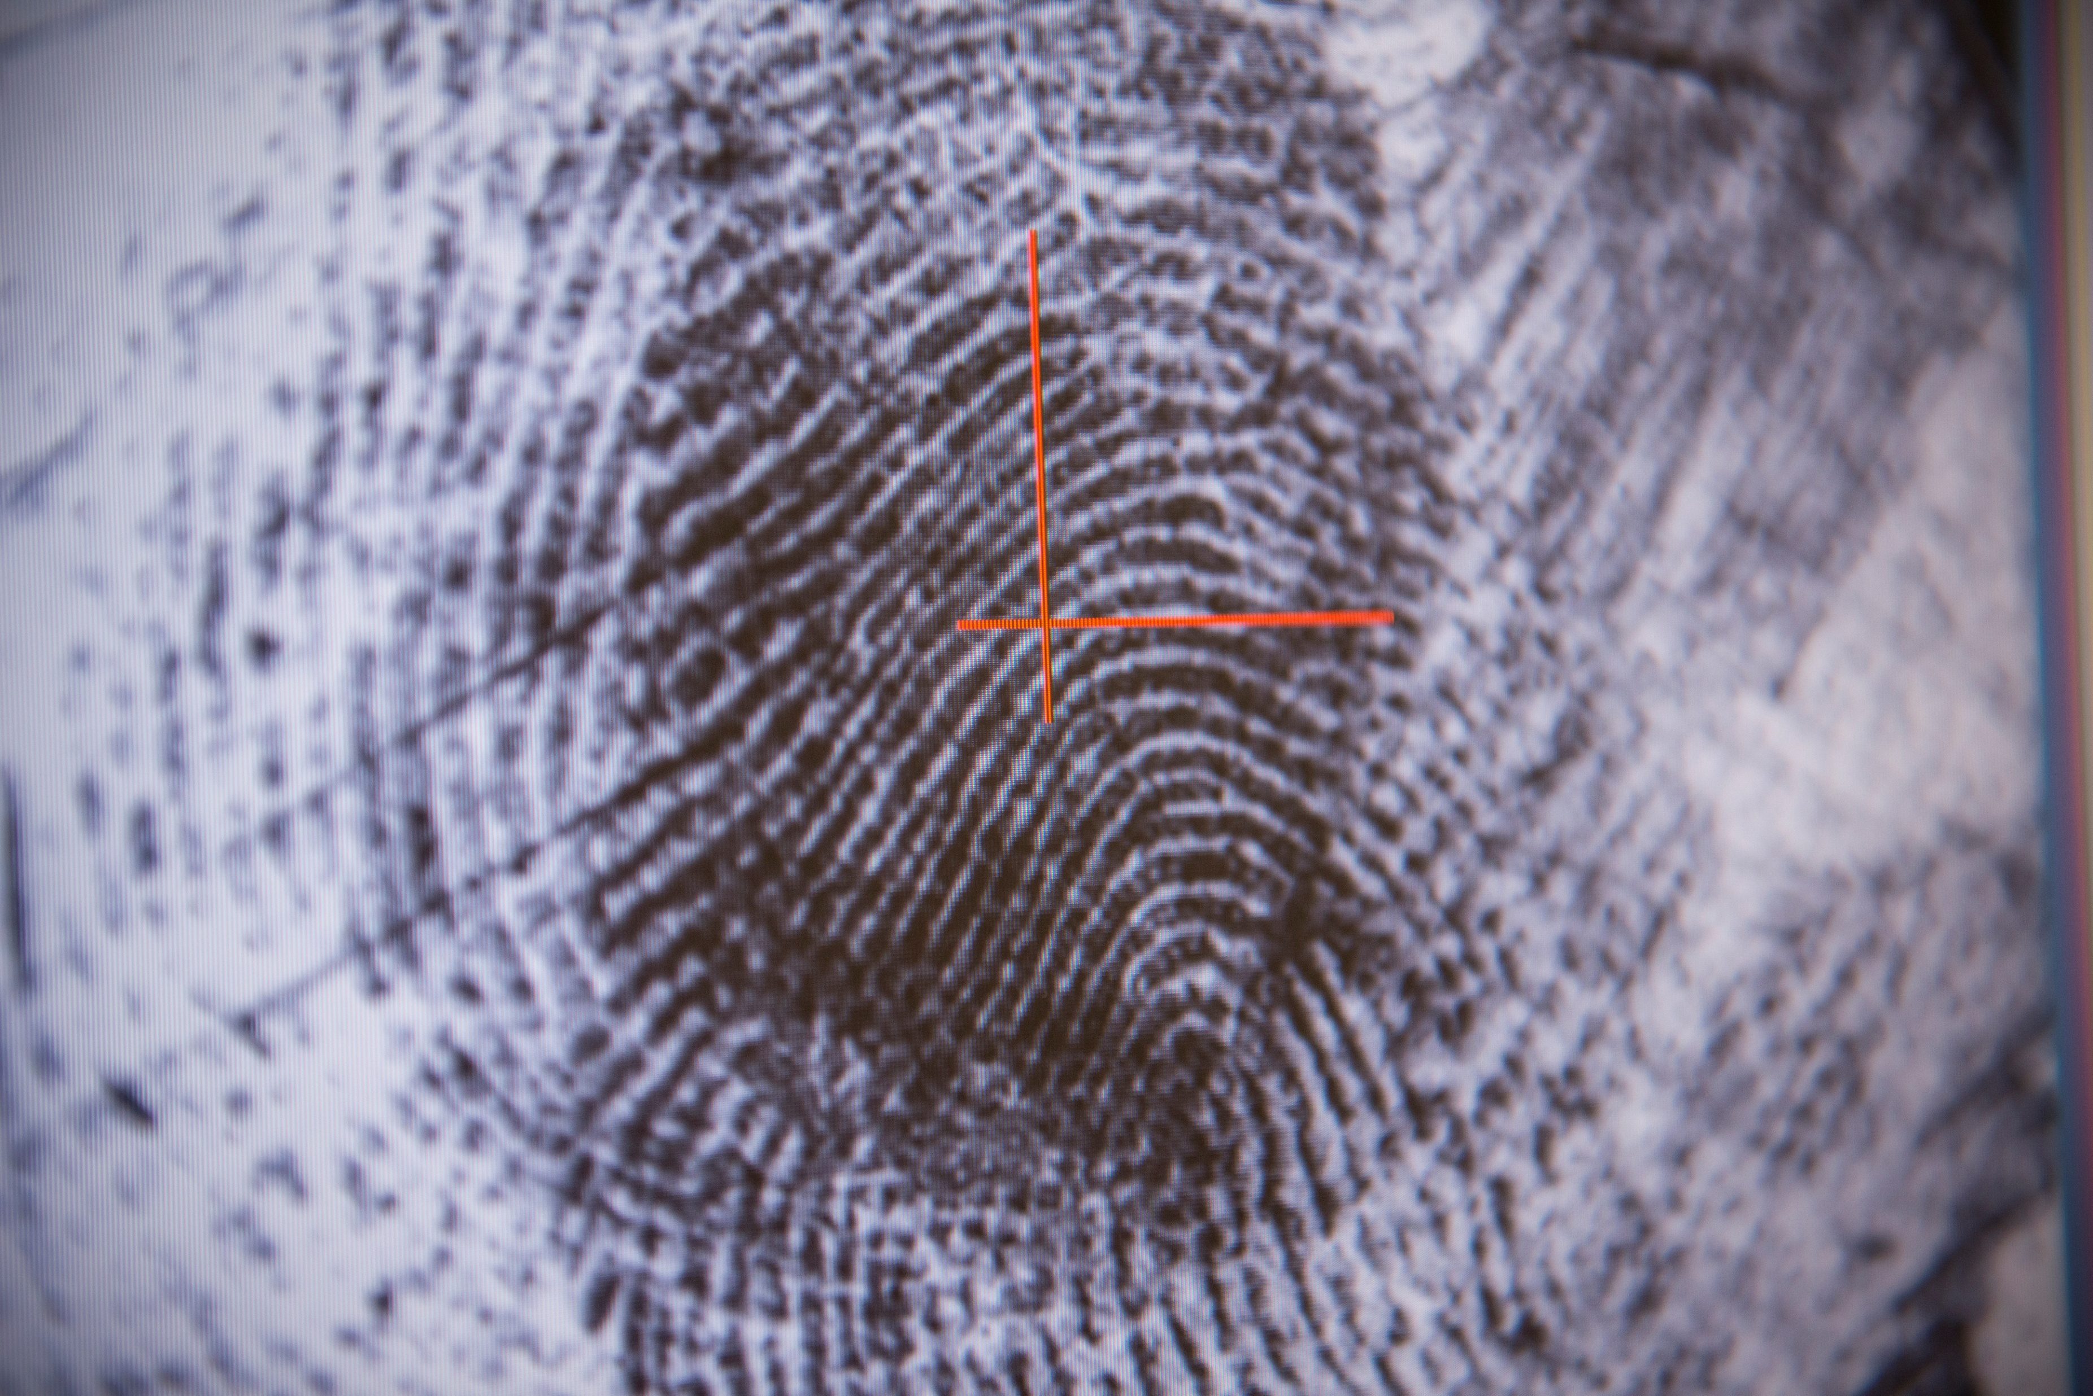
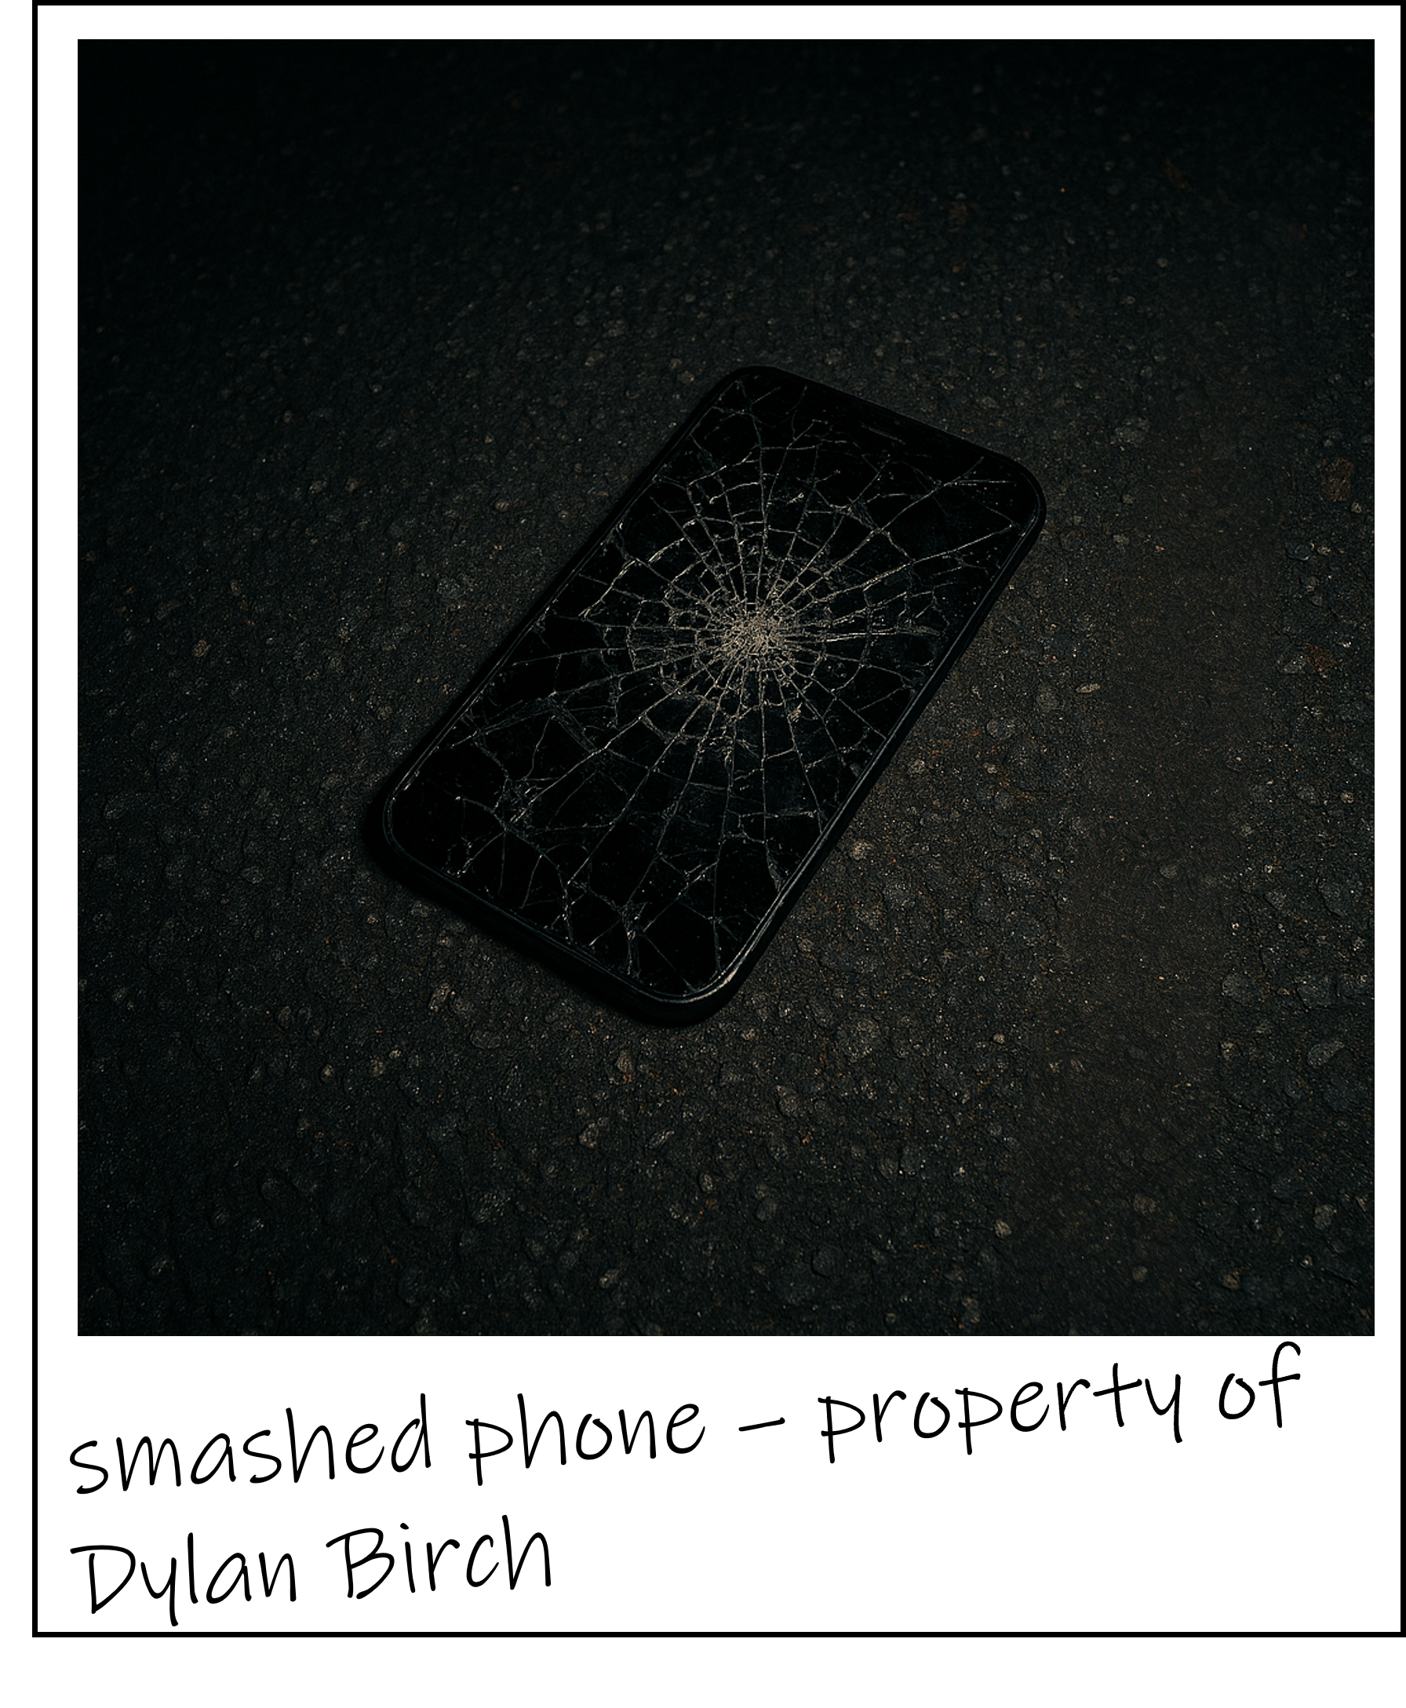
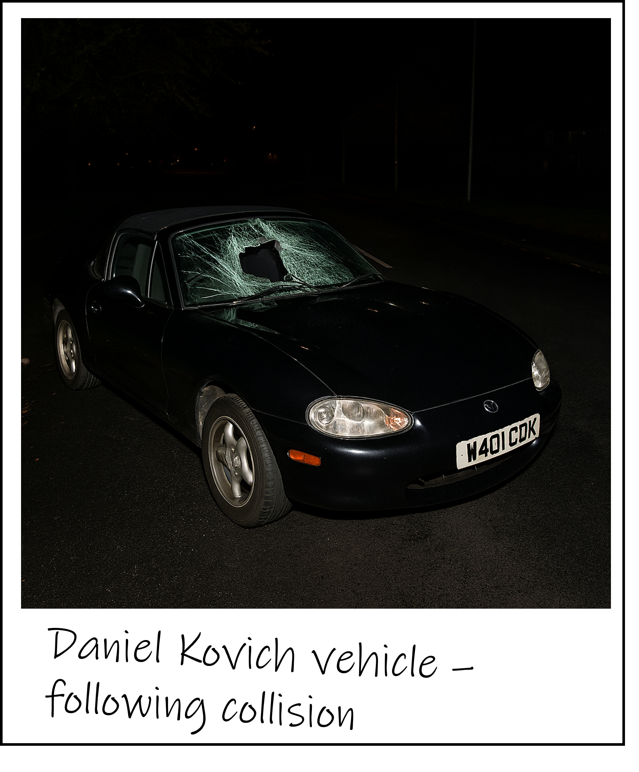
Evidence
Evidence
Report Page 4
Notes:
Add in roadside breath test (driver) - positive

Slide 15
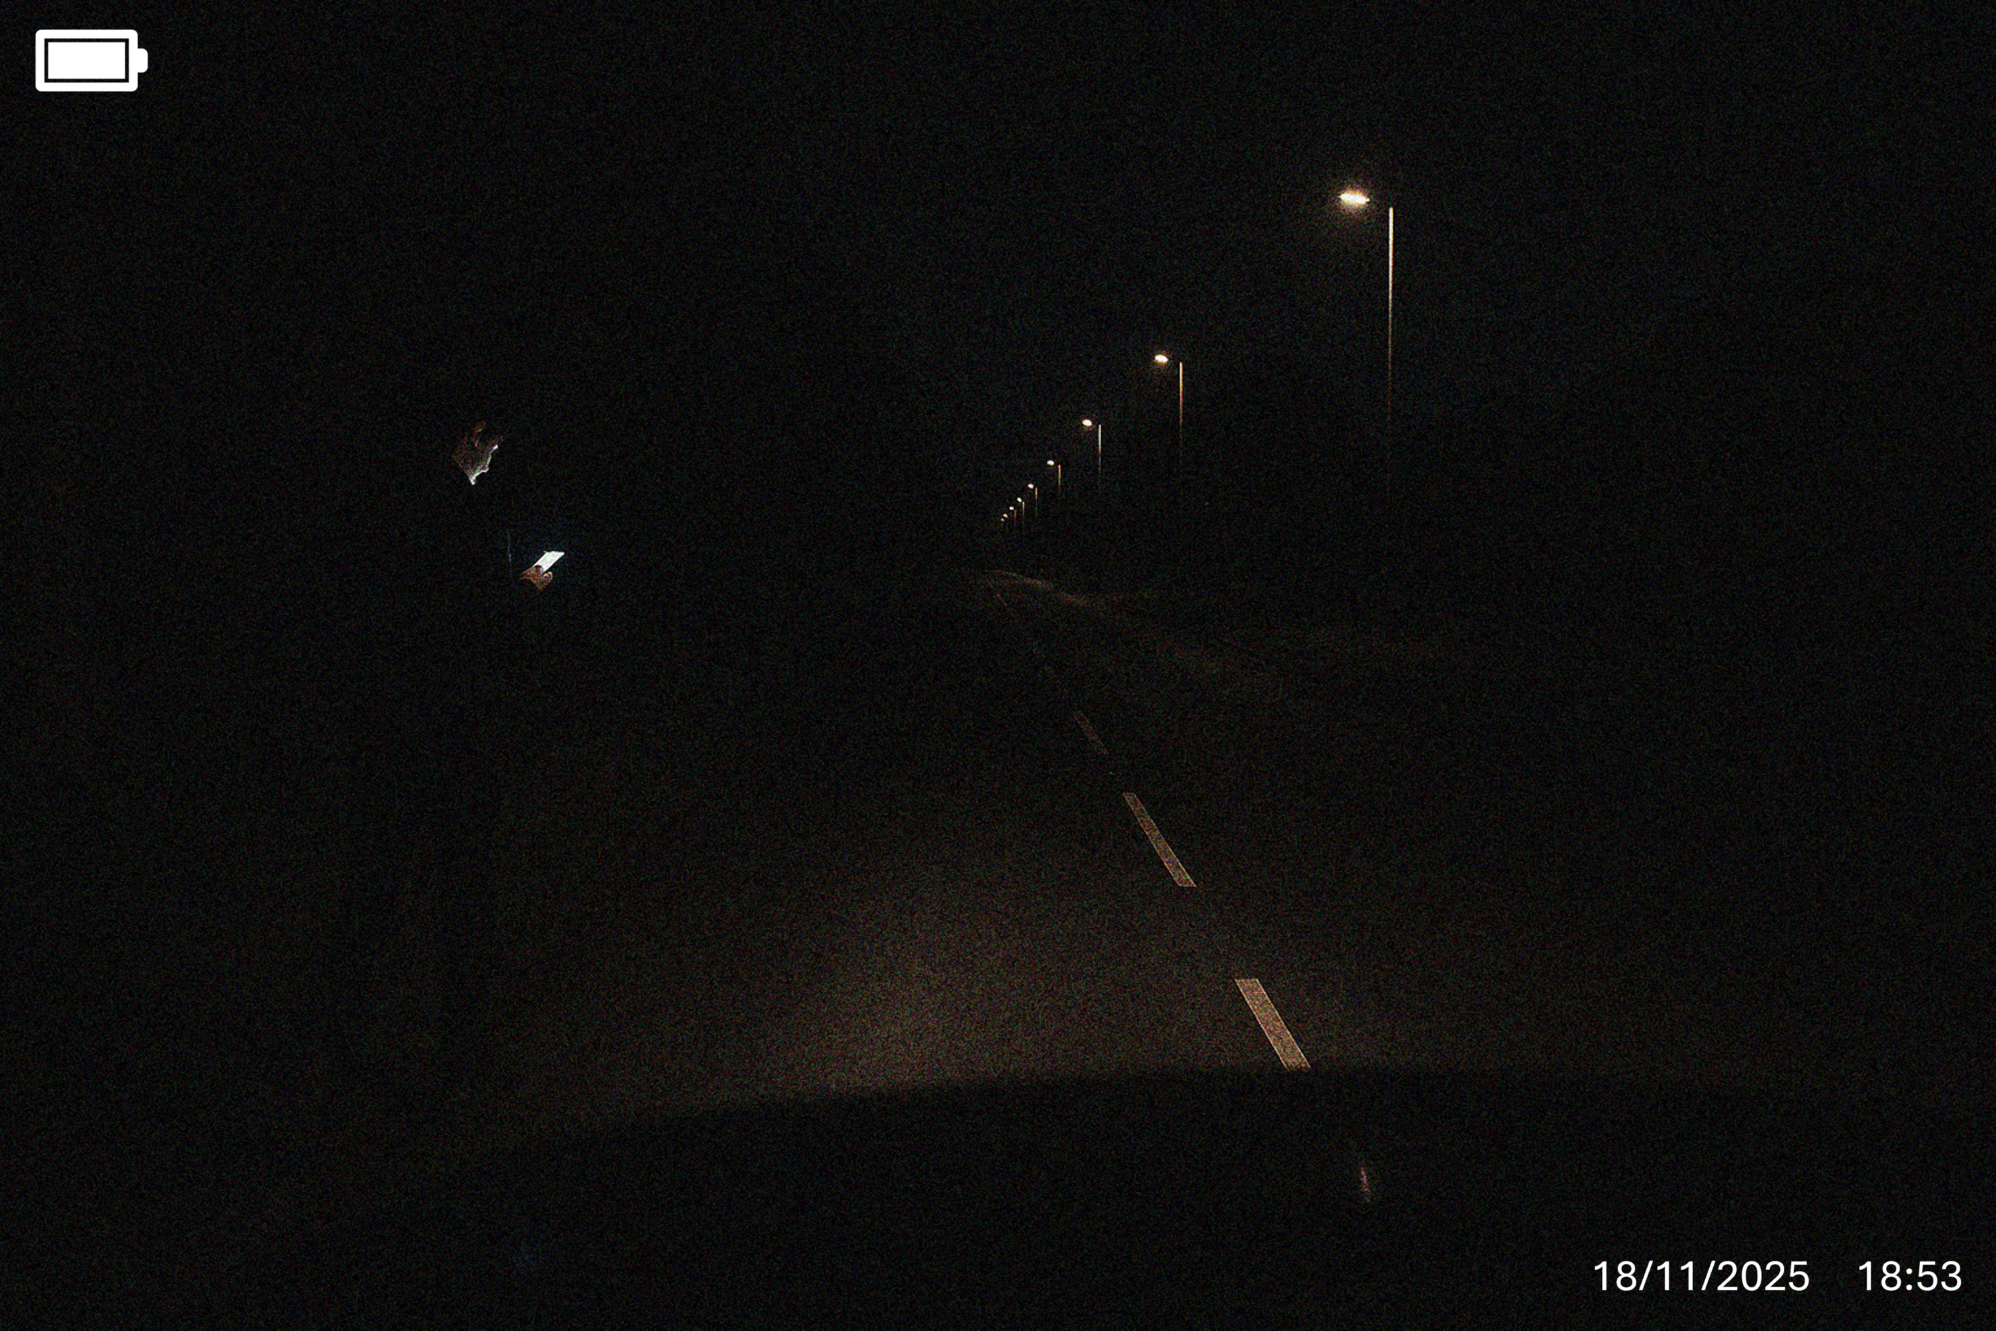
Dashcam footage – captured by R. Simm. Depicts D. Birch two minutes before collision
Report Page 5
Notes:
Boy on the phone in front of the car, minutes before the crash.
Note the boy is all in black, no reflective strips on coat

Slide 16
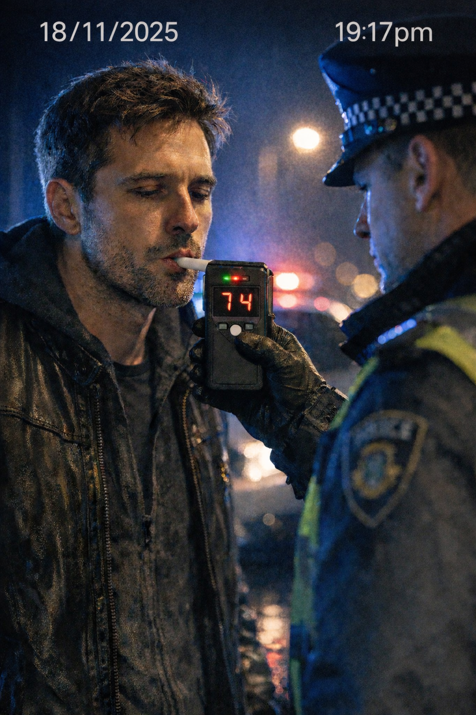
The police were suspicious of Daniel’s behaviour and asked him to do a breath test. He blew 74, over double the limit.
Report Page 6

Slide 17
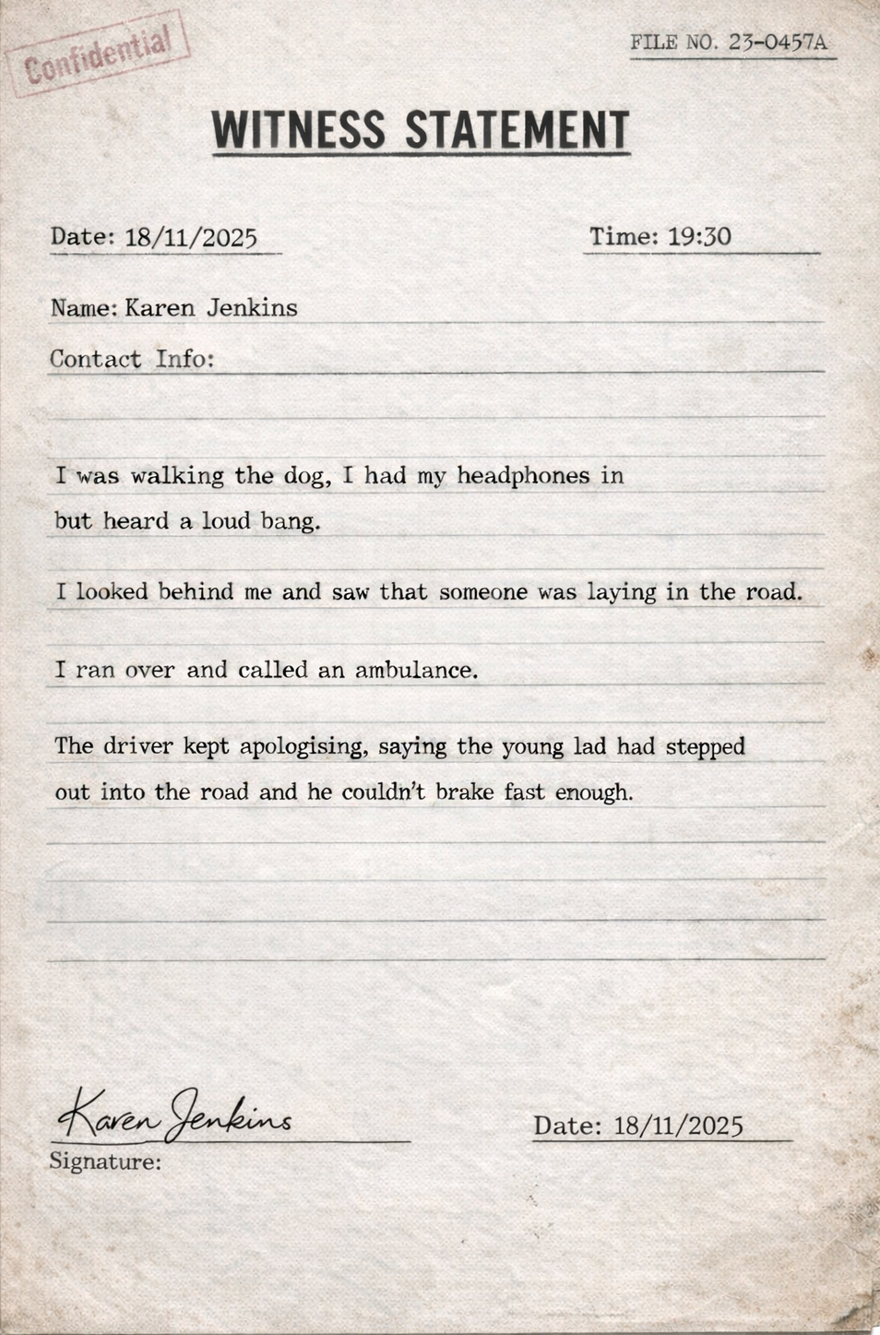
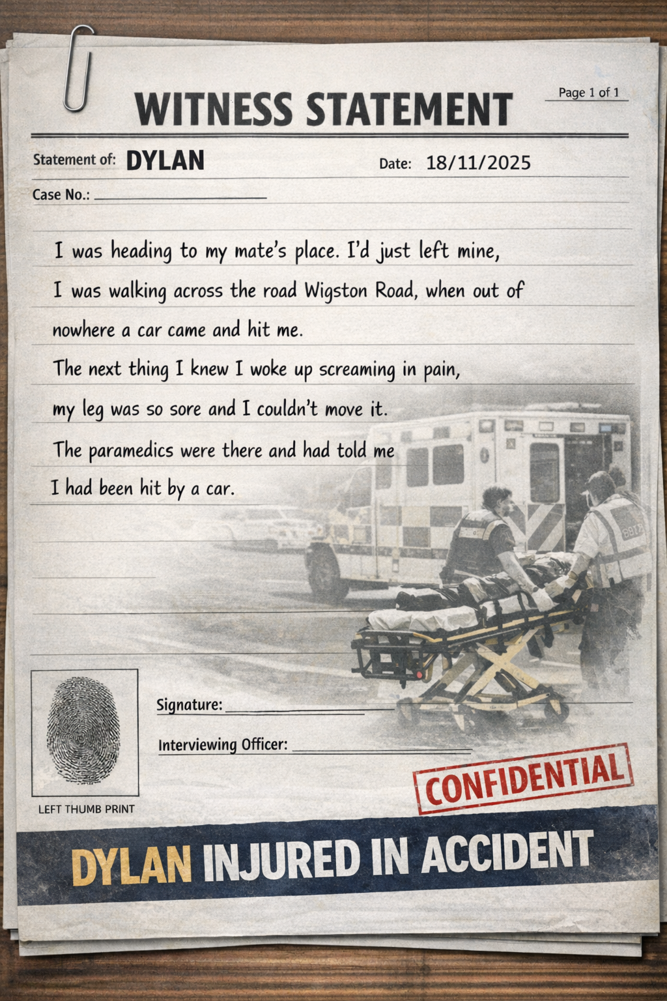
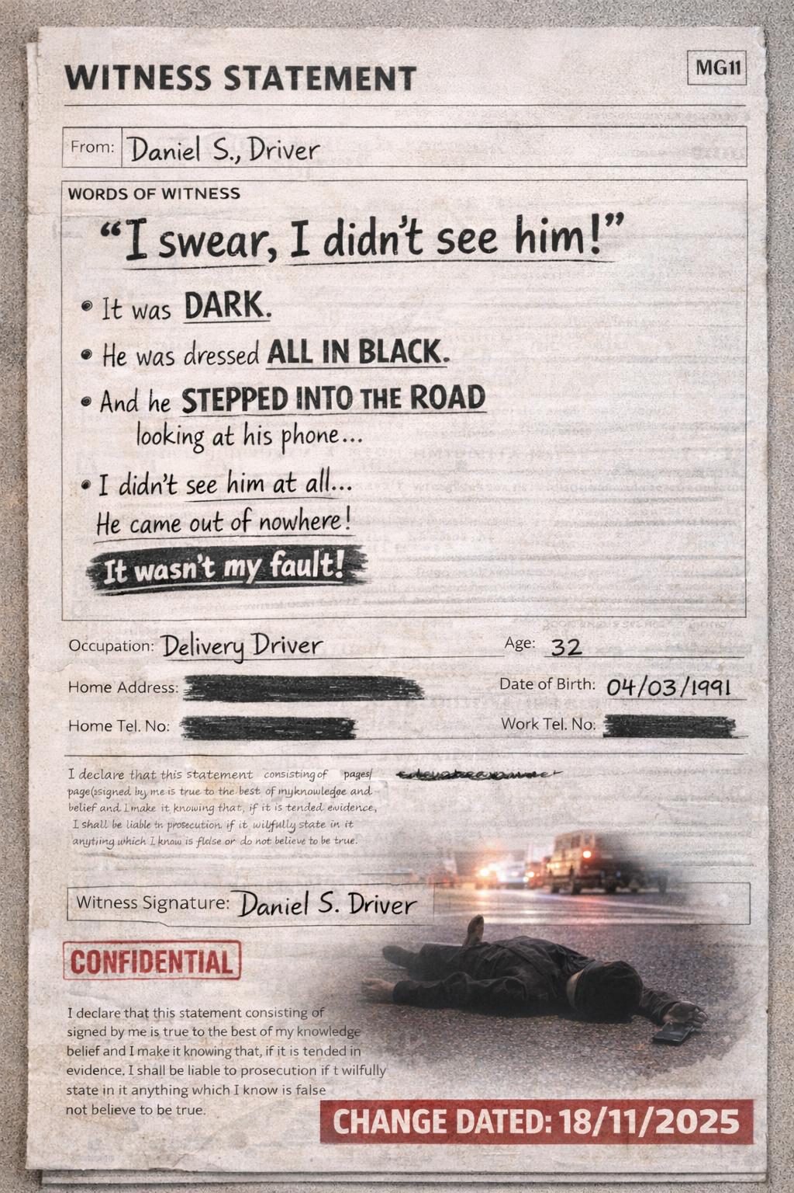
Witness Statements
Report Page 7

Slide 18
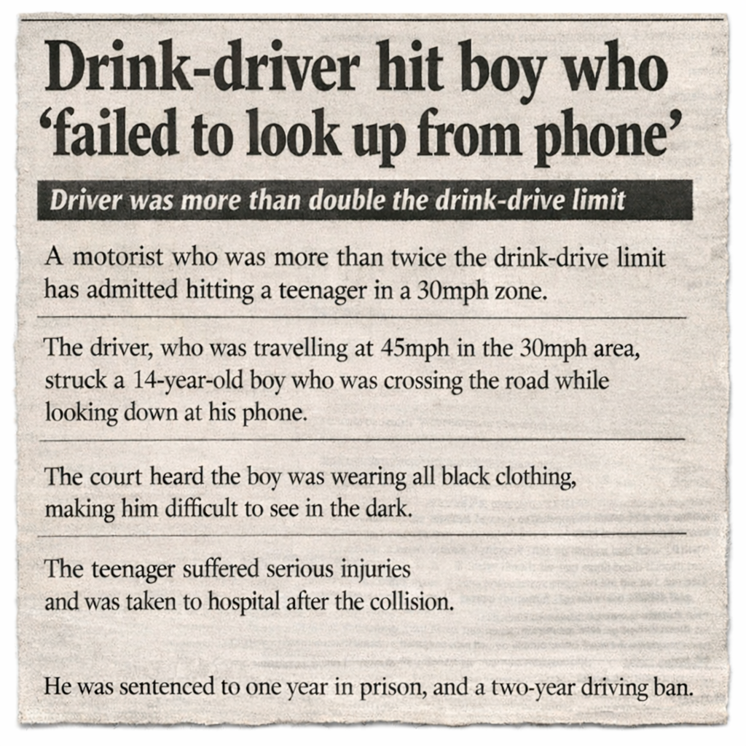
Outcome
Report Page 8

Slide 19

Analysis of the event…
Write down;
How could everyone have made better choices that evening? Daniel/Dylan/Witness
Do you think Daniel’s sentence was the right length?
Will Daniel’s punishment make Dylan and his family feel better?
How will this incident affect Daniel and Dylan’s social, emotional, physical and mental wellbeing?
Notes:
Daniel was with double the amount of alcohol allowed
Daniel was driving at 45pmh in a 30mph zone
Dylan was wearing all black
Dylan was on his phone
Dylan didn’t use the basic, stop, look, listen, think
Dylan didn’t use a formal crossing
Karen had headphones in, so couldn’t hear her surroundings very well, also for her personal safety might have been better to only wear one headphone.

Slide 20
Daniel was guilty and should not have drunk before driving, nor should he have been travelling at 40mph in a 30mph zone.
However, Dylan could have done more to protect himself, what are these actions?
Notes:
The basic of, stop, look and listen
Wore brighter colour clothing, or had something with a reflective strip
Stopped looking at his phone before crossing the road
Used the formalised crossing further down the road

Slide 21
Identify one action you could take to make sure you stay safe when using the road?

Slide 22
. In the lesson today, you have acknowledged the changes to the highway code. You have applied these new rules to the collision, as well as your own knowledge to detect who was at fault. You identified steps that each person in the collision could do to take personal responsibility and looked at what you could do when using the road, to make sure you stay safe.

Slide 23
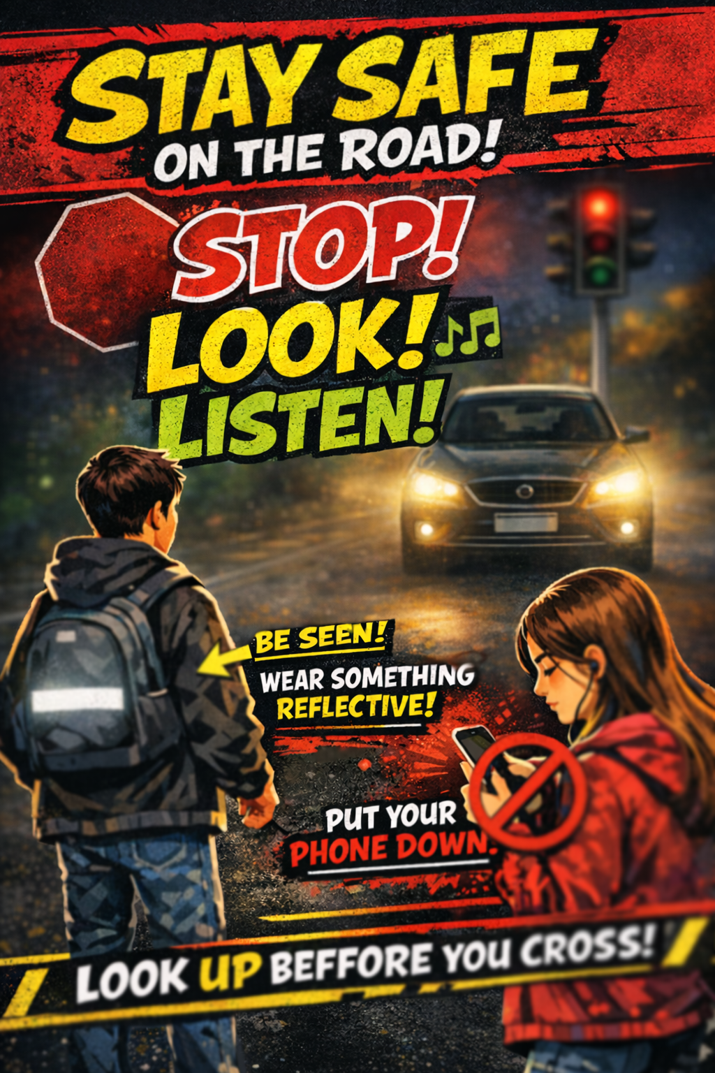

Slide 24
Thank you

Slide 25
Reference:
Photo by Pixabay: https://www.pexels.com/photo/pile-of-folders-357514/
Photo by MART PRODUCTION: https://www.pexels.com/photo/a-lamp-beside-a-stack-of-documents-on-a-wooden-desk-8872665/
https://www.gov.uk/government/news/the-highway-code-8-changes-you-need-to-know-from-29-january-2022
Photo by Leeloo The First: https://www.pexels.com/photo/question-marks-on-craft-paper-5428830/
Photo by cottonbro studio: https://www.pexels.com/photo/man-in-gray-long-sleeve-suit-holding-a-pen-8369520/

