Slide 1



Year 11
Passenger edition: keeping yourself and others safe!

Slide 2

Learning Objectives:
To identify the legal and social responsibility of a passenger to ensure safety during travelling independently.
To reflect on how we would act as a passenger in a dangerous situation

Slide 3
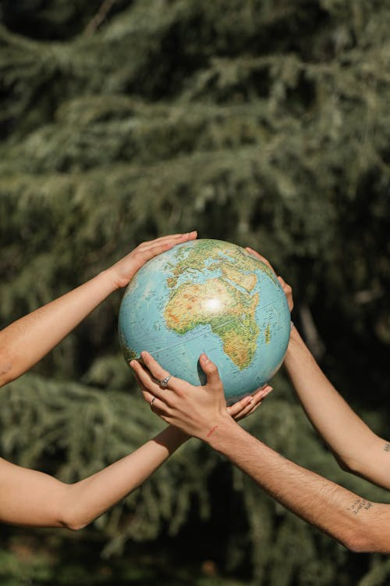
What is social and legal responsibility?
Social responsibility
Social Responsibility refers to the ethical obligation of individuals to act for the benefit of society.
Legal Responsibility
Legal responsibility means a duty placed on an individual to perform a task, imposed by law.

Slide 4
Passenger Responsibilities
Passengers have a legal and social duty to ensure safety during travel. This could be in a car or taxi, or on a bus, it is your role to act responsibly and promote responsible behaviour.
TASK:
List things passengers do that help drivers
List things passengers do that increase risk

Slide 5
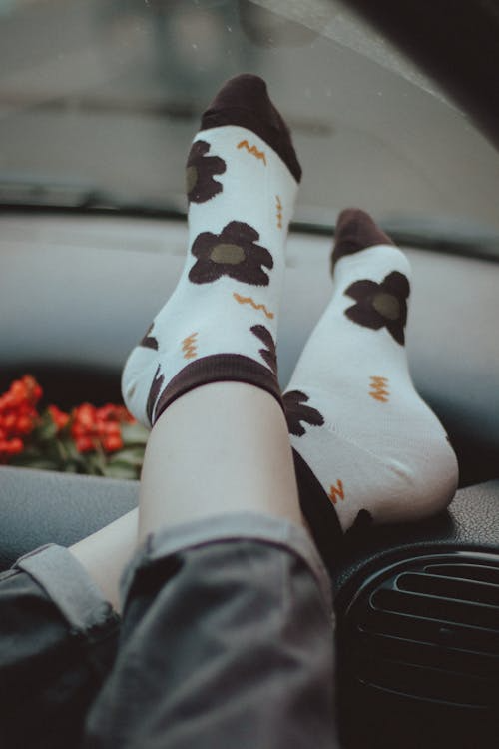
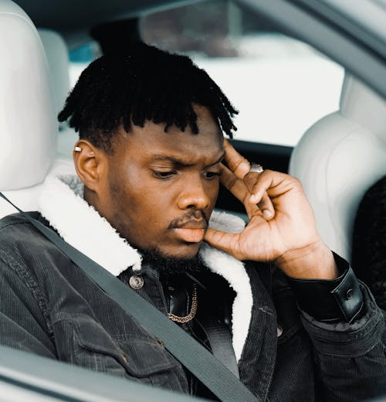
Passenger Responsibilities
Wear seat belts, always.
Phone away at night or turn facedown, as the glare from the screen can be distracting, as the drivers' eyes will divert to the light.
Don’t get in a car if the driver has been drinking or taking drugs, call an Uber or parents instead.
Avoid distracting the driver loud music/conversations, sudden movements, mobile phone use.
Help navigate, take control of satnav, directions, so they can concentrate on driving. Speak up if you can see a danger emerging but don’t be a backseat driver, as this will add pressure and increase the likelihood of the person making mistakes.
Sit still, try not to move around in the car while it is moving, feet on the floor not on the dash.
Respect other passengers and maintain appropriate behaviour.
Assist vulnerable passenger’s, elderly, disabled or young siblings, when safe to do so.
Do not interfere with vehicle controls, handbrake, gear stick or steering wheel.
Do not abuse others, no shouting out of windows.
Following driver rules, take your rubbish out of the car when you leave.
Speed – if they are going too fast then tell them – it’s your life at risk!
Belt up

Slide 6
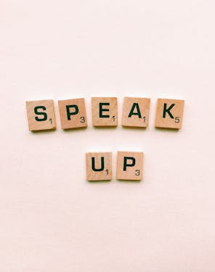
As a passenger it is important to speak up, to prevent accidents and improve overall road safety.
Drink/drugs, seatbelts, phone usage and speed are biggest killers so speak up;
Drink/Drug driving, tell them you're not getting in the car.
Speed, tell them to slow down and ask them to pull over.
Encourage them to put their phones away or ask them if you can help.
Ask them to put their seatbelt on!
Do so in a non-confrontational way.
You can either say you feel sick or need the toilet – the driver will then pull over. Once out of the car and it is calm, have a word and tell the driver you felt their driving was too fast or unsafe.
If you don’t feel confident to do this, text your parent/carer to let them know and ask them to pick you up.
By not speaking out and not wanting to offend others, you could risk your life and those of your friends.

Slide 7

Case Study
A 15-year-old girl was a backseat passenger in a car which was involved in a head-on collision.
At the time of the accident, she was leaning over the backseat to get something from the boot. She had removed her seat belt and was flung forward, hitting the windscreen causing extensive facial injuries.
Her treatment involved a consultant dermatologist, an orthopaedic surgeon, physiotherapists, and a skin camouflage specialist, as well as cognitive behaviour treatment for PTSD.

Slide 8
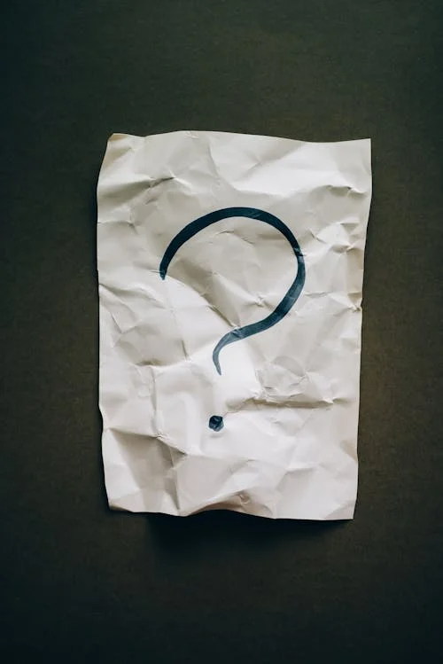
Discussion and question time…
If you were in this position, would you have done the same thing?
…it’s ok if you would have done this too.
If asked, would you lean over the back seat?
Would you feel confident to say no?
What could you say to the person asking you?
Is it worth doing, for the sake of risking your life or getting injured?
Would you speak out as a passenger if you felt unsafe, yes or no? Why?
As a driver bear in mind, if you ask a passenger to get something for you. The consequences can be huge.

Slide 9
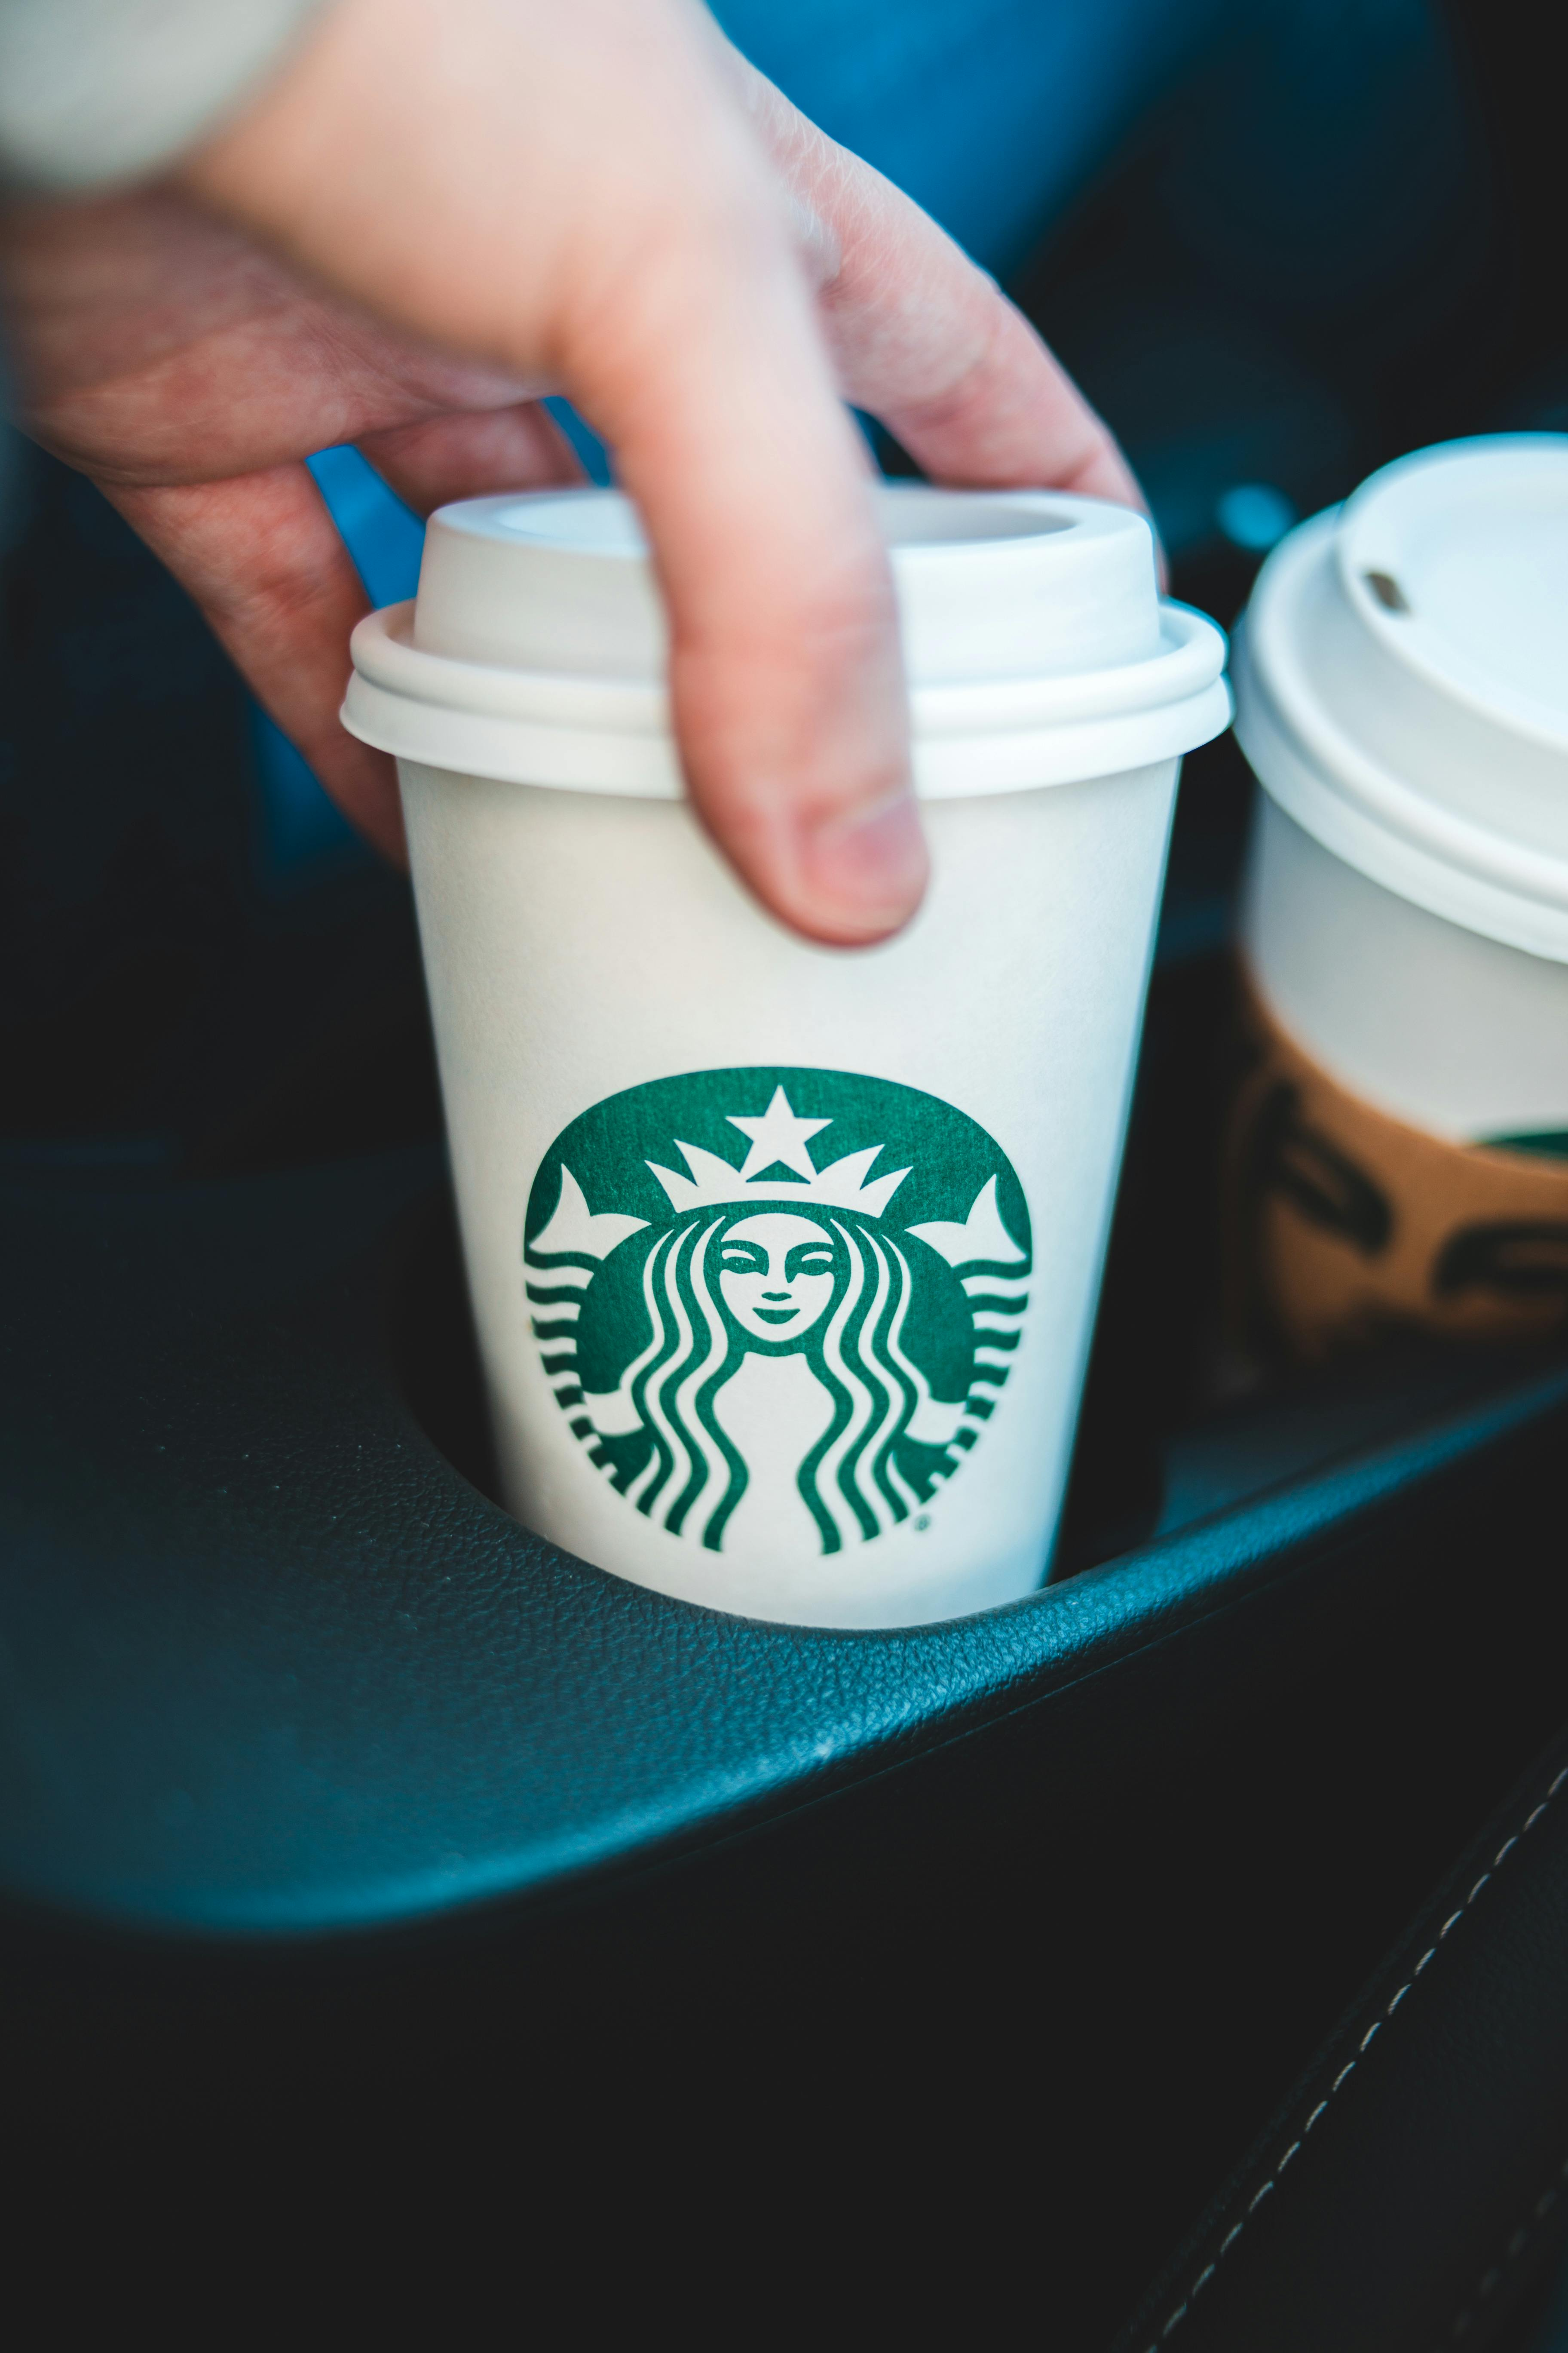
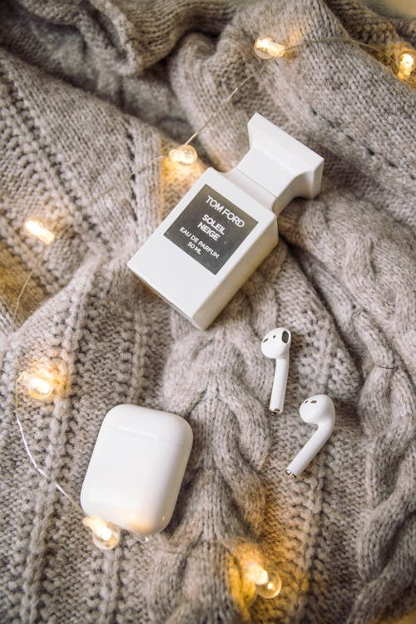
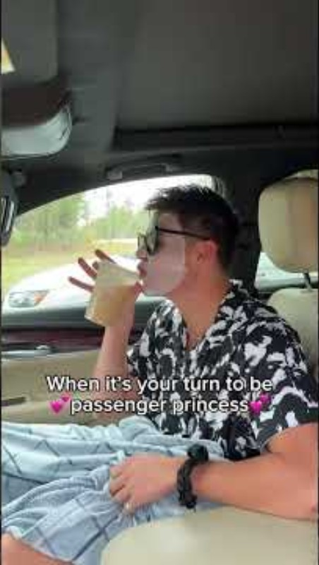
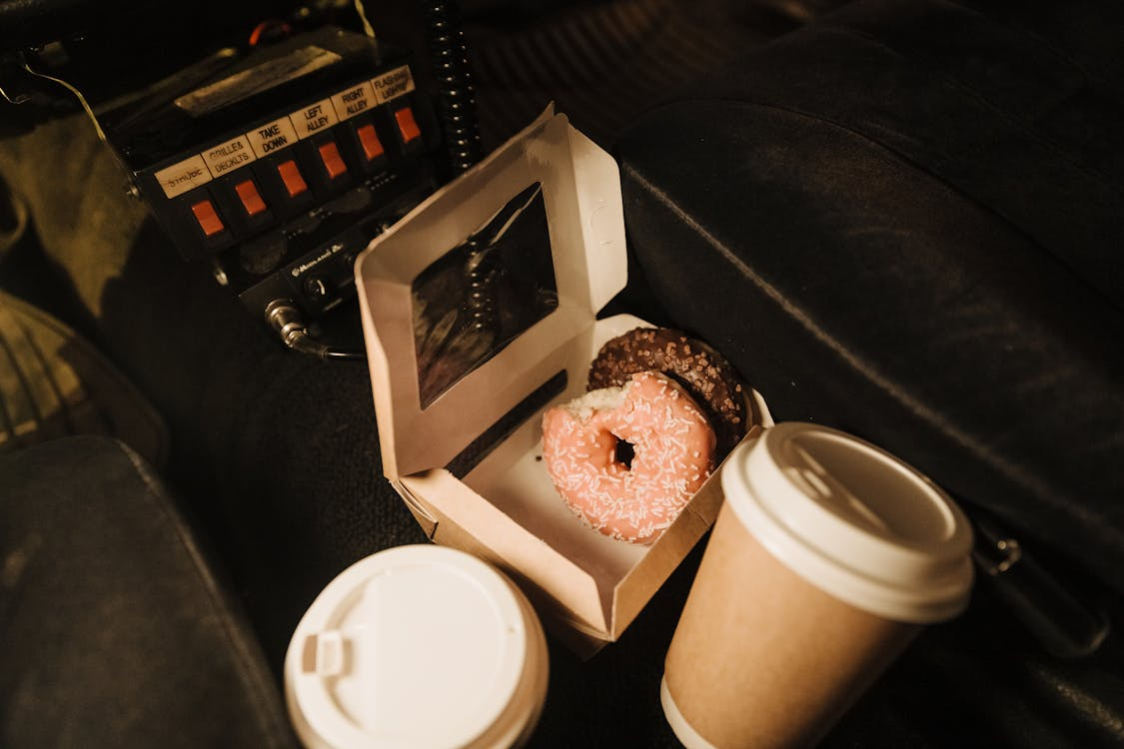
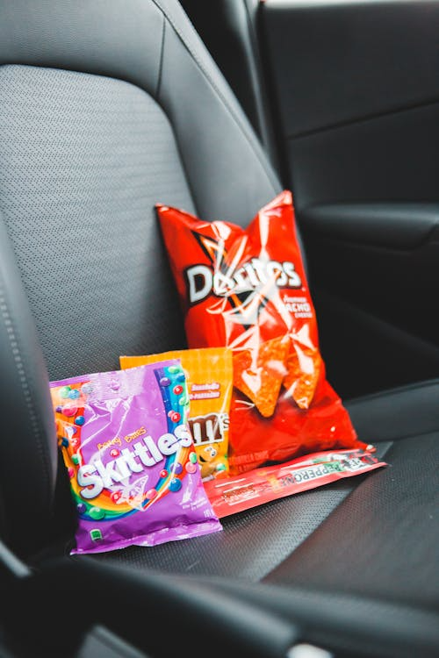
Be a Passenger Prince/ss: Sit Back, Relax, and Stay Safe!

Slide 10
Give an example to each table. Each table needs to state: The risk of each scenario. What is negative passenger response? What is positive passenger reaction?
Task
Example Scenarios:
A friend’s sibling is driving you home but state they have had a drink.
The driver is checking their phone at traffic lights.
Loud music and shouting in the back seat.
A driver is tired after a long day.
You’re running late and the driver starts speeding.
Your friend has been smoking cannabis at a house party but is also the designated driver.

Slide 11
Recap: State one thing you will do as a passenger to ensure you stay safe?

Slide 12
Thank you

Slide 13
References
Photo by amir graphy: https://www.pexels.com/photo/socks-with-flowers-18910081/
Photo by SALOMON BYUMA: https://www.pexels.com/photo/portrait-of-a-man-thinking-6650893/

