Slide 1



It’s not just you; it’s them! Future Drivers

Slide 2

Learning Objectives
Identify key road safety principles and risks when learning to drive.
Recognise the impact of distractions, peer pressure and poor decisions.
To develop confidence in making safe choices on the road.

Slide 3
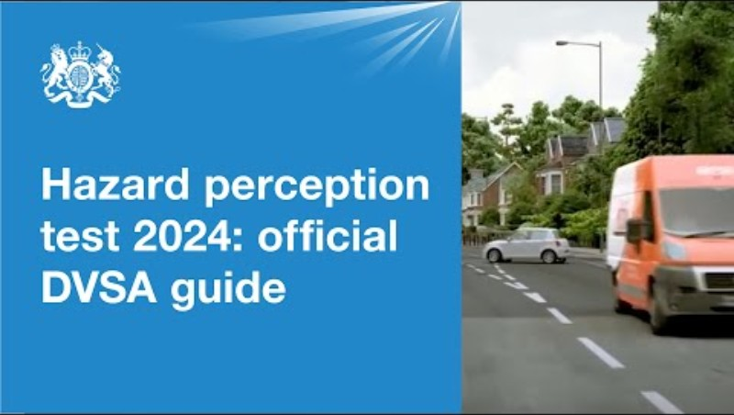
Can you spot the risks?
Notes:
ps://www.youtube.com/watch?v=SdQRkmdhwJs

Slide 4
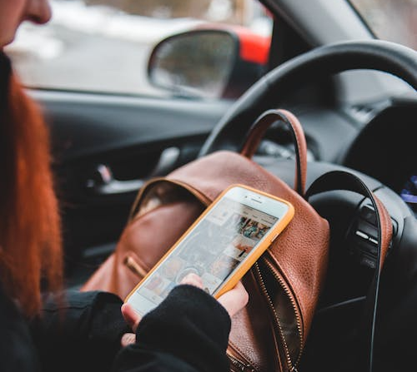
What are some dangerous behaviors whilst driving?
Speeding
Texting
Eating
Distractions – friends
Not wearing a seatbelt
Drink/drug driving
If you are doing any of these, it will be hard to see the hazards arise, that you have just watched.

Slide 5
You will hear this time and time again from parents, grandparents or carers. It’s not just about you breaking the rules and doing things you shouldn’t. It’s about being aware of other drivers who could be doing the same. Other drivers will be breaking the rules or distracted, and if you are too, you won’t have a quick enough reaction time to potentially do anything about it.
It’s not just you, it’s them…

Slide 6
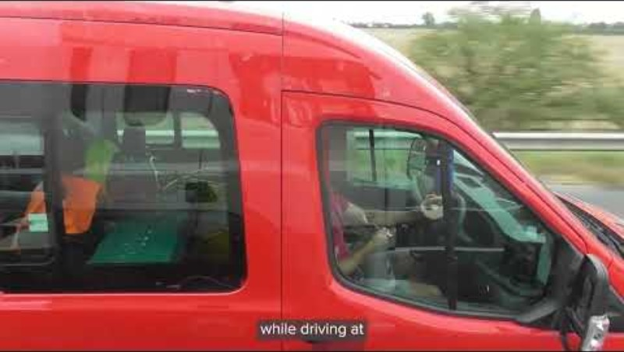
It’s not just you, it’s them…distractions
The driver is using WhatsApp and swerving between lanes.
If you were passing and they swerved, they could crash into you, but if you were paying attention, you might be able to react.
If you were also on WhatsApp and they swerved, this would be near impossible to react to.
Notes:
https://www.youtube.com/watch?v=k0qwhFvC8lY

Slide 7
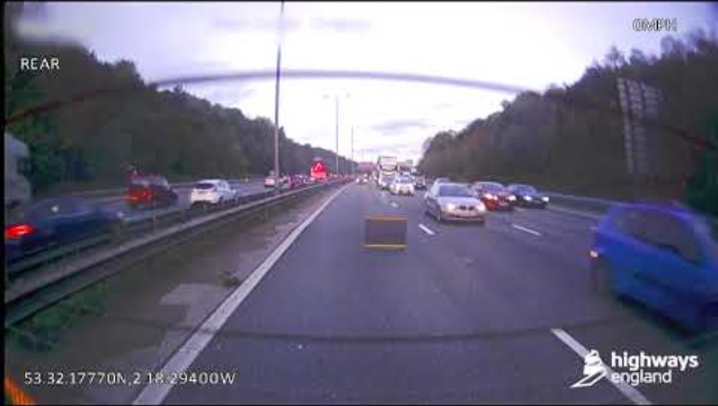
It’s not just you, it’s them…obeying signs
Driver ignored the lane closure sign on the screens and narrowly misses being hit by a HGV. If the lane states its closed move out of it, as early as possible. It’s not worth risking your lives and others to get 2 minutes ahead.

Slide 8
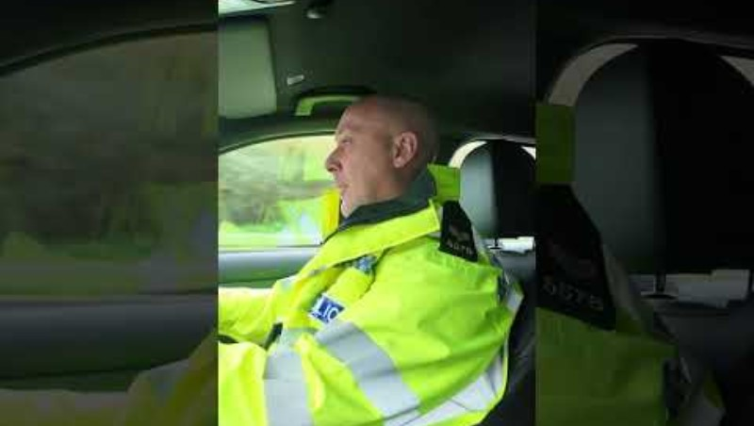
It’s not just you, it’s them…drink and drug driving
If police think you have been drug or drink driving, you will get tested at the side of the road to determine if you have drugs or drink in your system.
Everyone’s body reacts different to drugs and drink, so you have no idea how long it will stay in your system.
Be careful the next day after a night out with friends, driving back from a festival or a trip away. Most people get caught driving home the next morning.
Be aware and focus on the road, because you don’t know who might be driving under the influence, you may need to react quickly to their mistake.
Notes:
https://www.youtube.com/shorts/6ghF14Y5jjk

Slide 9
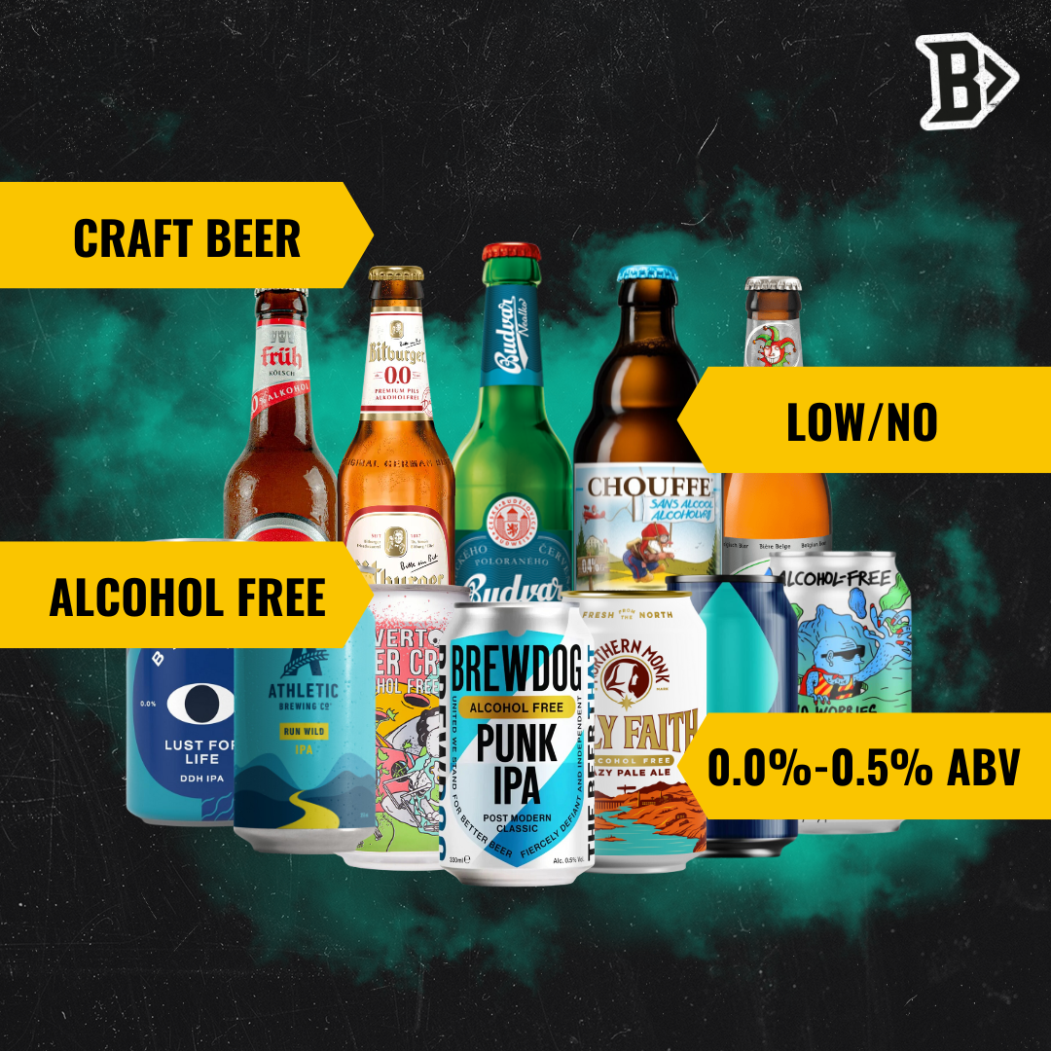
It’s not just you its, them alcohol limits…
Tip: If you want to drink, there are many 0% alcohol options available now.
There are strict alcohol limits for drivers in all parts of the UK. The limits are based on the amount of alcohol detected in someone’s breath, blood or urine.
It isn’t possible to work out how many units of alcohol will put you over the limit. That’s because it will be different for each person.
Due to;
Your weight, age, sex and metabolism (the rate your body uses energy)
The type and amount of alcohol you’re drinking
What you’ve eaten recently
Your stress levels at the time

Slide 10
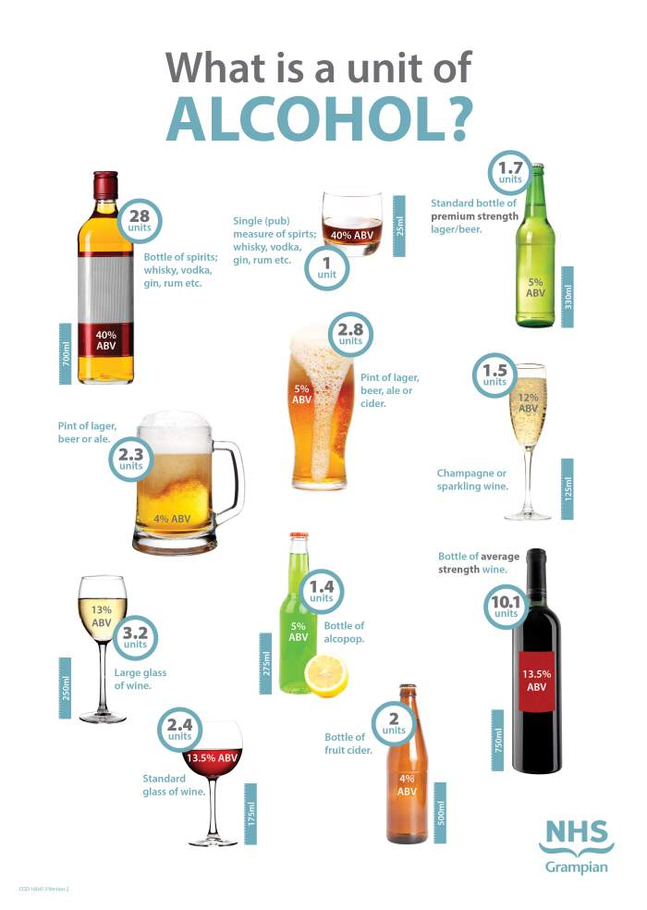
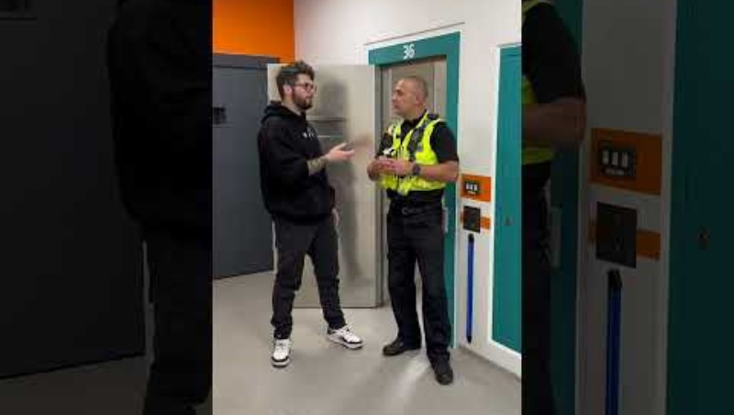

Slide 11
It’s not just you, it’s them…
When you are distracted or impaired: using your phone, eating, loud music, not abiding to the road signs or changes, you are also unaware of all the other people doing the same thing.
If you pay attention to the road, you have more chance of reacting to someone else’s mistake.

Slide 12
Case Study

Slide 13
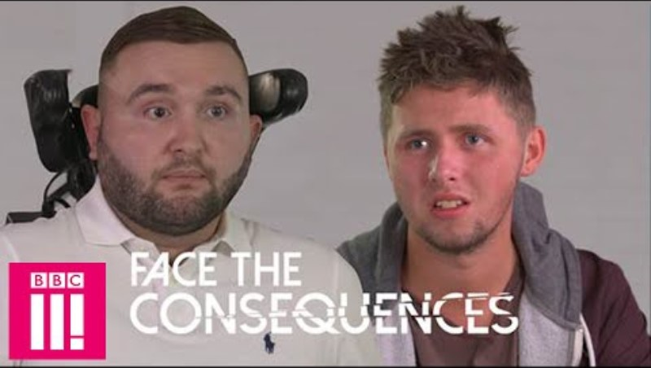
Face the consequences…
Notes:
https://www.youtube.com/watch?v=rvvveKDQfGk

Slide 14
It won’t happen to me…but…what about them?
How do you feel about the footage?
Do you think this could ever happen to you?
What responsibility do you have to others on the road?
What are the financial costs of reckless driving?
What are the emotional/phycological impacts?
Should repeat offenders have a complete ban on driving?
Notes:
What emotion did you feel?
Ask the learners if they brushed it off, as ‘yes, it’s sad, but that would never happen to me’? Give an example of where it could happen to them, friend driving to fast, boyfriend/girlfriend showing not knowing the road, driving to fast. https://www.leicestermercury.co.uk/news/local-news/teenage-dies-after-leicestershire-village-10772024 – link to local story.
To keep others safe, even if I want to show off, to protect those who are vulnerable, also cyclist, pedestrians as the car can cause so much damage to these people using the road. Also think about, young, elderly, additional needs.
Financial cost – NHS, fire, police services, damage to road, damage to car, if you work or go to school impact on this? Cost to parents, time off work?
Emotional/Phycological impact – on both them, the person in the car, or the pedestrian, their parents, friends, school? Depression, anxiety, PTSD
Discuss: Should repeat offenders have a complete ban on driving? Would stop them being able to hurt others, but what about impact on their ability to work, if they are isolated could this cause other issues?

Slide 15
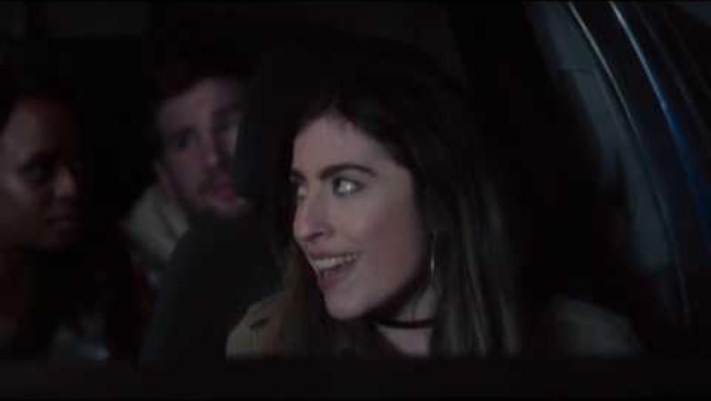
Light-hearted… Drive like Grans in the car…
Think about peer pressure from your friends, boyfriend/ girlfriend, who are in the car with you, pressuring you to driver faster or to look at something on their phone.

Slide 16

When it doesn’t feel right, it’s not.
THINK: Are your friends distracting you? Can you concentrate?
SPEAK: Tell them to be quiet, if they continue tell them you don’t feel well and might be sick, so will drop them home. This also works if you are in someone else’s car and feel unsafe, tell them you think you might be sick or need to go to the toilet.
DO: Ask them to pull over and get out, then phone or text someone to pick you up. You could also ask them to slow down, as you ‘don’t want to be sick in their car’, this will usually make them slow down as they don't want to be clearing up sick.

Slide 17
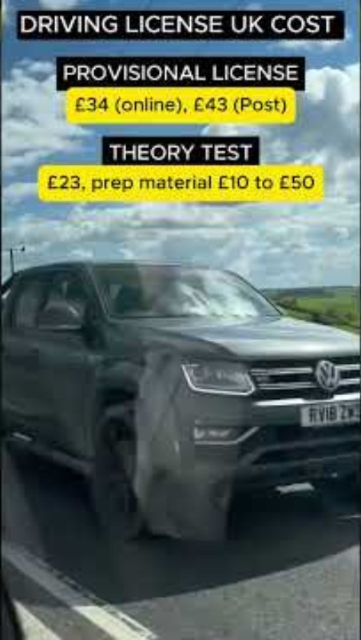
How much does it cost to learn to drive?
Roughly £1800
So don’t pay it twice, by loosing your license!
Notes:
https://www.youtube.com/shorts/RKlEgCiYdRw

Slide 18
RECAP
Give three pieces of information you remember from today’s lesson.
Explain two new facts you didn’t know already.
Pledge one thing you will do when learning to drive to make you and others safer on the road.

Slide 19
Reference
Photo by Erik Mclean: https://www.pexels.com/photo/female-driver-using-smartphone-in-car-4061593/
DGN Driving: https://www.youtube.com/watch?v=-FD0C-xEXhI
Prem Kumar UK: https://www.youtube.com/shorts/RKlEgCiYdRw
Scottish Government: https://www.youtube.com/watch?v=QbrYzezp7e8
BBC: https://www.youtube.com/watch?v=rvvveKDQfGk
GCMYT: https://www.youtube.com/shorts/8v1A54CLF5E
GMCYT: https://www.youtube.com/shorts/6ghF14Y5jjk
National Highways: https://www.youtube.com/watch?v=0-oXBCb-Cw8
Driver and Vehicle Standards agency: https://www.youtube.com/watch?v=SdQRkmdhwJs
Photo by Ann H: https://www.pexels.com/photo/colorful-letters-spelling-goals-on-orange-background-32370321/

Slide 20

Thank you!

