Slide 1
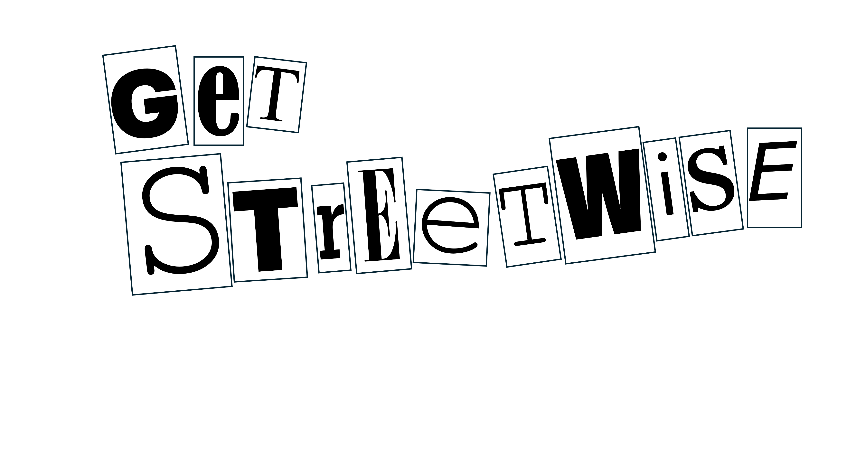


Year 13 Driving, and the consequences of doing so badly!
Notes:
I would change ‘doing so badly’ to consequences of making poor driving decisions

Slide 2
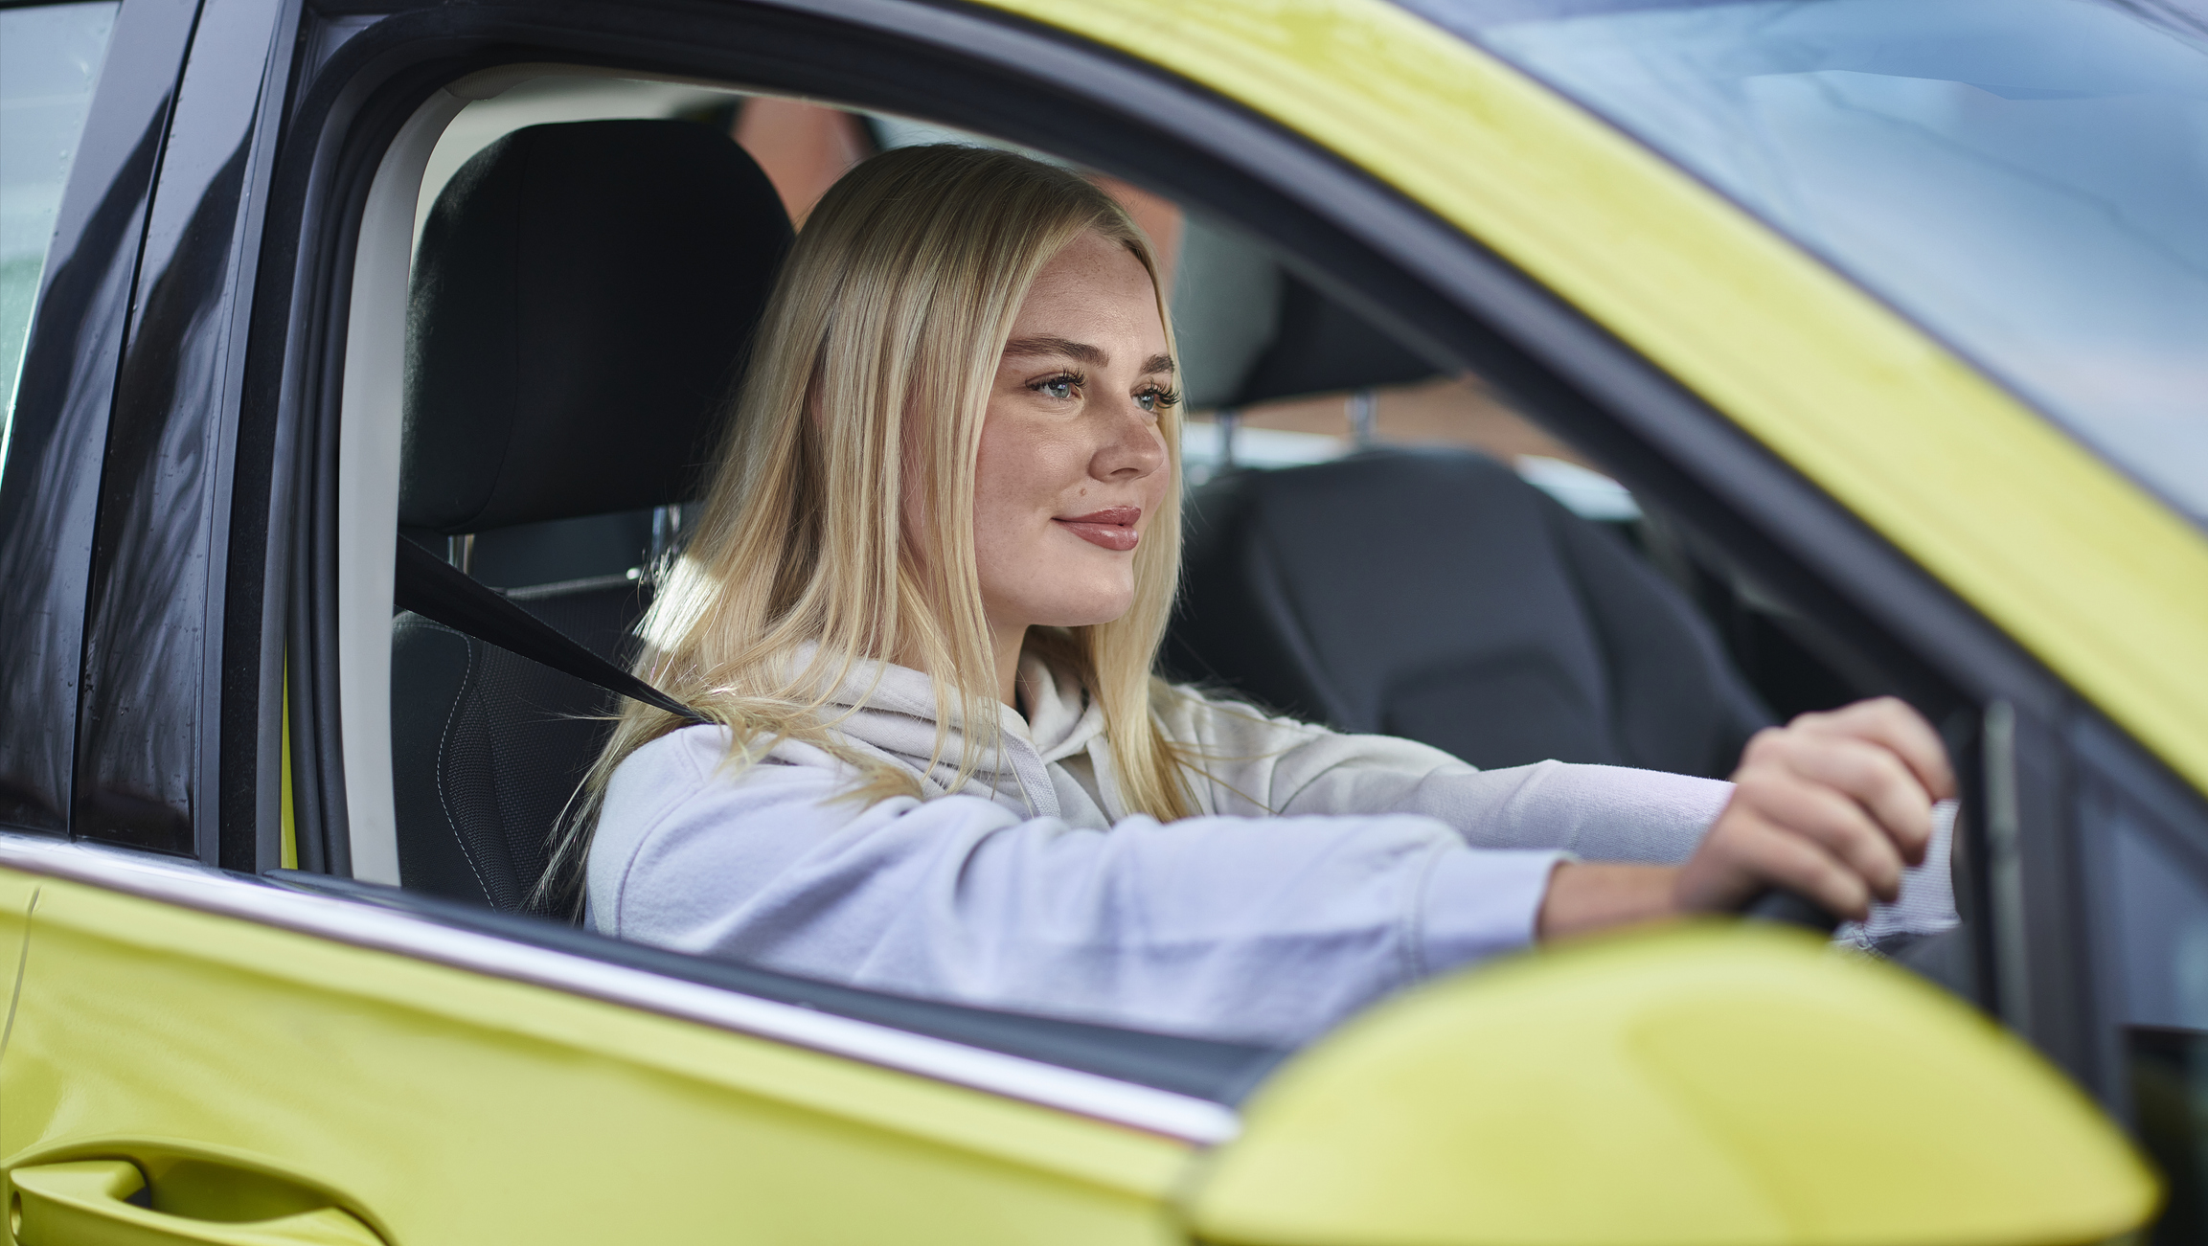
Learning outcome
I will be able to:
explain the impact that bad driving can have on myself
examine the consequences of bad driving
Notes:
Suggest –
Explain the impact that dangerous driving will have on myself
Examine the consequences of careless and inconsiderate driving

Slide 3
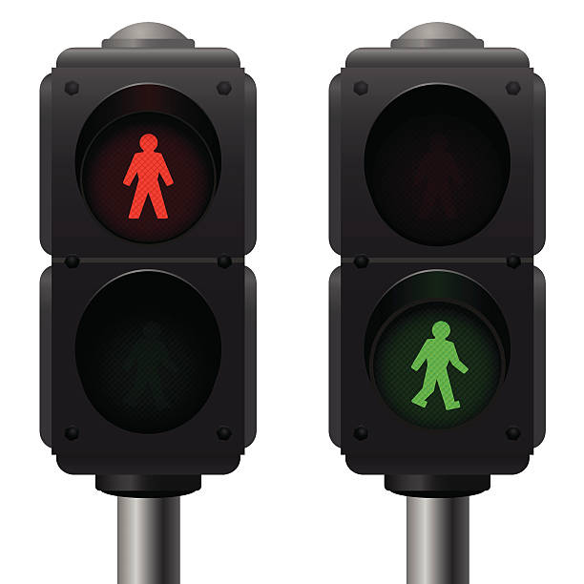
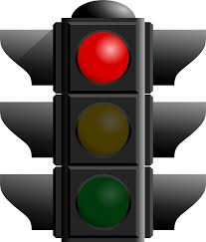
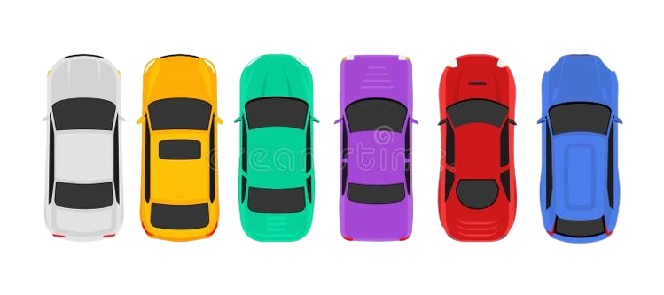
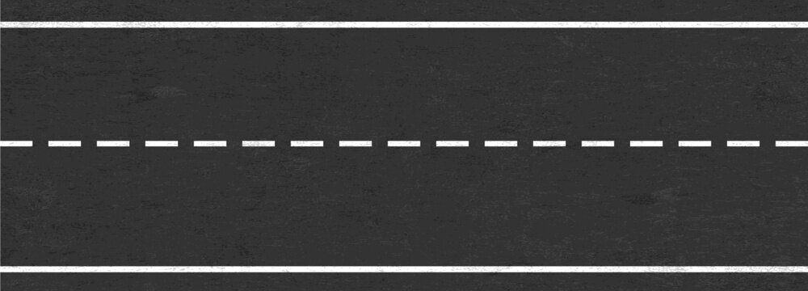
Scenario 1 A 19-year-old with two years experience is driving 10mph over the limit with friends in the car. They are distracted by loud music and jumped a red light.

Slide 4
In tables or small groups, think about the following questions?
What do you think about driving 10 mph over the speed limit?
Is this dangerous driving?
What could happen if you were driving 10mph over the limit?
Do you know the consequences of driving 10mph over the limit?

Slide 5
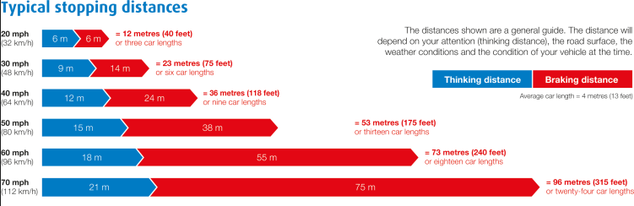
The distance between 30mhp and 40mph is
13 meters!
This could be made worse by drink, drugs, tiredness, distractions, weather.
Notes:
https://www.youtube.com/shorts/vS62Zua6aMU

Slide 6
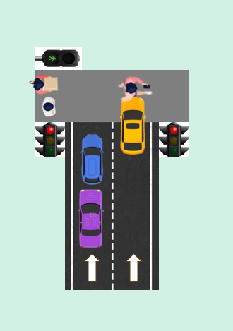
Scenario 2 A 19-year-old with two years experience is driving 10 mph over the limit with friends in the car. They are distracted by loud music and jumped the red light A 14- year-old on their phone, saw the green man but didn’t look before walking and collided with the car.

Slide 7
Now, think about the following questions again?
Do you think driving 10 mph over the speed limit is bad? Whatever your answer, state Why?
Is this dangerous driving?
What do you think about this situation?
Are any of these actions illegal?
If so what part?

Slide 8
Outcome 1
If the pedestrian is not seriously injured…
Be charged with driving without due care and attention (Careless driving)
Failing to comply with a traffic signal
Possibly using a handheld mobile phone while driving (if applicable)
Penalty: Fine and Points
Could be disqualified from driving
Potential court appearance

Slide 9
Outcome 2
If the pedestrian is seriously injured
Charged with causing serious injury by dangerous driving - this applies where driving falls far below the standard of a competent driver (e.g. distraction + red light)
Driving ban
Fine
Up to 5 years in prison

Slide 10
Outcome 3
If the pedestrian dies…
Charged with causing death by careless driving
Penalty (dangerous driving)
Up to 14 years’ imprisonment
Mandatory driving ban (minimum 2 years)
Extended retesting

Slide 11
What impact would these outcomes have on your future?
Even if it was the lesser of the three outcomes?

Slide 12
What will you do as a new driver to mitigate distractions?
Write all the distractions you might face as a new driver.
Write the different ways you can mitigations these distractions?
Notes:
Think about limiting passengers in the car
0 alcohol / drugs
Not using mobile phone / reading or looking at maps / eating/smoking / selecting or changing music
Asking passengers to be quiet or lower the noise

Slide 13
What is the one thing you will do as a driver to make sure you don’t harm yourself or others?
Notes:
Speeding / racing / driving aggressively / overtaking dangerously / misusing lanes (to get ahead) – unnecessary slow driving/braking / not dimming full beam (oncoming traffic dazzled)
Mobile phone use (including maps / music) - distraction
Unsafe vehicle (knowing there is a fault or unsafe load) / no MOT / Insurance / driving a vehicle you are not licenced to drive
Ignoring traffic lights / road signs / or concerns of your passengers
Driving when unfit (drink / drugs) this also includes some prescribed medication / having an injury yourself
Overtaking on the inside / driving too close to the vehicle in front

Slide 14
Thank you

