Slide 1



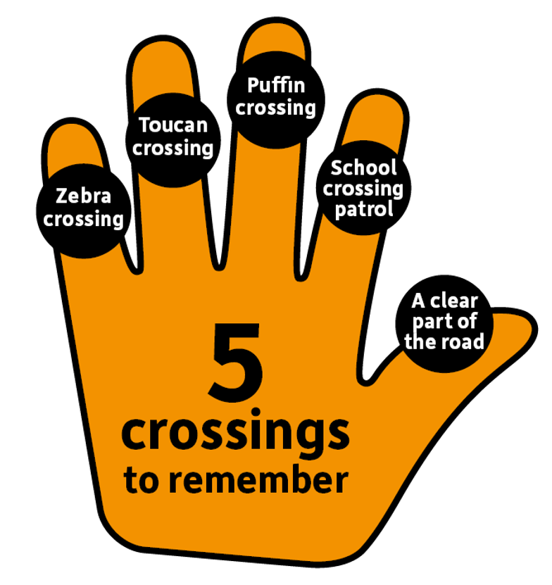

Road Safety
Education Year 2

Slide 2

Learning outcome:
To be able to use the Road Safety Hand, to stop in time every time, be alert and cross like a boss!
To be able to identify safe and non safe road safety habits.

Slide 3
Let’s learn the road Safety hand!
Notes:
Could we use props and or actions
Get the children up and do each action
Then get them to say them in the correct order

Slide 4
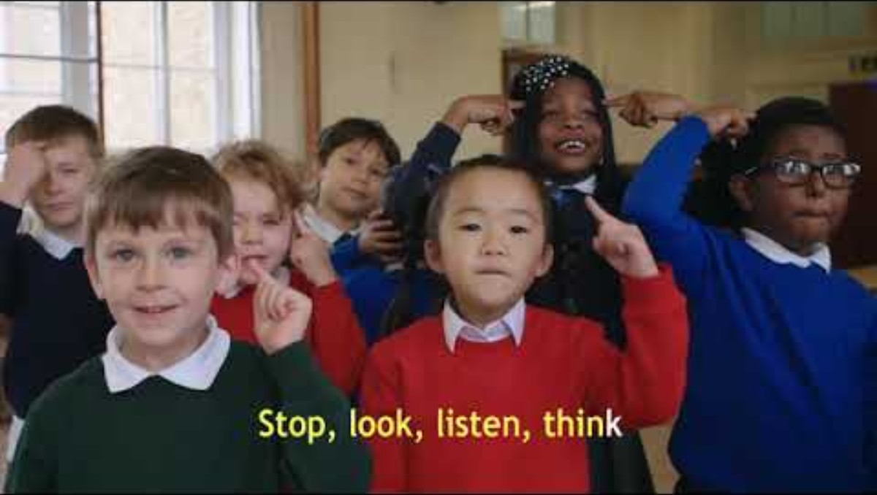
4
Notes:
https://www.youtube.com/watch?v=HXCN8V5u0Fg

Slide 5
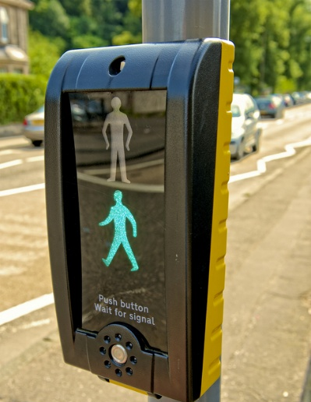
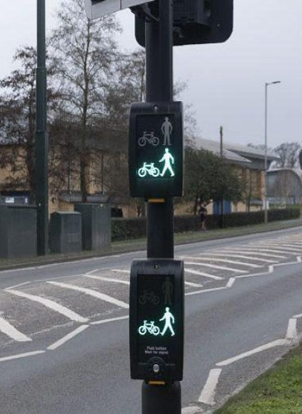
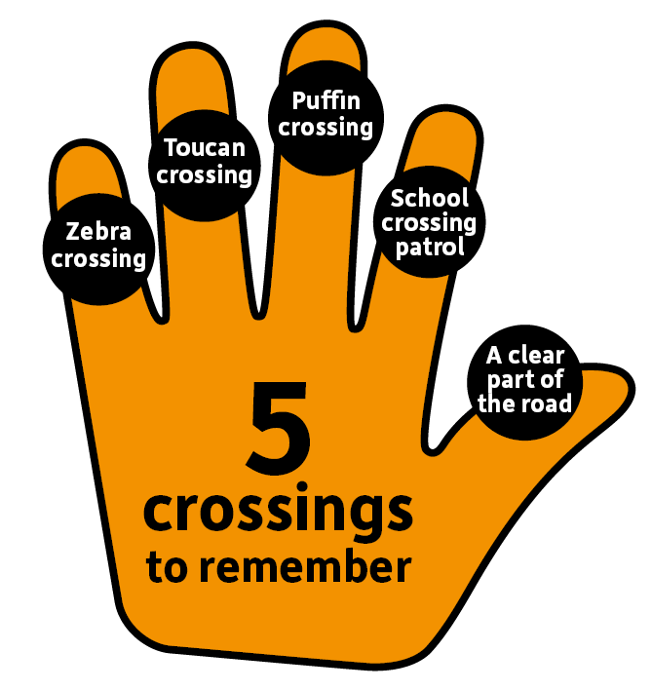
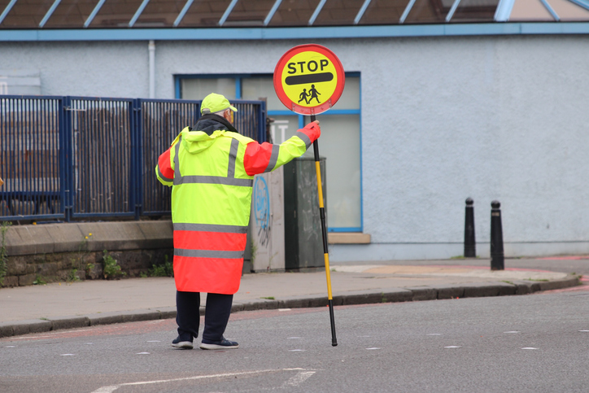

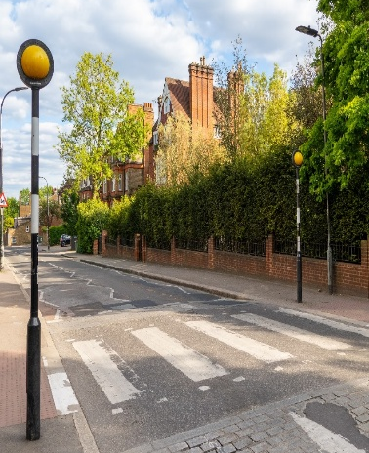
Safe places to cross
Can you match the crossings to their name?
Puffin Crossing
Toucan Crossing
School Crossing Patrol
A clear part of the road
Zebra Crossing

Slide 6
Activity time!
Use your thumbs up or thumbs down paddles to decide if the picture is safe or not
If you think it’s safe, you're going to show, thumbs up
If you think it’s not safe, you’re going to show, thumbs down

Slide 7
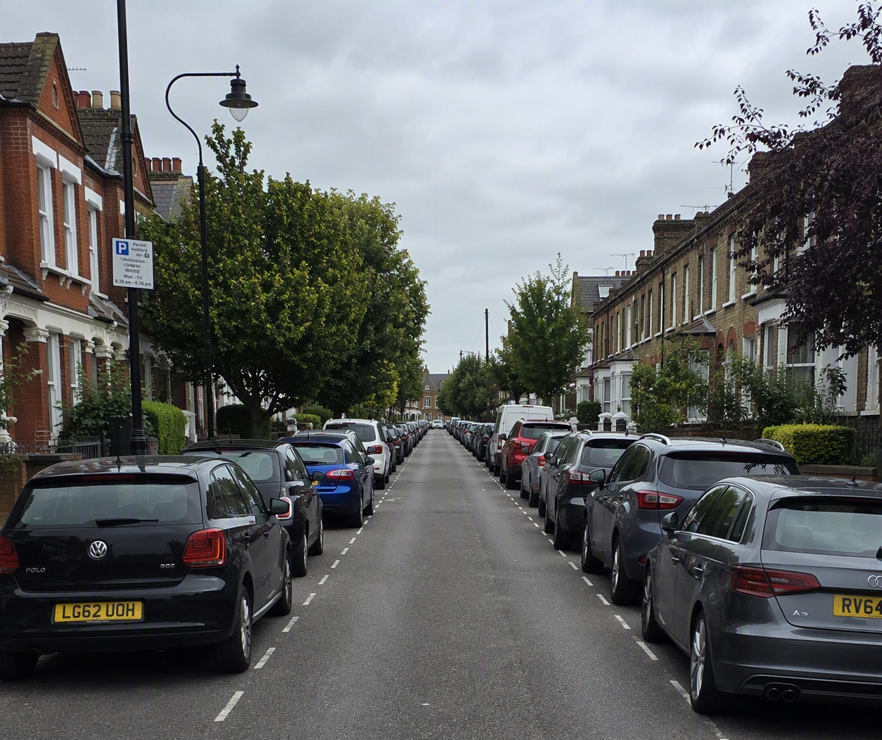


Is this a safe place to cross?

Slide 8
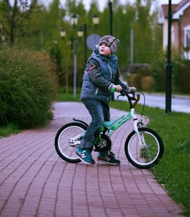

Is this child missing something important while on a bike ride?

Slide 9
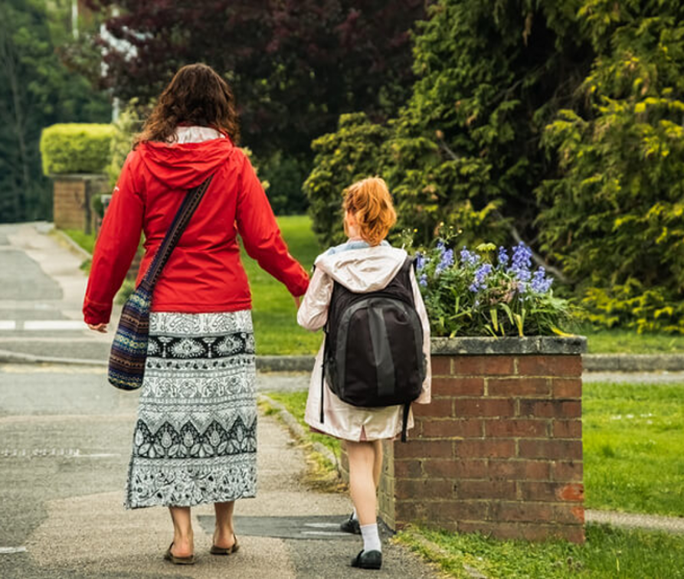

Correct way to walk with a grown up question

Slide 10
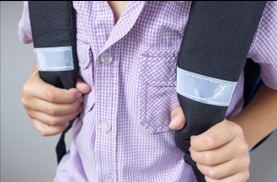
Is wearing something reflective at night a good idea

Slide 11
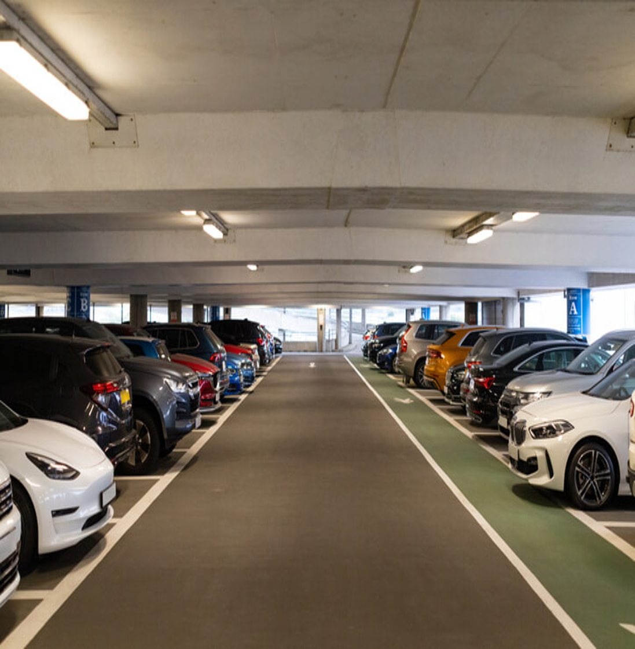
Is this a safe place to play?

Slide 12
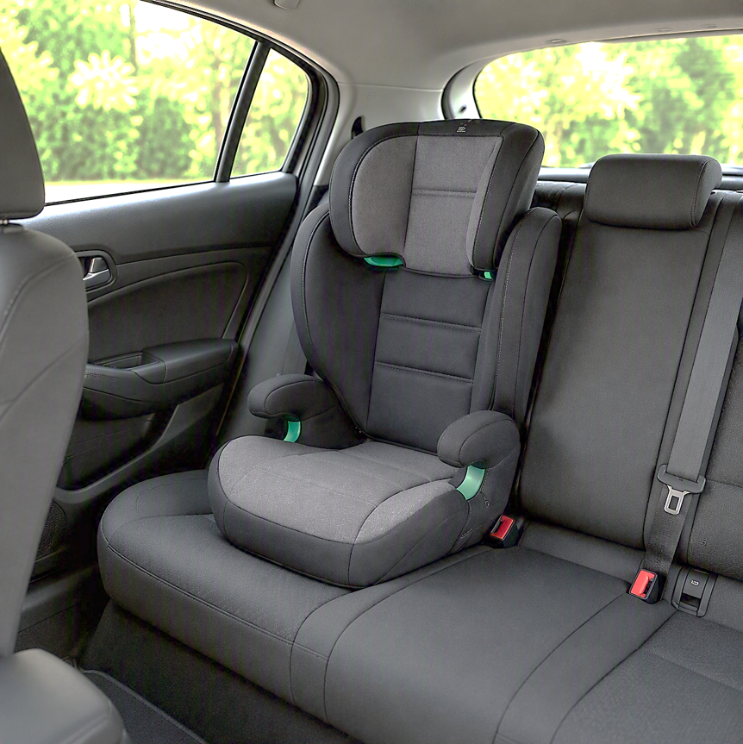

Is a car seat safe or not safe?

Slide 13
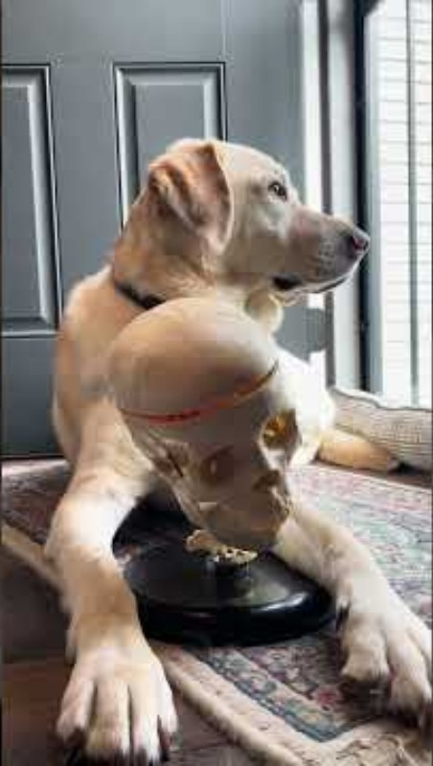

Is your helmet Fitted correctly?
Notes:
https://www.youtube.com/watch?v=BNyBWXwQBW8
Why it's important to wear a helmet | Ohio State Medical

Slide 14

Remember to always…

Slide 15

Thank you!
Leicestershire County Council | Traffic and Safety Team | RoadSafety@leics.gov.uk

